Slide 1
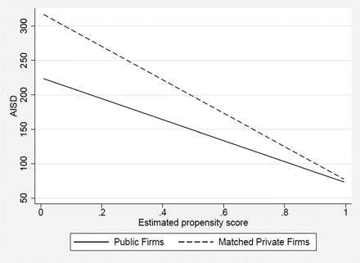
Figure 1 Loan spreads as a function of propensity scores using local linear matching Figure 1 is constructed as ...
Notes:
Figure 1 Loan spreads as a function of propensity scores using local linear matching Figure 1 is constructed as follows: We estimate the propensity score as explained in Section 3.1 and match each loan to a public firm with all private firm loans using local linear matching; i.e., the difference between the propensity score of the public firm loan and each private firm loan is used as a weight to calculate an average spread for the private firm loans. We sort the matched public and private firm loans by propensity score and plot loan spreads for both. We also construct this match using nearest-neighbor matching and obtain a similar picture. 1
Unless provided in the caption above, the following copyright applies to the content of this slide: © The Author 2011. Published by Oxford University Press on behalf of The Society for Financial Studies. All rights reserved. For Permissions, please e-mail: journals.permissions@oup.com.

