Slide 1
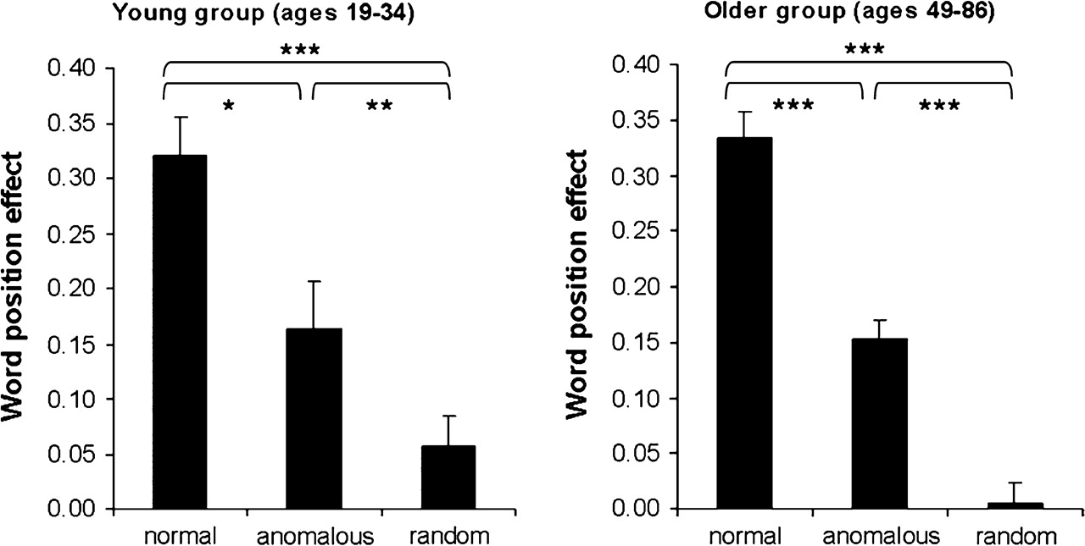
Figure 1. Behavioral results: showing the WPE (RT_{early} − RT_{late})/RT_{mean}) for each of ...
Notes:
Figure 1. Behavioral results: showing the WPE (RTearly − RTlate)/RTmean) for each of the 3 prose types: NP, AP, and RWO for the young and older groups. *P < 0.05, **P < 0.01, ***P < 0.001.
Unless provided in the caption above, the following copyright applies to the content of this slide: © 2009 The AuthorsThis is an Open Access article distributed under the terms of the Creative Commons Attribution Non-Commercial License (http://creativecommons.org/licenses/by-nc/2.0/uk/) which permits unrestricted non-commercial use, distribution, and reproduction in any medium, provided the original work is properly cited.

Slide 2
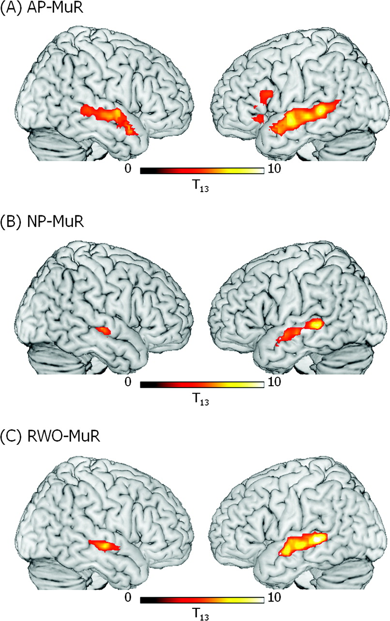
Figure 2. Significant clusters of activation in the young group (ages 19–34) for (A) AP–MuR, (B) NP–MuR, and (C) ...
Notes:
Figure 2. Significant clusters of activation in the young group (ages 19–34) for (A) AP–MuR, (B) NP–MuR, and (C) RWO–MuR. Activation is rendered on the surface of a canonical brain image. Color scale indicates T value of contrast. Voxel-level threshold P < 0.001, cluster size threshold P < 0.05 (see text).
Unless provided in the caption above, the following copyright applies to the content of this slide: © 2009 The AuthorsThis is an Open Access article distributed under the terms of the Creative Commons Attribution Non-Commercial License (http://creativecommons.org/licenses/by-nc/2.0/uk/) which permits unrestricted non-commercial use, distribution, and reproduction in any medium, provided the original work is properly cited.

Slide 3
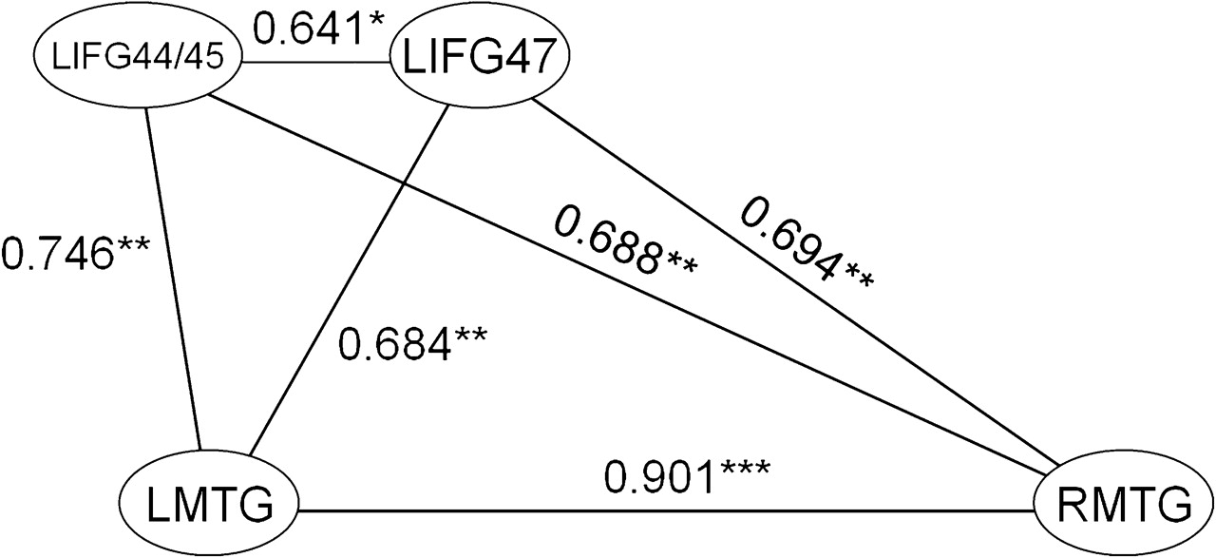
Figure 3. Significant (at P < 0.01.) correlations between activity in significantly activated regions for the contrast ...
Notes:
Figure 3. Significant (at P < 0.01.) correlations between activity in significantly activated regions for the contrast AP–MuR in the young group. *P < 0.05, **P < 0.01, ***P < 001.
Unless provided in the caption above, the following copyright applies to the content of this slide: © 2009 The AuthorsThis is an Open Access article distributed under the terms of the Creative Commons Attribution Non-Commercial License (http://creativecommons.org/licenses/by-nc/2.0/uk/) which permits unrestricted non-commercial use, distribution, and reproduction in any medium, provided the original work is properly cited.

Slide 4
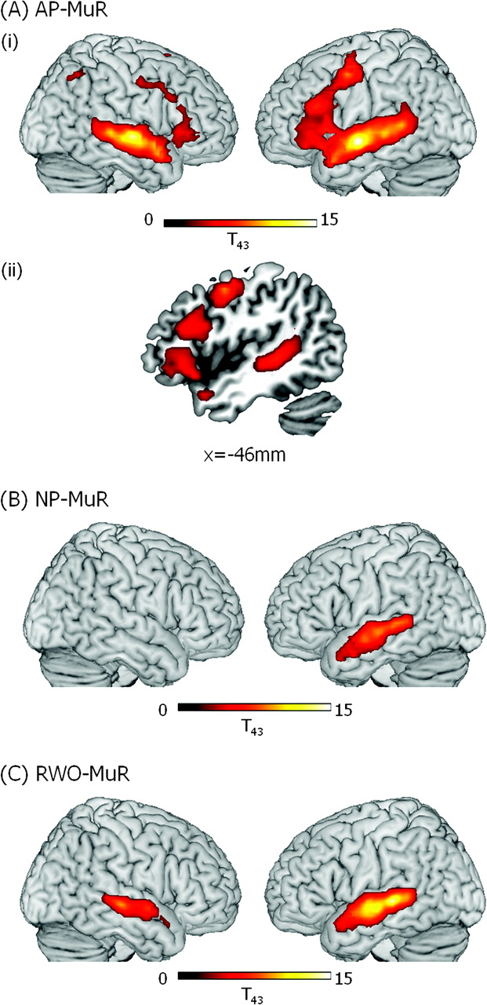
Figure 4. Significant clusters of activation in older participants (ages 49–86) for (A) AP–MuR, (i) activations ...
Notes:
Figure 4. Significant clusters of activation in older participants (ages 49–86) for (A) AP–MuR, (i) activations rendered onto the surface of a canonical brain image, (ii) LH frontotemporal activity in saggital slice at x = −53; (B) Normal prose–musical rain (NP–MuR) activations rendered onto the surface of a canonical brain image; and (C) RWO (RWO–MuR) activations rendered onto the surface of a canonical brain image. Color scale indicates T value of contrast. Voxel-level threshold P < 0.001, cluster size threshold P < 0.05.
Unless provided in the caption above, the following copyright applies to the content of this slide: © 2009 The AuthorsThis is an Open Access article distributed under the terms of the Creative Commons Attribution Non-Commercial License (http://creativecommons.org/licenses/by-nc/2.0/uk/) which permits unrestricted non-commercial use, distribution, and reproduction in any medium, provided the original work is properly cited.

Slide 5
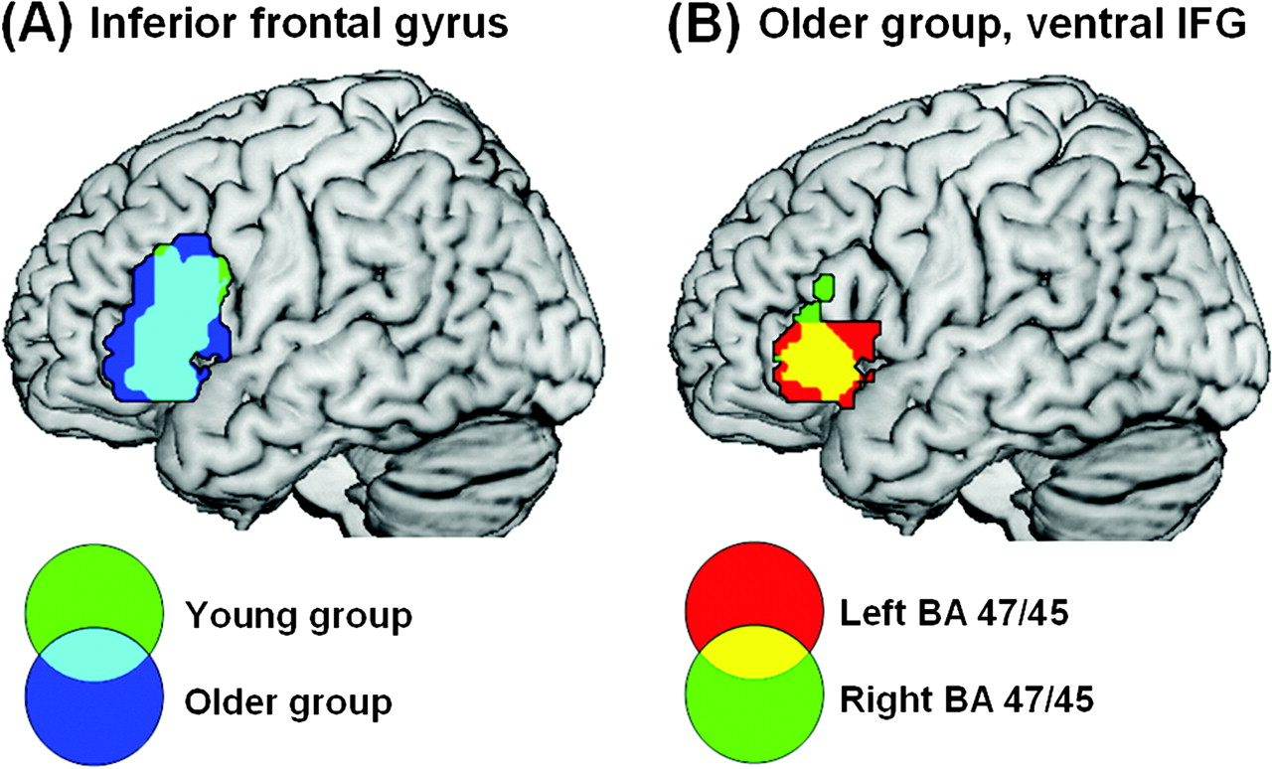
Figure 5. Common activation to AP–MuR in LIFG between young and older groups (A) and left and right hemisphere in the ...
Notes:
Figure 5. Common activation to AP–MuR in LIFG between young and older groups (A) and left and right hemisphere in the older group (B). (A) The young and older groups activate overlapping regions within LIFG. Activation is shown in LIFG only and involves BA 45, 47, and 44. Clusters significant at P < 0.05 corrected with voxel-level P < 0.001 in the older group and lowered to P < 0.005 in the young group to show the full extent of the overlap. (B) The older group activate homologous regions in left and right BA 45/47. Activation shown in BA 45/47 only, clusters significant at P < 0.05 corrected, voxel-level P < 0.001.
Unless provided in the caption above, the following copyright applies to the content of this slide: © 2009 The AuthorsThis is an Open Access article distributed under the terms of the Creative Commons Attribution Non-Commercial License (http://creativecommons.org/licenses/by-nc/2.0/uk/) which permits unrestricted non-commercial use, distribution, and reproduction in any medium, provided the original work is properly cited.

Slide 6
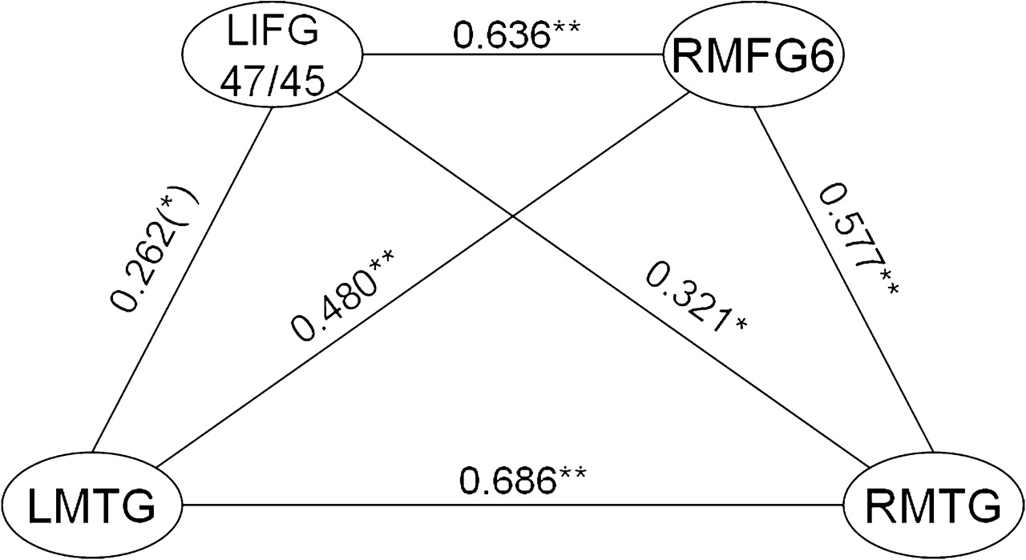
Figure 6. Significant (at P < 0.01) correlations between activity in significantly activated regions for the contrast ...
Notes:
Figure 6. Significant (at P < 0.01) correlations between activity in significantly activated regions for the contrast AP–MuR in the older group. (*)P < 0.1, *P < 0.05, **P < 0.01.
Unless provided in the caption above, the following copyright applies to the content of this slide: © 2009 The AuthorsThis is an Open Access article distributed under the terms of the Creative Commons Attribution Non-Commercial License (http://creativecommons.org/licenses/by-nc/2.0/uk/) which permits unrestricted non-commercial use, distribution, and reproduction in any medium, provided the original work is properly cited.

Slide 7
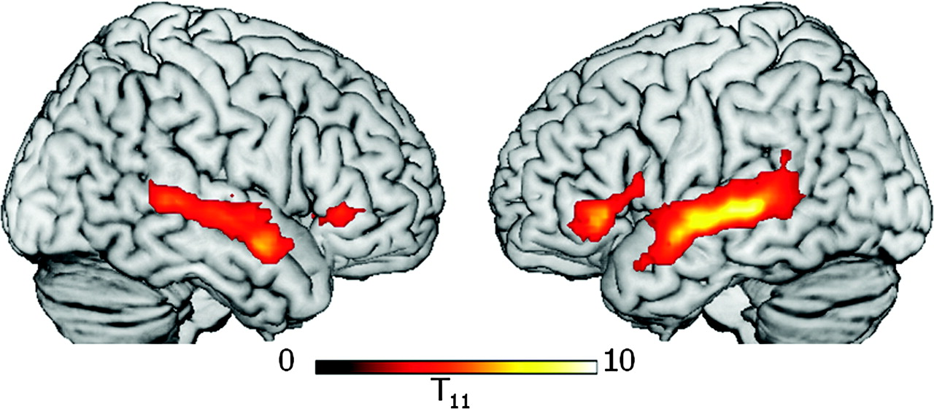
Figure 7. Activation to AP–MuR in the absence of a task in a subset of the older group (ages 56–81). Participants ...
Notes:
Figure 7. Activation to AP–MuR in the absence of a task in a subset of the older group (ages 56–81). Participants passively listened to stimuli identical to those used in the word-monitoring task 12–14 months after their first scan. Activation is shown only in voxels active during word monitoring, with threshold lowered to voxel-level P 60 to maximize sensitivity to common effects. Clusters in LIFG BA 47/45, RIFG BA 47/45, and bilateral MTG were significant at P < 0.05 corrected, except RIFG (P < 0.05 uncorrected). No effects were seen in MFG or parietal lobe.
Unless provided in the caption above, the following copyright applies to the content of this slide: © 2009 The AuthorsThis is an Open Access article distributed under the terms of the Creative Commons Attribution Non-Commercial License (http://creativecommons.org/licenses/by-nc/2.0/uk/) which permits unrestricted non-commercial use, distribution, and reproduction in any medium, provided the original work is properly cited.

Slide 8
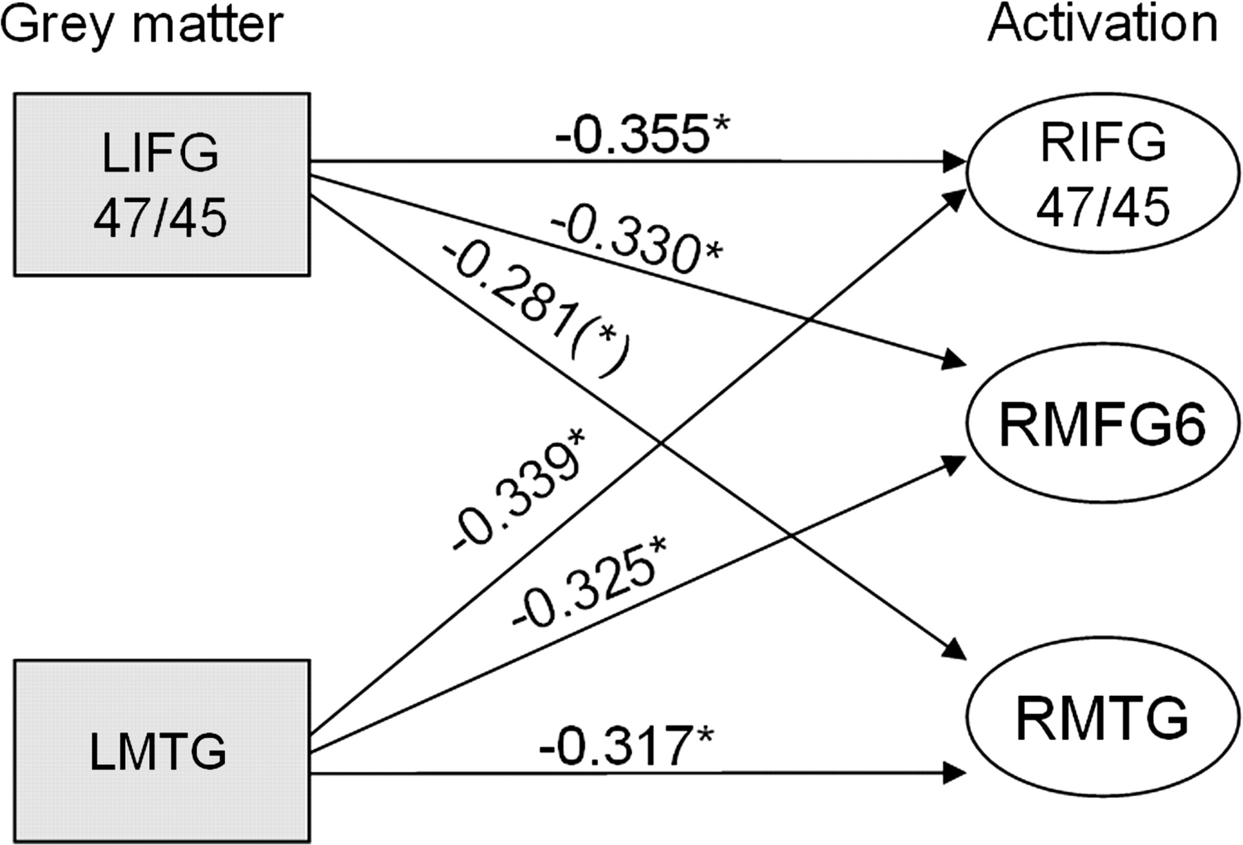
Figure 8. Correlations between measures of GM integrity and neural activity in the older group. Gray squares represent ...
Notes:
Figure 8. Correlations between measures of GM integrity and neural activity in the older group. Gray squares represent GM changes and white ovals represent significant clusters of activity in specified regions. The graph shows that decreases in GM in left frontotemporal regions are associated with increases in right frontotemporal activation (*)P < 0.1, *P < 0.05.
Unless provided in the caption above, the following copyright applies to the content of this slide: © 2009 The AuthorsThis is an Open Access article distributed under the terms of the Creative Commons Attribution Non-Commercial License (http://creativecommons.org/licenses/by-nc/2.0/uk/) which permits unrestricted non-commercial use, distribution, and reproduction in any medium, provided the original work is properly cited.

