Slide 1
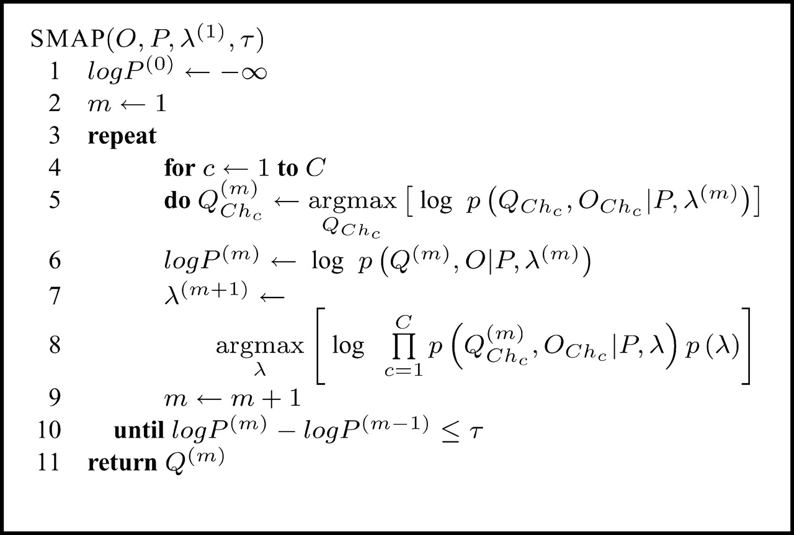
Fig. 1. The SMAP algorithm. The SMAP procedure takes as input a start solution of parameters and prior information. ...
Notes:
Fig. 1. The SMAP algorithm. The SMAP procedure takes as input a start solution of parameters and prior information. The process of joint posterior maximization is done by alternating optimization of the copy number assignments, with fixed parameters and optimization of the parameters, with fixed assignments, until no significant improvements can be made (i.e. improvement below a given threshold τ). During optimization, we consider logarithmic probabilities due to machine precision limitations.
Unless provided in the caption above, the following copyright applies to the content of this slide: © 2008 The Author(s)This is an Open Access article distributed under the terms of the Creative Commons Attribution Non-Commercial License (http://creativecommons.org/licenses/by-nc/2.0/uk/) which permits unrestricted non-commercial use, distribution, and reproduction in any medium, provided the original work is properly cited.

Slide 2
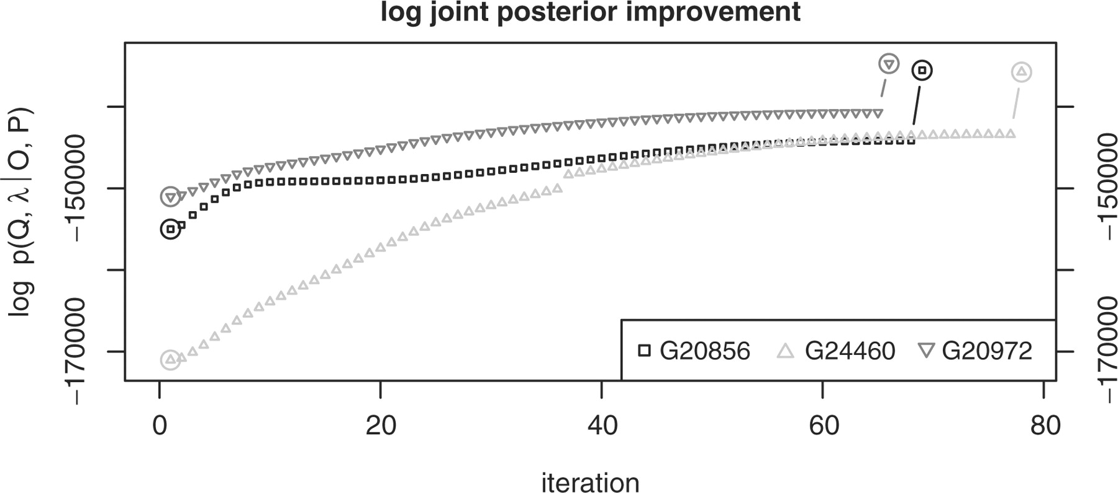
Fig. 2. Improvement of log p(Q, λ|O, P) during execution of SMAP on the GBM samples G20856, G24460 and G20972. ...
Notes:
Fig. 2. Improvement of log p(Q, λ|O, P) during execution of SMAP on the GBM samples G20856, G24460 and G20972. Optimizations of the copy number assignments, using a modified Viterbi algorithm, are marked by larger, circled, dots and the iteration steps in between refer to iterations of the optimization of model parameters, using the gradient descent scheme.
Unless provided in the caption above, the following copyright applies to the content of this slide: © 2008 The Author(s)This is an Open Access article distributed under the terms of the Creative Commons Attribution Non-Commercial License (http://creativecommons.org/licenses/by-nc/2.0/uk/) which permits unrestricted non-commercial use, distribution, and reproduction in any medium, provided the original work is properly cited.

Slide 3
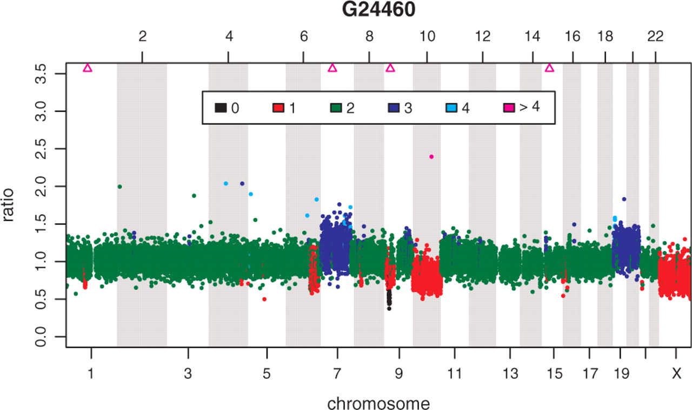
Fig. 3. Identified segments of copy number aberrations in GBM sample G24460.
Notes:
Fig. 3. Identified segments of copy number aberrations in GBM sample G24460.
Unless provided in the caption above, the following copyright applies to the content of this slide: © 2008 The Author(s)This is an Open Access article distributed under the terms of the Creative Commons Attribution Non-Commercial License (http://creativecommons.org/licenses/by-nc/2.0/uk/) which permits unrestricted non-commercial use, distribution, and reproduction in any medium, provided the original work is properly cited.

Slide 4
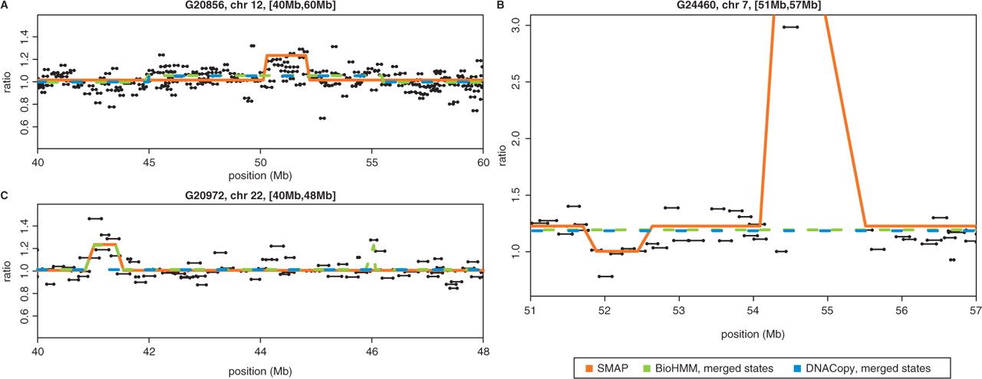
Fig. 4. Comparison of predictions made by SMAP, BioHMM and DNACopy on zoomed in regions of chromosome 12 in sample ...
Notes:
Fig. 4. Comparison of predictions made by SMAP, BioHMM and DNACopy on zoomed in regions of chromosome 12 in sample G20856 (A), chromosome 7 in sample G24460 (B) and chromosome 22 in sample G20975 (C). In figure B, clone RP11-164O17 (≊54.5–54.8 Mb) was omitted due to size limitations (ratio ≊14.5). Horizontal black lines with dotted ends represent clones.
Unless provided in the caption above, the following copyright applies to the content of this slide: © 2008 The Author(s)This is an Open Access article distributed under the terms of the Creative Commons Attribution Non-Commercial License (http://creativecommons.org/licenses/by-nc/2.0/uk/) which permits unrestricted non-commercial use, distribution, and reproduction in any medium, provided the original work is properly cited.

