Slide 1
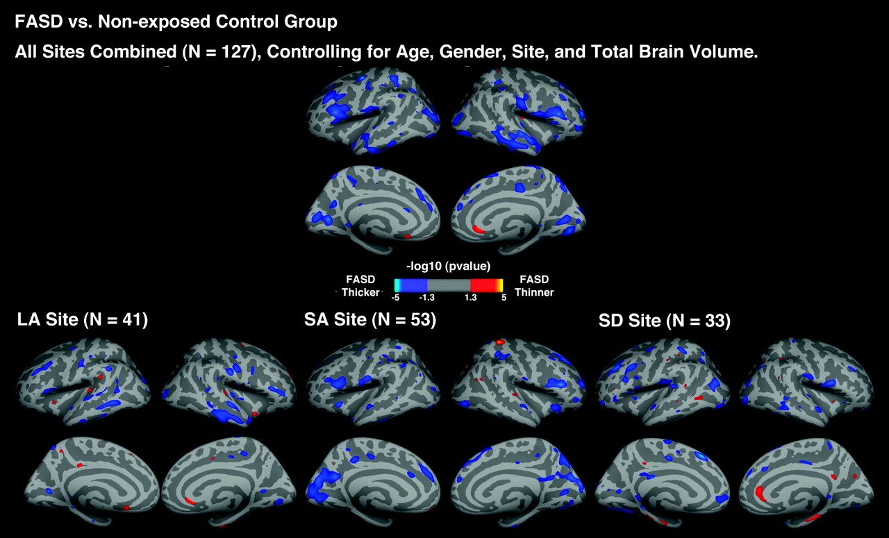
Figure 1. Uncorrected P maps representing the significant group difference in cortical thickness for the FASD versus ...
Notes:
Figure 1. Uncorrected P maps representing the significant group difference in cortical thickness for the FASD versus control comparisons across the entire sample of 127 subjects and within LA, SA, and SD site, controlling for age, gender, and total brain volume.
Unless provided in the caption above, the following copyright applies to the content of this slide: © The Author 2011. Published by Oxford University Press. All rights reserved. For permissions, please e-mail: journals.permissions@oup.com

Slide 2
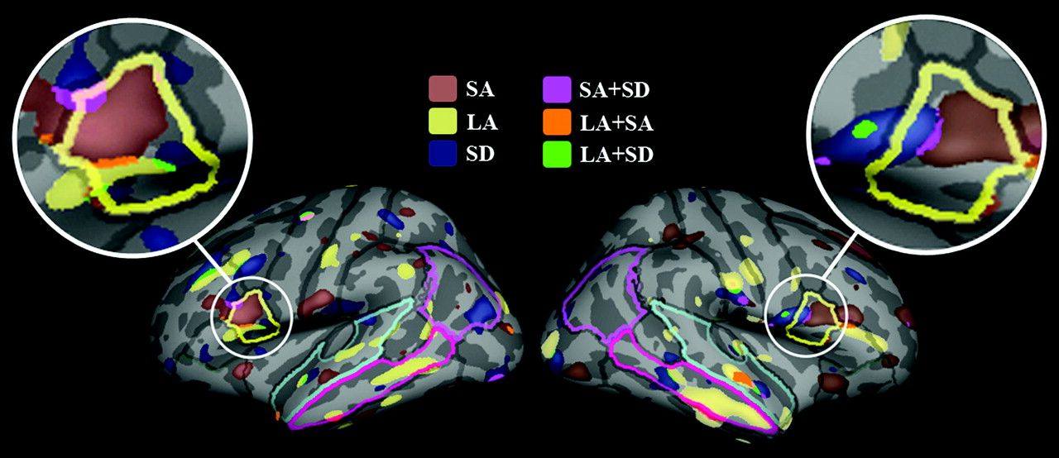
Figure 2. Illustrations of the significant inferior frontal thickness increases in FASD compared with nonexposed ...
Notes:
Figure 2. Illustrations of the significant inferior frontal thickness increases in FASD compared with nonexposed control group both within and across sites. The ROIs were also highlighted as follows: inferior frontal gyrus (IFG; yellow), superior temporal gyrus (STG; pal blue), middle temporal gyrus (MTG; bright pink), and inferior parietal gyrus (IPG; pink).
Unless provided in the caption above, the following copyright applies to the content of this slide: © The Author 2011. Published by Oxford University Press. All rights reserved. For permissions, please e-mail: journals.permissions@oup.com

Slide 3
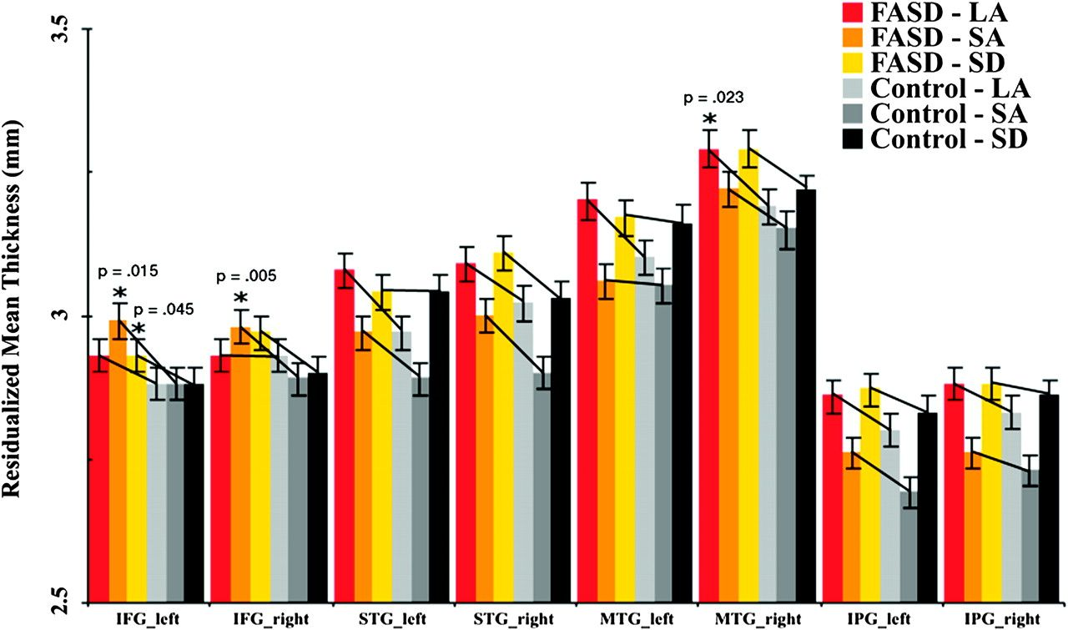
Figure 3. Average thickness of the left and right inferior frontal gyrus (IFG), superior temporal gyrus (STG), middle ...
Notes:
Figure 3. Average thickness of the left and right inferior frontal gyrus (IFG), superior temporal gyrus (STG), middle temporal gyrus (MTG), and the inferior parietal gyrus (IPG) of the FASD and control subjects within each site, corrected for age, gender, and total brain volume. The vertical lines represent the standard error bars.
Unless provided in the caption above, the following copyright applies to the content of this slide: © The Author 2011. Published by Oxford University Press. All rights reserved. For permissions, please e-mail: journals.permissions@oup.com

Slide 4
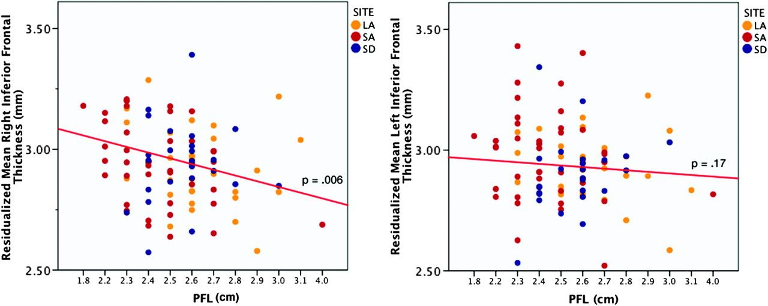
Figure 4. Relationships between average thickness in left and right inferior frontal gyrus and PFL scores after ...
Notes:
Figure 4. Relationships between average thickness in left and right inferior frontal gyrus and PFL scores after controlling for age, gender, site, and total brain volume in FASD subjects. The partial correlation coefficient between left and right inferior frontal thickness and PFL partialling out age, gender, site, and total brain volume is −0.36 and −0.18, respectively.
Unless provided in the caption above, the following copyright applies to the content of this slide: © The Author 2011. Published by Oxford University Press. All rights reserved. For permissions, please e-mail: journals.permissions@oup.com

