Slide 1
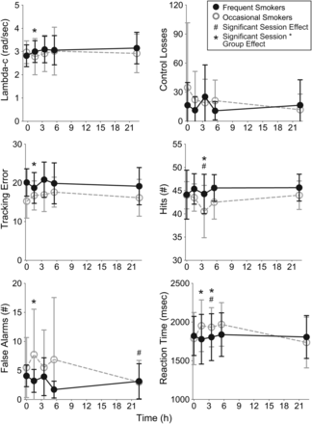
Figure 1. Mean (standard deviation) for critical tracking task (lambda-c) and divided attention (Control losses, ...
Notes:
Figure 1. Mean (standard deviation) for critical tracking task (lambda-c) and divided attention (Control losses, tracking error, hits, false alarms and reaction time) for 14 frequent and 8 (CTT) or 11 (DAT) occasional cannabis smokers following controlled smoking of a 6.8% THC (54 mg) cannabis cigarette.
Unless provided in the caption above, the following copyright applies to the content of this slide: Published by Oxford University Press 2015. This work is written by (a) US Government employee(s) and is in the public domain in the US.

Slide 2
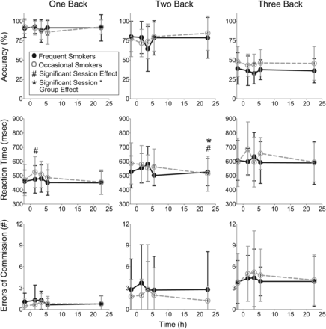
Figure 2. Mean (standard deviation) for accuracy, reaction time and errors of commission on the n-back for 14 frequent ...
Notes:
Figure 2. Mean (standard deviation) for accuracy, reaction time and errors of commission on the n-back for 14 frequent and 10 occasional cannabis smokers following controlled smoking of a 6.8% THC (54 mg) cannabis cigarette.
Unless provided in the caption above, the following copyright applies to the content of this slide: Published by Oxford University Press 2015. This work is written by (a) US Government employee(s) and is in the public domain in the US.

Slide 3
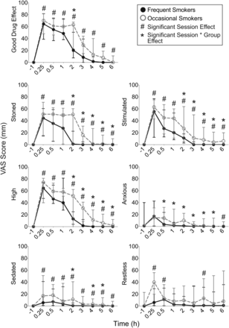
Figure 3. Mean (standard deviation) Visual Analog Scale (VAS) score for 14 frequent and 11 occasional cannabis smokers ...
Notes:
Figure 3. Mean (standard deviation) Visual Analog Scale (VAS) score for 14 frequent and 11 occasional cannabis smokers following controlled smoking of a 6.8% THC (54 mg) cannabis cigarette.
Unless provided in the caption above, the following copyright applies to the content of this slide: Published by Oxford University Press 2015. This work is written by (a) US Government employee(s) and is in the public domain in the US.

Slide 4
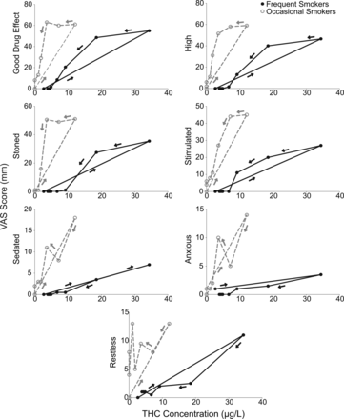
Figure 4. Median VAS scores in function of THC concentrations for 14 frequent and 11 occasional cannabis smokers ...
Notes:
Figure 4. Median VAS scores in function of THC concentrations for 14 frequent and 11 occasional cannabis smokers following controlled smoking of a 6.8% THC (54 mg) cannabis cigarette.
Unless provided in the caption above, the following copyright applies to the content of this slide: Published by Oxford University Press 2015. This work is written by (a) US Government employee(s) and is in the public domain in the US.

Slide 5
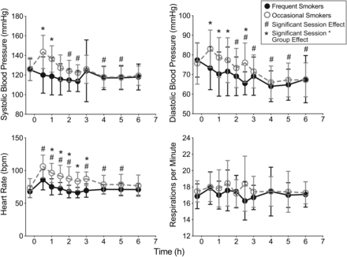
Figure 5. Mean (standard deviation) physiological measures for 14 frequent and 11 occasional cannabis smokers following ...
Notes:
Figure 5. Mean (standard deviation) physiological measures for 14 frequent and 11 occasional cannabis smokers following controlled smoking of a 6.8% THC (54 mg) cannabis cigarette.
Unless provided in the caption above, the following copyright applies to the content of this slide: Published by Oxford University Press 2015. This work is written by (a) US Government employee(s) and is in the public domain in the US.

