Slide 1
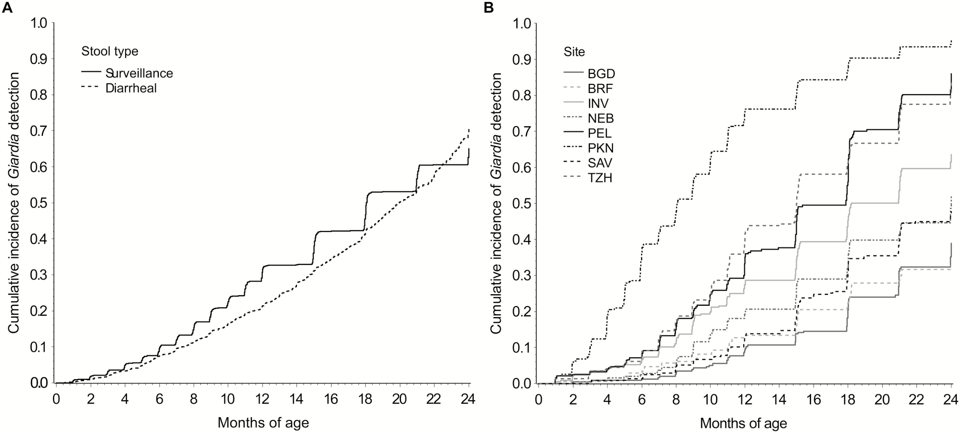
Figure 1. Cumulative incidence of Giardia detection in surveillance and diarrheal stool samples across all sites (A) ...
Notes:
Figure 1. Cumulative incidence of Giardia detection in surveillance and diarrheal stool samples across all sites (A) and in surveillance stool samples within each site (B) among 2089 children in the Etiology, Risk Factors, and Interactions of Enteric Infections and Malnutrition and the Consequences for Child Health and Development Project (MAL-ED) cohort with at least 1 stool tested for Giardia.
Unless provided in the caption above, the following copyright applies to the content of this slide: © The Author 2017. Published by Oxford University Press on behalf of The Journal of the Pediatric Infectious Diseases Society.This is an Open Access article distributed under the terms of the Creative Commons Attribution License (http://creativecommons.org/licenses/by/4.0/), which permits unrestricted reuse, distribution, and reproduction in any medium, provided the original work is properly cited.

