Slide 1
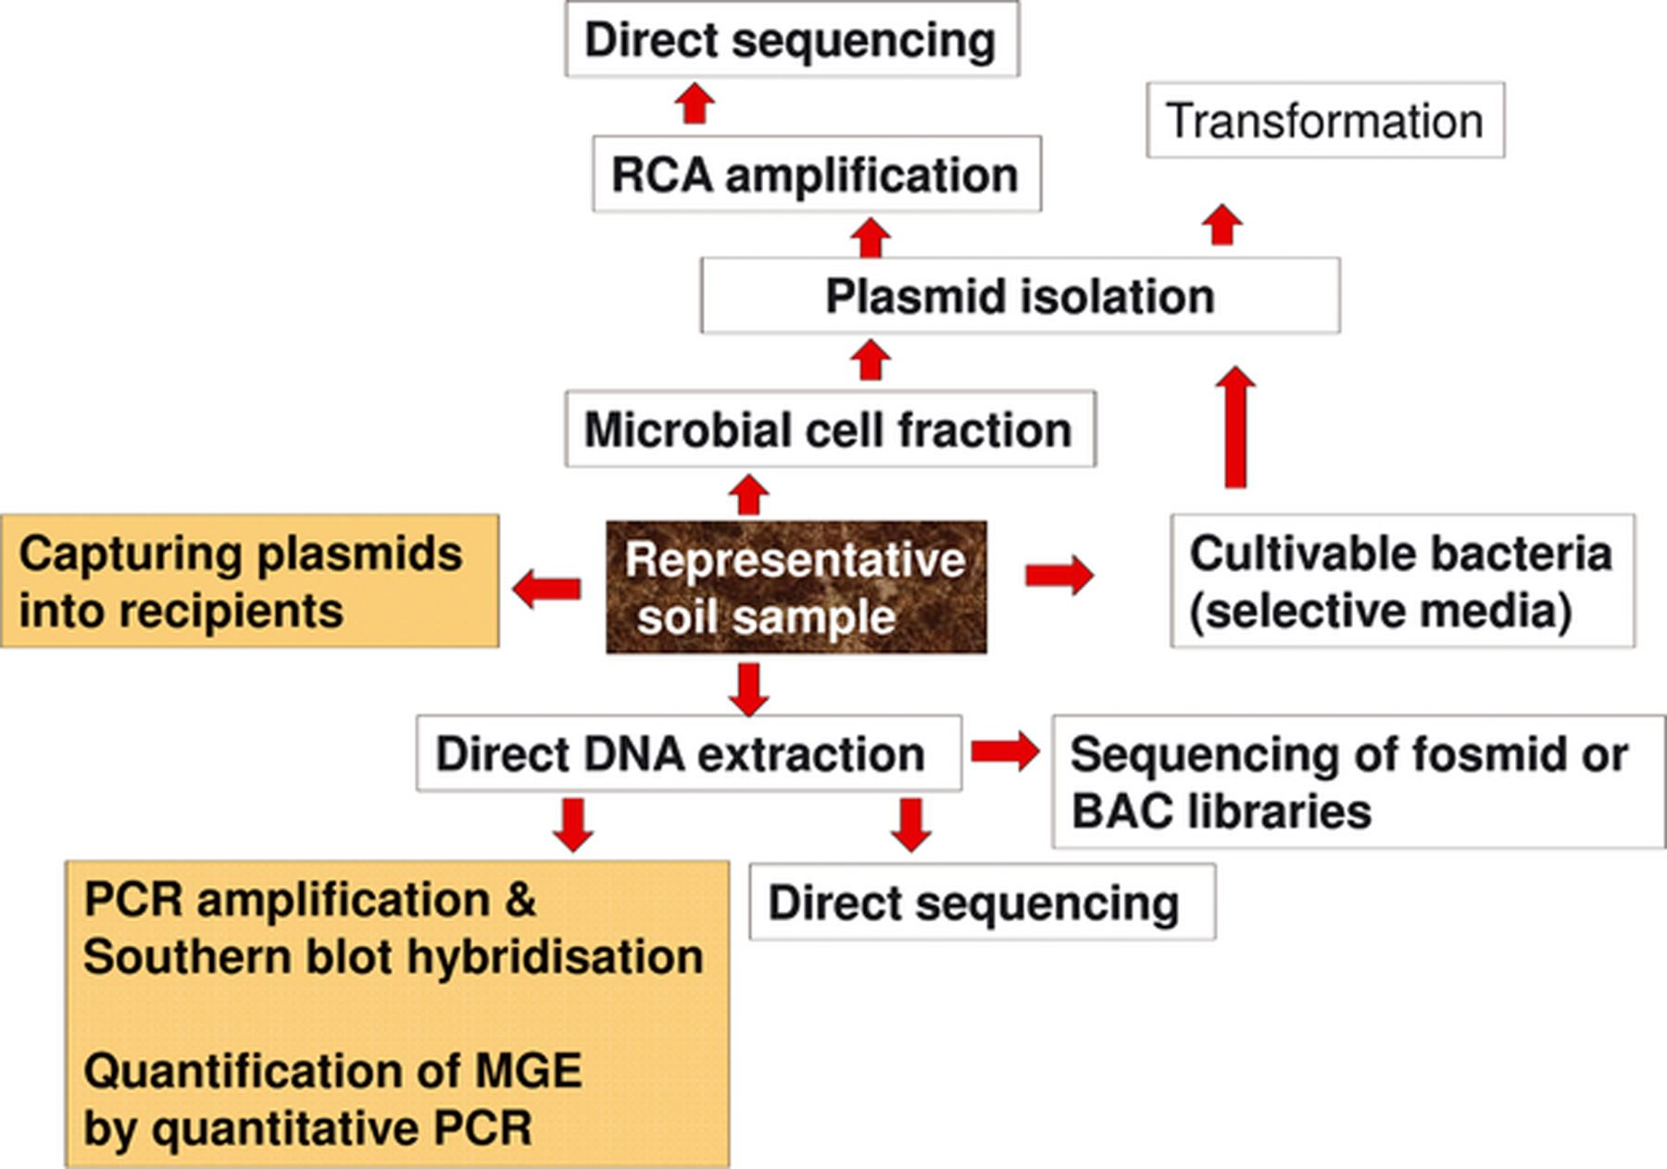
Figure 1 Cultivation-dependent and -independent approaches to detect and analyze plasmids from soil bacteria. RCA: ...
Notes:
Figure 1 Cultivation-dependent and -independent approaches to detect and analyze plasmids from soil bacteria. RCA: Rolling circle amplification; BAC: Bacterial artificial chromosome; MGE: Mobile genetic element.
Unless provided in the caption above, the following copyright applies to the content of this slide: © 2012 Federation of European Microbiological Societies.

Slide 2
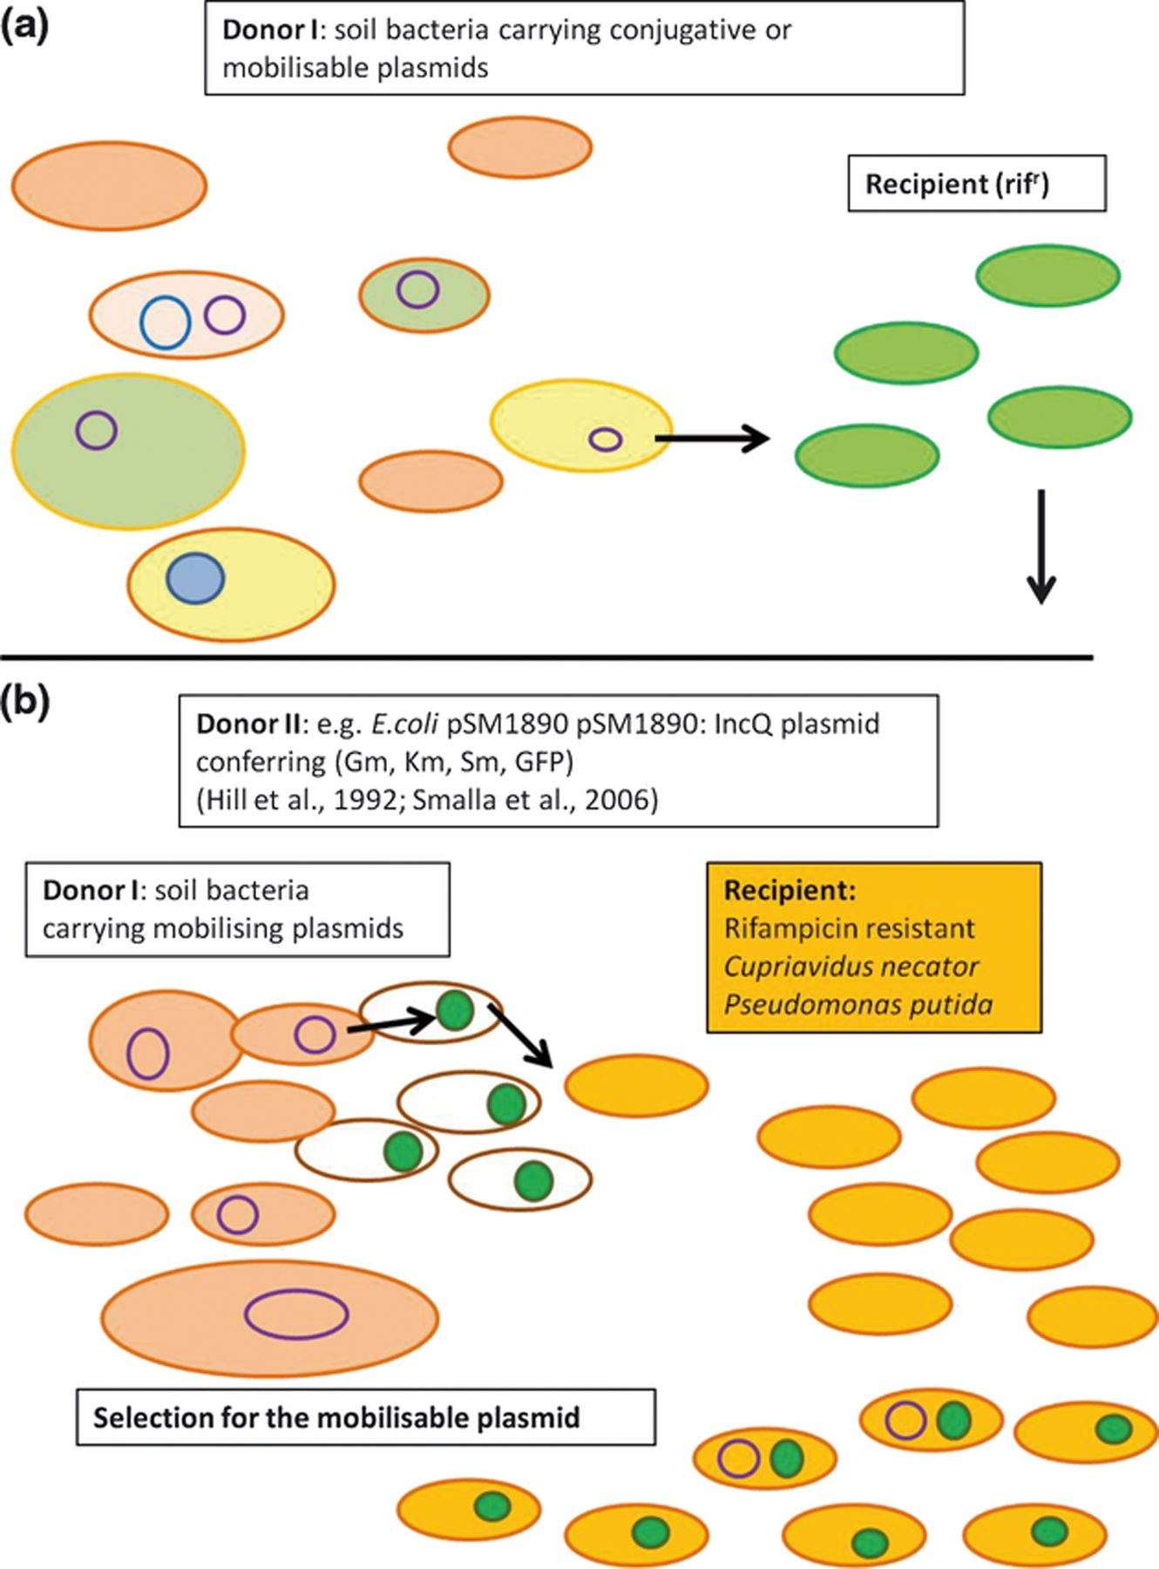
Figure 2 Exogenous isolation of plasmids directly from soil bacteria into labeled recipients in (a) biparental and (b) ...
Notes:
Figure 2 Exogenous isolation of plasmids directly from soil bacteria into labeled recipients in (a) biparental and (b) triparental matings, modified from Bale et al. (1988) and Hill et al. (1992). Adapted by L. Bandounas.
Unless provided in the caption above, the following copyright applies to the content of this slide: © 2012 Federation of European Microbiological Societies.

Slide 3
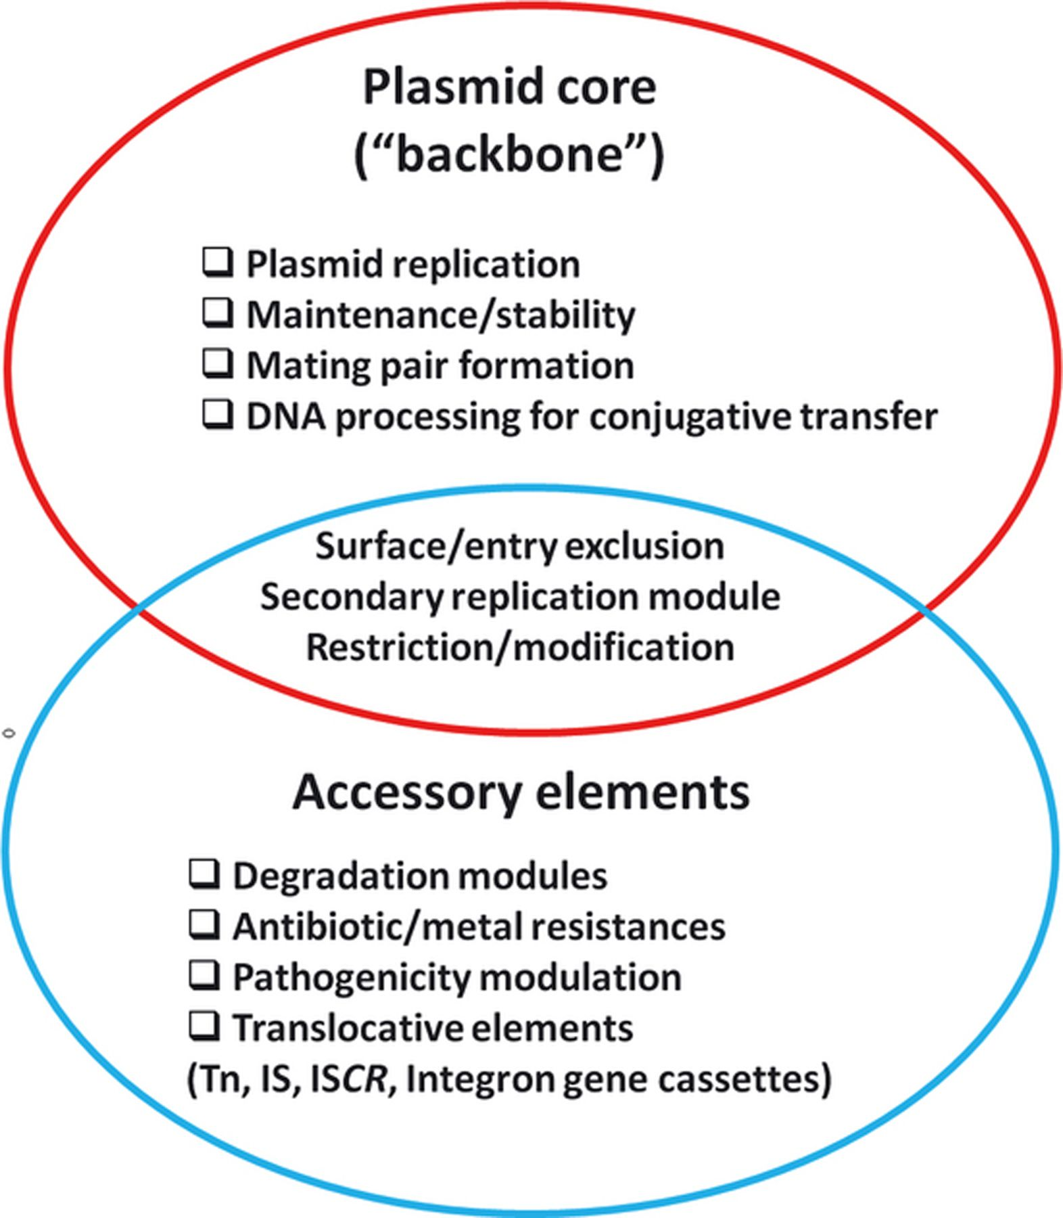
Figure 3 Analysis of plasmid sequences indicated a modular structure composed of conserved core elements and flexible ...
Notes:
Figure 3 Analysis of plasmid sequences indicated a modular structure composed of conserved core elements and flexible accessory elements.
Unless provided in the caption above, the following copyright applies to the content of this slide: © 2012 Federation of European Microbiological Societies.

Slide 4
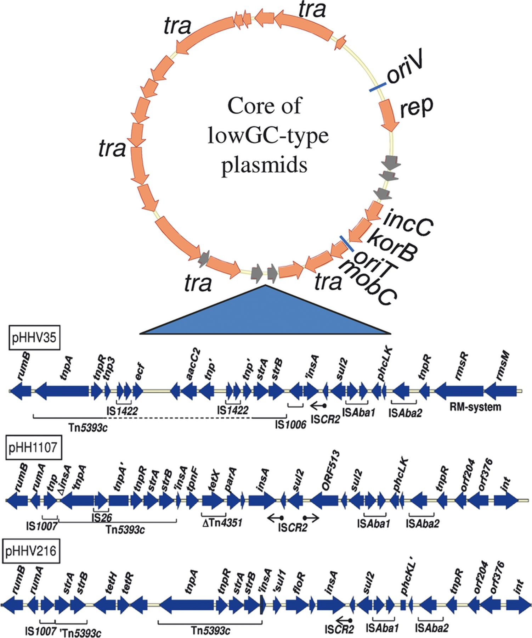
Figure 4 LowGC plasmids share identical backbone genes but vary considerably in their flexible genes. Modified from ...
Notes:
Figure 4 LowGC plasmids share identical backbone genes but vary considerably in their flexible genes. Modified from Heuer et al. (2009).
Unless provided in the caption above, the following copyright applies to the content of this slide: © 2012 Federation of European Microbiological Societies.

Slide 5
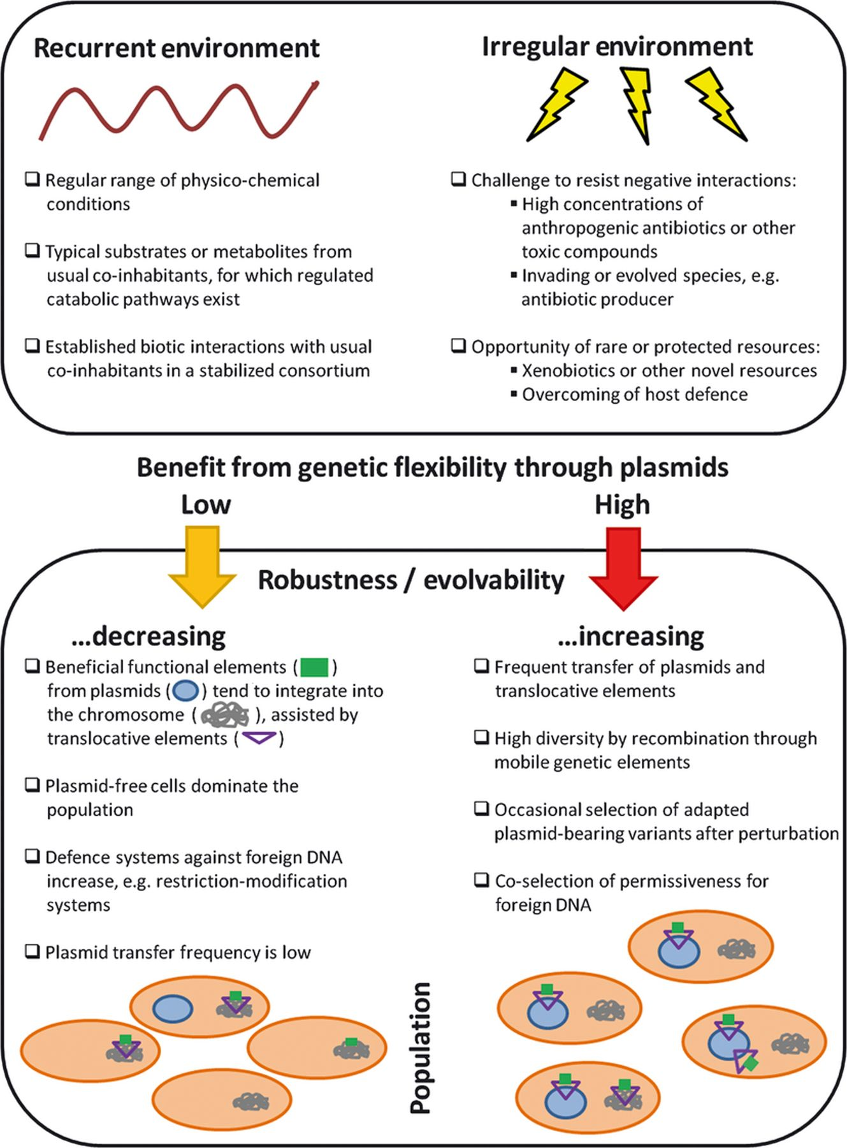
Figure 5 Contribution of broad-host-range plasmids to the adaptability of bacterial populations in soil when the ...
Notes:
Figure 5 Contribution of broad-host-range plasmids to the adaptability of bacterial populations in soil when the environment shows a constant or long-term recurring range of conditions vs. an irregular challenge or opportunity. Adapted by L. Bandounas.
Unless provided in the caption above, the following copyright applies to the content of this slide: © 2012 Federation of European Microbiological Societies.

