Slide 1
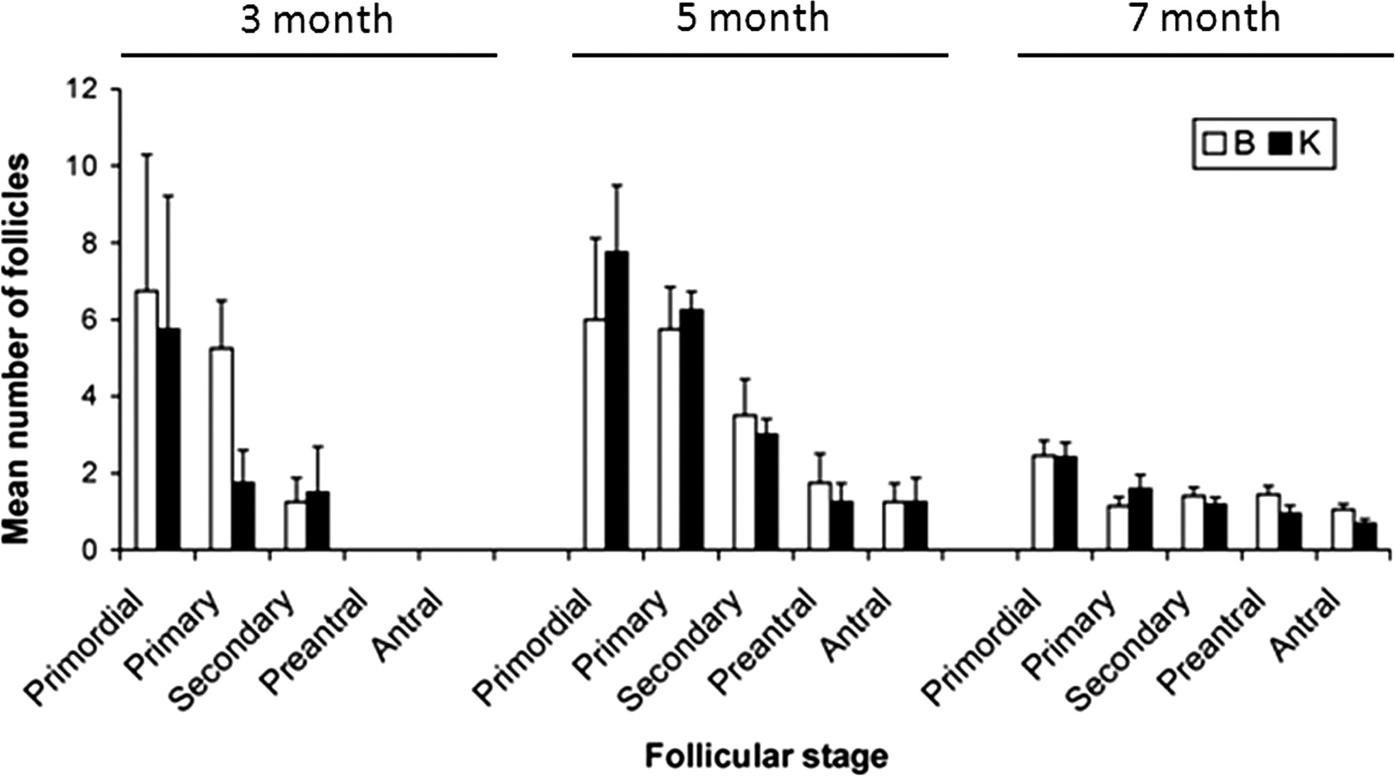
Figure 1 Mean number of human follicles at a specific stage observed in the mouse B-site (open bar) or K-site (solid ...
Notes:
Figure 1 Mean number of human follicles at a specific stage observed in the mouse B-site (open bar) or K-site (solid bar) 3, 5 and 7 months after OT grafting in Experiment I. No significant differences were observed between B- and K-sites (Mann–Whitney U test, P > 0.05).
Unless provided in the caption above, the following copyright applies to the content of this slide: © The Author 2010. Published by Oxford University Press on behalf of the European Society of Human Reproduction and Embryology. All rights reserved. For Permissions, please email: journals.permissions@oxfordjournals.org

Slide 2
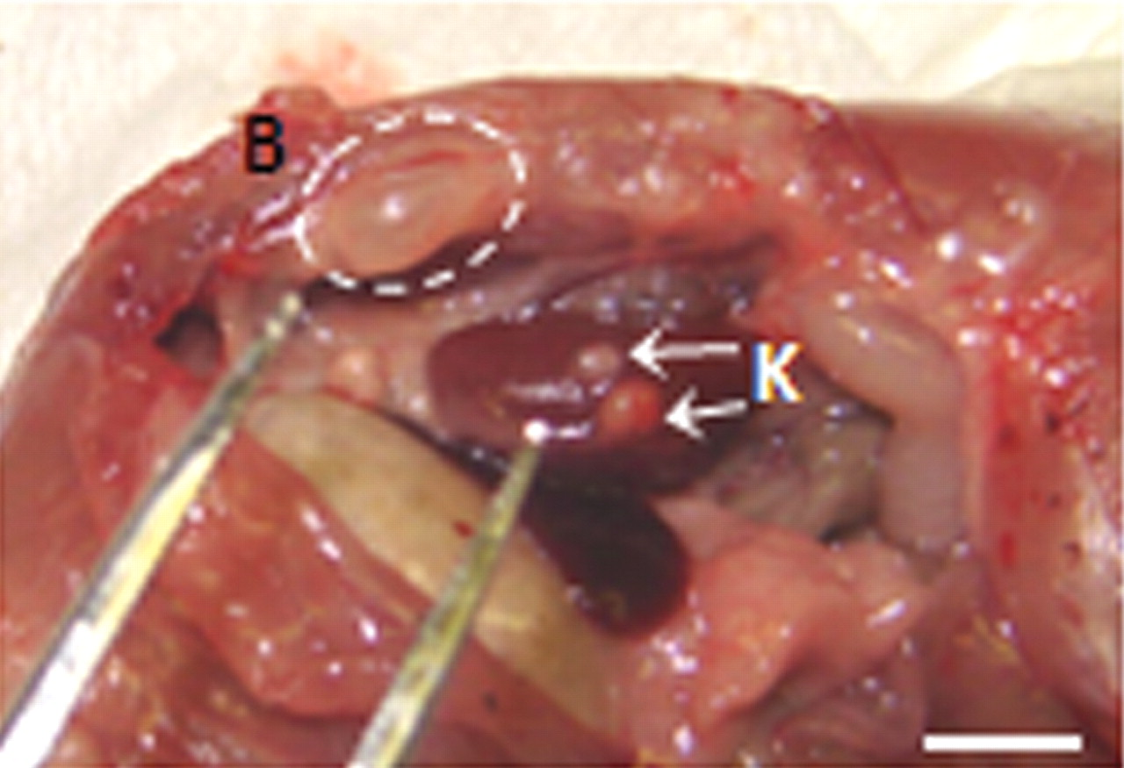
Figure 2 Macroscopic comparison of follicle size in mouse B- and K-grafting sites 5 months after xenografting human OT ...
Notes:
Figure 2 Macroscopic comparison of follicle size in mouse B- and K-grafting sites 5 months after xenografting human OT (scale bar 6 mm).
Unless provided in the caption above, the following copyright applies to the content of this slide: © The Author 2010. Published by Oxford University Press on behalf of the European Society of Human Reproduction and Embryology. All rights reserved. For Permissions, please email: journals.permissions@oxfordjournals.org

Slide 3
Figure 3 Apoptosis and proliferation in xenografted human OT, assessed using IHC. (a) K-site, AC-3: ovarian follicles ...
Notes:
Figure 3 Apoptosis and proliferation in xenografted human OT, assessed using IHC. (a) K-site, AC-3: ovarian follicles demonstrating apoptosis. (b) K-site, AC-3: negative control, the same follicles shown in (a). (c) B-site, PCNA: growing primary follicles with PCNA-positive surrounding granulosa cells, 4 weeks after grafting. (d) B-site, anti-mouse CD31 (platelet endothelial cell adhesion molecule-1): the same follicle shown in (c) with surrounding blood vessels. (e) B-site, anti-mouse CD31: negative control, primary antibody omitted. The same follicle shown in (c) and (d).
Unless provided in the caption above, the following copyright applies to the content of this slide: © The Author 2010. Published by Oxford University Press on behalf of the European Society of Human Reproduction and Embryology. All rights reserved. For Permissions, please email: journals.permissions@oxfordjournals.org

Slide 4
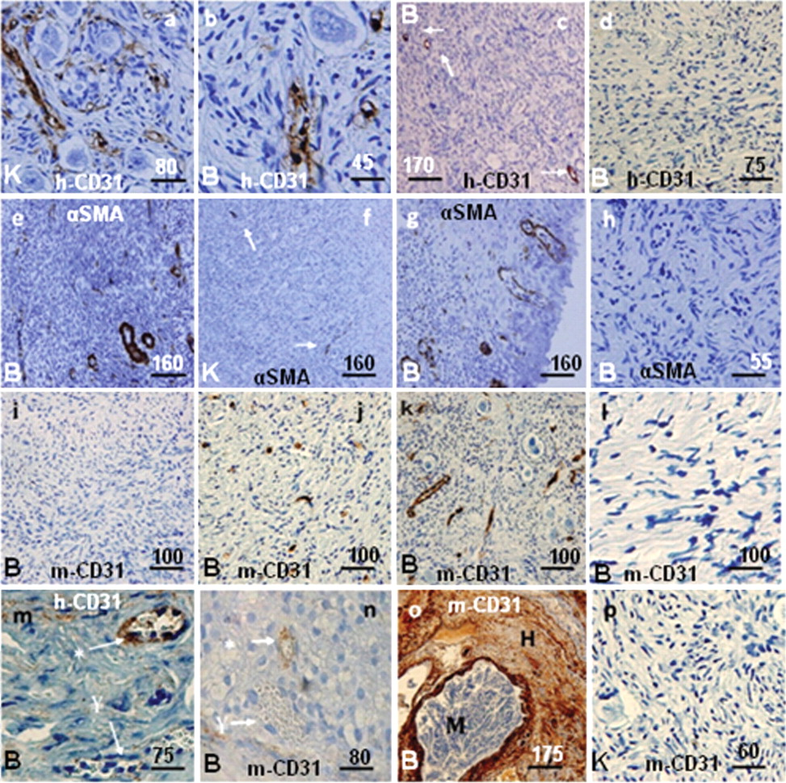
Figure 4 IHC evaluation of angiogenesis in human OT xenografts. (a–d) Anti-human CD31 staining. (a) Existing human ...
Notes:
Figure 4 IHC evaluation of angiogenesis in human OT xenografts. (a–d) Anti-human CD31 staining. (a) Existing human blood vessels in OT around the follicles 1 day after grafting. (b) Human blood vessels 1 day after grafting—do not contain blood cells. (c) Reduced number of human blood vessels 12 weeks after grafting. (d) Negative control: the primary antibody was omitted. (e–h) α-SMA. (e) Mature blood vessels 12 weeks after grafting. (f) Ten days after grafting. (g) Mature and functioning blood vessels, 7 months after grafting. (h) Negative control: the primary antibody was omitted. (i–l) Anti-mouse CD31staining. (i) No cells showing signs of angiogenesis 1 day after grafting. (j) Mouse blood vessels invading xenografted human OT, 7 days after grafting. (k) Functioning mouse blood vessels in human OT graft, 12 weeks after grafting. (l) Negative control: the primary antibody was omitted. (m) ‘*’ indicates actively functioning blood vessels positively stained with anti-human CD31; ‘¥’ indicates actively functioning blood vessels negative for anti-human CD31. (n) ‘*’ indicates actively functioning blood vessels positively stained with anti-mouse CD31; ‘¥’ indicates actively functioning blood vessels negative for anti-mouse CD31. (o) M, mouse blood vessels highly stained with anti-mouse CD31; H, human tissue negative for anti-mouse CD31. This slide is a differential control for species-specific anti-mouse CD31. (p) No evidence of angiogenesis is seen 3 days after grafting. Scale bars are μm.
Unless provided in the caption above, the following copyright applies to the content of this slide: © The Author 2010. Published by Oxford University Press on behalf of the European Society of Human Reproduction and Embryology. All rights reserved. For Permissions, please email: journals.permissions@oxfordjournals.org

Slide 5
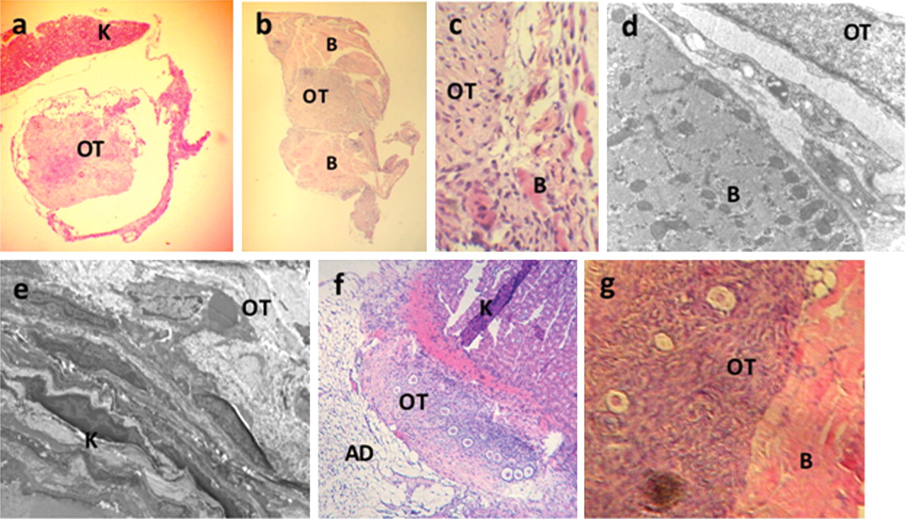
Figure 5 Integration of grafted human OTs in mouse B- and K-sites. (a) K-site, H&E: 8 days after xenotransplantation. ...
Notes:
Figure 5 Integration of grafted human OTs in mouse B- and K-sites. (a) K-site, H&E: 8 days after xenotransplantation. The connection of grafted OT with mouse kidney and K-site is easily lost. (b) B-site, H&E: 8 days after xenotransplantation. Very good integration of grafted OT in the muscle tissue. (c) Higher magnification of connection site between OT and B shown in (b). (d) B-site, EM: ultrastructure of OT fragments at the site of graft connection point. (d) B-site grafting. (e) K-site, EM: ultrastructure of OT fragments at the site of graft connection point. (f) K-site, 12 weeks after grafting: adipose tissue (AD) surrounding the graft. (g) B-site, 12 weeks after grafting: very good connection and integration of OT in the muscle tissue.
Unless provided in the caption above, the following copyright applies to the content of this slide: © The Author 2010. Published by Oxford University Press on behalf of the European Society of Human Reproduction and Embryology. All rights reserved. For Permissions, please email: journals.permissions@oxfordjournals.org

Slide 6
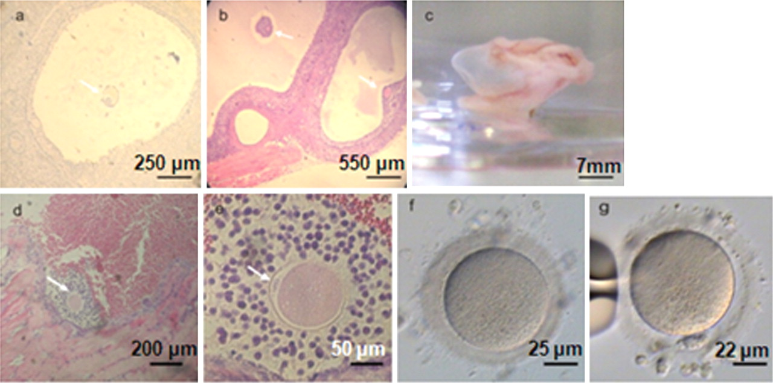
Figure 6 Macroscopic analysis of B-site grafts. (a) Antral follicle containing a germinal vesicle oocyte. (b) Graft ...
Notes:
Figure 6 Macroscopic analysis of B-site grafts. (a) Antral follicle containing a germinal vesicle oocyte. (b) Graft with multiple antral follicles containing oocytes. (c) OT recovered after 7 months. (d) Antral follicle containing an MII oocyte. (e) Higher magnification of the MII oocyte from (d) with a visible polar body. (f) MI oocyte obtained from B-site grafting. This oocyte became MII after IVM. (g) MII oocyte obtained from B-site grafting.
Unless provided in the caption above, the following copyright applies to the content of this slide: © The Author 2010. Published by Oxford University Press on behalf of the European Society of Human Reproduction and Embryology. All rights reserved. For Permissions, please email: journals.permissions@oxfordjournals.org

Slide 7
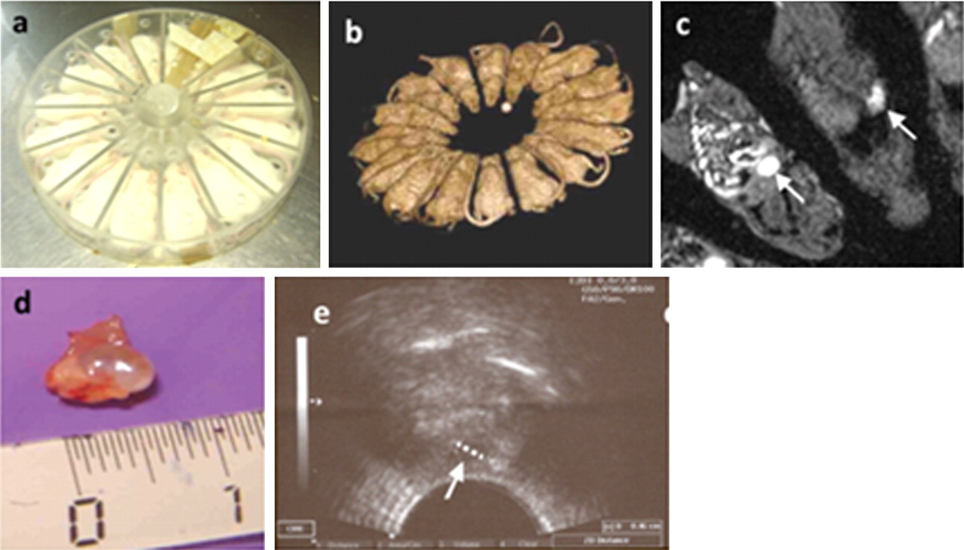
Figure 7 Visualization of growing follicles after grafting, using MRI. (a) Box designed for restraining the animals ...
Notes:
Figure 7 Visualization of growing follicles after grafting, using MRI. (a) Box designed for restraining the animals for MRI. (b) Fast MRI, scanning of the animals to position them correctly before final imaging. (c) Antral follicle visualized by MRI, grafted into B-site. (d) Macroscopic image of the same follicle as (c) after recovery. (e) Growing follicle in B-site OT graft, visualized by ultrasonography (scale bar 4.6 mm). Please notice that owing to oval shape of the follicle, the transverse axis of the follicle (scale bar 4.6 mm) was recorded as the actual size (longitudinal axis in this follicle is 6.5 mm).
Unless provided in the caption above, the following copyright applies to the content of this slide: © The Author 2010. Published by Oxford University Press on behalf of the European Society of Human Reproduction and Embryology. All rights reserved. For Permissions, please email: journals.permissions@oxfordjournals.org

Slide 8
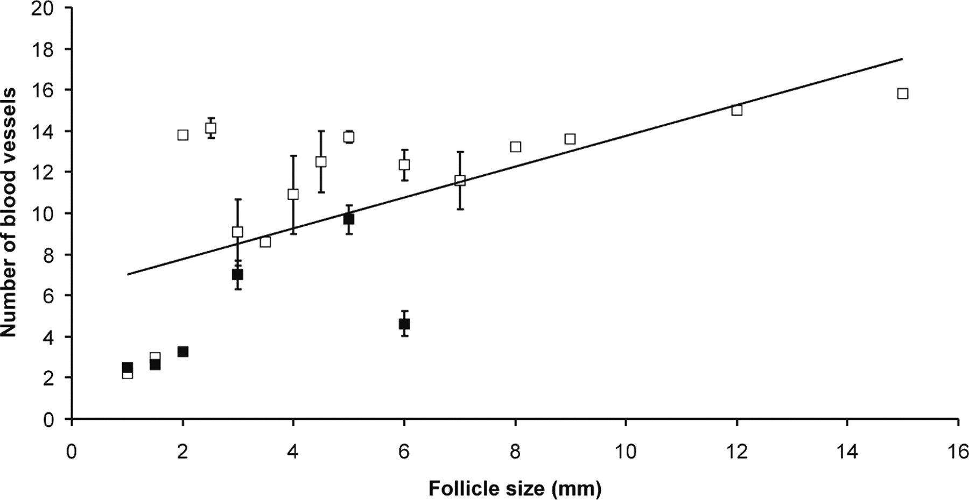
Figure 8 Human follicle size and vascularization of the follicles obtained after B-site (open squares) or K-site ...
Notes:
Figure 8 Human follicle size and vascularization of the follicles obtained after B-site (open squares) or K-site (solid squares) grafting in mice. Data are mean ± SD. The correlation of the size of the follicles with the number of blood vessels (Spearman's rank correlation coefficient = 0.73) is highly significant (P < 0.001).
Unless provided in the caption above, the following copyright applies to the content of this slide: © The Author 2010. Published by Oxford University Press on behalf of the European Society of Human Reproduction and Embryology. All rights reserved. For Permissions, please email: journals.permissions@oxfordjournals.org

