Slide 1
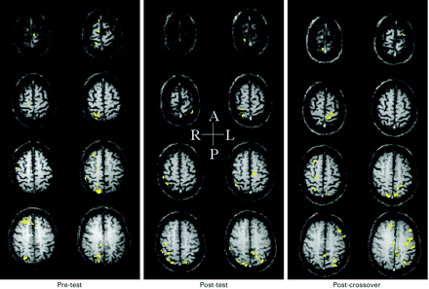
Fig. 6 Functional MRIs (rostral eight slices) for one subject (Subject 10) in the stroke control group (1.3 ...
Notes:
Fig. 6 Functional MRIs (rostral eight slices) for one subject (Subject 10) in the stroke control group (1.3 years post‐stroke) performing the finger movement tracking test with his paretic right hand before (pre‐test) and after (post‐test) the control period and again after 20 sessions of finger tracking training (post‐crossover). Cortical activation is predominantly ipsilateral both before and after the control period and predominantly contralateral after training. Laterality indexes for the sensorimotor cortex, primary motor cortex, primary sensory cortex, premotor cortex and supplementary motor area at pre‐test were –1, –1, –1, –1 and 0, respectively. At post‐test, they were –0.60, 0.53, –0.64, –0.09 and 0.33, respectively. At post‐crossover, they were 0.70, 0.73, 0.65, 0.70 and 0.50, respectively.
Unless provided in the caption above, the following copyright applies to the content of this slide:

Slide 2
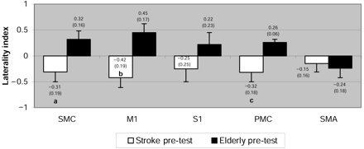
Fig. 1 Mean (± standard error) laterality indexes for the sensorimotor cortex (SMC), primary motor cortex ...
Notes:
Fig. 1 Mean (± standard error) laterality indexes for the sensorimotor cortex (SMC), primary motor cortex (M1), primary sensory cortex (S1), premotor cortex (PMC) and supplementary motor area (SMA) for all subjects with stroke (n = 9) compared with all well elderly subjects (n = 9) on the pre‐test. aSignificantly different from well elderly pre‐test SMC (P = 0.011); bsignificantly different from well elderly pre‐test M1 (P = 0.002); csignificantly different from well elderly pre‐test PMC (P = 0.004)
Unless provided in the caption above, the following copyright applies to the content of this slide:

Slide 3
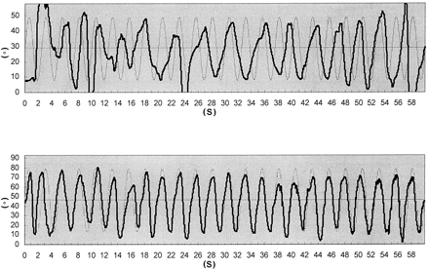
Fig. 2 Finger movement tracking responses from a subject with stroke (Subject 4) performing with his paretic ...
Notes:
Fig. 2 Finger movement tracking responses from a subject with stroke (Subject 4) performing with his paretic right hand before (upper: accuracy index = –56.4%) and after (lower: accuracy index = 43.5%) 20 sessions of finger tracking training. Finger extension is upward and finger flexion is downward.
Unless provided in the caption above, the following copyright applies to the content of this slide:

Slide 4
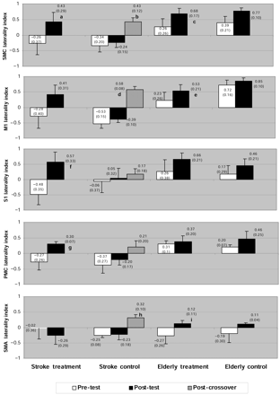
Fig. 3 Mean (± standard error) laterality indexes for the sensorimotor cortex (SMC), primary motor cortex ...
Notes:
Fig. 3 Mean (± standard error) laterality indexes for the sensorimotor cortex (SMC), primary motor cortex (M1), primary sensory cortex (S1), premotor cortex (PMC) and supplementary motor area (SMA) for each group on pre‐test, post‐test and post‐crossover test. For stroke treatment pre‐test–post‐test comparison n = 4. For stroke control pre‐test–post‐test comparison n = 5 but for stroke control post‐test–post‐crossover comparison n = 4 (loss of one subject at post‐crossover due to head movement). For elderly treatment pre‐test–post‐test comparison n = 5. For elderly control pre‐test–post‐test comparison n = 4. aTrend toward significant difference from pre‐test (P = 0.055); bsignificantly different from post‐test (P = 0.045); csignificantly different from pre‐test (P = 0.029); dsignificantly different from post‐test (P = 0.007); esignificantly different from pre‐test (P = 0.014); fsignificantly different from pre‐test (P = 0.028); gtrend toward significant difference from pre‐test (P = 0.051); htrend toward significant difference from post‐test (P = 0.051); itrend toward significant difference from pre‐test (P = 0.050).
Unless provided in the caption above, the following copyright applies to the content of this slide:

Slide 5
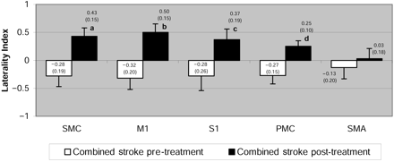
Fig. 4 Mean (± standard error) laterality indexes for the sensorimotor cortex (SMC), primary motor cortex ...
Notes:
Fig. 4 Mean (± standard error) laterality indexes for the sensorimotor cortex (SMC), primary motor cortex (M1), primary sensory cortex (S1), premotor cortex (PMC) and supplementary motor area (SMA) for the stroke subjects only (n = 8), after combining the pre‐test for the stroke treatment group with the post‐test for the stroke control group (combined stroke pre‐treatment) and combining the post‐test for the stroke treatment group with the post‐crossover for the stroke control group (combined stroke post‐treatment). aSignificantly different from pre‐treatment (P = 0.004); bsignificantly different from pre‐treatment (P = 0.004); csignificantly different from pre‐treatment (P = 0.044); dsignificantly different from pre‐treatment (P = 0.006).
Unless provided in the caption above, the following copyright applies to the content of this slide:

Slide 6
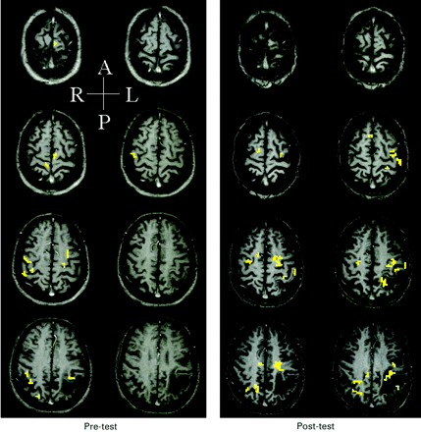
Fig. 5 fMRIs (rostral eight slices) for one subject (Subject 4) in the stroke treatment group (9.4 years ...
Notes:
Fig. 5 fMRIs (rostral eight slices) for one subject (Subject 4) in the stroke treatment group (9.4 years post‐stroke) performing the finger movement tracking test with his paretic right hand before (pre‐test) and after (post‐test) 20 sessions of finger tracking training. An infarct in the left parietal cortex is evident in the lower three images of each set. Cortical activation is predominantly ipsilateral before training and predominantly contralateral after training. Cortical activation at the peri‐infarct zone is evident after training. Laterality indexes for the sensorimotor cortex, primary motor cortex, primary sensory cortex, premotor cortex and supplementary motor area at pre‐test were –0.71, –0.90, –0.43, 0.20 and 1, respectively. At post‐test, they were 0.85, 1, 0.71, 0.30 and –1, respectively.
Unless provided in the caption above, the following copyright applies to the content of this slide:

