Slide 1
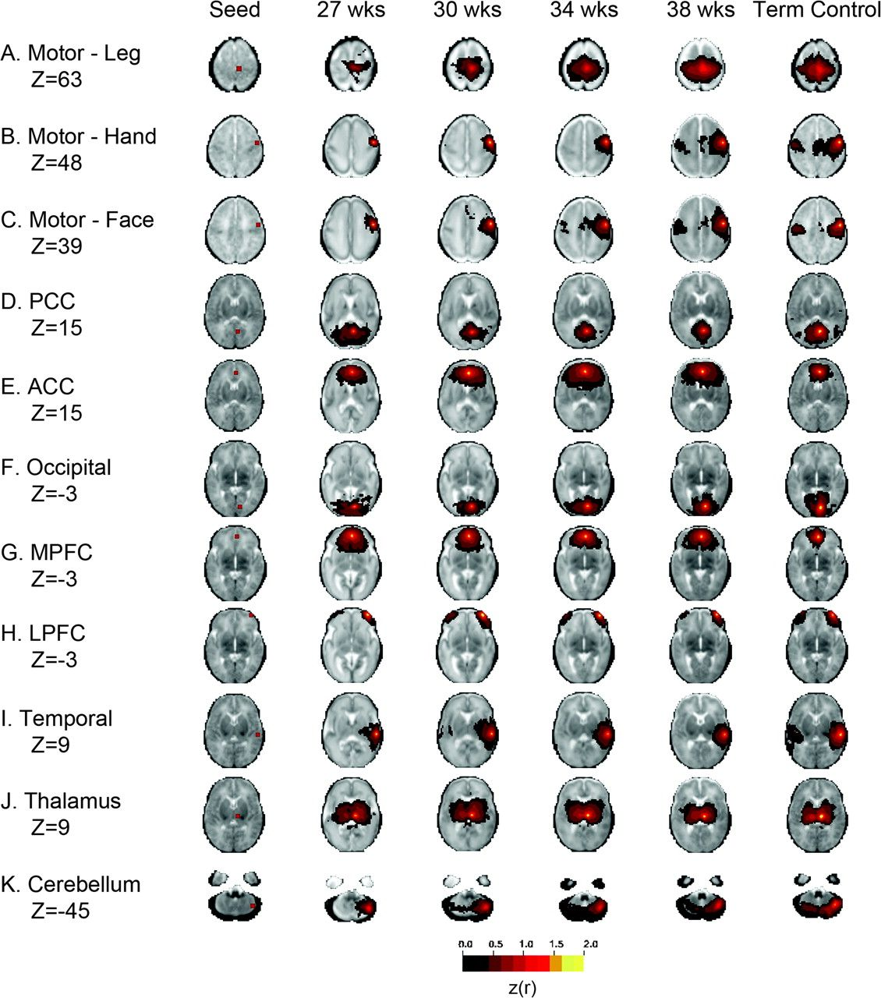
Figure 1. Longitudinal neural network development in preterm infants. Average fcMRI correlation maps corresponding to ...
Notes:
Figure 1. Longitudinal neural network development in preterm infants. Average fcMRI correlation maps corresponding to varied seed locations. The images are organized in columns corresponding to PMA at time of imaging. The illustrated quantity is the group mean Fisher z-transformed correlation coefficient (threshold value = 0.3) overlaid on the gestational age–specific atlas (Supplementary Figs 1 and Supplementary Data). Each row shows the axial slice at the level of the seed region. Networks in preterm infants demonstrated limited intrahemispheric connectivity. Note age-dependent network maturation. Included are networks identified utilizing seeds located in the (A) motor cortex—leg (Z = 63), (B) motor cortex—hand (Z = 48), (C) motor cortex—face (Z = 39), (D) posterior cingulate cortex (PCC) (Z = 15), (E) anterior cingulate cortex (ACC) (Z = 15), (F) occipital cortex (Z = −3), (G) medial prefrontal cortex (MPFC) (Z = −3), (H) lateral prefrontal cortex (LPFC) (Z = −3), (I) temporal cortex (Z = 9), (J) thalamus (Z = 9), and (K) cerebellum (Z = −45). The right side of the image corresponds to the right side of the brain. The number of subjects contributing to each PMA group is 27 weeks, n = 10; 30 weeks, n = 16; 34 weeks, n = 36; 38 weeks, n = 28; and term control infants, n = 10 (see also Table 1 and Supplementary Table 1).
Unless provided in the caption above, the following copyright applies to the content of this slide: © The Author 2010. Published by Oxford University Press. All rights reserved. For permissions, please e-mail: journals.permissions@oxfordjournals.org

Slide 2
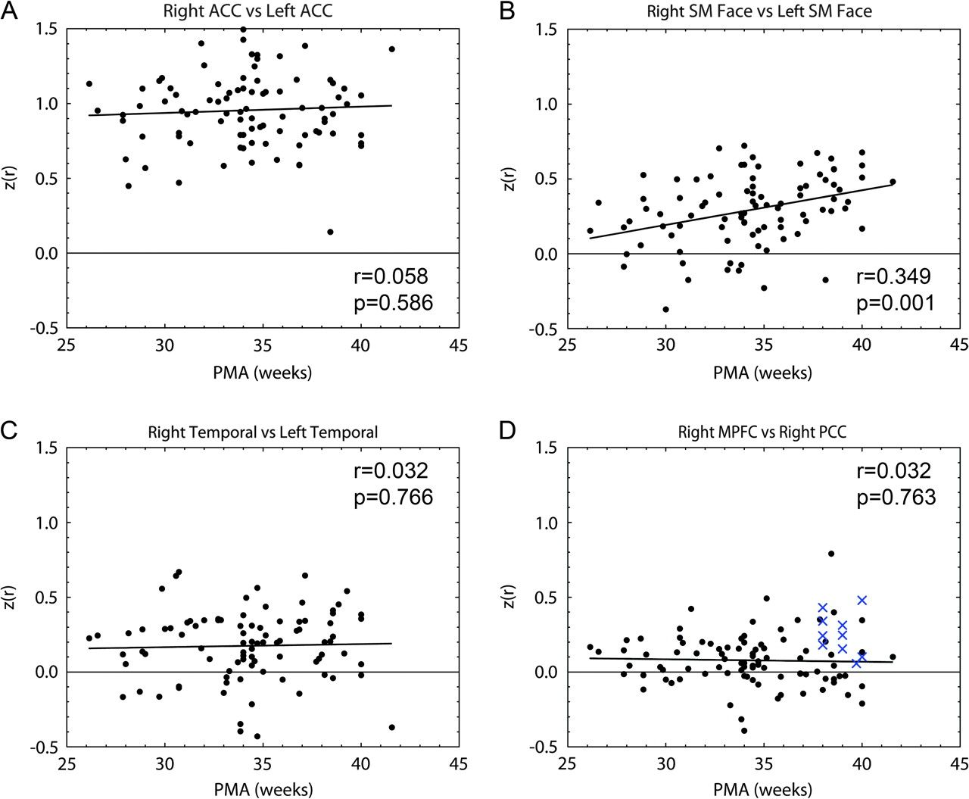
Figure 2. Functional connections demonstrate characteristic patterns of maturation based on location. Scatter plots ...
Notes:
Figure 2. Functional connections demonstrate characteristic patterns of maturation based on location. Scatter plots demonstrating relationship between correlation values for regions of interest and PMA. Linear regression performed on result with correlation coefficient and measure of significance included. (A) Right and left anterior cingulate cortex (ACC) demonstrates significant interhemispheric connectivity between homotopic counterparts from earliest acquisition point with limited variability with advancing gestational age. Image is representative of those produced using medial seed locations. (B) Right and left sensorimotor (SM) cortex demonstrates statistically significant increase in interhemispheric connectivity between homotopic counterparts with advancing gestational age. Image is representative of those produced using lateral seed locations. (C) Right and left temporal cortex demonstrates limited interhemispheric connectivity between homotopic counterparts throughout early development. (D) Right medial prefrontal cortex (MPFC) and right posterior cingulate cortex (PCC) demonstrate limited connectivity between regions of interest in preterm infants (solid black circles), including those at term equivalent PMA. A subset of term control infants (blue Xs) demonstrate increased connectivity between these regions.
Unless provided in the caption above, the following copyright applies to the content of this slide: © The Author 2010. Published by Oxford University Press. All rights reserved. For permissions, please e-mail: journals.permissions@oxfordjournals.org

Slide 3
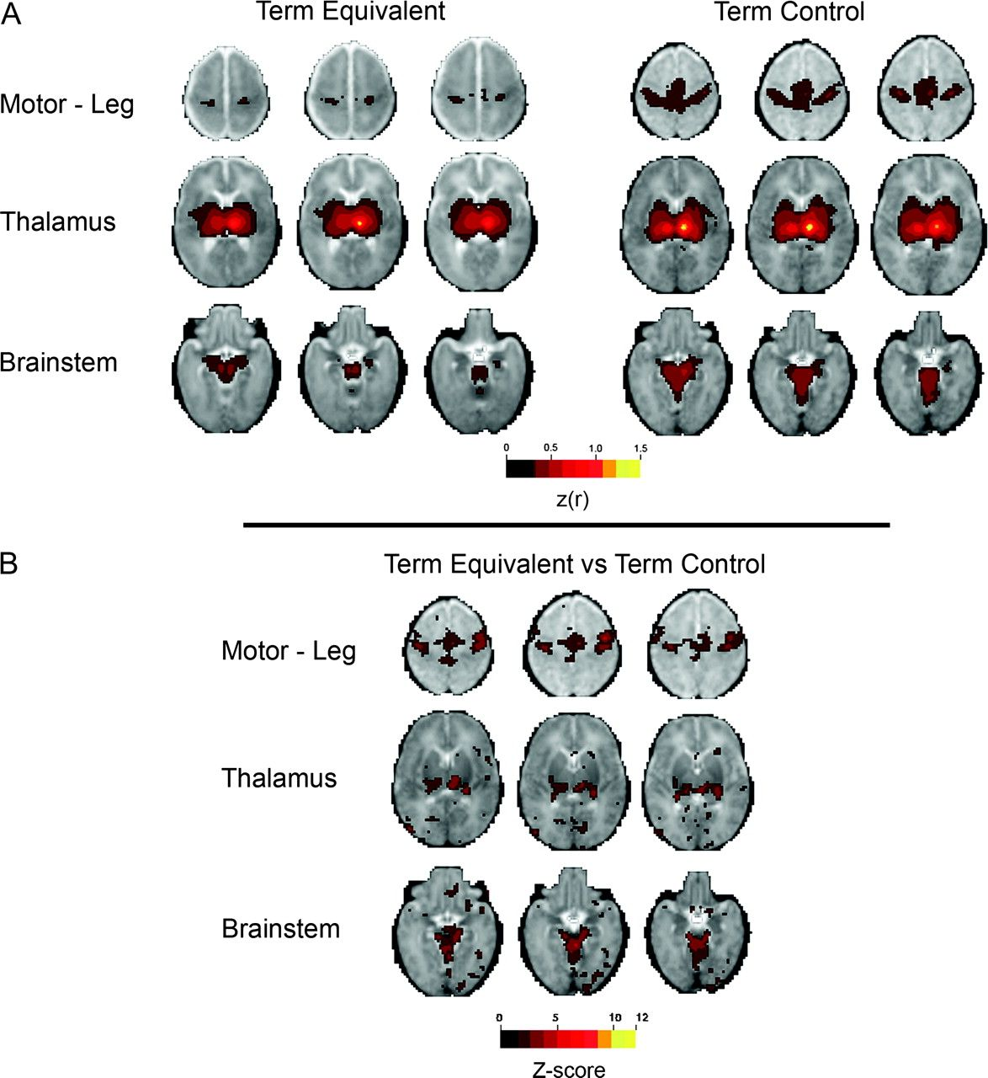
Figure 3. Significant differences in functional connectivity between term equivalent and term control infants using ...
Notes:
Figure 3. Significant differences in functional connectivity between term equivalent and term control infants using seed region located in the thalamus. (A) Average fcMRI correlation maps generated using a right thalamic seed demonstrating qualitative differences in functional connections between preterm infants at term equivalent PMA (n = 28) and term control infants (n = 10). Included are sensorimotor cortex—leg (Z = 54/51/48), thalamic (Z = 12/9/6), and brainstem (Z = −15/−18/−21) regions. The correlation map generated for the term equivalent infants demonstrates limited functional connections superiorly to the sensorimotor cortex and inferiorly to the brainstem and cerebellum in comparison with those identified for term control infants. z(r) threshold 0.3 used. (B) These patterns are confirmed through direct comparison between these populations via voxel-wise t-test with subsequent conversion of t statistic values to equiprobable Z scores (random-effects analysis). Connections between the thalamus and sensorimotor cortex and brainstem and cerebellum are significantly stronger in term control infants. Z score threshold 1.65 (corresponding to P < 0.05) used. The right side of the image corresponds to the right side of the brain.
Unless provided in the caption above, the following copyright applies to the content of this slide: © The Author 2010. Published by Oxford University Press. All rights reserved. For permissions, please e-mail: journals.permissions@oxfordjournals.org

Slide 4
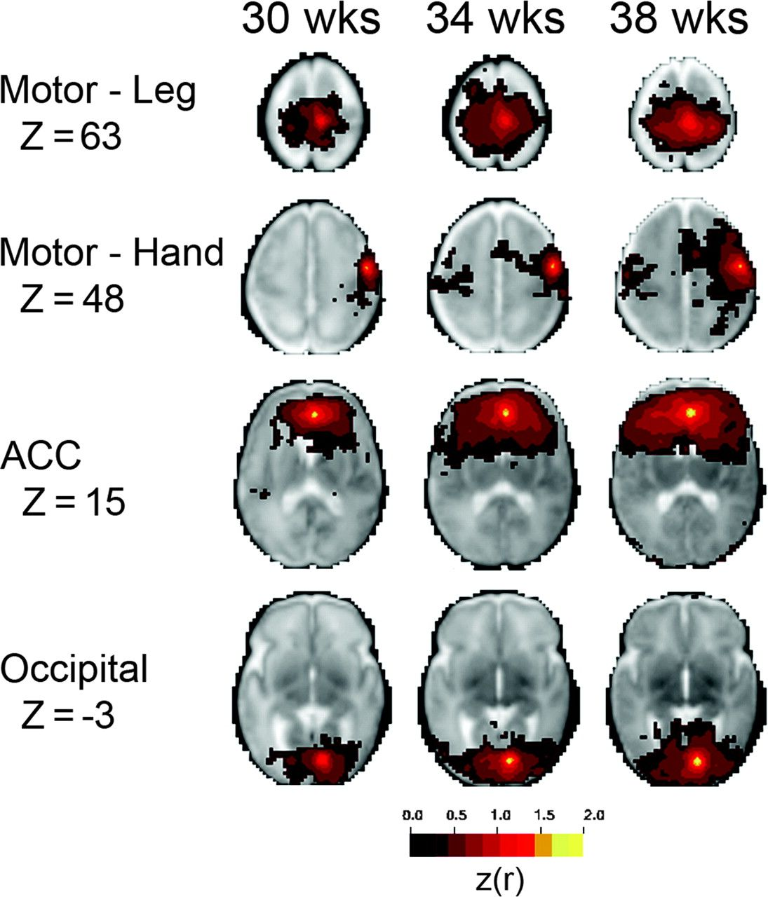
Figure 4. Results for infants with complete longitudinal data sets are consistent with those obtained for larger group ...
Notes:
Figure 4. Results for infants with complete longitudinal data sets are consistent with those obtained for larger group analysis. Average fcMRI correlation maps generated using sensorimotor cortex—leg (Z = 63), sensorimotor cortex—hand (Z = 48), anterior cingulate cortex (ACC) (Z = 15), and occipital cortex (Z = −3) seed locations demonstrating longitudinal neural network development in 5 subjects studied at final 3 acquisition times. Results are similar to those from larger group analysis, demonstrating a comparable age-dependent pattern of development with increasing strength and organization with advancing gestational age. This demonstrates that correlation maps obtained in the larger group analysis were not biased by inclusion of specific infant populations. z(r) threshold 0.3 used. The right side of the image corresponds to the right side of the brain.
Unless provided in the caption above, the following copyright applies to the content of this slide: © The Author 2010. Published by Oxford University Press. All rights reserved. For permissions, please e-mail: journals.permissions@oxfordjournals.org

Slide 5
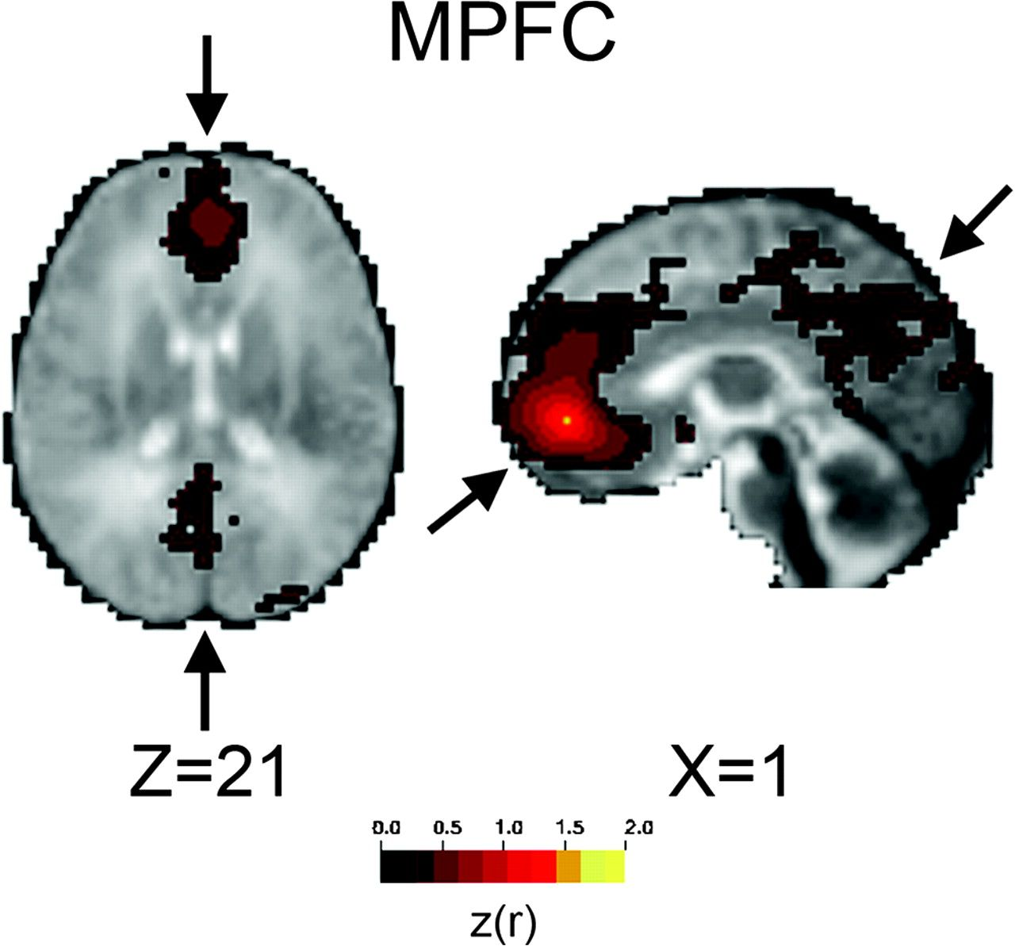
Figure 5. Default mode network precursors identified in term infants. Average fcMRI maps demonstrating putative default ...
Notes:
Figure 5. Default mode network precursors identified in term infants. Average fcMRI maps demonstrating putative default mode network precursors, including connections between the medial prefrontal and posterior cingulate cortices (arrows), identified in term control infants (n = 10) utilizing right medial prefrontal cortex (MPFC) seed location (Z = 21, X = 1). Further quantitative analysis demonstrates that these images likely reflect prominent anterior–posterior connectivity in a subset of these infants, with a number of infants within the group continuing to show limited connection strength between these regions. Comparable findings were not identified in preterm infants, including those at term equivalent PMA. z(r) threshold 0.3 used. The right side of the image corresponds to the right side of the brain.
Unless provided in the caption above, the following copyright applies to the content of this slide: © The Author 2010. Published by Oxford University Press. All rights reserved. For permissions, please e-mail: journals.permissions@oxfordjournals.org

