Slide 1
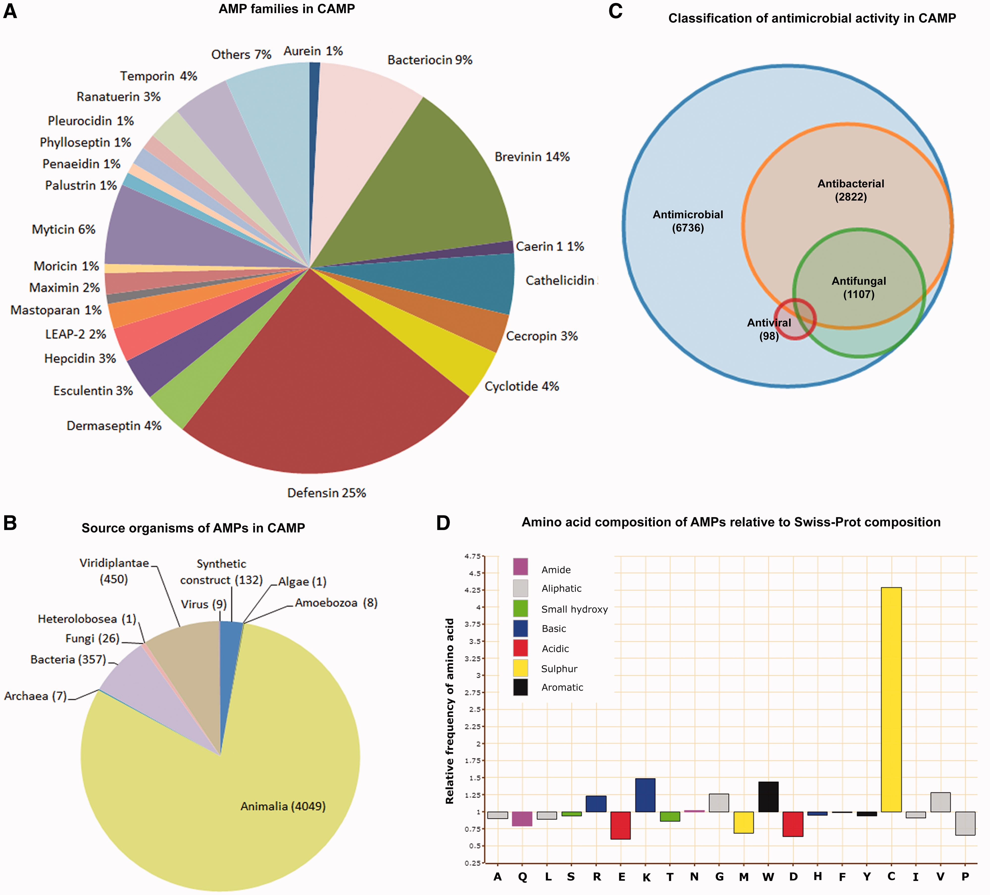
Figure 1. (A) Pie chart of AMP families in CAMP, (B) Pie chart of source organisms of AMPs in CAMP, (C) Venn diagram of ...
Notes:
Figure 1. (A) Pie chart of AMP families in CAMP, (B) Pie chart of source organisms of AMPs in CAMP, (C) Venn diagram of classification of AMP activity in CAMP and (D) Relative amino acid composition of experimentally validated and predicted sequences of AMPs in CAMP as compared with Swiss-Prot composition.
Unless provided in the caption above, the following copyright applies to the content of this slide: © The Author(s) 2013. Published by Oxford University Press.This is an Open Access article distributed under the terms of the Creative Commons Attribution Non-Commercial License (http://creativecommons.org/licenses/by-nc/3.0/), which permits non-commercial re-use, distribution, and reproduction in any medium, provided the original work is properly cited. For commercial re-use, please contact journals.permissions@oup.com

