Slide 1
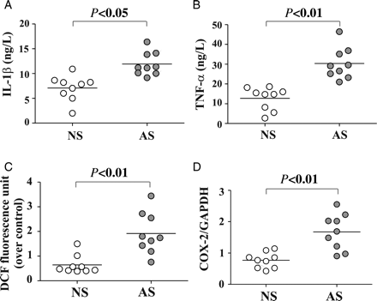
Figure 1 Serum cytokine levels in individual active smokers (AS) and non-smokers (NS) and effect of serum from ...
Notes:
Figure 1 Serum cytokine levels in individual active smokers (AS) and non-smokers (NS) and effect of serum from individuals on ROS generation and COX-2 in endothelial cells. Serum concentration of (A) IL-1β, and (B) TNF-α in AS (filled circle) and NS (circle). Confluent TrHBMECs were incubated with 1% human serum from individual AS or NS, and (C) intracellular ROS production was detected after 5 min incubation, and (D) COX-2 mRNA was analysed by QRT–PCR after 1 h serum treatment.
Unless provided in the caption above, the following copyright applies to the content of this slide: Published on behalf of the European Society of Cardiology. All rights reserved. © The Author 2011. For permissions please email: journals.permissions@oup.com

Slide 2
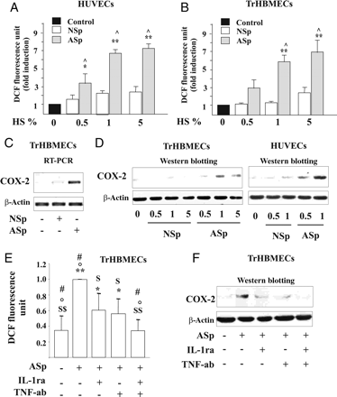
Figure 2 Effects of IL-1β and TNF-α present in smokers' serum on endothelial dysfunction in endothelial cells. ...
Notes:
Figure 2 Effects of IL-1β and TNF-α present in smokers' serum on endothelial dysfunction in endothelial cells. Concentration-dependent effect of the pool of serum from nine AS (ASp) or pool of serum from nine NS (NSp) subjects on (A and B) ROS production. (C) COX-2 mRNA levels were detected by RT–PCR after 1 h exposure to ASp serum or NSp serum. (D) COX-2 protein expression was determined after 6 h of treatment with ASp serum or of the NSp serum. (E) Intracellular ROS generation and (F) COX-2 protein expression in TrHBMECs pre-incubated with IL-1ra and/or TNF-ab and then stimulated with ASp. *P < 0.05 and **P < 0.01 vs. control; ^P < 0.01 vs. NSp; $P < 0.05 and $ $P < 0.01 vs. ASp; °P < 0.05 vs. ASp + IL-1ra; #P < 0.05 vs. ASp + TNF-ab.
Unless provided in the caption above, the following copyright applies to the content of this slide: Published on behalf of the European Society of Cardiology. All rights reserved. © The Author 2011. For permissions please email: journals.permissions@oup.com

Slide 3
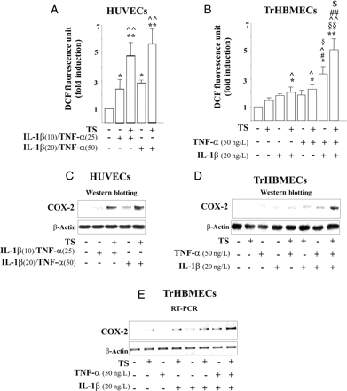
Figure 3 Effects of IL-1β and TNF-α combined with TS on endothelial dysfunction. (A and B) ROS generation after 5 min' ...
Notes:
Figure 3 Effects of IL-1β and TNF-α combined with TS on endothelial dysfunction. (A and B) ROS generation after 5 min' stimulation (*P < 0.05 and **P < 0.01 vs. control, ^P < 0.05 and ^^P < 0.01 vs. TS, #P < 0.05 and #P < 0.01 vs. IL-1β, §P < 0.05 and §§ vs. TNF-α, and $P < 0.05 vs. IL-1β/TNF-α). (C and D) COX-2 protein and (E) COX-2 mRNA levels after stimulation with TS, TNF-α and/or IL-1β.
Unless provided in the caption above, the following copyright applies to the content of this slide: Published on behalf of the European Society of Cardiology. All rights reserved. © The Author 2011. For permissions please email: journals.permissions@oup.com

Slide 4
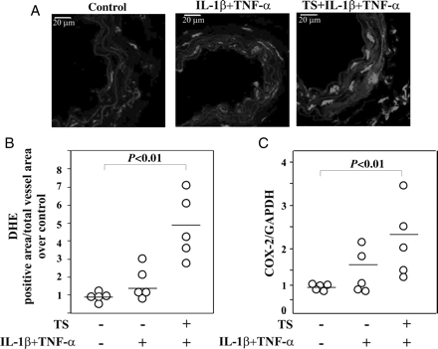
Figure 4 Effect of TS and/or IL-1β/TNF-α on ROS production and COX-2 expression in vivo. (A) Representative carotid ...
Notes:
Figure 4 Effect of TS and/or IL-1β/TNF-α on ROS production and COX-2 expression in vivo. (A) Representative carotid cross-section labelled with the fluorescent dye DHE. Scale bars = 20 μm and (B) Quantitative fluorescent dye DHE of carotid after 2 h of tail vein injection of stimulus. (C) COX-2 mRNA of aortic tissue analysed by QRT–PCR after 2 h of treatment. (five animals per group).
Unless provided in the caption above, the following copyright applies to the content of this slide: Published on behalf of the European Society of Cardiology. All rights reserved. © The Author 2011. For permissions please email: journals.permissions@oup.com

Slide 5
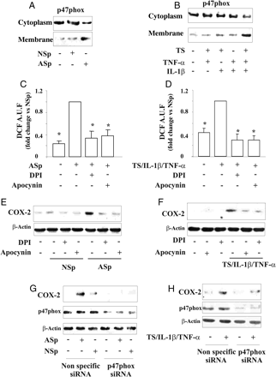
Figure 5 p47phox translocation and role of NADPH oxidase in the regulation of ROS generation and COX-2 expression ...
Notes:
Figure 5 p47phox translocation and role of NADPH oxidase in the regulation of ROS generation and COX-2 expression induced by pooled serum and TS/IL-1β/TNF-α. Effect of (A) NSp serum or ASp serum, and (B) TS, IL-1β and/or TNF-α. TrHBMECs were pre-treated with (C–F) DPI or apocynin, or (G and H) transfected with non-specific siRNA or p47phox siRNA and then stimulated with pooled serum, or TS/IL-1β/TNF-α. (C and D) Intracellular ROS generation. (*P < 0.01 vs. ASp or TS/IL-1β/TNF-α). (E–H) COX-2 expression.
Unless provided in the caption above, the following copyright applies to the content of this slide: Published on behalf of the European Society of Cardiology. All rights reserved. © The Author 2011. For permissions please email: journals.permissions@oup.com

Slide 6
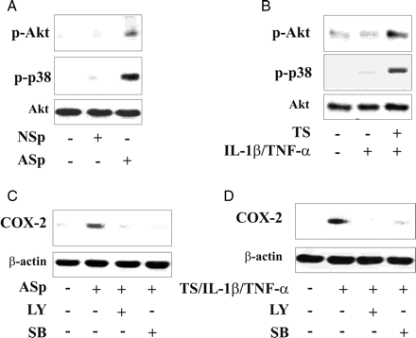
Figure 6 Role of Akt and p38MAPK on COX-2 expression in endothelial cells incubated with different stimuli. After ...
Notes:
Figure 6 Role of Akt and p38MAPK on COX-2 expression in endothelial cells incubated with different stimuli. After exposure to pooled AS/NS serum, or TS and/or IL-1β/TNF-α, or TS/IL-1β/TNF-α, endothelial cells were lysed and processed for (A and B) phosphorylation of Akt (p-Akt) and p38MAPK (p-p38). In (C and D) TrHBMECs were preincubated in the presence or absence of LY294002 (LY), SB203580 (SB) for 2 h then stimulated with the ASp serum or TS/IL-1β/TNF-α and processed for COX-2 protein.
Unless provided in the caption above, the following copyright applies to the content of this slide: Published on behalf of the European Society of Cardiology. All rights reserved. © The Author 2011. For permissions please email: journals.permissions@oup.com

