Slide 1
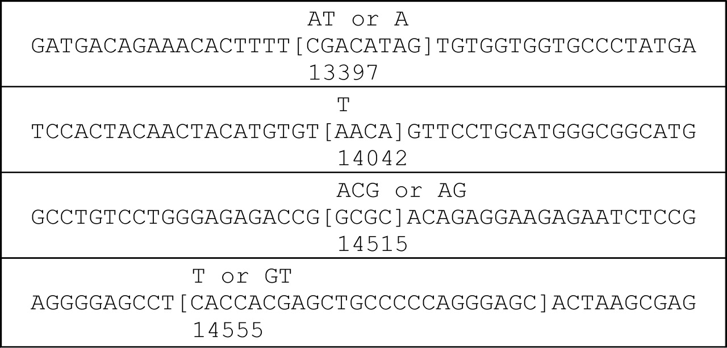
Figure 1. Sequence context of identical or recurroid microindels. Sequence context of the four sites where two TP53 ...
Notes:
Figure 1. Sequence context of identical or recurroid microindels. Sequence context of the four sites where two TP53 somatic microindels occurred and deleted the same sequence. Deleted sequence is shown in square brackets and inserted sequence is shown above. Base numbering below the sequence indicates the number of the base that is aligned with the first digit according to GenBank genomic sequence accession no. X54156.1.
Unless provided in the caption above, the following copyright applies to the content of this slide: © The Author 2008. Published by Oxford University Press. All rights reserved. For Permissions, please email: journals.permissions@oxfordjournals.org

Slide 2
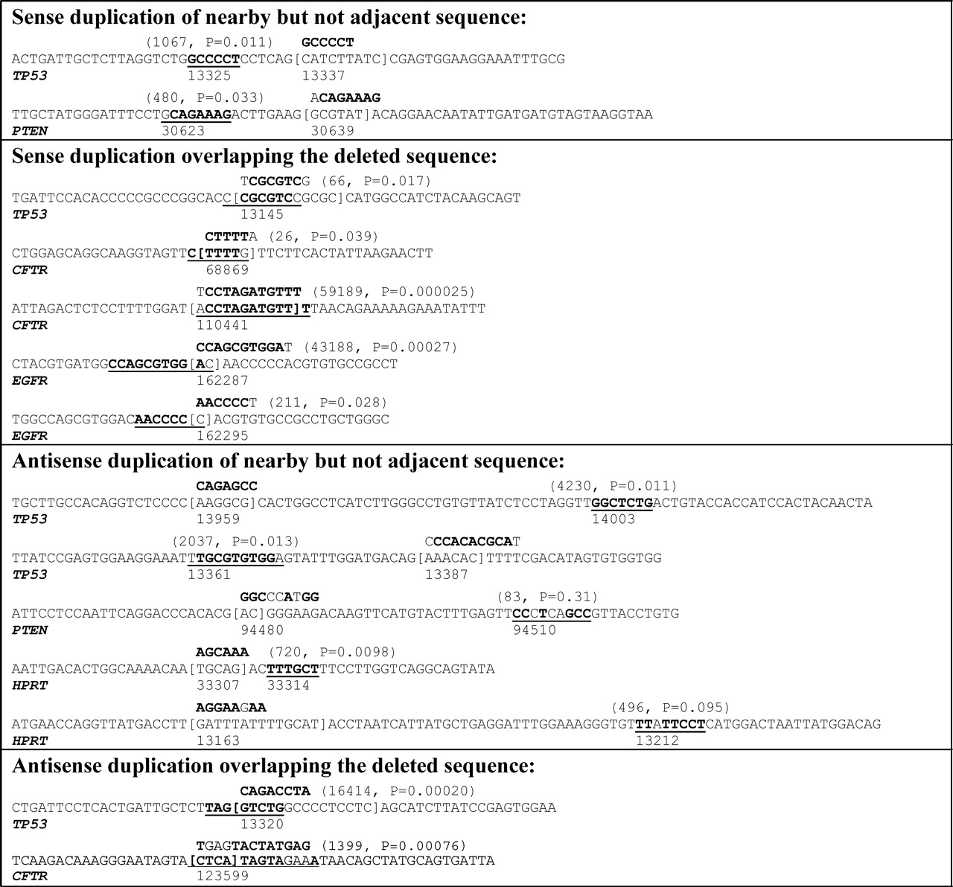
Figure 2. Sequence context of microindels with larger insertions. Sequence context of TP53 microindels ( Supplementary ...
Notes:
Figure 2. Sequence context of microindels with larger insertions. Sequence context of TP53 microindels ( Supplementary Material, Table S5 ) plus microindels in CFTR (Human Gene Mutation Database, public version as of 4 April 2007) ( 17 ), microindels in EGFR (Epidermal Growth Factor Receptor Mutation Database, http://www.cityofhope.org/cmdl/egfr_db ) ( 16 ), microindels in HPRT (Human HPRT Mutation Database, http://www.ibiblio.org/dnam/mainpage.html , Supplementary Material, Table S9 ) and microindels in PTEN (Catalogue of Somatic Mutations in Cancer, as of 8 June 2007) ( 15 ) in which the inserted sequence is at least six nucleotides. Deleted sequence is shown in square brackets, inserted sequence is shown above and the putative sense or antisense template for the inserted sequence is shown underlined. Bold font indicates sense or antisense matching bases in the inserted sequence and template (regular font indicates a mismatch). The first number shown in parentheses above the putative insertion template is the expected distance to the first instance of the inserted sequence with the same number of mismatches as the putative template. The P -value is the chance probability of the putative template or its reverse complement occurring at the observed distance or closer. Both values are calculated by simulation (see Materials and Methods). Base numbering below the sequence indicates the number of the reference sequence nucleotide that is aligned with the first digit ( TP53 , X54156.1; CFTR , NC_000007.12 region 116907253–117095955; EGFR , NC_000007.12 region 55054219–55242525; HPRT , NC_000023.9 region 133421923–133462362; PTEN , NC_000010.9 region 89613175–89716382).
Unless provided in the caption above, the following copyright applies to the content of this slide: © The Author 2008. Published by Oxford University Press. All rights reserved. For Permissions, please email: journals.permissions@oxfordjournals.org

Slide 3
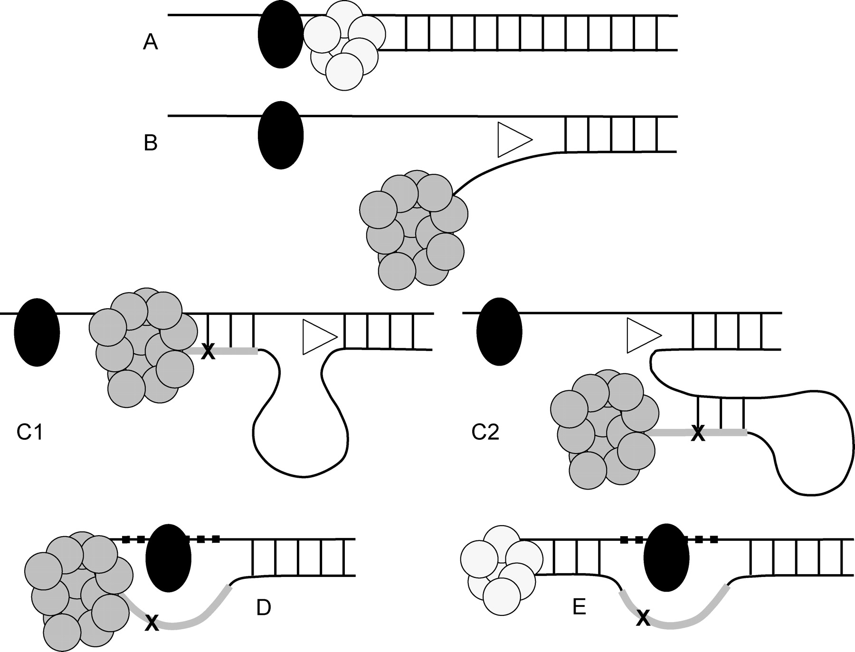
Figure 3. Tarzan Model: proposed mechanism of indelogenesis. Replication by the normal DNA polymerase (small cluster ...
Notes:
Figure 3. Tarzan Model: proposed mechanism of indelogenesis. Replication by the normal DNA polymerase (small cluster of circles) is blocked by a large DNA adduct (black oval) on the template DNA ( A ). To bypass the adduct, an error-prone translesion polymerase (large cluster of circles) and a helicase (triangle) are recruited. The translesion polymerase is also blocked by the adduct but the helicase disassociates the nascent strand from the template ( B ), allowing the translesion polymerase to synthesize a few nucleotides from the template ( C1 ) or the nascent strand ( C2 ). A few additional nucleotides are synthesized, sometimes with errors (X), generating the inserted sequence of the microindel (thick line). Thus, the inserted sequence is either a sense (in the case of C1) or antisense (in the case of C2) copy, sometimes with errors, of nearby sequence. The helicase then disassociates the segment synthesized by the translesion polymerase from the template (in the case of C1) or the nascent strand (in the case of C2). With the additional length of synthesized DNA, the translesion polymerase is able to swing across the adduct and save the cell, as Tarzan would use a vine to ‘swing’ across an obstacle and save the day. This process results in the skipping of some nucleotides on the template ( D, thick dashes) resulting in the microdeletion part of the microindel. Some of the skipped bases (or their complements on the nascent strand in the case of C2) may have been part of the template for the inserted sequence in which case there is overlap of the inserted and deleted sequences of the microindel. After the adduct is bypassed, the normal polymerase can proceed with replication ( E ).
Unless provided in the caption above, the following copyright applies to the content of this slide: © The Author 2008. Published by Oxford University Press. All rights reserved. For Permissions, please email: journals.permissions@oxfordjournals.org

