Slide 1
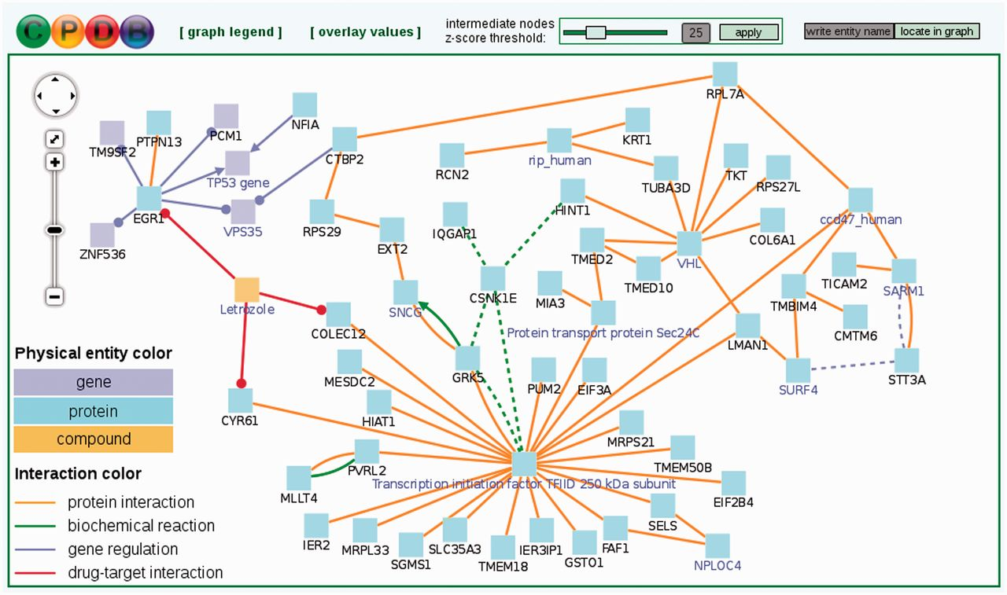
Figure 3. Induced network module analysis of a cancer-related gene list. Each node represents a physical entity (gene, ...
Notes:
Figure 3. Induced network module analysis of a cancer-related gene list. Each node represents a physical entity (gene, protein or compound). Nodes with black labels are from the input gene list (seed nodes) and nodes with a purple label are intermediate nodes that are not in the input list but connect seed nodes and have significantly many links in the induced network module. Each edge represents an interaction (physical, biochemical, regulatory or drug–target interaction). Numerical values can be overlaid on nodes (Supplementary Figure S1). This example network resulted from an induced network module analysis of 100 genes differentially expressed in metastatic prostate cancer as compared to non-metastatic primary prostate carcinoma and may represent a module that governs the metastatic potential of prostate cancer.
Unless provided in the caption above, the following copyright applies to the content of this slide: © The Author(s) 2012. Published by Oxford University Press.This is an Open Access article distributed under the terms of the Creative Commons Attribution License (http://creativecommons.org/licenses/by-nc/3.0/), which permits non-commercial reuse, distribution, and reproduction in any medium, provided the original work is properly cited. For commercial re-use, please contact journals.permissions@oup.com.

Slide 2
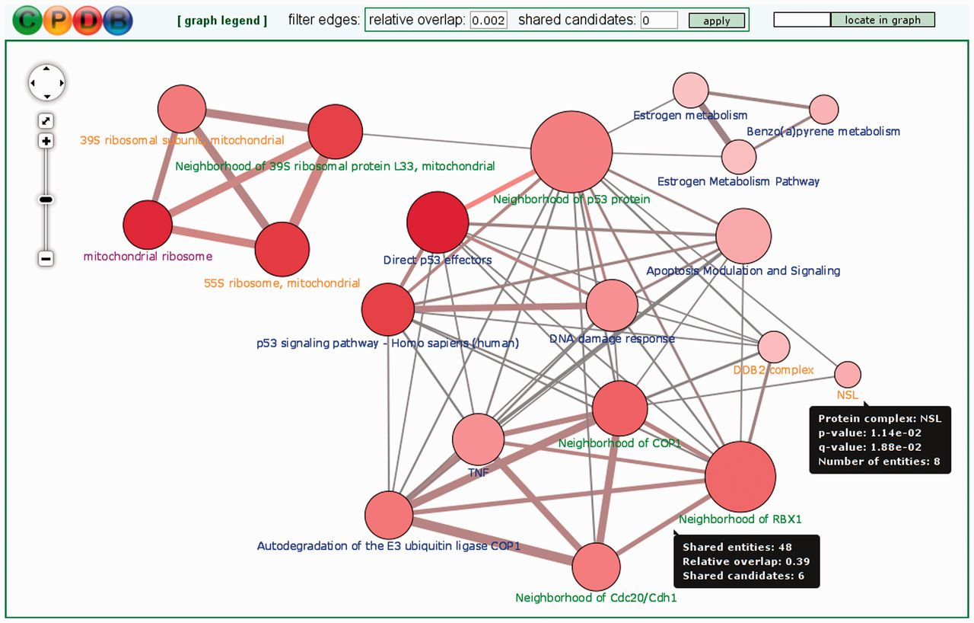
Figure 2. Functional gene set overlap graph summarizing predefined gene sets (and their pairwise overlaps) that are ...
Notes:
Figure 2. Functional gene set overlap graph summarizing predefined gene sets (and their pairwise overlaps) that are over-represented in an input list of 410 genes differentially expressed after treatment of human hepatocite-like cells with the genotoxic chemical benzo[a]pyrene. Benzo[a]pyrene causes mutations in the DNA and leads to carcinogenesis (38). Each node in the overlap graph is a predefined gene set (blue label: curated pathway, purple label: Gene Ontology category, green label: NEST and orange label: protein complex). The node size reflects the size of the gene set and the node color—its P-value (deeper red means smaller P-value). Each edge denotes an overlap between gene sets (i.e. shared genes). The edge width reflects the size of the overlap and its color reflects the number of genes/metabolites from the input list that are contained in the overlap. Details are shown in tooltips.
Unless provided in the caption above, the following copyright applies to the content of this slide: © The Author(s) 2012. Published by Oxford University Press.This is an Open Access article distributed under the terms of the Creative Commons Attribution License (http://creativecommons.org/licenses/by-nc/3.0/), which permits non-commercial reuse, distribution, and reproduction in any medium, provided the original work is properly cited. For commercial re-use, please contact journals.permissions@oup.com.

Slide 3
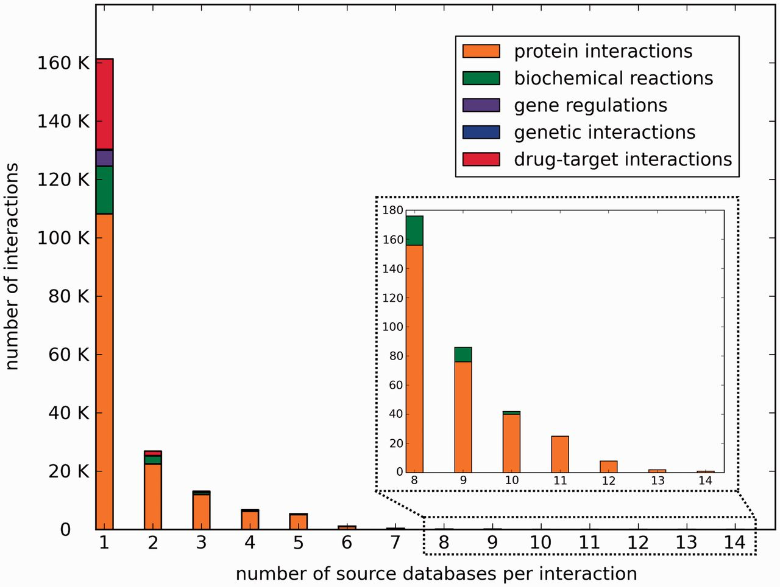
Figure 1. Histogram of the number of source databases per interaction in ConsensusPathDB.
Notes:
Figure 1. Histogram of the number of source databases per interaction in ConsensusPathDB.
Unless provided in the caption above, the following copyright applies to the content of this slide: © The Author(s) 2012. Published by Oxford University Press.This is an Open Access article distributed under the terms of the Creative Commons Attribution License (http://creativecommons.org/licenses/by-nc/3.0/), which permits non-commercial reuse, distribution, and reproduction in any medium, provided the original work is properly cited. For commercial re-use, please contact journals.permissions@oup.com.

