Slide 1
Fig. 1. Each preparation is repeatedly measured on 8–16 gels. Foreground intensities of spots correspond to protein ...
Notes:
Fig. 1. Each preparation is repeatedly measured on 8–16 gels. Foreground intensities of spots correspond to protein concentrations. Background was determined locally around the spots.
Unless provided in the caption above, the following copyright applies to the content of this slide: © The Author 2007. Published by Oxford University Press. All rights reserved. For Permissions, please email: journals.permissions@oxfordjournals.org

Slide 2
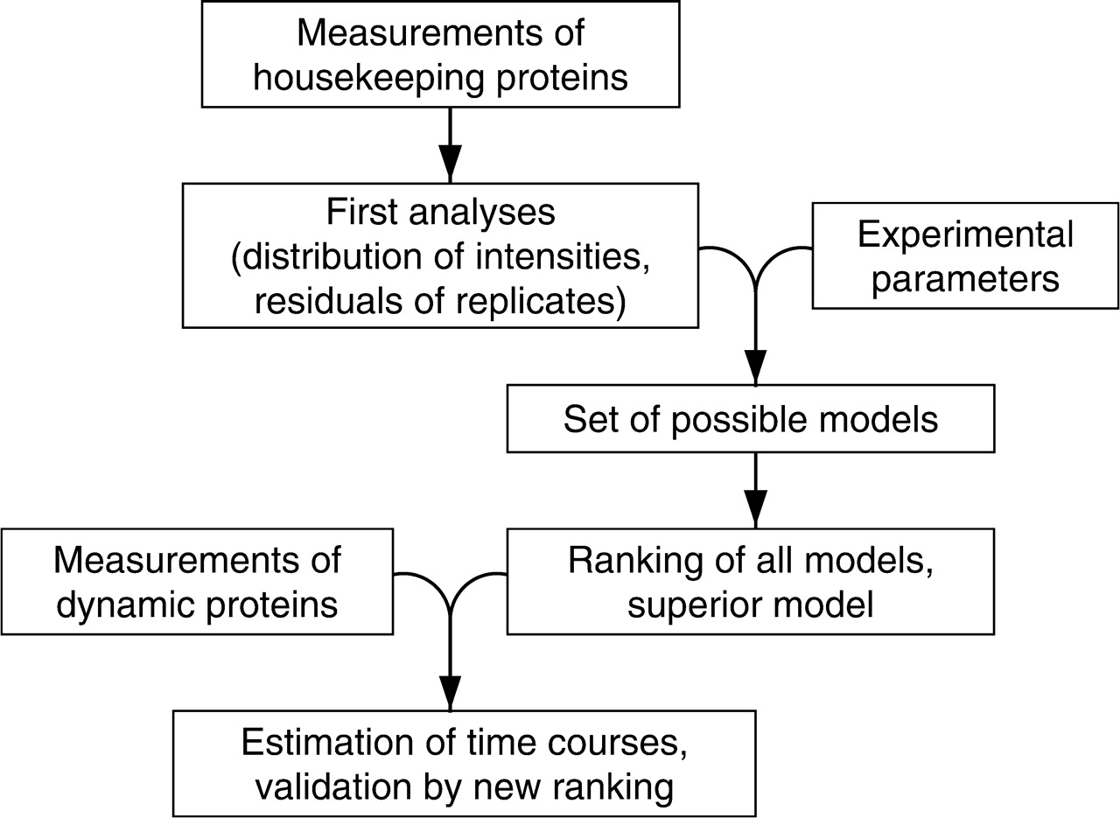
Fig. 2. Overview of applied analysis steps. First, analyses of housekeeping proteins enhance possibility of ...
Notes:
Fig. 2. Overview of applied analysis steps. First, analyses of housekeeping proteins enhance possibility of log-transformation and ratios foreground over background. In combination with different experimental parameters, 26 error models are introduced and evaluated. The superior model is used for determination of time courses.
Unless provided in the caption above, the following copyright applies to the content of this slide: © The Author 2007. Published by Oxford University Press. All rights reserved. For Permissions, please email: journals.permissions@oxfordjournals.org

Slide 3
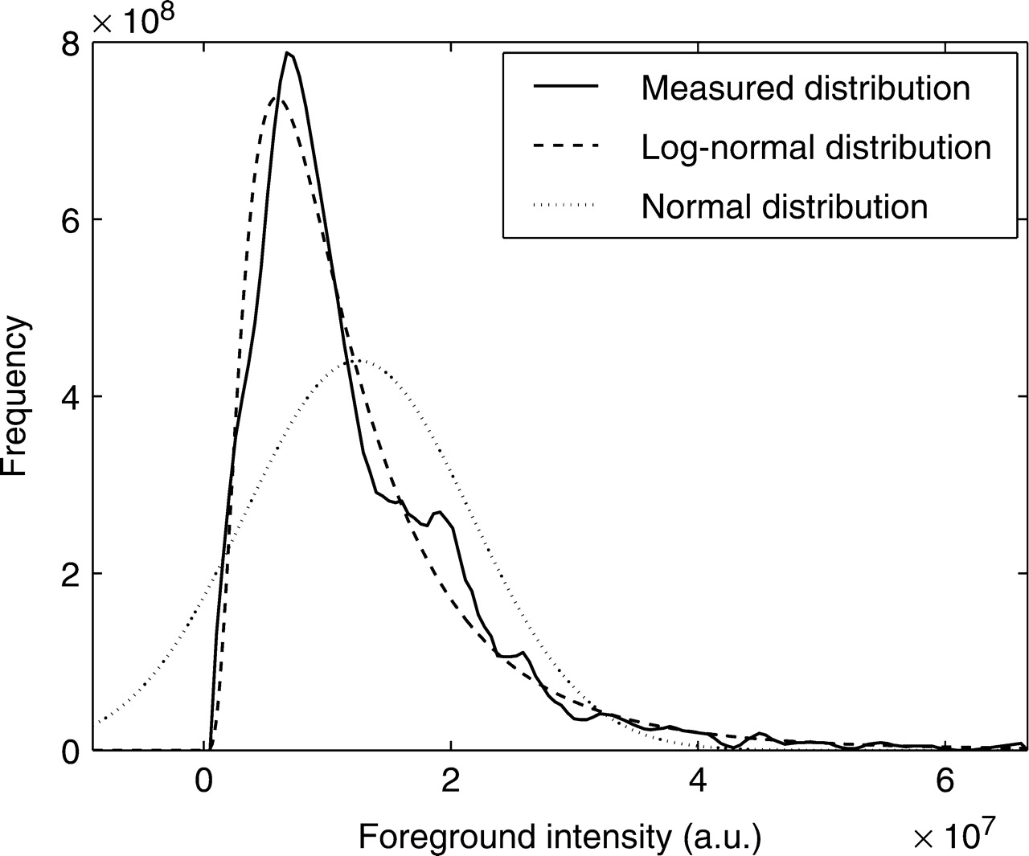
Fig. 3. Measured distribution of foreground intensities agrees with lognormal distribution. Its asymmetry is in ...
Notes:
Fig. 3. Measured distribution of foreground intensities agrees with lognormal distribution. Its asymmetry is in contradiction with normal distribution.
Unless provided in the caption above, the following copyright applies to the content of this slide: © The Author 2007. Published by Oxford University Press. All rights reserved. For Permissions, please email: journals.permissions@oxfordjournals.org

Slide 4
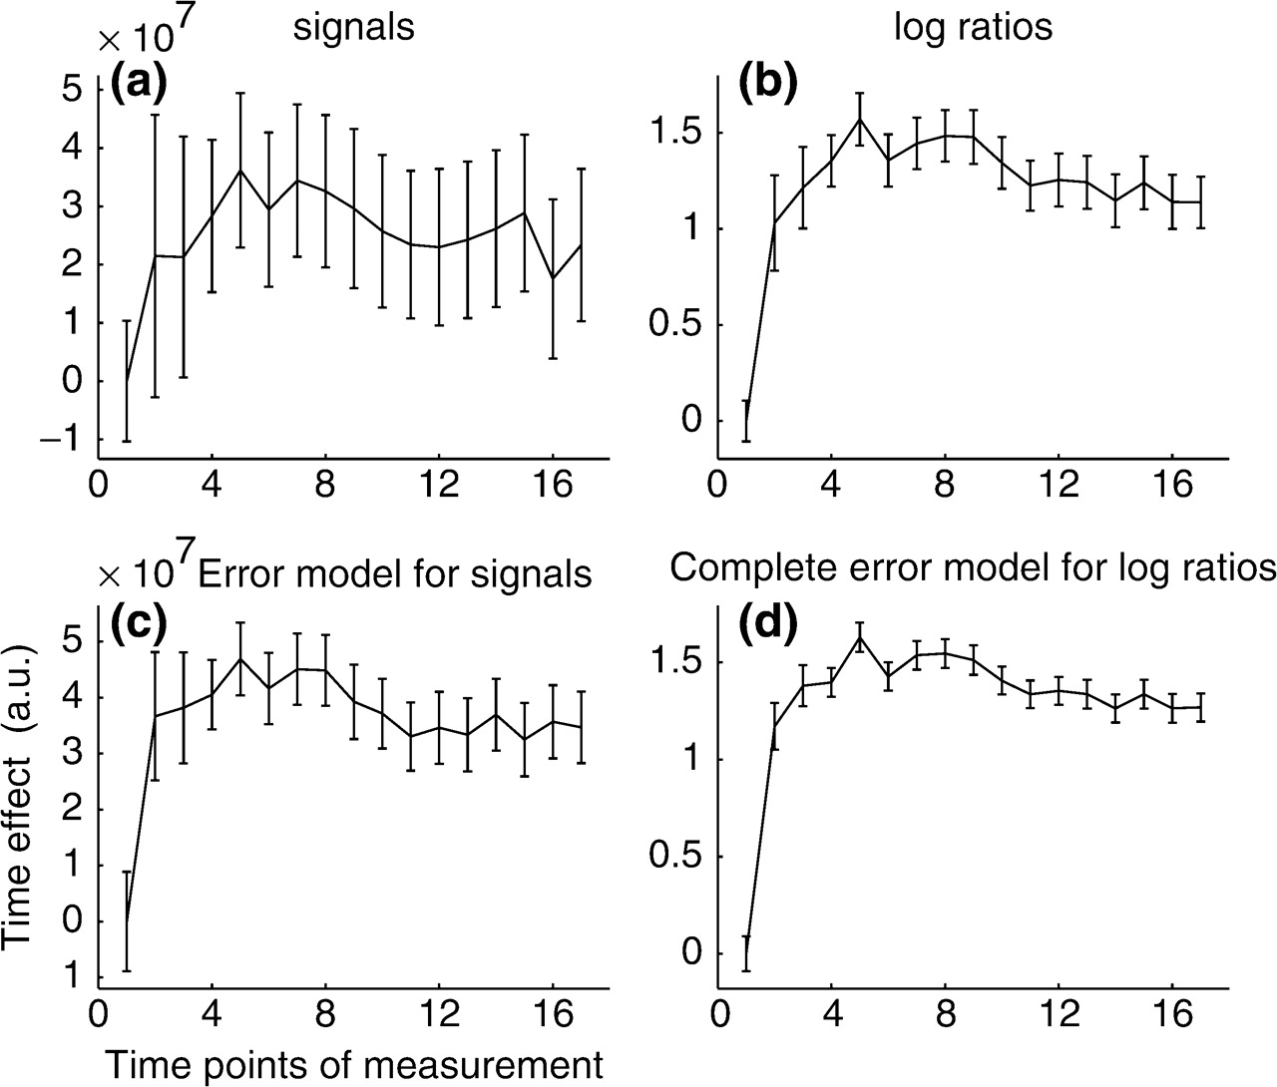
Fig. 4. Activation of Insulin receptor estimated (a) from signals, (b) from log-ratios, (c) from signals with ...
Notes:
Fig. 4. Activation of Insulin receptor estimated (a) from signals, (b) from log-ratios, (c) from signals with elimination of systematic errors and (d) for the full model with log-transformation and multiplicative background correction.
Unless provided in the caption above, the following copyright applies to the content of this slide: © The Author 2007. Published by Oxford University Press. All rights reserved. For Permissions, please email: journals.permissions@oxfordjournals.org

