Slide 1
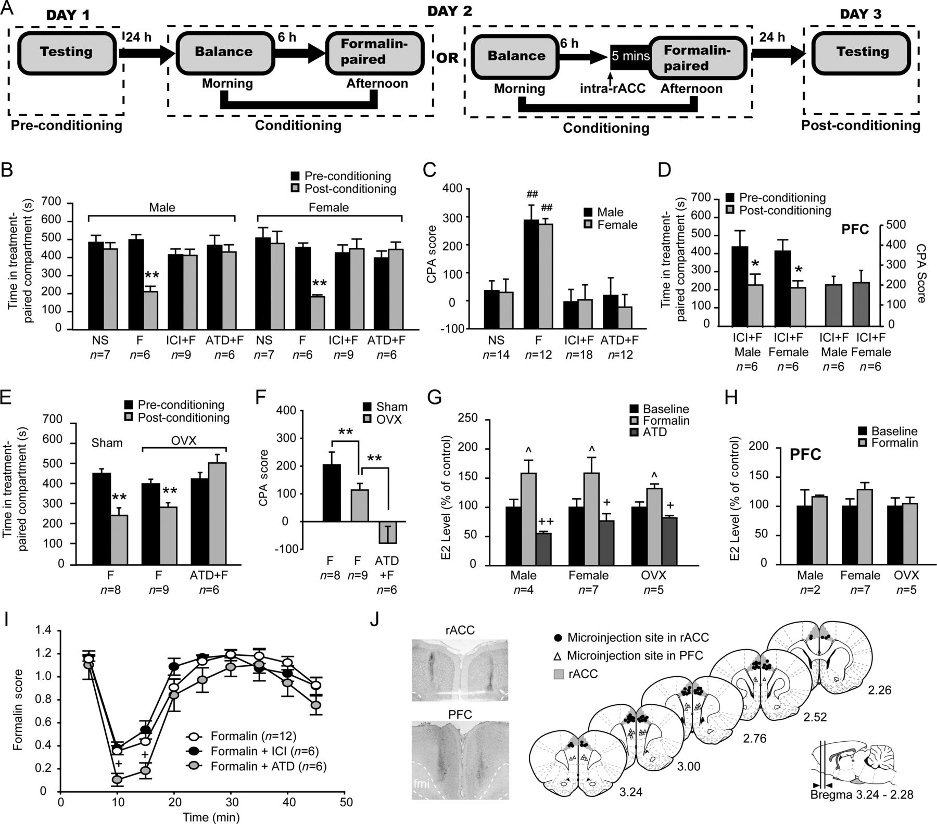
Figure 1. Endogenous estrogen in the rACC contributes to F-CPA acquisition. (A) Schematic of the protocol for F-CPA. (B ...
Notes:
Figure 1. Endogenous estrogen in the rACC contributes to F-CPA acquisition. (A) Schematic of the protocol for F-CPA. (B and C) The effects of intra-rACC microinjection of classical ERs inhibitor ICI 182, 780 (ICI) (20 μM, 0.6 μL per side) or aromatase inhibitor androstatrienedione (ATD) (200 μM, 0.6 μL per side) on F-CPA in both sexes, as indicated by time spent in the treatment-paired compartment on preconditioning and postconditioning days (B) and CPA scores (the time spent in the treatment-paired compartment on the pre-conditioning day minus that on the post-conditioning day) (C). (D) The effects of Intra-PFC injections of ICI on F-CPA in both sexes. (E and F) The effects of intra-rACC injection of ATD on F-CPA in the female rats which were subjected to bilateral ovariectomy (OVX), as indicated by time spent in the treatment-paired compartment on preconditioning and postconditioning days (E) and CPA scores (F). (G and H) E2 levels in extracellular dialysate (flow rate: 8 μL/min) in the rACC (G) and PFC (H) from male, female and OVX rats during 40 min before and after i. pl injection of formalin (5%, 50 μL) and intra-rACC injection of ATD with i. pl formalin. (I) formalin-induced biphasic nociceptive responses. (J) Photomicrograph of coronal section and histological reconstruction of microinjection sites in the bilateral rACC and PFC. *P < 0.05, **P < 0.01 versus preconditioning day; ##P < 0.01 versus NS; ^P < 0.05 versus baseline; +P < 0.05, ++P < 0.01 versus formalin. F, formalin; PFC, prefrontal cortex; rACC, rostral anterior cingulate cortex.
Unless provided in the caption above, the following copyright applies to the content of this slide: © The Author 2012. Published by Oxford University Press. All rights reserved. For Permissions, please e-mail: journals.permissions@oup.com

Slide 2
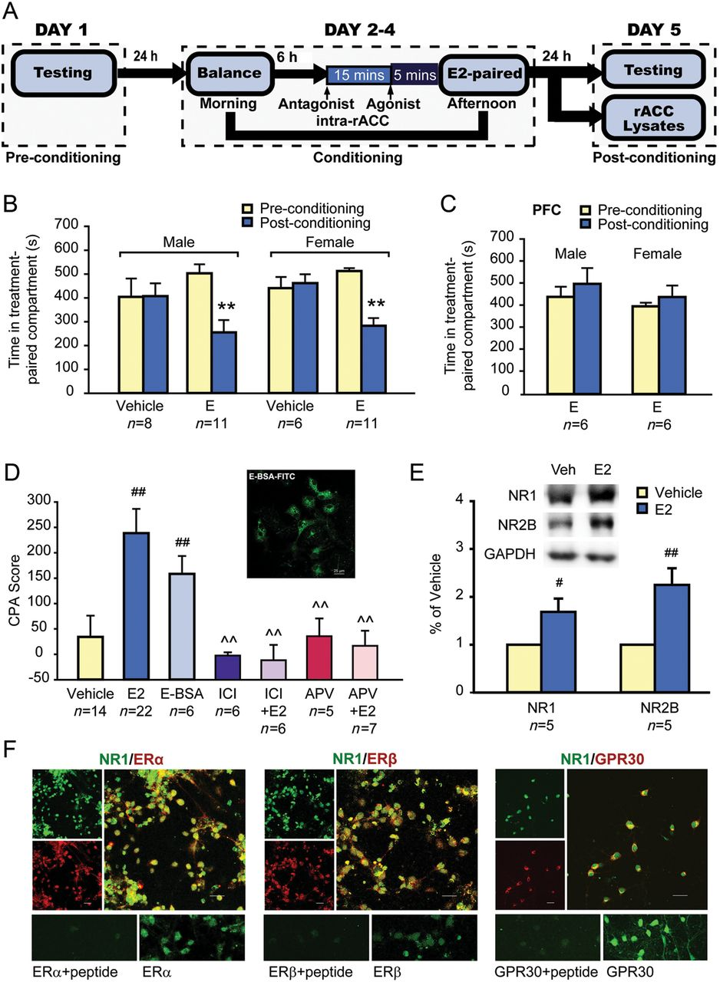
Figure 2. Exogenous estrogen elicits CPA via estrogen receptors. (A) Schematic of the protocol for the experiments B–E. ...
Notes:
Figure 2. Exogenous estrogen elicits CPA via estrogen receptors. (A) Schematic of the protocol for the experiments B–E. (B) Intra-rACC injections of E2 (20 μM, 0.6 μL per side) induce CPA in both sexes, as indicated by time spent in the treatment-paired compartment on preconditioning and postconditioning days. (C) Intra-PFC injections of E2 (20 μM, 0.6 μL per side) cannot induce CPA in both sexes. (D) Intra-rACC injections of E2 and membrane-impermeable estrogen conjugate E2-BSA (20 μM, 0.6 μL per side) but not vehicle, ICI182, 780 (ICI) or APV alone induce CPA. Pre-injection of ICI or NMDA receptor antagonist APV (25 mM, 0.6 μL per side) into the rACC attenuate E-CPA scores. Insert photograph for E2-BSA-FITC staining in cultured rACC neurons. Sex group averages were pooled in these experiments. (E) Western blot analysis reveals a significant increase of NR1 and NR2B in the rACC following E-CPA conditioning (rats received the same training trial on days 1–4 of the conditioning procedure as they received for E-CPA and were then sacrificed on day 5). Glyceraldehyde 3-phosphate dehydrogenase serves as loading control. (F) Double immunocytochemistry reveals the colocalization of ERα, ERβ and GPR30 with NMDA receptor subunit NR1 in cultured rACC neurons. **P < 0.01 versus preconditioning day; #P < 0.05, ##P < 0.01 versus vehicle; ^^P < 0.01 versus E2.
Unless provided in the caption above, the following copyright applies to the content of this slide: © The Author 2012. Published by Oxford University Press. All rights reserved. For Permissions, please e-mail: journals.permissions@oup.com

Slide 3
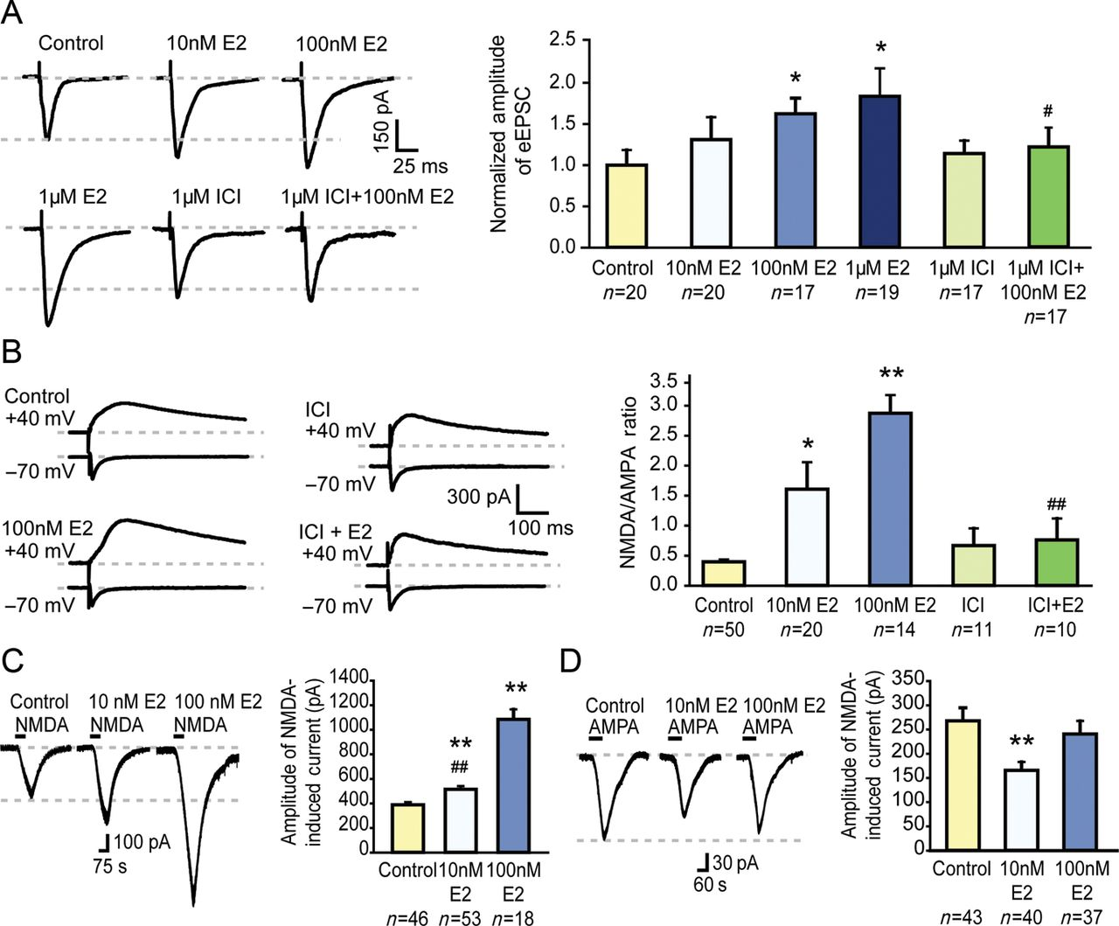
Figure 3. Effects of E2 on glutamatergic excitatory synaptic transmission. (A) E2 dose-dependently enhances EPSCs in ...
Notes:
Figure 3. Effects of E2 on glutamatergic excitatory synaptic transmission. (A) E2 dose-dependently enhances EPSCs in rACC pyramidal neurons, which is blocked by ICI 182, 780 (ICI). Representative traces are averages of 10 EPSCs. (B) E2 enhances NMDA/AMPA ratio, which is blocked by ICI. Representative traces are averages of 10 EPSCs. AMPA-EPSCs and NMDA-EPSCs in response to stimulation at holding potentials of −70 mV in the presence of APV (50 μM) and +40 mV in the presence of CNQX (20 μM), respectively. Measurements are counted at the peak point for the traces at −70 mV and at 40 ms after the stimulation artifacts for the traces at +40 mV. (C) E2 dose dependently enhances NMDAR-evoked currents. (D) Low dose of E2 decreases AMPAR-evoked currents. *P < 0.05, **P < 0.01 versus control; #P < 0.05, ##P < 0.01 versus 100 nM E2.
Unless provided in the caption above, the following copyright applies to the content of this slide: © The Author 2012. Published by Oxford University Press. All rights reserved. For Permissions, please e-mail: journals.permissions@oup.com

Slide 4
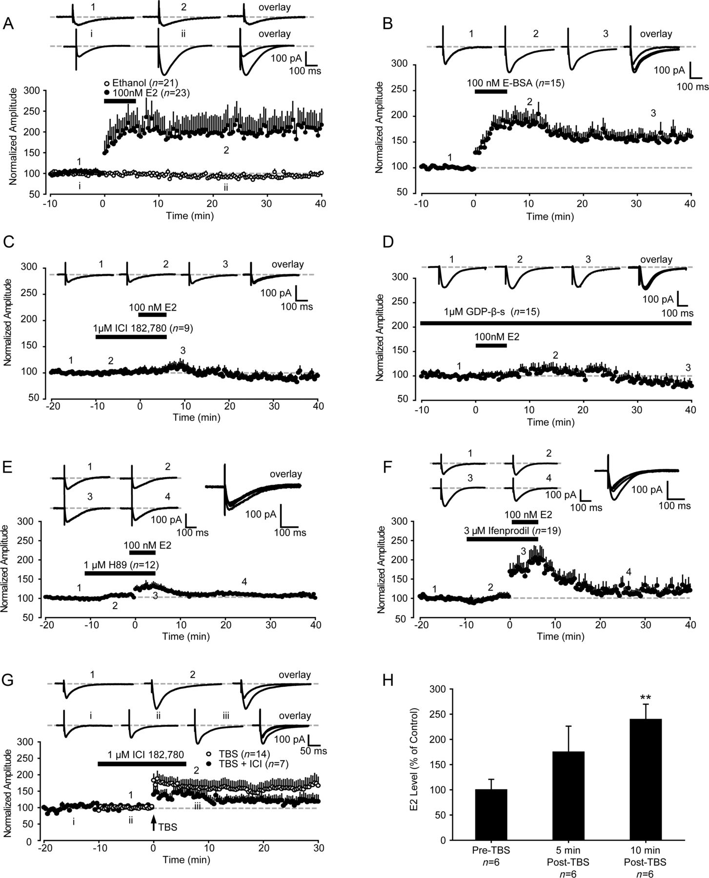
Figure 4. Estrogen induces NMDA-LTP via the GPCR-associated PKA-NR2B pathway. (A) E2 induces a long-lasting ...
Notes:
Figure 4. Estrogen induces NMDA-LTP via the GPCR-associated PKA-NR2B pathway. (A) E2 induces a long-lasting potentiation of NMDA-mediated EPSCs (NMDA-LTP) in pyramidal neurons in rACC slices. The vehicle (0.1% ethanol) does not affect the NMDA-mediated EPSCs. (B) E2-BSA induces NMDA-LTP. (C) Bath ICI 182, 780 (ICI) completely blocks E2-induced NMDA-LTP. (D) GDP-β-s in the intracellular solution completely occludes E2-induced NMDA-LTP. (E and F) Bath PKA inhibitor H89 (E) or NR2B antagonist Ifenprodil (F) markedly blocks E2-induced NMDA-LTP. (G) LTP is induced by the TBS protocol (indicated by an arrow). Pre-application of ICI markedly inhibits TBS-induced LTP. (H) TBS increases E2 release in rACC slices. E2 concentrations of slice perfusate are measured before and after TBS. The insets show averages of 3 EPSCs before and after E2/E-BSA or ICI/H89/Ifenprodil perfusion (point 1 and 2; or point i and ii). The dashed line indicates the mean basal synaptic responses. **P < 0.01 versus pre-TBS.
Unless provided in the caption above, the following copyright applies to the content of this slide: © The Author 2012. Published by Oxford University Press. All rights reserved. For Permissions, please e-mail: journals.permissions@oup.com

Slide 5
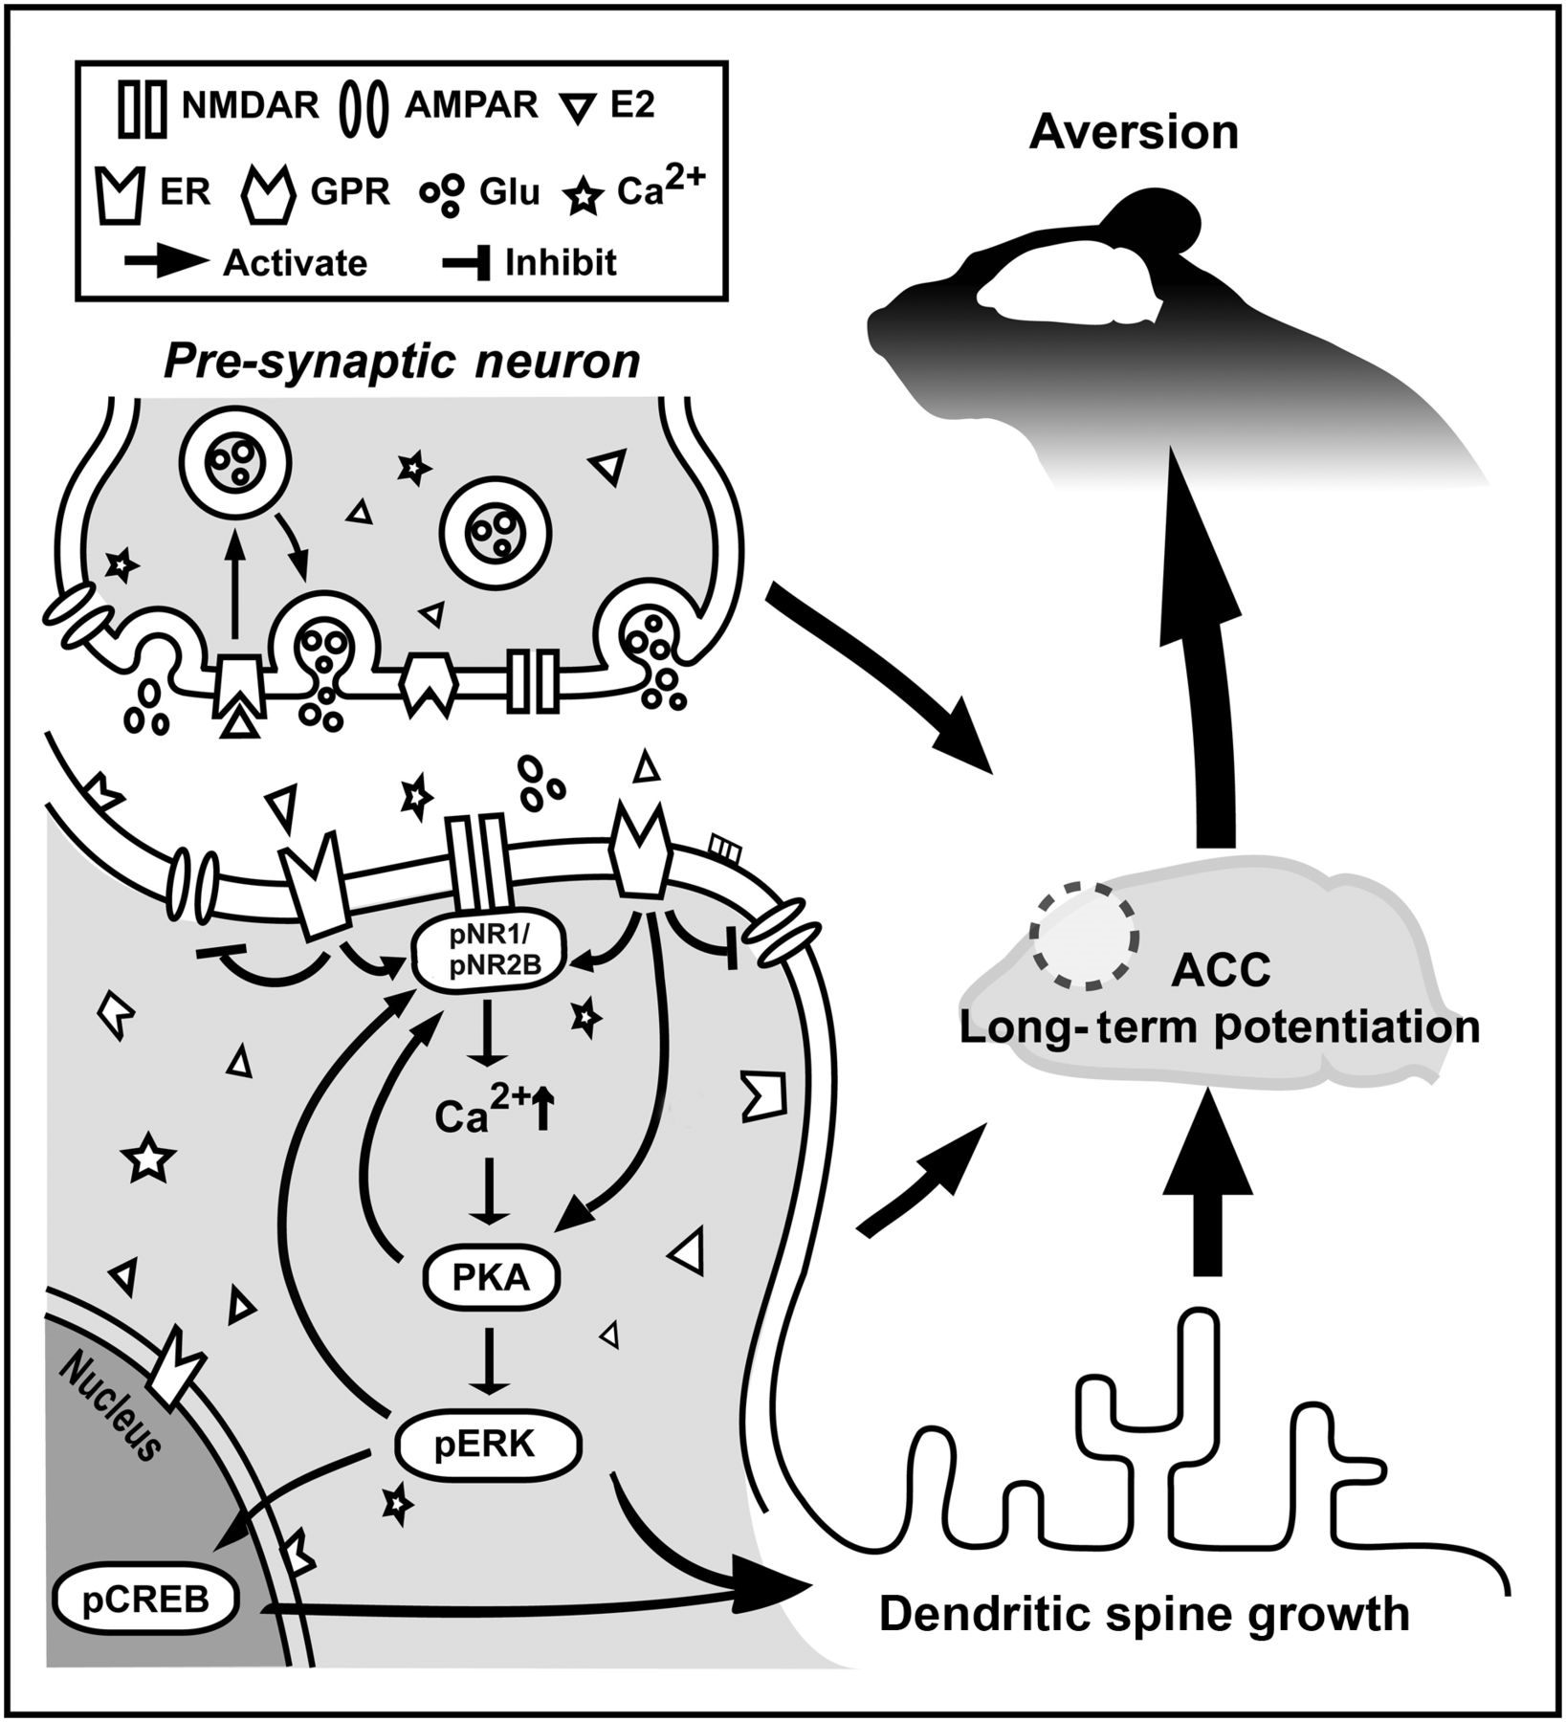
Figure 6. Schematic illustration of probable mechanisms for estrogen in the rACC driving affective pain. See Discussion ...
Notes:
Figure 6. Schematic illustration of probable mechanisms for estrogen in the rACC driving affective pain. See Discussion for details.
Unless provided in the caption above, the following copyright applies to the content of this slide: © The Author 2012. Published by Oxford University Press. All rights reserved. For Permissions, please e-mail: journals.permissions@oup.com

Slide 6
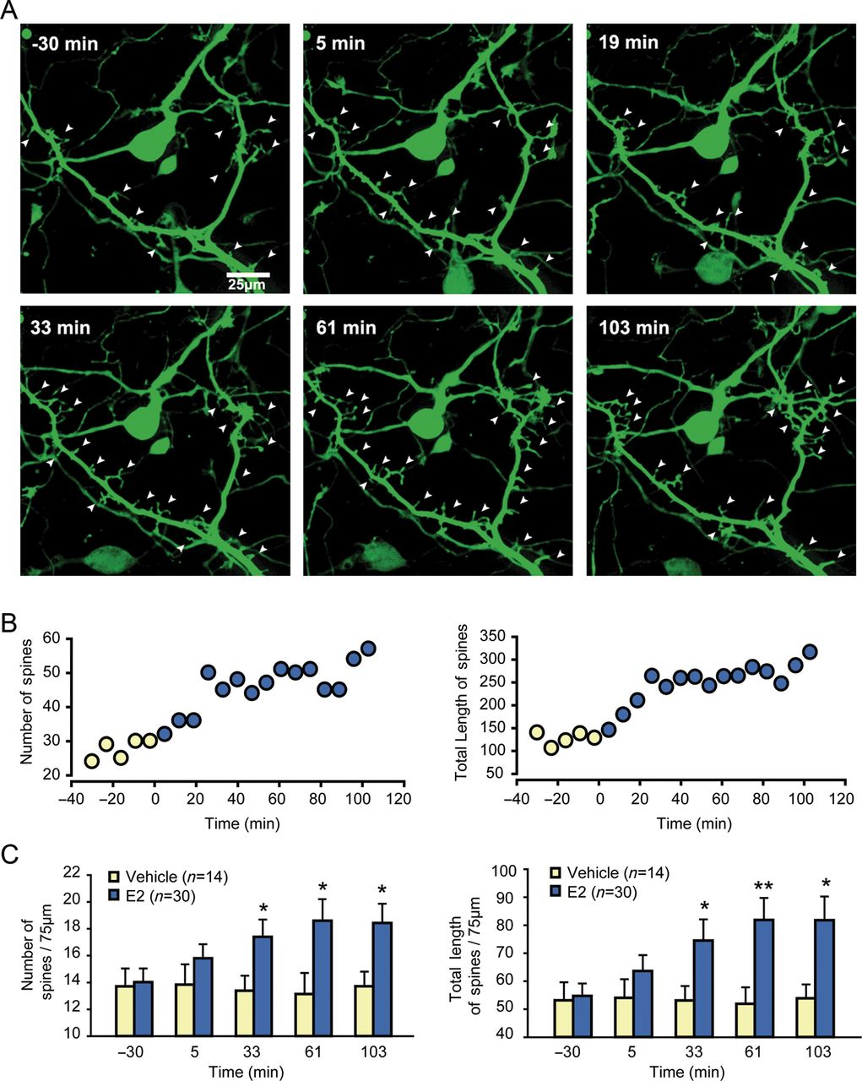
Figure 5. Estrogen rapidly induces formation of dendritic spines. (A) E2 enhances dendritic spine densities and length ...
Notes:
Figure 5. Estrogen rapidly induces formation of dendritic spines. (A) E2 enhances dendritic spine densities and length in GFP-expressing rACC neurons. Live-cell images are captured before and after E2 treatment. (B) An example showing time course of E2-induced increase in spine numbers (left) and spine lengths (right), respectively. Open circles represent time points recorded prior to E2 application. Closed circles represent time points recorded after E2 application. (C) Quantization of spine densities (left) total spine lengths (right) in E2- and vehicle-treated groups. *P < 0.05, **P < 0.01 versus vehicle controls.
Unless provided in the caption above, the following copyright applies to the content of this slide: © The Author 2012. Published by Oxford University Press. All rights reserved. For Permissions, please e-mail: journals.permissions@oup.com

