Slide 1
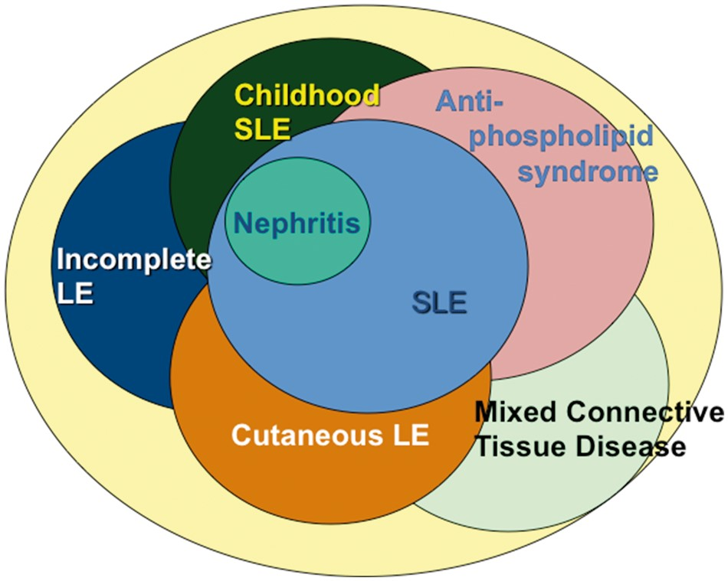
Fig. 1 Heterogeneity of lupus syndromes SLE is one component of the lupus spectrum. Adult or paediatric patients ...
Notes:
Fig. 1 Heterogeneity of lupus syndromes SLE is one component of the lupus spectrum. Adult or paediatric patients with nephritis also have SLE, but other lupus syndromes incompletely overlap with SLE itself. Incomplete lupus and cutaneous LE may be subsets that include individuals who will eventually develop SLE. MCTD has distinct elements outside of the usual lupus spectrum, such as erosive arthritis. Anti-phospholipid syndrome may exist as a separate entity or may be part of SLE.
Unless provided in the caption above, the following copyright applies to the content of this slide: © The Author 2016. Published by Oxford University Press on behalf of the British Society for Rheumatology. All rights reserved. For Permissions, please email: journals.permissions@oup.com

