Slide 1
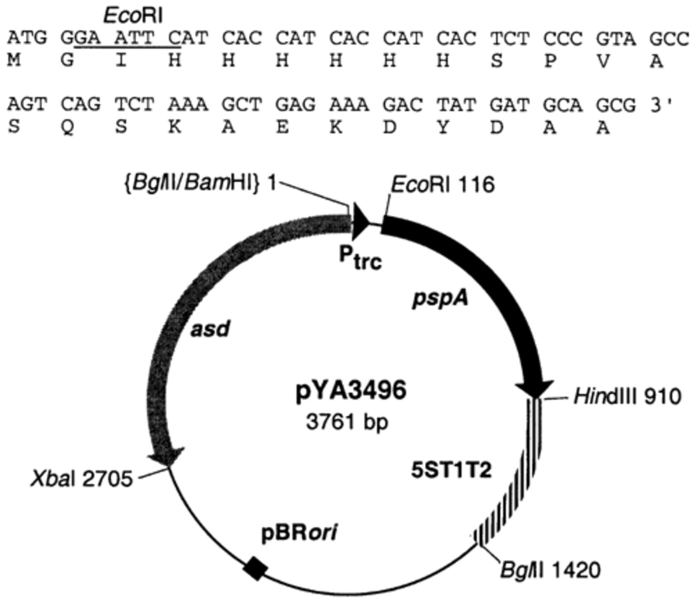
Figure 1 Recombinant plasmid pYA3496 for His₆-tagged rPspA expression. A fragment of the pspA gene ...
Notes:
Figure 1 Recombinant plasmid pYA3496 for His6-tagged rPspA expression. A fragment of the pspA gene specifying the α-helical region from amino acid residues 3–257 of the mature PspA protein of S. pneumoniae Rx1 was polymerase chain reaction (PCR)-amplified and cloned into the pYA3342 vector, resulting in pYA3496 [5]. The N-terminal primer contains an Eco RI site and six consecutive histidine codons (alternate use of CAT and CAC) for histidine6 tagging at the N-terminus. The N-terminal 25 amino acid residues and corresponding nucleotide sequences are presented. The C-terminal primer specifies two consecutive stop codons (TAA TAG) followed by a Hin dIII site. 5ST1T2 is a transcriptional terminator.
Unless provided in the caption above, the following copyright applies to the content of this slide: © 2003 Federation of European Microbiological Societies.

Slide 2
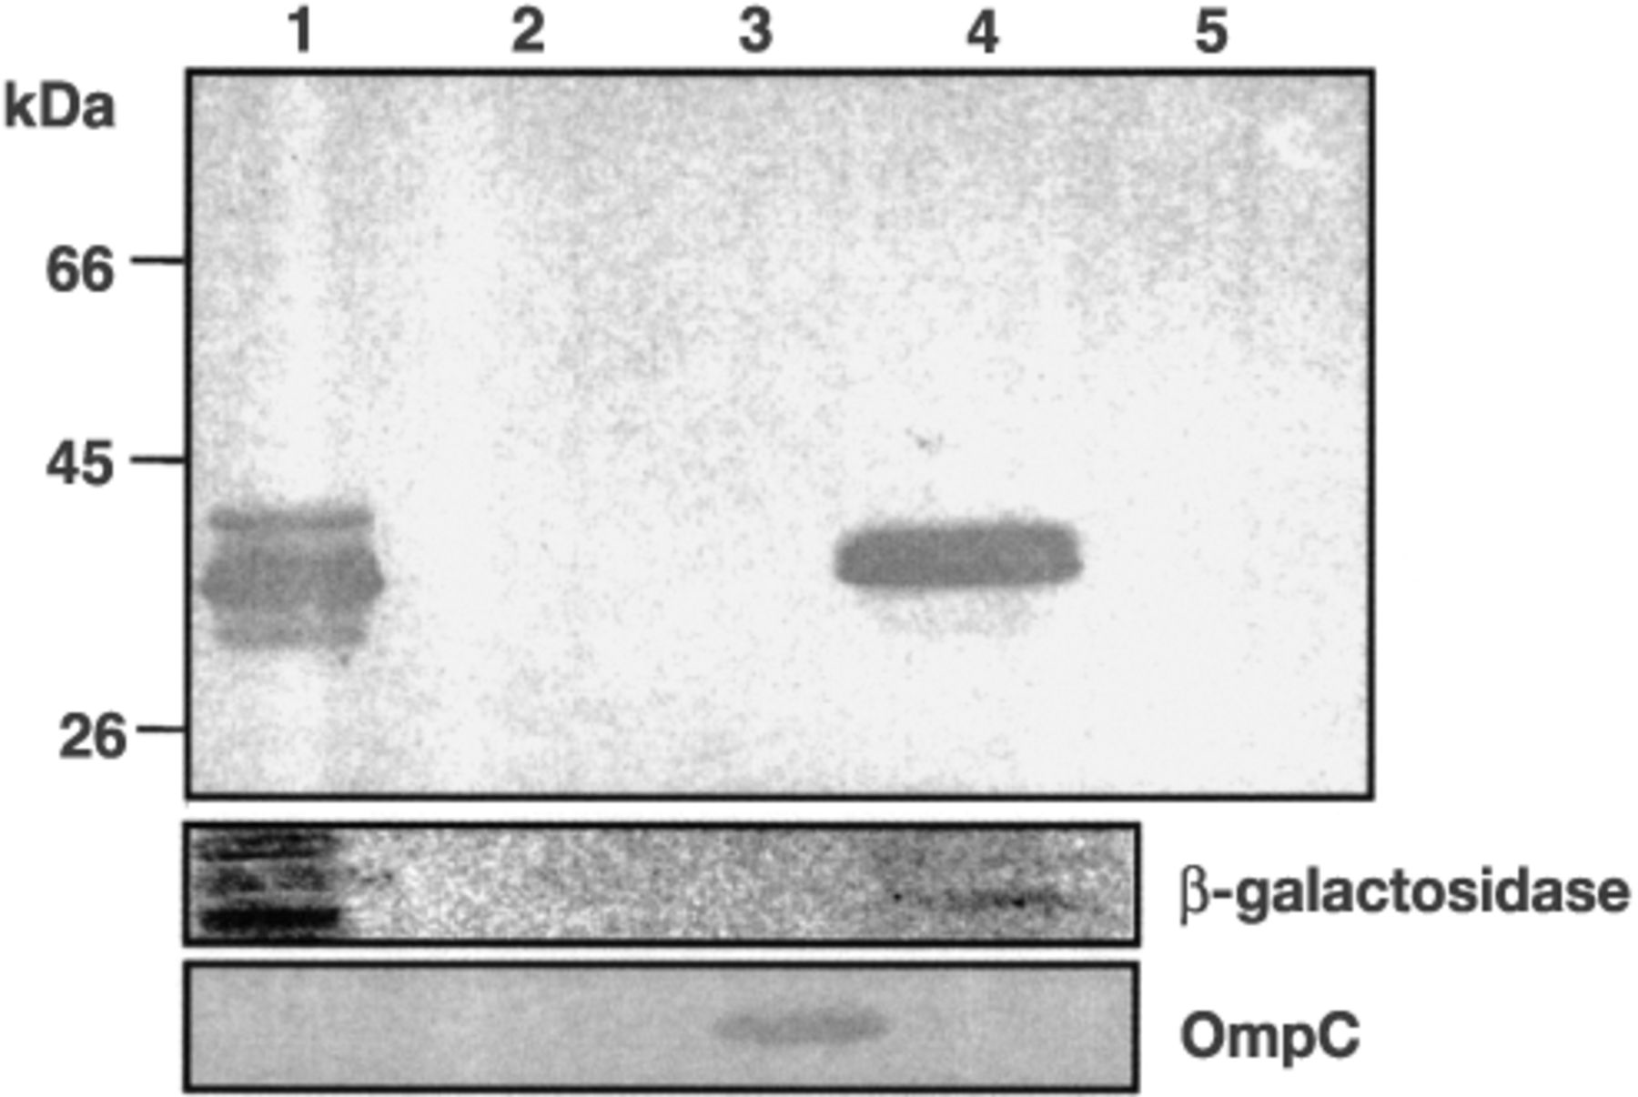
Figure 2 Subcellular location of expressed His₆-rPspA in S. typhimurium. Subcellular fractions were ...
Notes:
Figure 2 Subcellular location of expressed His6-rPspA in S. typhimurium. Subcellular fractions were prepared from S. typhimuriumχ8599 (pYA3496) cells grown in LB broth at 37°C by the same procedures as described by Kang et al. [5]. Fractions equivalent to 30 µl volumes of the OD600 0.8 culture, except for supernatant fluids were analyzed by SDS–PAGE and the His6-rPspA was detected by immunoblot with PspA-specific monoclonal antibody Xi126 [18]. β-Galactosidase and OmpC were used as fractionation controls for cytoplasmic and outer membrane fractions, respectively. Standards are indicated to the left. Lanes; 1, cytoplasm; 2, periplasm; 3, outer membrane; 4, concentrated supernatant (750 µl); 5, supernatant (10 µl).
Unless provided in the caption above, the following copyright applies to the content of this slide: © 2003 Federation of European Microbiological Societies.

Slide 3
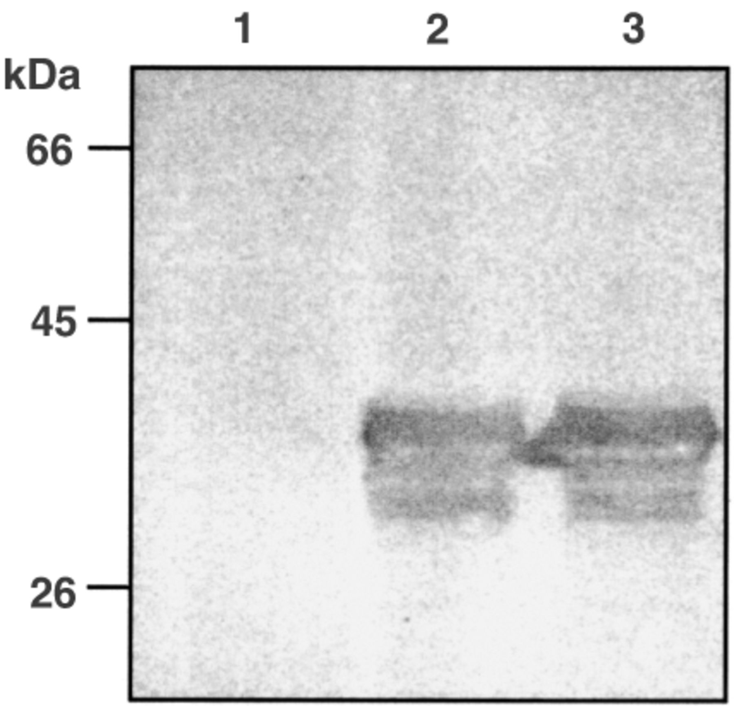
Figure 3 Expression of rPspA in the S. typhimuriumχ8501 vaccine strain. χ8501 (pYA3493, vector control), χ8501 ...
Notes:
Figure 3 Expression of rPspA in the S. typhimuriumχ8501 vaccine strain. χ8501 (pYA3493, vector control), χ8501 (pYA3494) and χ8501 (pYA3496) were cultured in LB broth at 37°C. Total cells (equivalent to 7.5×108 cells) were subjected to SDS–PAGE analysis for immunoblot. The rPspA was detected by immunoblot with PspA-specific monoclonal antibody Xi126. Molecular markers are indicated to the left. Lanes 1, 2 and 3 represent protein profiles of χ8501 (pYA3493), χ8501 (pYA3494) and χ8501 (pYA3496), respectively.
Unless provided in the caption above, the following copyright applies to the content of this slide: © 2003 Federation of European Microbiological Societies.

Slide 4
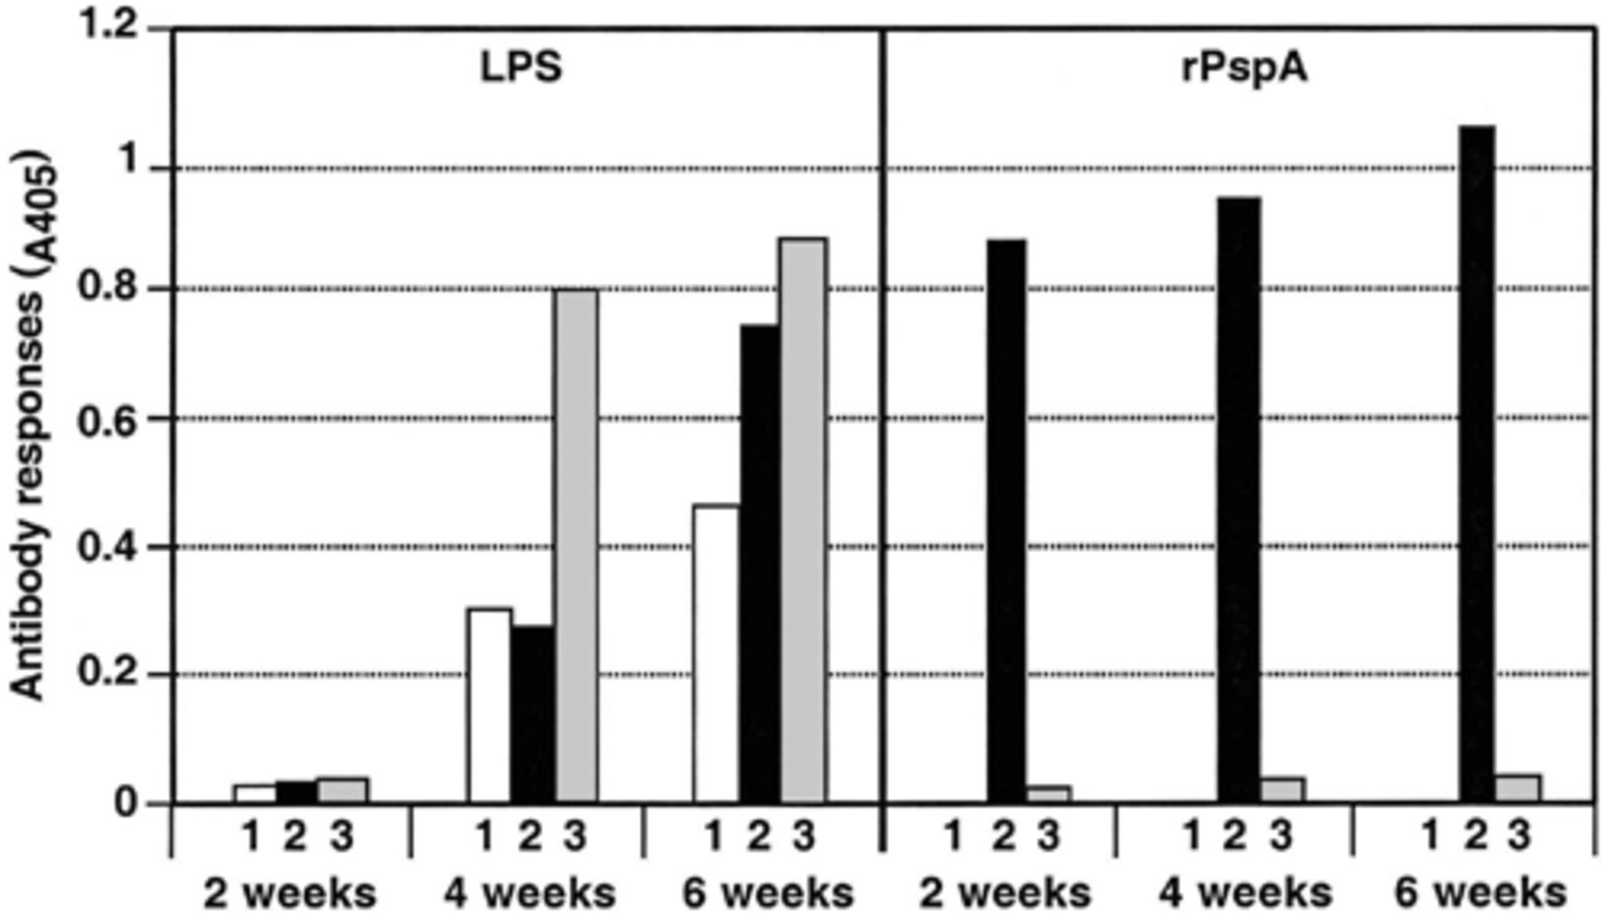
Figure 4 Serum IgG responses to S. typhimurium LPS and rPspA. The data represent IgG antibody levels induced in mice ...
Notes:
Figure 4 Serum IgG responses to S. typhimurium LPS and rPspA. The data represent IgG antibody levels induced in mice orally immunized with χ8501 (pYA3493) (vector control), χ8501 (pYA3494) (secreting rPspA) and χ8501 (pYA3496) (cytoplasmic His6-rPspA) at designated weeks after immunization. Sera diluted 1:1200 were used in ELISA assays. ELISA analysis is described in Section 2. Columns: 1, χ8501 (pYA3493); 2, χ8501 (pYA3494); 3, χ8501 (pYA3496).
Unless provided in the caption above, the following copyright applies to the content of this slide: © 2003 Federation of European Microbiological Societies.

