Slide 1
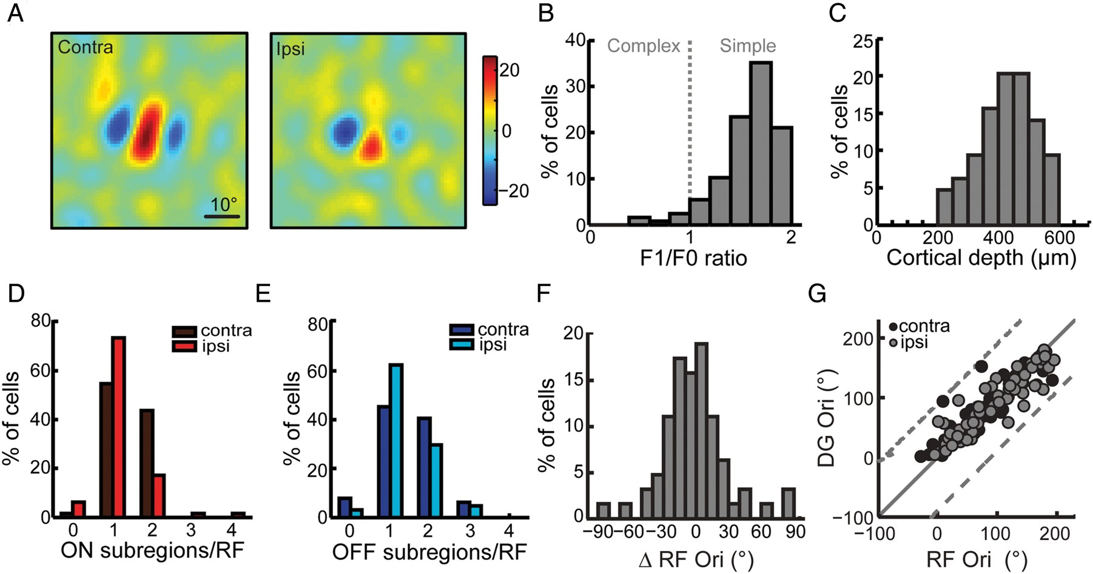
Figure 1. Binocular matching of RF orientations in mouse V1. (A) An example neuron's RFs mapped through the ...
Notes:
Figure 1. Binocular matching of RF orientations in mouse V1. (A) An example neuron's RFs mapped through the contralateral (top) and ipsilateral (bottom) eyes using STA. Intensity scale is in luminance units; Red: bright, On; Blue: dark, Off. (B) Majority of the cells whose RFs were mapped with STA modulated their responses at the temporal frequency of the drifting grating stimuli, that is, an F1/F0 ratio of ≥1, characteristic of simple cells (∼92%, n = 59/64). (C) Most cells were found at depths of 350–550 μm below the cortical surface, corresponding to layer 4 (∼70%, n = 45/64). (D–E) Comparison of the number of On (D, n = 167) and Off (E, n = 180) subregions per RF. (F) Distribution of the difference of RF orientations between the 2 eyes. For most cells, the difference was small (median of absolute values = 15.5°, n = 64). (G) Correlation between the preferred orientation (DG Ori) and the orientation of the RF (RF Ori) measured through either the contralateral (black dots) or ipsilateral eye (gray dots).
Unless provided in the caption above, the following copyright applies to the content of this slide: © The Author 2013. Published by Oxford University Press. All rights reserved. For Permissions, please e-mail: journals.permissions@oup.com

Slide 2
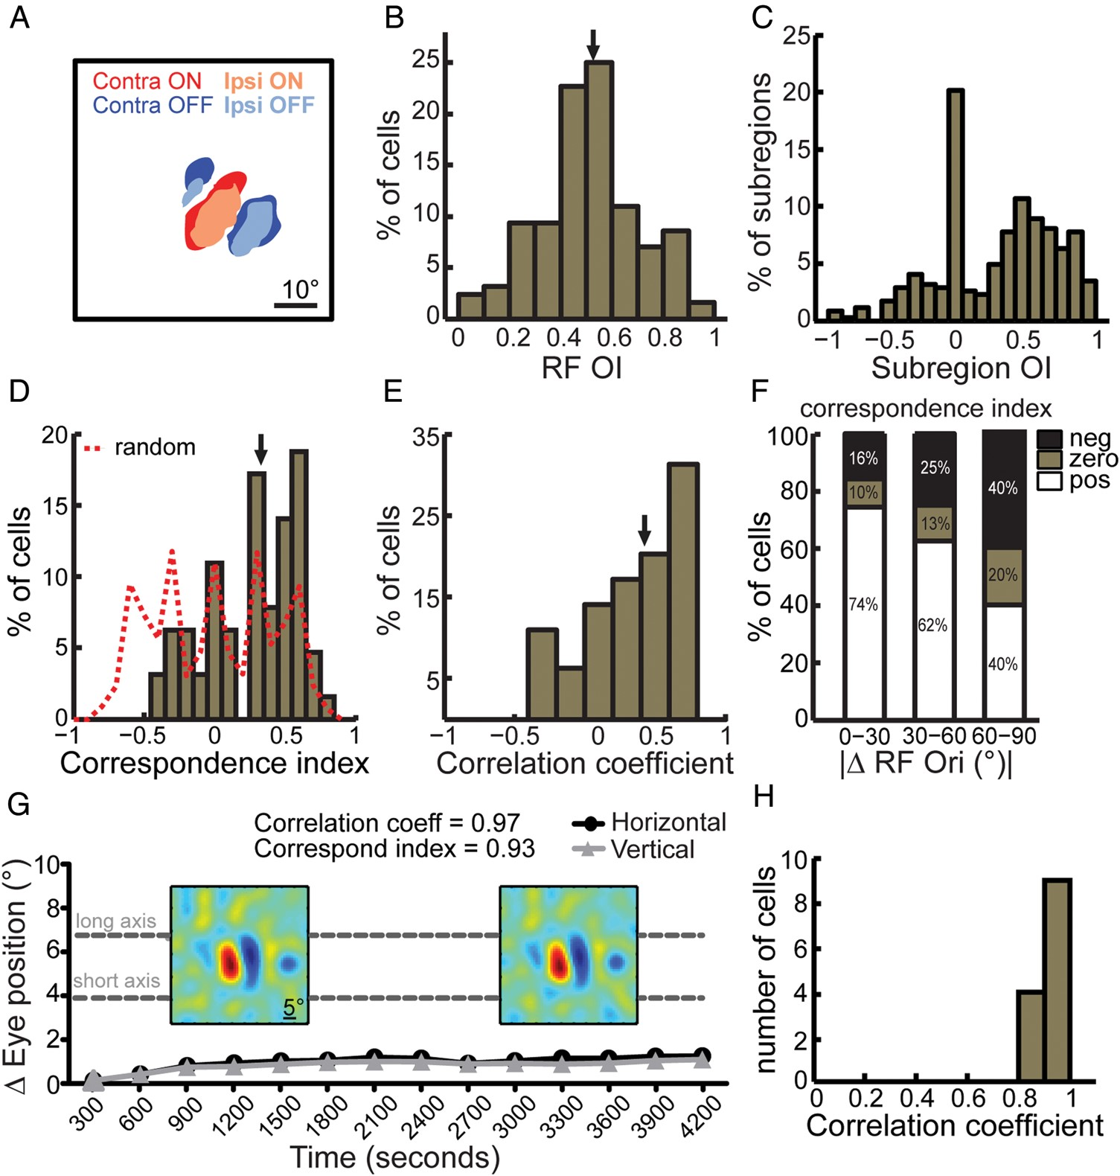
Figure 2. Binocular correspondence of RF subregions. (A) Overlay of the contralateral (darker colors) and ipsilateral ...
Notes:
Figure 2. Binocular correspondence of RF subregions. (A) Overlay of the contralateral (darker colors) and ipsilateral (lighter colors) RFs of an example cell that had binocularly matched orientation. Red: On; Blue: Off. (B) Distribution of OI between the 2 RFs of each cell (n = 64). Arrow indicates median = 0.51. (C) sOI for all subregions (n = 347) in these RFs. Positive values indicate same-sign (On–On or Off–Off) overlap, negative indicate opposite-sign (On–Off) overlap, and zero indicates no overlap. (D) Distribution of correspondence index, which is the median sOI for all subregions from both RFs of a cell. The dotted line is the distribution if same and opposite signs overlapped with equal probability. Arrow indicates median = 0.34. (E) Distribution of correlation coefficients between pairs of unfiltered RFs (n = 64). Arrow indicates median = 0.42. (F) Correspondence indices grouped by the degree of matching of RF orientations between the 2 eyes (0−30°: n = 51/64, 30−60°: n = 8/64, 60−90°: n = 5/64). (G) Population mean of the change in eye position plotted over the entire recording session (n = 12 sessions, bin size = 300 s). The dotted lines indicate the half short and long axes of subregions estimated from the experimentally observed subregion aspect ratios. Overlaid are the RFs of the same example neuron mapped twice, showing good reproducibility. (H) High correlation between RFs mapped from the same neurons (n = 13).
Unless provided in the caption above, the following copyright applies to the content of this slide: © The Author 2013. Published by Oxford University Press. All rights reserved. For Permissions, please e-mail: journals.permissions@oup.com

Slide 3
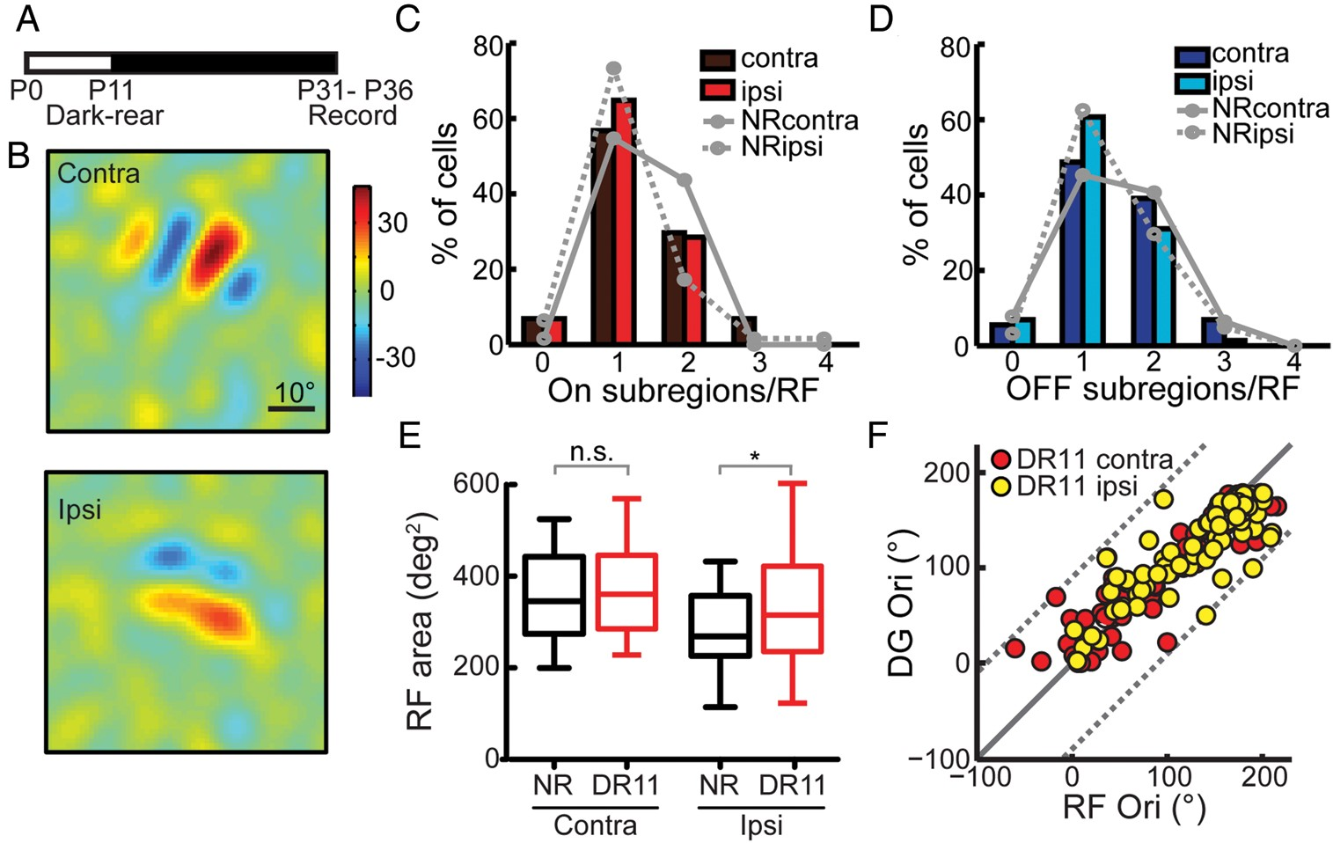
Figure 3. Normal monocular RF structures in visually deprived mice. (A) Schematic of the dark-rearing timeline. (B) ...
Notes:
Figure 3. Normal monocular RF structures in visually deprived mice. (A) Schematic of the dark-rearing timeline. (B) Spatial RFs of an example cell in dark-reared mice, showing normal RF geometry and similar retinotopic locations through the contralateral (top) and ipsilateral (bottom) eyes. Intensity scale in luminance units; Red: bright, On; Blue: dark, Off. (C,D) Numbers of On (C) and Off (D) subregions per RF in dark-reared (DR11) mice (On 1.3 ± 0.05/RF, Off 1.4 ± 0.06/RF) are similar to normal (NR) mice (solid gray: contralateral; dotted gray: ipsilateral, reproduced from Fig. 1D,E for comparison, P = 0.7). (E) Area of entire RFs in normal (black) and dark-reared (red) mice. Compared with NR mice, the DR11 mice have similar total area for contralateral RFs, but slightly larger for the ipsilateral RFs (NR, 282 ± 13.2 deg2, DR11, 331 ± 16 deg2, P = 0.03). (F) Correlation between the preferred orientation (DG Ori) and the orientation of the RF (RF Ori) measured through either the contralateral (red dots) or ipsilateral eye (yellow dots). Absolute differences in RF orientation and preferred orientation in NR (black: contra, gray: ipsi, n = 64) and DR11 (red: contra, yellow: ipsi, n = 74) groups are similar (P > 0.07), both significantly better than a uniform distribution of the differences, which would indicate no correlation (dotted line; P < 0.001).
Unless provided in the caption above, the following copyright applies to the content of this slide: © The Author 2013. Published by Oxford University Press. All rights reserved. For Permissions, please e-mail: journals.permissions@oup.com

Slide 4
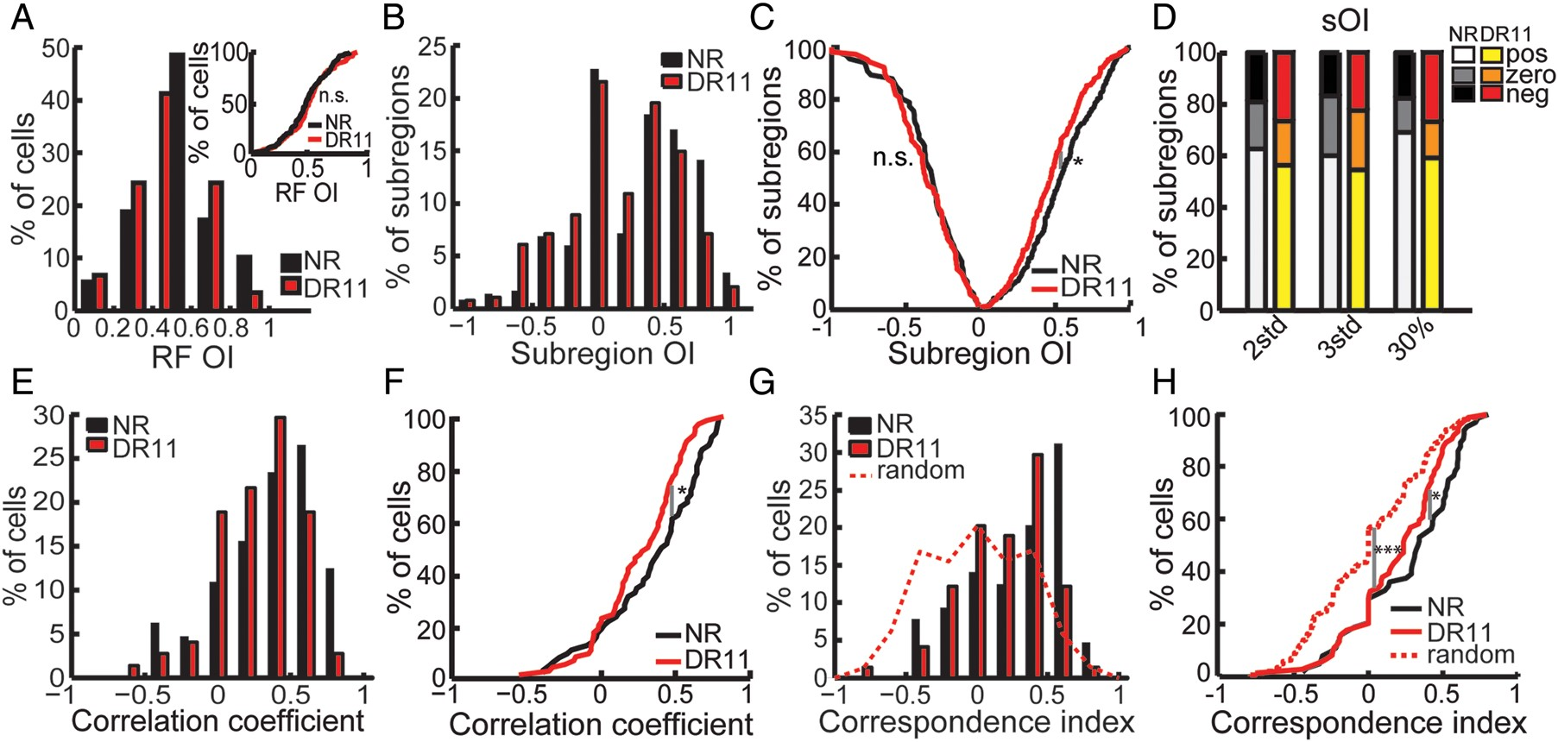
Figure 4. Visual deprivation degrades subregion correspondence. (A) Distribution of overall RF OI, showing similar ...
Notes:
Figure 4. Visual deprivation degrades subregion correspondence. (A) Distribution of overall RF OI, showing similar spatial overlap between contralateral and ipsilateral RFs in normal-reared (NR) and dark-reared (DR11) mice. Inset, cumulative distribution of RF OI. (B,C) Histogram and cumulative distribution of sOI in NR and DR11 mice. Decrease in high values of positive sOI is seen in DR11 mice in the histogram (B) and by the leftward shift in the positive sOI distribution (C). (D) The decrease in the percentage of positive sOIs and the increase in negative sOIs are observed at all thresholds tested for filtering the RFs. 2std: mean ± 2 standard deviation of noise, 3std: mean ± 3 standard deviation of noise, 30%: 30% of maximum On and Off values in the STA. (E,F) Histogram (E) and cumulative distributions (F) of the Pearson's correlation coefficient between the 2 RFs of individual neurons in NR and DR11 mice shows a decrease in the same-sign overlap, that is, positive values. (G,H) Correspondence index distributions of NR and DR11 mice. The correspondence in DR11 mice was disrupted, that is fewer positive values in (G) and left-shifted distribution in (H) compared with NR, but remained significantly different from random (dotted line, assuming equal probability of same and opposite-sign overlap).
Unless provided in the caption above, the following copyright applies to the content of this slide: © The Author 2013. Published by Oxford University Press. All rights reserved. For Permissions, please e-mail: journals.permissions@oup.com

Slide 5
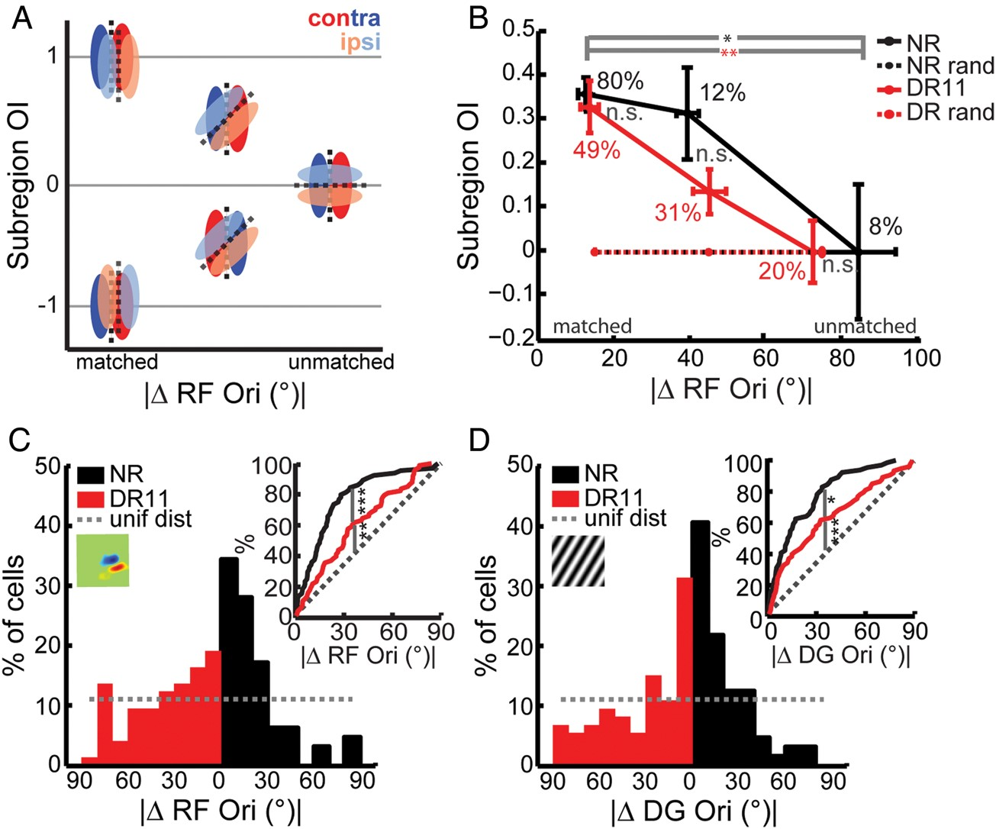
Figure 5. Subregion correspondence and binocular matching in normal and dark-reared mice. (A) Cartoon showing RF ...
Notes:
Figure 5. Subregion correspondence and binocular matching in normal and dark-reared mice. (A) Cartoon showing RF orientations (RF Ori) can be matched between the contralateral (dark colors) and ipsilateral (light colors) eyes by subregion overlap between either same signs (sOI = 1) or opposite signs (sOI = −1). Red: On; Blue: Off; dashed lines indicate RF orientations. (B) Medians of subregion OI, grouped by their degree of RF orientation matching. The numbers next to the plots are the percentage of cells in each group (0−30°, n = 51/64 in NR and 36/74 in DR11; 30−60°, 8/64 in NR and 23/74 in DR11; 60−90°, 5/64 in NR and 15/74 in DR11). Error bars indicate standard error of the median. Random distributions were obtained by rotating the ipsilateral RF relative to the contralateral RF, followed by sOI calculation. (C) Distribution of the absolute difference in RF orientations (RF Ori, inset cartoon) between the 2 eyes. Inset, cumulative distributions showing degraded RF Ori matching in DR11 mice compared with NR (P < 0.001), dotted gray: uniform distribution (DR11 vs. uniform distribution, P = 0.002). (D) Distribution of the absolute difference in the preferred orientations between the 2 eyes, measured from responses to drifting gratings (DG Ori, inset cartoon). Inset, cumulative distributions showing degraded DG Ori matching in DR11 mice compared with NR (P = 0.03) (DR11 vs. uniform distribution, P < 0.001).
Unless provided in the caption above, the following copyright applies to the content of this slide: © The Author 2013. Published by Oxford University Press. All rights reserved. For Permissions, please e-mail: journals.permissions@oup.com

Slide 6
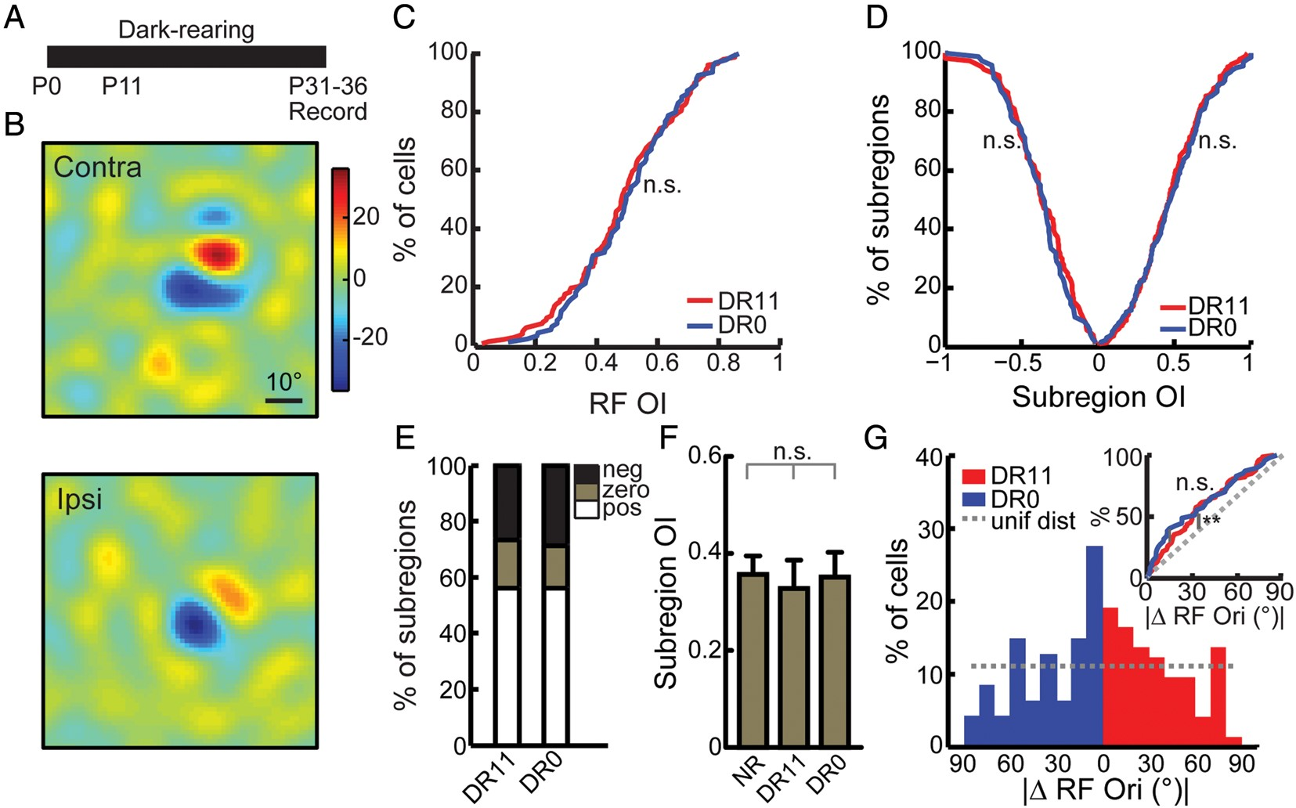
Figure 6. Subregion correspondence in the absence of any light exposure. (A) Timeline showing mice were reared in the ...
Notes:
Figure 6. Subregion correspondence in the absence of any light exposure. (A) Timeline showing mice were reared in the dark from birth (DR0), until the time of recording (P31–36). (B) Example RFs in these mice, through the contralateral (top) or ipsilateral (bottom) eye. Intensity scale in luminance units; Red: bright, On; Blue: dark, Off. (C) Cumulative distribution plots of overall RF overlap, in DR11 (n = 74) and DR0 (n = 47) cells. (D) Cumulative plots of sOI. (E) Percentages of subregions having positive sOI, negative sOI, or zero in DR11 (n = 394) and DR0 (n = 243) groups. No difference is seen between the 2 groups. (F) Medians of subregion OI in cells with binocularly matched RF orientations (ΔRF Ori ≤ 30°, n = 51/64 in NR, 36/74 in DR11 and 23/47 in DR0). Error bars indicate standard error of the median. (G) Distribution of absolute binocular difference in RF orientations, showing similar distributions between DR11 and DR0 groups. Inset, cumulative plot of absolute difference in RF orientations between the 2 eyes. Dotted line: uniform distribution if the matching were completely random.
Unless provided in the caption above, the following copyright applies to the content of this slide: © The Author 2013. Published by Oxford University Press. All rights reserved. For Permissions, please e-mail: journals.permissions@oup.com

Slide 7
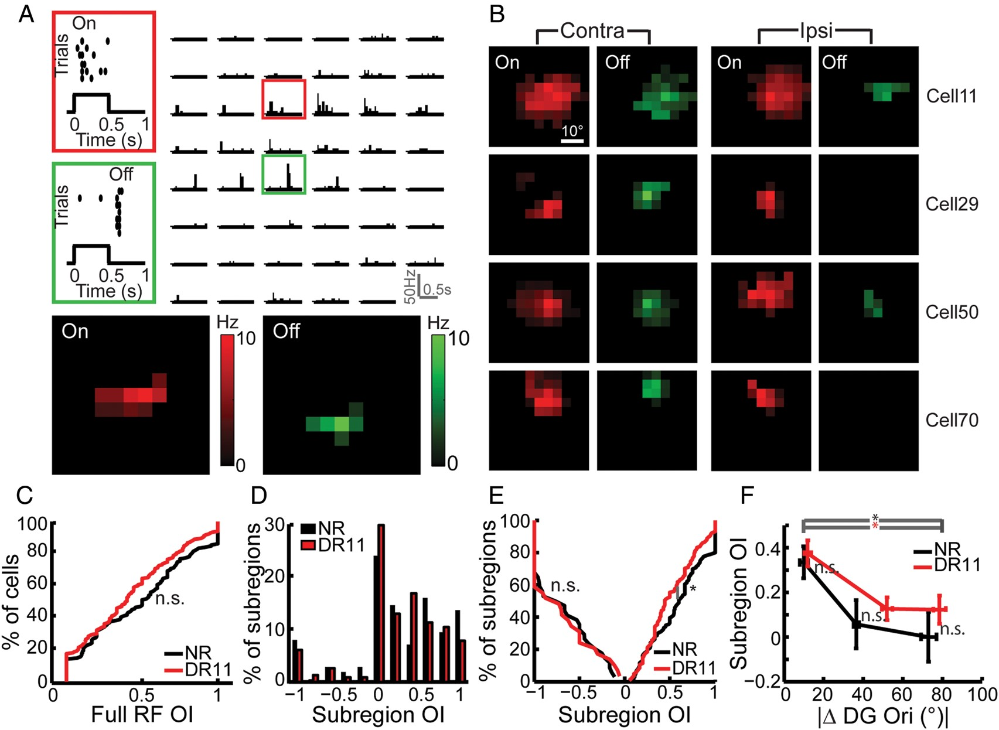
Figure 7. Mapping RFs with flashed spot stimuli. (A) Responses to flashed spot stimuli are shown in PSTHs (top) at ...
Notes:
Figure 7. Mapping RFs with flashed spot stimuli. (A) Responses to flashed spot stimuli are shown in PSTHs (top) at different grid locations (4° grid) and separated into On (red box) and Off (green box). Bottom: Spatial representation of On (red) and Off (green) responses after subtraction of the spontaneous firing rate. (B) Examples of On and Off subregions of contralateral (left) and ipsilateral (right) RFs. (C) Cumulative plots showing similar binocular overlap of overall RFs in NR and DR11 mice. (D) Subregion correspondence (positive subregion OI) is decreased in DR11 (n = 233) compared with NR (n = 214) mice. (E) Cumulative distributions showing a decrease in positive values of sOI in DR11 mice. (F) Medians of subregion OIs, grouped by their degree of RF orientation matching (number of cells, 0−30°: NR: 48/75, DR11: 43/89, 30−60°: NR: 16/75, DR11: 23/89, 60−90°: NR: 11/75, DR11: 23/89). Error bars indicate standard error of the median.
Unless provided in the caption above, the following copyright applies to the content of this slide: © The Author 2013. Published by Oxford University Press. All rights reserved. For Permissions, please e-mail: journals.permissions@oup.com

