Slide 1
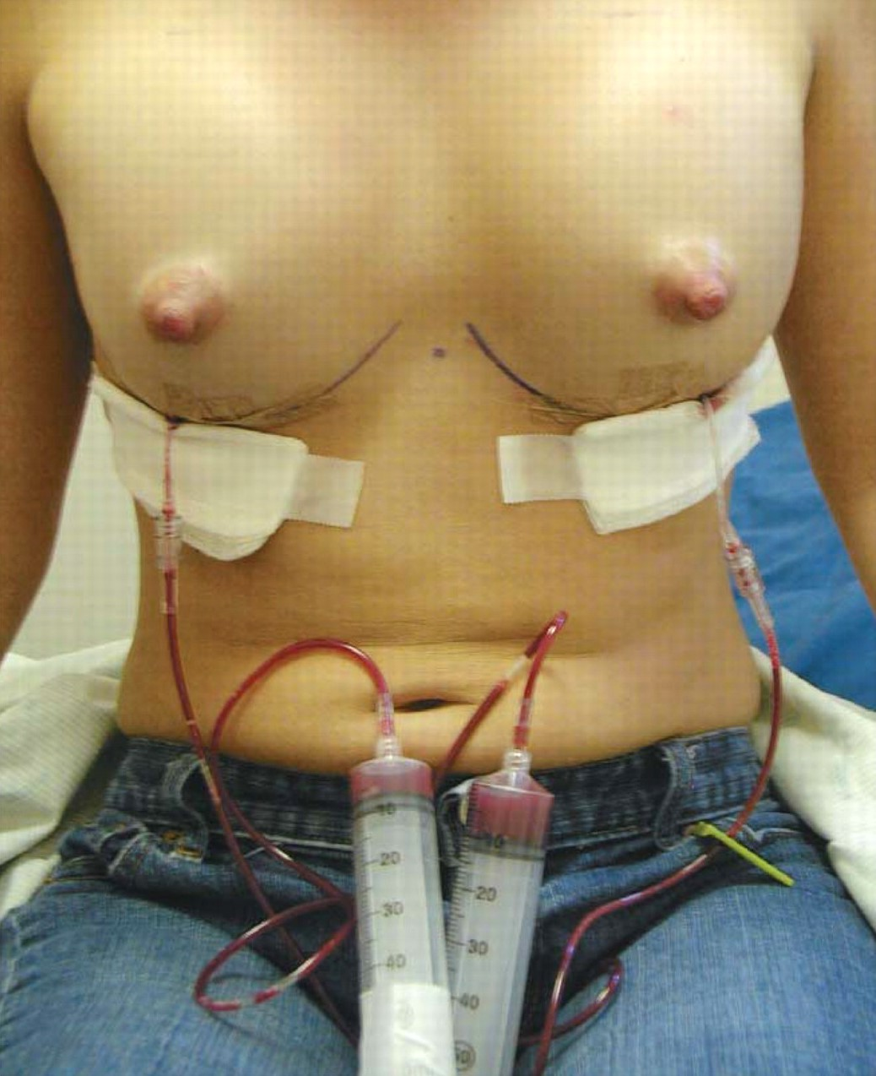
Figure 1 Bloody aspirate is visible about 45 minutes after office instillation of 20 mL of bupivacaine into each ...
Notes:
Figure 1 Bloody aspirate is visible about 45 minutes after office instillation of 20 mL of bupivacaine into each catheter. The extension tubing is placed between the syringe and the catheter.
Unless provided in the caption above, the following copyright applies to the content of this slide: © 2008 American Society for Aesthetic Plastic Surgery

Slide 2
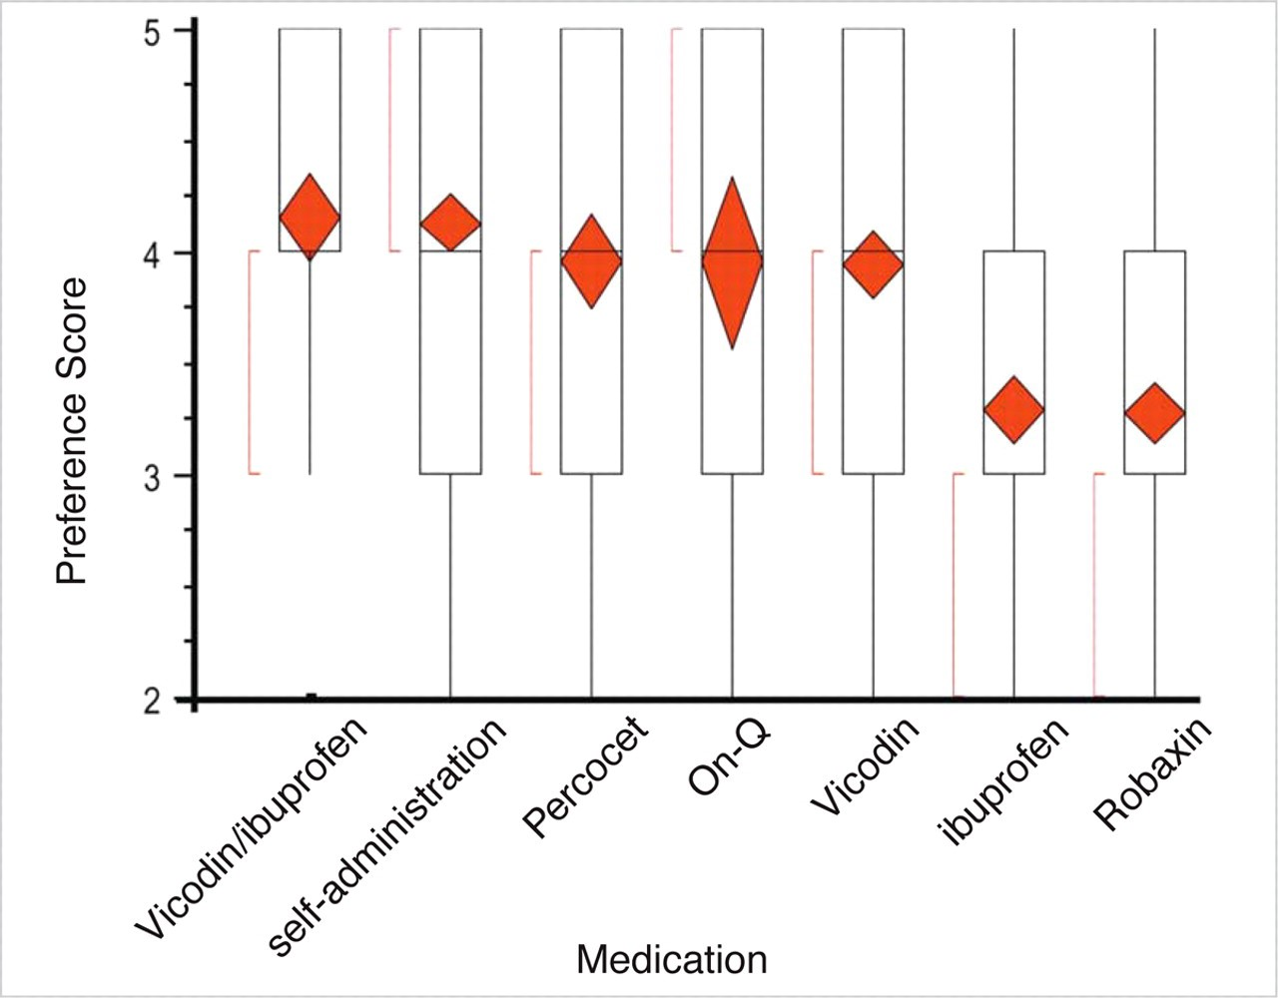
Figure 2 Analgesic preference. Box plots above the name of each medication represent the range of ratings of ...
Notes:
Figure 2 Analgesic preference. Box plots above the name of each medication represent the range of ratings of effectiveness of each analgesic. Analgesics are presented in order of mean response from most effective (best = 5), to least effective (no help = 1). While the first five treatments were consistently rated effective, ibuprofen and Robaxin received statistically lower scores. The colored diamond is centered on the mean response and ends at the 95% confidence intervals.
Unless provided in the caption above, the following copyright applies to the content of this slide: © 2008 American Society for Aesthetic Plastic Surgery

Slide 3
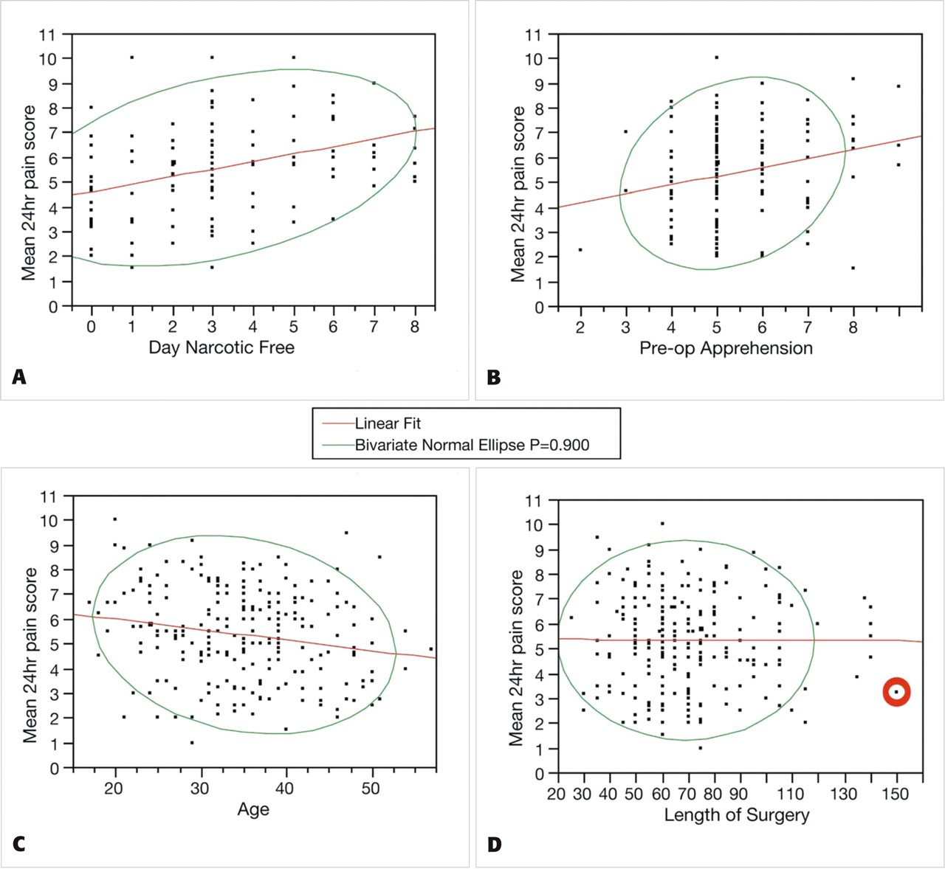
Figure 3 Pre- and postoperative correlates of pain. A sampling of the relationship between average pain scores ...
Notes:
Figure 3 Pre- and postoperative correlates of pain. A sampling of the relationship between average pain scores recorded in the first 24 hours postoperatively and possible predictors of the degree of discomfort experienced by the patient. Each panel indicates the mean 24-hour pain score on the y-axis with covariants on the x-axis. A, Relationship between 24-hour pain scores and the number of days the patient used narcotics. Patients reporting greater discomfort were more likely to use narcotics for longer periods of time. B, Relationship between preoperative apprehension and pain scores. Patients reporting greater apprehension were also more likely to report greater discomfort. C, Relationship between patient age and pain scores. Older patients generally reported less discomfort. D, Relationship between the length of surgery and pain scores. There is no clear correlation between the length of the surgical procedure and pain experienced by the patient. In fact, the point circled in red indicates the single longest surgery in the study with pain scores well below average. Red lines indicate a best-fit linear regression through all points on the graph. The green line is a bivariate normal ellipse enclosing 90% of the data.
Unless provided in the caption above, the following copyright applies to the content of this slide: © 2008 American Society for Aesthetic Plastic Surgery

Slide 4
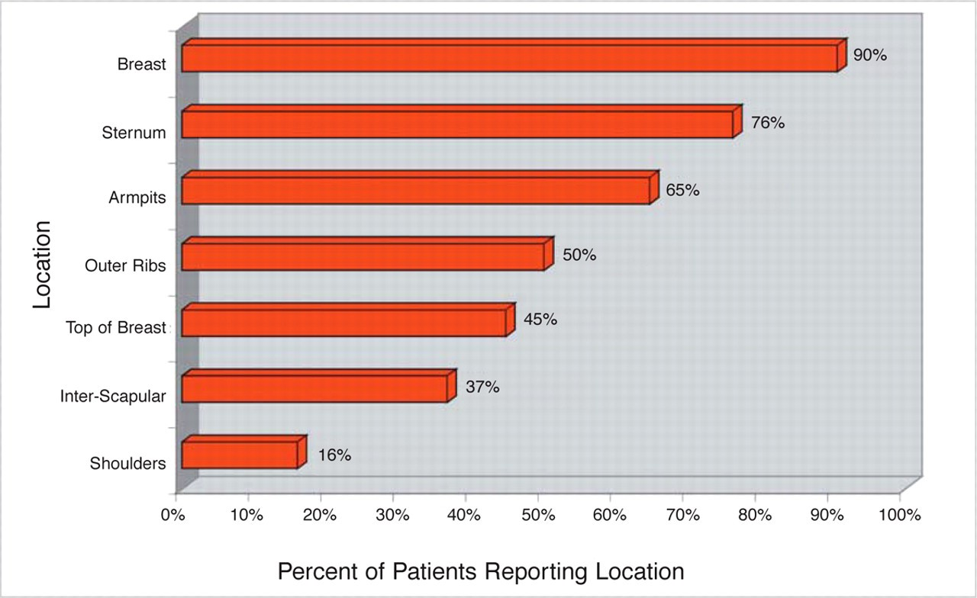
Figure 4 Pain location. A summary of the frequency of pain experienced in each location expressed as a percentage of ...
Notes:
Figure 4 Pain location. A summary of the frequency of pain experienced in each location expressed as a percentage of patients reporting pain in that location.
Unless provided in the caption above, the following copyright applies to the content of this slide: © 2008 American Society for Aesthetic Plastic Surgery

Slide 5
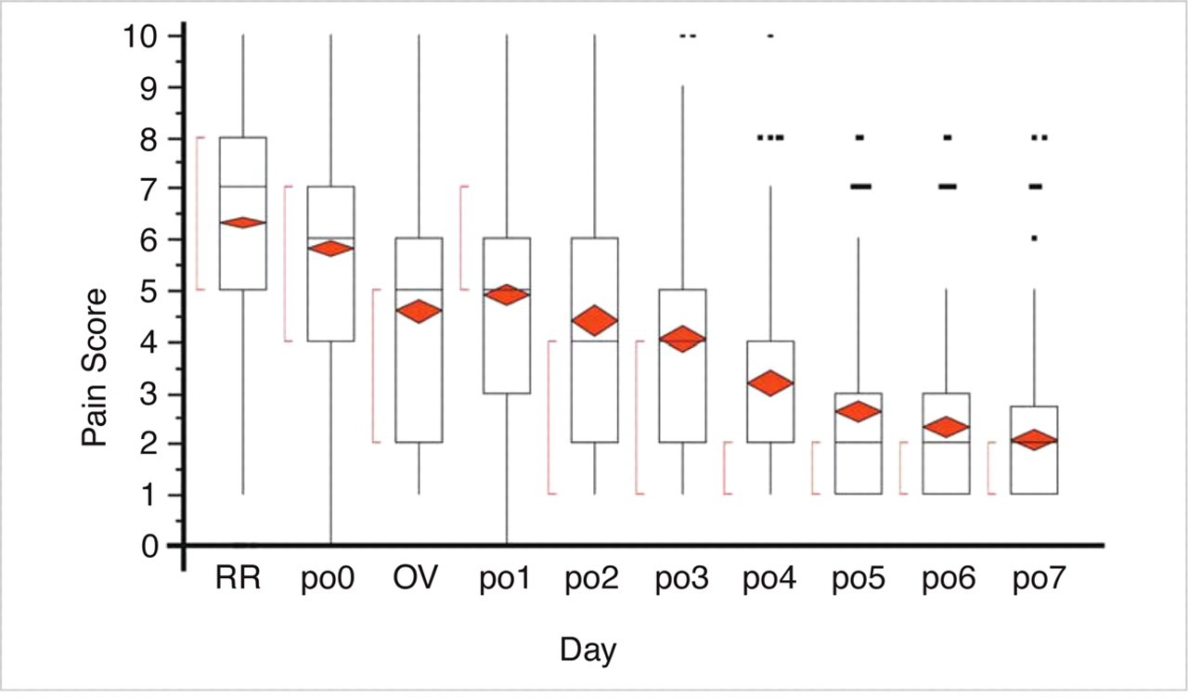
Figure 5 Pain regression over 7 days: This figure shows the pooled pain scores collected over the full 7-day period. ...
Notes:
Figure 5 Pain regression over 7 days: This figure shows the pooled pain scores collected over the full 7-day period. The colored diamond is centered on the mean response and ends at the 95% confidence intervals. (RR = recovery room; po0 = day of surgery; OV, office visit; po1 = day after surgery (1 day postoperative); po2 = 2 days postoperatively; po3 = 3 days postoperatively; po4 = 4 days postoperatively; po5 = 5 days postoperatively; po6 = 6 days postoperatively; po7 = 7 days postoperatively.).
Unless provided in the caption above, the following copyright applies to the content of this slide: © 2008 American Society for Aesthetic Plastic Surgery

