Slide 1
Figure 1. (Left) Examples of stimuli used for the 2 analogue and the 2 symbolic conditions. (Right) Time course of ...
Notes:
Figure 1. (Left) Examples of stimuli used for the 2 analogue and the 2 symbolic conditions. (Right) Time course of events in a run: blocs of 16 s (8 trials) were alternating with resting periods of 14 s.
Unless provided in the caption above, the following copyright applies to the content of this slide: © The Author 2011. Published by Oxford University Press. All rights reserved. For permissions, please e-mail: journals.permissions@oup.com

Slide 2
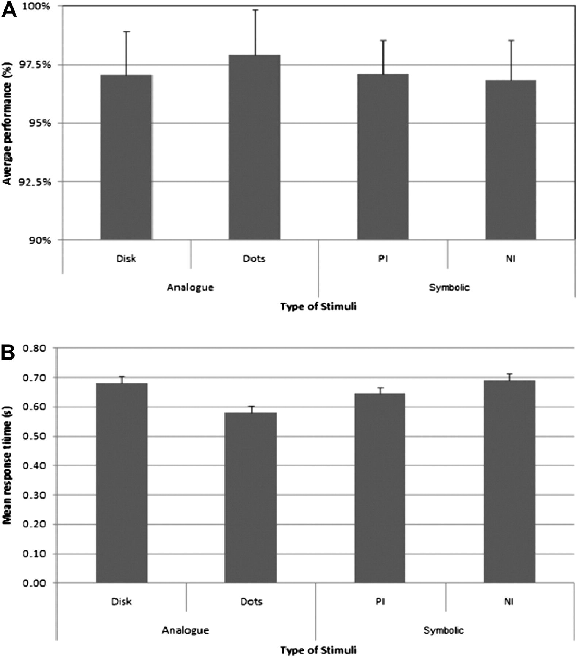
Figure 2. Behavioral results as a function of experimental conditions. (A) Mean performance of the participants and (B) ...
Notes:
Figure 2. Behavioral results as a function of experimental conditions. (A) Mean performance of the participants and (B) mean response time of the participants. The bars indicate standard errors of the mean. PI, positive integers; NI, negative integers.
Unless provided in the caption above, the following copyright applies to the content of this slide: © The Author 2011. Published by Oxford University Press. All rights reserved. For permissions, please e-mail: journals.permissions@oup.com

Slide 3
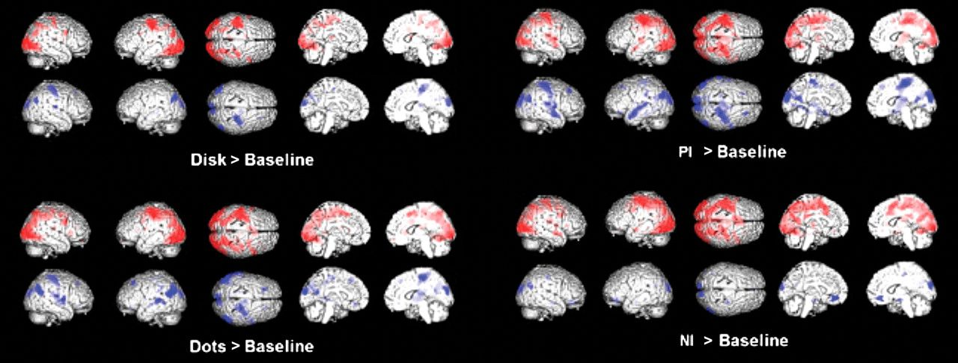
Figure 3. Basic contrast of each condition against the baseline. PI, positive integers; NI, negative integers. Note. ...
Notes:
Figure 3. Basic contrast of each condition against the baseline. PI, positive integers; NI, negative integers. Note. The sites marked in red are activated and the sites marked in blue are deactivated.
Unless provided in the caption above, the following copyright applies to the content of this slide: © The Author 2011. Published by Oxford University Press. All rights reserved. For permissions, please e-mail: journals.permissions@oup.com

Slide 4
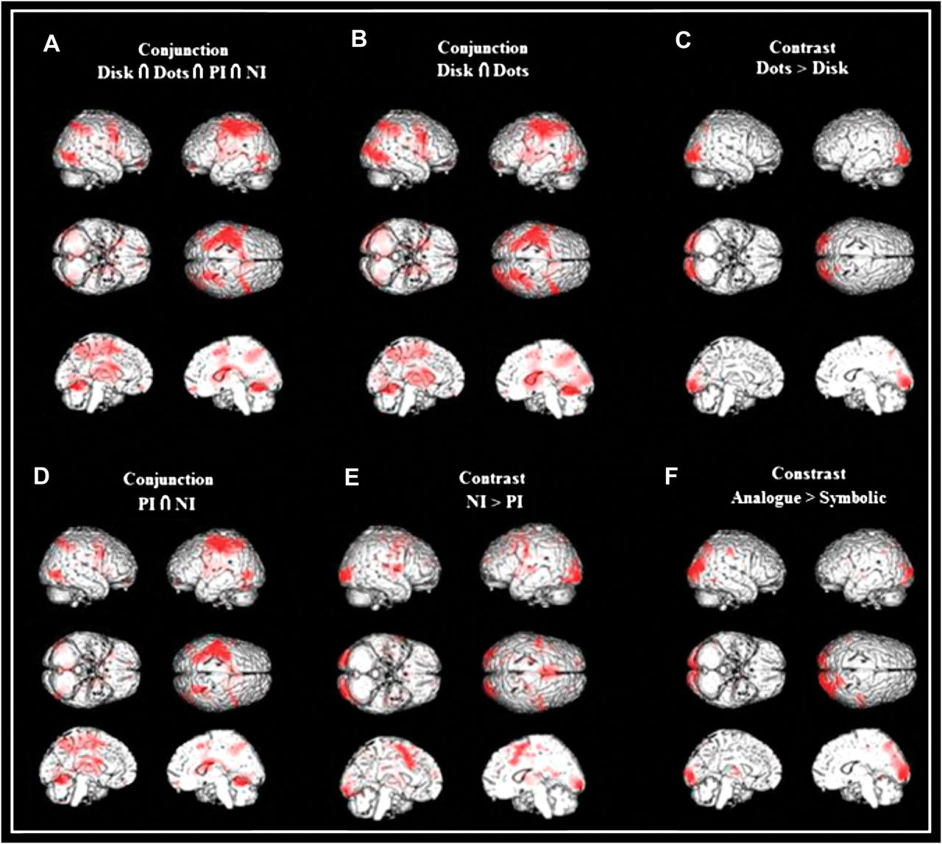
Figure 4. (A) Activation map resulting from the conjunction analysis including the 4 experimental basic contrasts. This ...
Notes:
Figure 4. (A) Activation map resulting from the conjunction analysis including the 4 experimental basic contrasts. This contrast reveals the areas that were active in all conditions and thus putatively play a central role in any task involving a comparison between quantities. (B) Activation map of the conjunction analysis of the 2 analogue conditions (i.e., disk and dots). This contrast reveals the core areas that constitute the inherited number system. (C) Dots > disk contrast. It reveals the elements that are the most fundamental to number mining and processing. (D) The conjunction of negative integers (NI) and positive integers (PI). It reveals the areas that are engaged in symbolic processing regardless of the level of abstraction of the mathematical entity being processed. (E) The NI > PI contrast reveals the area in charge of coding the notion of negativity. (F) The analogue > symbolic contrast shows the regions that are involved in extraction of visually coded quantities.
Unless provided in the caption above, the following copyright applies to the content of this slide: © The Author 2011. Published by Oxford University Press. All rights reserved. For permissions, please e-mail: journals.permissions@oup.com

Slide 5
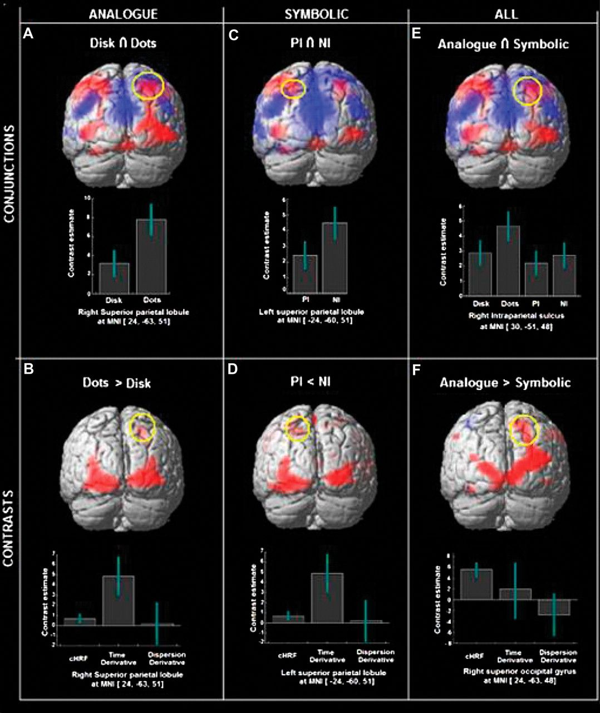
Figure 5. Location and parameter estimates for each site of peak activity. (A) Right superior parietal lobule, (B) ...
Notes:
Figure 5. Location and parameter estimates for each site of peak activity. (A) Right superior parietal lobule, (B) right superior parietal lobule, (C) left superior parietal lobule, (D) left superior parietal lobule, (E) right IPS, and (F) right superior occipital gyrus. Note. The sites marked in red are activated and the sites marked in blue are deactivated. Note. PI, positive integers; NI, negative integers.
Unless provided in the caption above, the following copyright applies to the content of this slide: © The Author 2011. Published by Oxford University Press. All rights reserved. For permissions, please e-mail: journals.permissions@oup.com

Slide 6
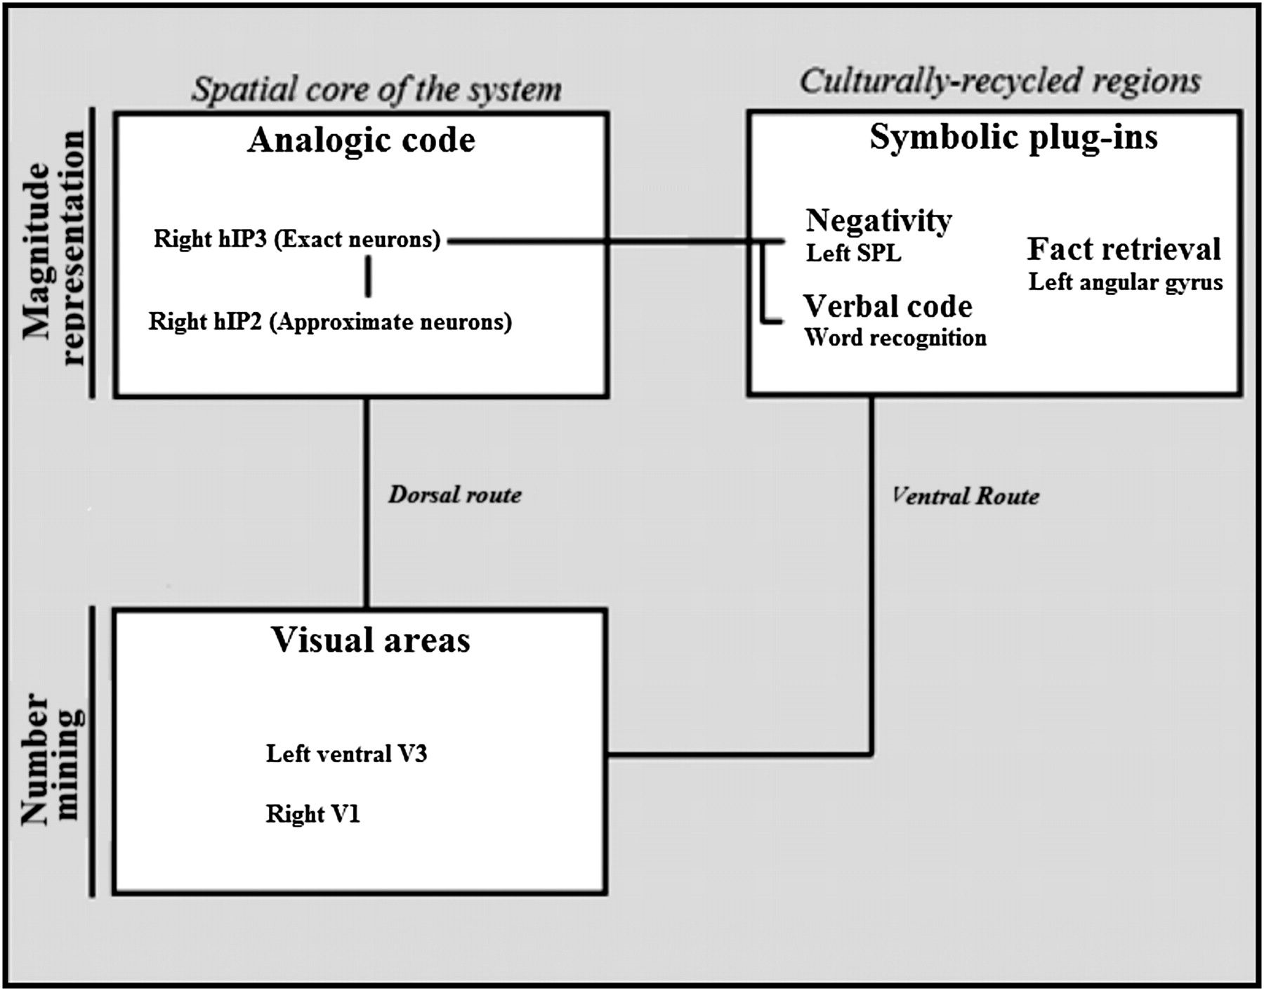
Figure 6. Proposed functional neuroanatomy for the extraction and comparison of quantities (mapped into the triple-code ...
Notes:
Figure 6. Proposed functional neuroanatomy for the extraction and comparison of quantities (mapped into the triple-code model; Dehaene et al. 2003).
Unless provided in the caption above, the following copyright applies to the content of this slide: © The Author 2011. Published by Oxford University Press. All rights reserved. For permissions, please e-mail: journals.permissions@oup.com

