Slide 1
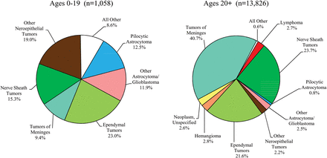
Fig. 7. Distribution of Spinal Cord, Spinal Meninges and Cauda Equina Tumors by Age Group and Histology.
Notes:
Fig. 7. Distribution of Spinal Cord, Spinal Meninges and Cauda Equina Tumors by Age Group and Histology.
Unless provided in the caption above, the following copyright applies to the content of this slide: © The Centers for Disease Control. Published by Oxford University Press on behalf of the Society for Neuro-Oncology in cooperation with the Central Brain Tumor Registry 2012.

Slide 2
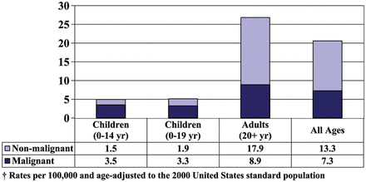
Fig. 1. Average Annual Age-Adjusted Incidence Rates† of Primary Brain and CNS Tumors by Age and Behavior.
Notes:
Fig. 1. Average Annual Age-Adjusted Incidence Rates† of Primary Brain and CNS Tumors by Age and Behavior.
Unless provided in the caption above, the following copyright applies to the content of this slide: © The Centers for Disease Control. Published by Oxford University Press on behalf of the Society for Neuro-Oncology in cooperation with the Central Brain Tumor Registry 2012.

Slide 3
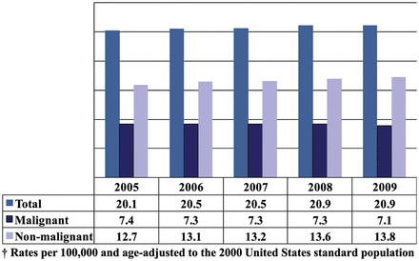
Fig. 2. Annual Age-Adjusted Incidence Rates† of Primary Brain and CNS Tumors by Year and Behavior.
Notes:
Fig. 2. Annual Age-Adjusted Incidence Rates† of Primary Brain and CNS Tumors by Year and Behavior.
Unless provided in the caption above, the following copyright applies to the content of this slide: © The Centers for Disease Control. Published by Oxford University Press on behalf of the Society for Neuro-Oncology in cooperation with the Central Brain Tumor Registry 2012.

Slide 4
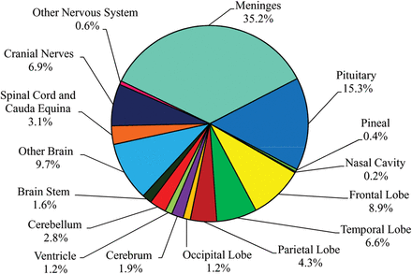
Fig. 3. Distribution of Primary Brain and CNS Tumors by Site (N = 311,202).
Notes:
Fig. 3. Distribution of Primary Brain and CNS Tumors by Site (N = 311,202).
Unless provided in the caption above, the following copyright applies to the content of this slide: © The Centers for Disease Control. Published by Oxford University Press on behalf of the Society for Neuro-Oncology in cooperation with the Central Brain Tumor Registry 2012.

Slide 5
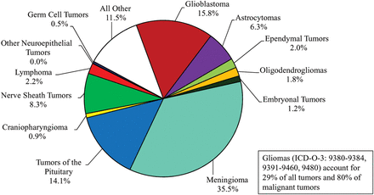
Fig. 4. Distribution of Primary Brain and CNS Tumors by Histology (N = 311,202).
Notes:
Fig. 4. Distribution of Primary Brain and CNS Tumors by Histology (N = 311,202).
Unless provided in the caption above, the following copyright applies to the content of this slide: © The Centers for Disease Control. Published by Oxford University Press on behalf of the Society for Neuro-Oncology in cooperation with the Central Brain Tumor Registry 2012.

Slide 6
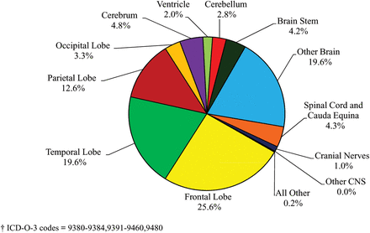
Fig. 5. Distribution of Primary Brain and CNS Gliomas† by Site (N = 90,828).
Notes:
Fig. 5. Distribution of Primary Brain and CNS Gliomas† by Site (N = 90,828).
Unless provided in the caption above, the following copyright applies to the content of this slide: © The Centers for Disease Control. Published by Oxford University Press on behalf of the Society for Neuro-Oncology in cooperation with the Central Brain Tumor Registry 2012.

Slide 7
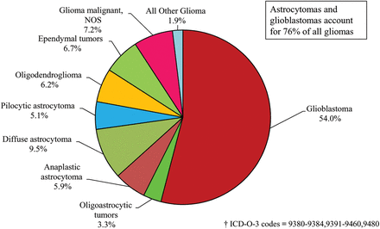
Fig. 6. Distribution of Primary Brain and CNS Gliomas† by Histology Subtypes (N = 90,828).
Notes:
Fig. 6. Distribution of Primary Brain and CNS Gliomas† by Histology Subtypes (N = 90,828).
Unless provided in the caption above, the following copyright applies to the content of this slide: © The Centers for Disease Control. Published by Oxford University Press on behalf of the Society for Neuro-Oncology in cooperation with the Central Brain Tumor Registry 2012.

Slide 8
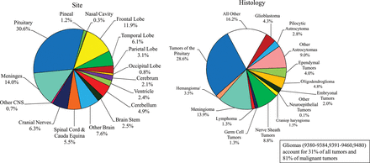
Fig. 8. Distribution of Primary Brain and CNS Tumors by Site and Histology in Young Adults (Ages 20-34 years) (N = ...
Notes:
Fig. 8. Distribution of Primary Brain and CNS Tumors by Site and Histology in Young Adults (Ages 20-34 years) (N = 26,616)
Unless provided in the caption above, the following copyright applies to the content of this slide: © The Centers for Disease Control. Published by Oxford University Press on behalf of the Society for Neuro-Oncology in cooperation with the Central Brain Tumor Registry 2012.

Slide 9
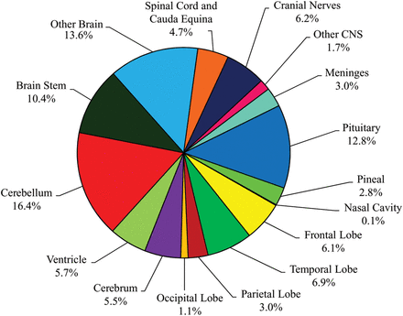
Fig. 13. Distribution of Childhood (Ages 0-19 years) Primary Brain and CNS Tumors by Site (N = 20,709).
Notes:
Fig. 13. Distribution of Childhood (Ages 0-19 years) Primary Brain and CNS Tumors by Site (N = 20,709).
Unless provided in the caption above, the following copyright applies to the content of this slide: © The Centers for Disease Control. Published by Oxford University Press on behalf of the Society for Neuro-Oncology in cooperation with the Central Brain Tumor Registry 2012.

Slide 10
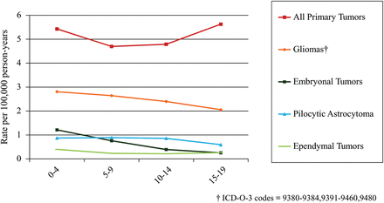
Fig. 15. Age-Specific Incidence of Childhood Brain and CNS Tumors by Selected Histologies.
Notes:
Fig. 15. Age-Specific Incidence of Childhood Brain and CNS Tumors by Selected Histologies.
Unless provided in the caption above, the following copyright applies to the content of this slide: © The Centers for Disease Control. Published by Oxford University Press on behalf of the Society for Neuro-Oncology in cooperation with the Central Brain Tumor Registry 2012.

Slide 11
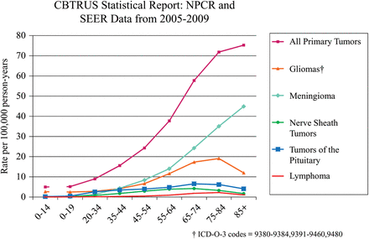
Fig. 11. Age-Specific Incidence Rates of Primary Brain and CNS Tumors by Selected Histologies.
Notes:
Fig. 11. Age-Specific Incidence Rates of Primary Brain and CNS Tumors by Selected Histologies.
Unless provided in the caption above, the following copyright applies to the content of this slide: © The Centers for Disease Control. Published by Oxford University Press on behalf of the Society for Neuro-Oncology in cooperation with the Central Brain Tumor Registry 2012.

Slide 12
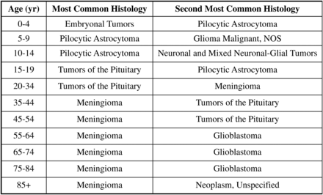
Fig. 12. Most Common Primary Brain and CNS Tumors by Age.
Notes:
Fig. 12. Most Common Primary Brain and CNS Tumors by Age.
Unless provided in the caption above, the following copyright applies to the content of this slide: © The Centers for Disease Control. Published by Oxford University Press on behalf of the Society for Neuro-Oncology in cooperation with the Central Brain Tumor Registry 2012.

Slide 13
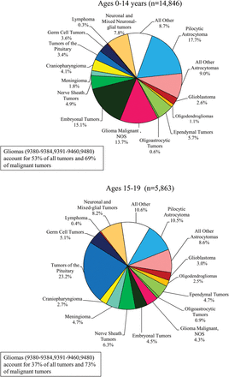
Fig. 14. Distribution of Childhood Primary Brain and CNS Tumors by Histology.
Notes:
Fig. 14. Distribution of Childhood Primary Brain and CNS Tumors by Histology.
Unless provided in the caption above, the following copyright applies to the content of this slide: © The Centers for Disease Control. Published by Oxford University Press on behalf of the Society for Neuro-Oncology in cooperation with the Central Brain Tumor Registry 2012.

Slide 14
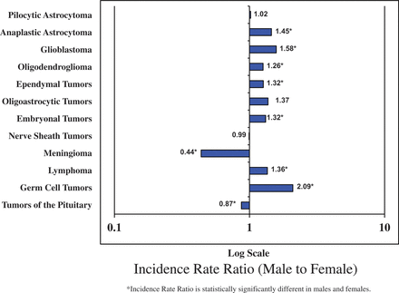
Fig. 9. Patterns by Gender for Selected Histologies.
Notes:
Fig. 9. Patterns by Gender for Selected Histologies.
Unless provided in the caption above, the following copyright applies to the content of this slide: © The Centers for Disease Control. Published by Oxford University Press on behalf of the Society for Neuro-Oncology in cooperation with the Central Brain Tumor Registry 2012.

Slide 15
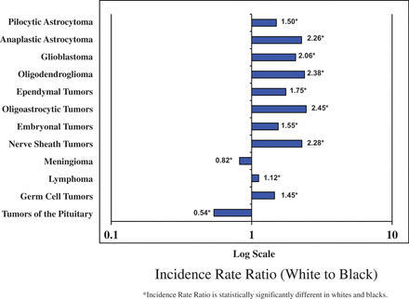
Fig. 10. Patterns by Race for Selected Histologies.
Notes:
Fig. 10. Patterns by Race for Selected Histologies.
Unless provided in the caption above, the following copyright applies to the content of this slide: © The Centers for Disease Control. Published by Oxford University Press on behalf of the Society for Neuro-Oncology in cooperation with the Central Brain Tumor Registry 2012.

