Slide 1
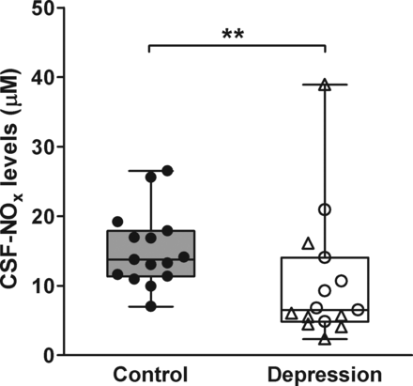
Figure 1. Changes of CSF-NO_{x} levels in depression. Boxplot showing the median, 25th–75th percentiles, and ...
Notes:
Figure 1. Changes of CSF-NOx levels in depression. Boxplot showing the median, 25th–75th percentiles, and the range of the nitrate and nitrite (NOx) levels in the postmortem CSF of depressive patients (open symbols) and controls (solid circles). CSF-NOx levels showed a significant 53% decrease in depressive patients. Triangles: MDD; empty circles: BD. Double asterisks indicates P < 0.01.
Unless provided in the caption above, the following copyright applies to the content of this slide: © The Author 2012. Published by Oxford University Press. All rights reserved. For Permissions, please e-mail: journals.permissions@oup.com

Slide 2
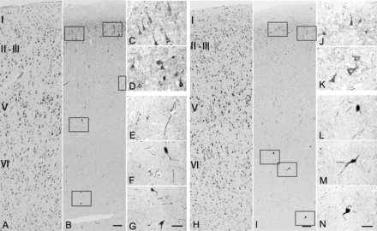
Figure 2. Representative microphotographs of NOS1-ir in the ACC. The laminar structure is visible in the adjacent ...
Notes:
Figure 2. Representative microphotographs of NOS1-ir in the ACC. The laminar structure is visible in the adjacent thionine-stained sections (A and H). In the control subject (A–G, NBB #97-143), the majority of NOS1-immunoreactivity (ir) was observed to distribute in the layer II of the ACC (B). Note that in the ACC, the NOS1 staining is present in small- and medium-sized pyramidal neurons in layers II–III (C and D), in scattered fibers (E and F), and large multipolar neurons (G) in layers V–VI. In the depressive patient (H–N, NBB #06-011), the number and size of NOS1-ir neurons are reduced in layer II (I), the morphology of NOS1-ir neurons in all the layers is comparable with the control subject, that is, in proximal parts of major dendrites and in the perikarya of layers II–III pyramidal neurons (J and K), scattered fibers (L), and large multipolar neurons (M and N) in layers V–VI. Scale bars: A, B, H, and I, 100 mm; C–G and J–N, 20 mm.
Unless provided in the caption above, the following copyright applies to the content of this slide: © The Author 2012. Published by Oxford University Press. All rights reserved. For Permissions, please e-mail: journals.permissions@oup.com

Slide 3
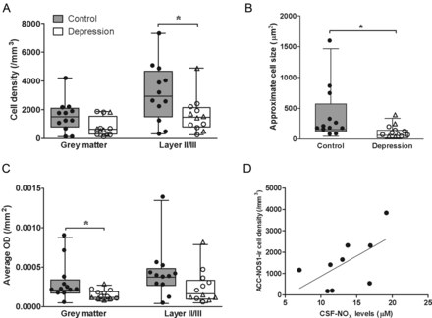
Figure 3. Alterations of NOS1-ir in the ACC in depression. Boxplot showing the median, 25th–75th percentiles, and the ...
Notes:
Figure 3. Alterations of NOS1-ir in the ACC in depression. Boxplot showing the median, 25th–75th percentiles, and the range of the cell density (A), the approximate size of NOS1-positive cells (B), and the average OD (C) of NOS1-ir in the ACC of depressive patients (open symbols) and controls (solid circles). There was a significant 49% reduction of NOS1-ir cell density in layers II–III and a trend towards a lower NOS1-ir cell density in the entire gray matter of ACC in depressive patients (A). The approximation of NOS1-ir cell size showed a significant decrease (60%) in layers II–III (B). The average OD of NOS1-ir showed a significant reduction in the entire gray matter (45%) and a trend towards a reduction in layers II–III of the ACC in depression (C). There was a significantly positive correlation between CSF-NOx levels and NOS1-ir cell densities in the gray matter of ACC in the control subjects (rho = 0.667, P = 0.050, N = 9) (D). Triangles: MDD, empty circles: BD. Asterisk indicates P < 0.05.
Unless provided in the caption above, the following copyright applies to the content of this slide: © The Author 2012. Published by Oxford University Press. All rights reserved. For Permissions, please e-mail: journals.permissions@oup.com

