Slide 1
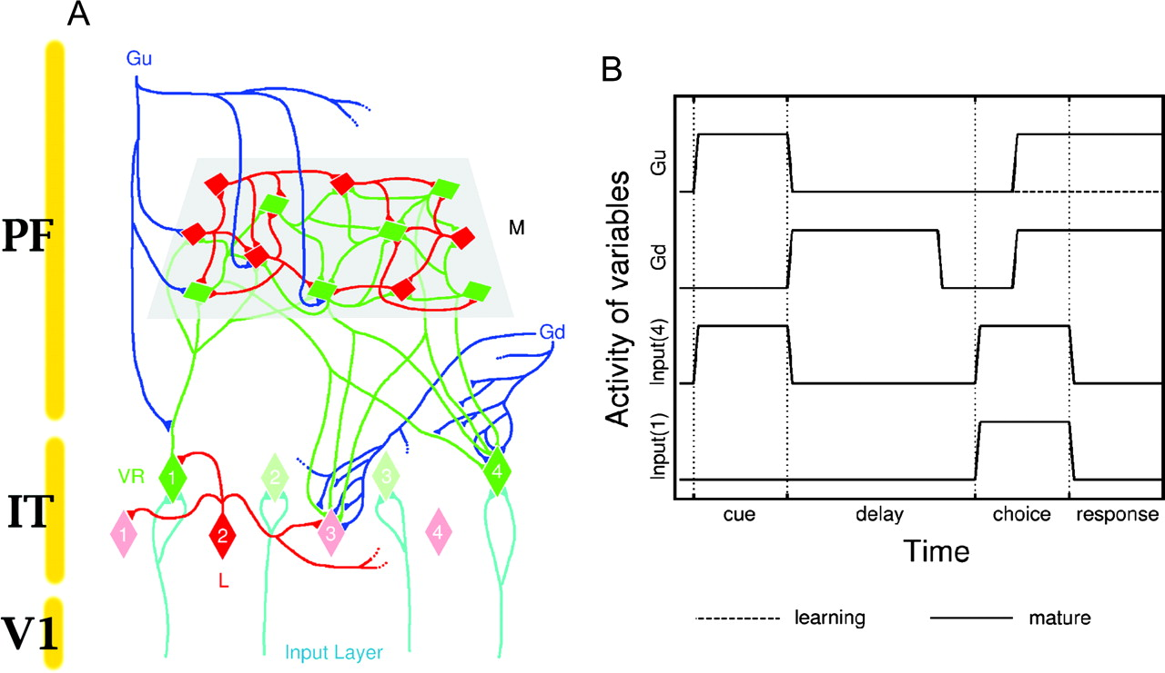
Figure 1. (A) Overall diagram of the model and definition of variables. Gold lines on the left sketch tentative ...
Notes:
Figure 1. (A) Overall diagram of the model and definition of variables. Gold lines on the left sketch tentative assignments of neurons to cortical regions, i.e. M to prefrontal and VR and L to IT (see text for details). Excitatory neurons are represented in green colour, inhibitory in red. Blue lines represent synaptic connections from executive areas, which gate connections between layers M, VR and L. For clarity, only a small sample of connections and M neurons have been drawn. (B) Time activity during a typical trial where image 4 is used as sample and 1 as distractor. Input variable (4) depicts presentation of stimulus 4 (the sample and target); input variable (1) that of stimulus 1, which is the distractor in this trial, denoted as ‘4 → 4 + 1’; executive gating variables Gu and Gd, are set to 1 only when bottom-up (resp. top-down) information flow is allowed. Gating activity during learning and during routine task performance in the mature network differ only by the value of gating Gu in the choice and response periods, being 1 for the mature network and 0 for the immature network.
Unless provided in the caption above, the following copyright applies to the content of this slide: Cerebral Cortex V 15 N 5 © Oxford University Press 2004; all rights reserved

Slide 2
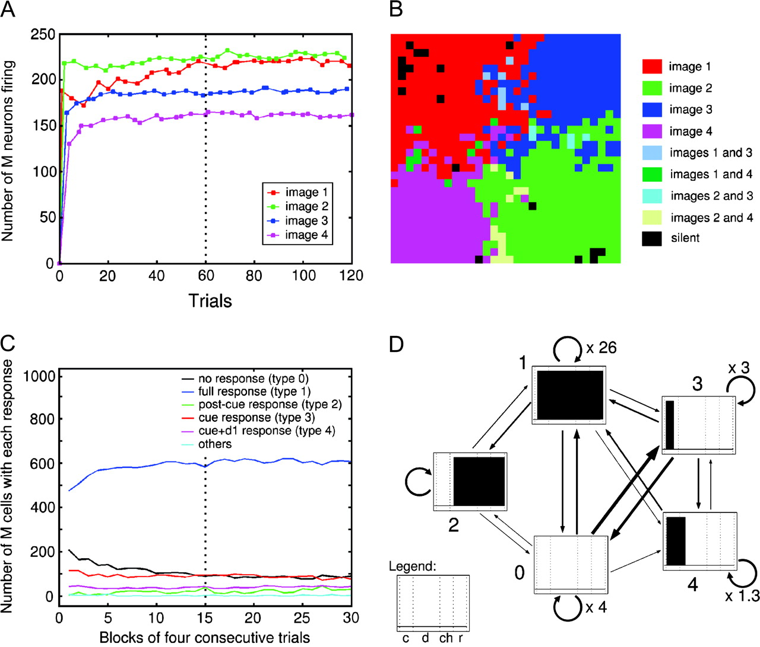
Figure 2. Evolution of response characterstics of layer M neurons. (A) Number of neurons from layer M responding to ...
Notes:
Figure 2. Evolution of response characterstics of layer M neurons. (A) Number of neurons from layer M responding to each image during a run. The dotted line indicates the end of the training period. Neurons are quickly recruited to their preferred image, in clusters which stabilize in ∼10 trials, as seen on the final plateaus. (B) Distribution of cells in layer M according to their stimulus specificity recorded during the learning phase. Most neurons (848 out of 900) respond only to one of the four images and a very small minority (18/900) do not fire at all. The remaining 34 cells respond to two images in the course of learning. They are found at the border between regions occupied by stimulus-specific cells. (C) Evolution, during a complete run, of the number of neurons of layer M with given responses and reacting only to a single image. The dotted line indicates the end of the training phase. Each curve represents the number of cells exhibiting one particular response pattern during a trial. Five categories (presented on D) generally encompass almost all cells, the remainder (turquoise curve) being on the order of 1%. For better statistics, we have averaged the cells' outputs over four trials, each trial using one of the four stimuli as target (d1 = first 0.3 s of the delay). (D) Diagram of single-cell response evolution during learning for neurons in layer M. This illustrates the possible changes in firing pattern a cell might undergo at the next trial, given its response in the current trial. A trial consists of c: cue; d: delay; ch: choice; r: response periods (see ‘legend’); a response pattern describes the presence (black) or absence (white) of reaction during all successive trial phases. The figure was obtained by compiling the transition matrix between response patterns for all 900 M neurons during the first 60 trials of the run (where most of transitions in cell firing takes place). The result, divided by the total number of transitions, gives the probability that one cell chooses pattern x at the present trial if it exhibited pattern y at the previous one. This can be understood as a ‘flow’ diagram of response pattern activity. Each box represents one of the five most common type of neural response during a whole trial. Arrow widths represent relative probabilities for the transition from one response to the other (numerical factors are used to indicate the large probabilities for no response change).
Unless provided in the caption above, the following copyright applies to the content of this slide: Cerebral Cortex V 15 N 5 © Oxford University Press 2004; all rights reserved

Slide 3
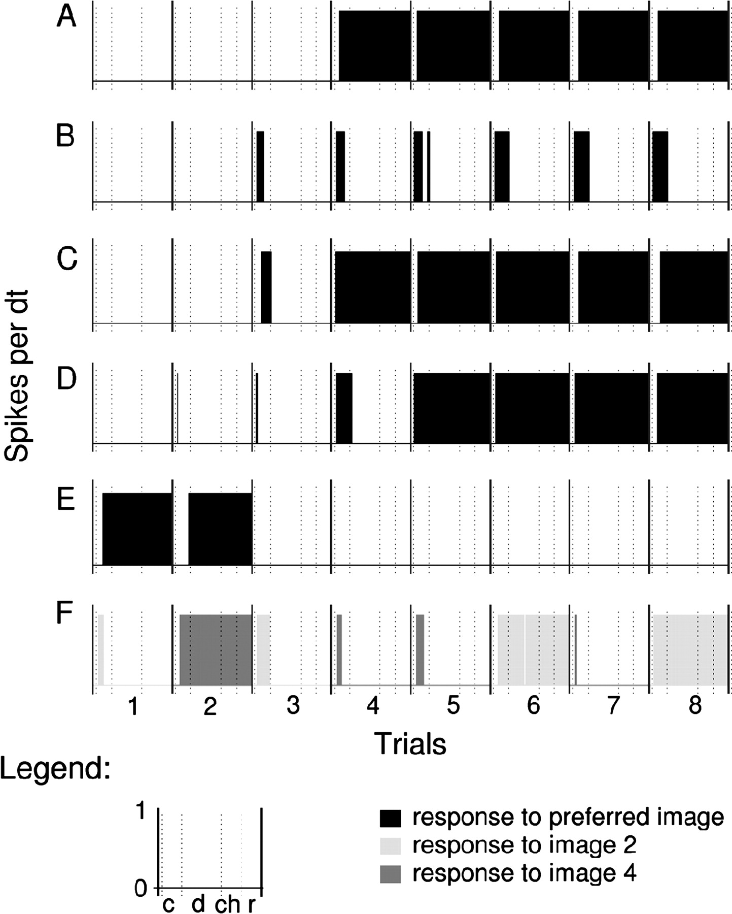
Figure 3. Evolution of the response of VR neuron activity during consecutive trials at the very beginning of the ...
Notes:
Figure 3. Evolution of the response of VR neuron activity during consecutive trials at the very beginning of the learning period (c: cue; d: delay; ch: choice; r: response). Solid vertical lines separate trials, dotted lines separate periods of a given trial. (A–E) Neurons responding to a single image. Most cells in the system behave like shown in (A–D), increasing their firing during trials. For cell response type definition, see text. (A) A transition from type 0 to 1, (B) from type 0 to 3, (C) from type 0 to 3 to 1 and (D) from 0 to 3, then 4 and finally 1. Fewer cells on the contrary have responses which decrease during learning, as demonstrated in (E), which makes a transition from 1 to 0. Only trials where the cells' preferred image is used as sample have been used here. (F) An example of a cell which initially responds to image 4 (dark grey) but shifts to image 2 (light grey) after a few trials. Only trials using images 2 and 4 are plotted here.
Unless provided in the caption above, the following copyright applies to the content of this slide: Cerebral Cortex V 15 N 5 © Oxford University Press 2004; all rights reserved

Slide 4
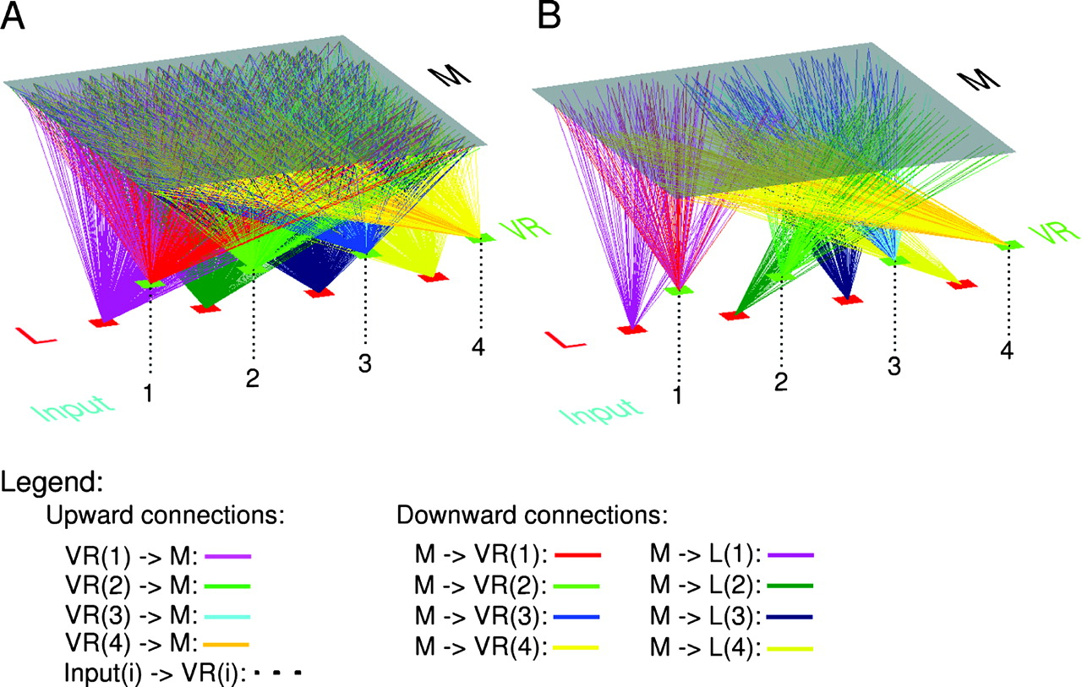
Figure 4. Selection of vertical connections during the learning phase. Evolution of bottom-up and top-down connections ...
Notes:
Figure 4. Selection of vertical connections during the learning phase. Evolution of bottom-up and top-down connections between layers M, VR and L dictating the dynamics of the network (connections within layer M are not represented). (A) Initial configuration of the system. Overall connection pattern is homogeneous and diffuse, except for upward projections from layer VR to M which have a slight bias toward each of the corners of layer M. (B) Strengthened connections which dominate the network dynamics after completion of learning. These connections (with, typically, a strength ≥ 0.75) constitute a two-way network of projections linking each VR(i) neuron (i = 1, 2, 3, 4) with the corresponding neural cluster of image i and the lateral inhibitor neuron L(i).
Unless provided in the caption above, the following copyright applies to the content of this slide: Cerebral Cortex V 15 N 5 © Oxford University Press 2004; all rights reserved

Slide 5
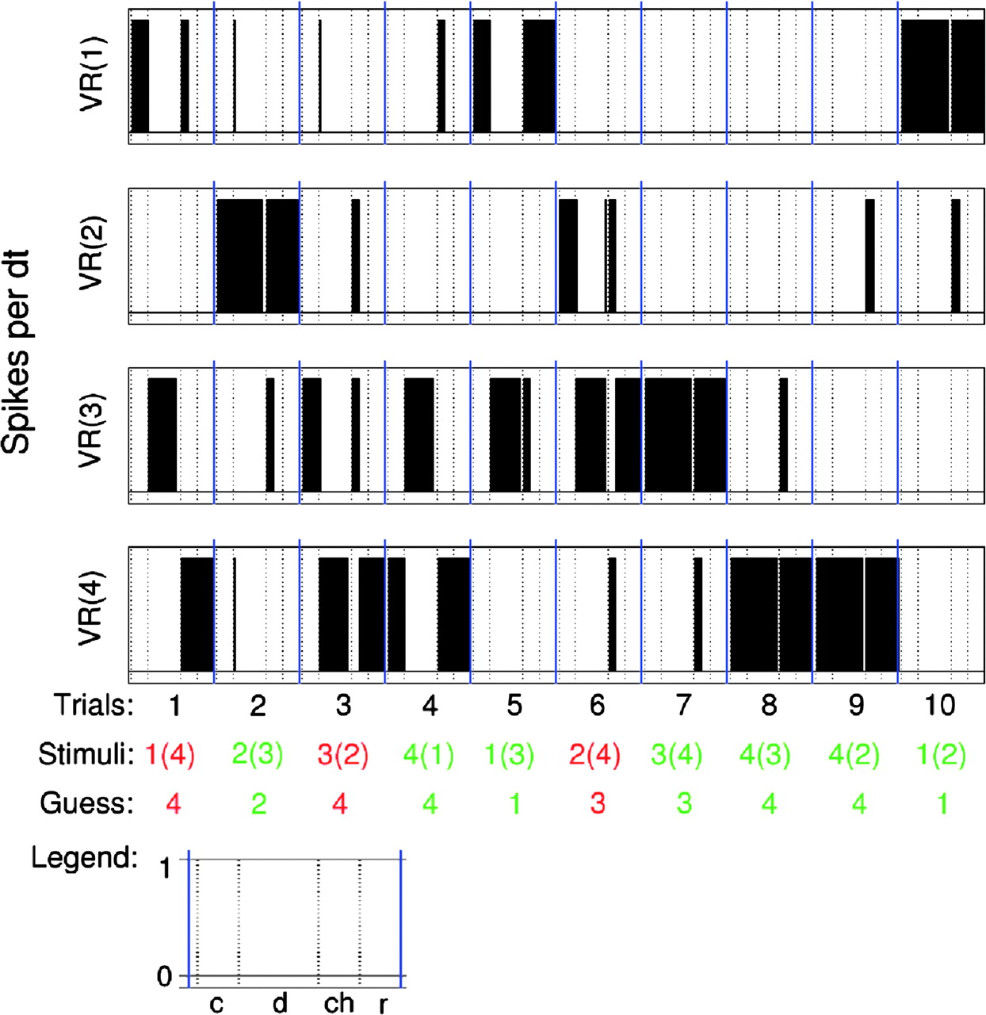
Figure 5. Response of VR cells during the first 10 trials of a run. Records for trials are separated by blue lines; ...
Notes:
Figure 5. Response of VR cells during the first 10 trials of a run. Records for trials are separated by blue lines; each numbered trial is divided by dotted lines in c: cue; d: delay; ch: choice; and r: response periods. Indicated below the records are: (Trials) number of the current trial; (Stimuli) the stimuli used for each trial (sample, and distractor in parentheses); (Guess) the tentative target proposed by the network for each trial. Reward awarded to the network for each trial is indicated by colour (red = negative reward, green = positive reward). Trial 1 – sample: 1 – failed. VR(1) fires and initiates a bottom-up representation of stimulus 1, which propagates upward into layer M where it triggers the cluster specific to this image (not shown). The system fails twice at sustaining activity of VR(1) once the sample image is hidden: during the delay [when it triggers VR(3)] and during the choice period (it activates VR(4) corresponding to the distractor). R = −1: Connections from the M-cluster of image 1 onto VR(4) and L(4) are weakened by decrements of −δJR all the way to J0. Trial 2 – sample: 2 – succeeded. VR(2) and the cluster in M of image 2 are triggered by the sample presentation during the cue period. VR(2), however, stays on during the delay, although the system ‘hesitated’ for a few instants and triggered VR(1) and VR(4). During the choice period, the network selects activity corresponding to the target, VR(2) and L(2). R = 1: reinforcement of all connections between the M-cluster of image 2 and VR(2) and L(2). Trial 3 – sample: 3 – failed. Similar to trial 1 though with sample image 3. System wrongly expects image 4 as target instead of stimulus 3 and receives negative reward as a result: the expectation of image 4 as a target by the system suppresses the activity of cells VR(2) and VR(3), disregarding them although they code for images actually presented to the network. Trial 4 – sample: 4 – succeeded. The model passes the trial even though it made the wrong assumption for target during the delay (choosing image 3 instead of 4). Connections from the cluster of image 4 in M toward VR(4) and L(4) are reinforced. Trial 5 – sample: 1 – succeeded. Another example of a successful trial in spite of wrong choice during the delay period. Trial 6 – sample: 2 – failed. The system chose an image as target (image 3) which was neither the sample nor the distractor, even though it passed trial 2 where the sample was image 2. The final four trials are successful.
Unless provided in the caption above, the following copyright applies to the content of this slide: Cerebral Cortex V 15 N 5 © Oxford University Press 2004; all rights reserved

Slide 6
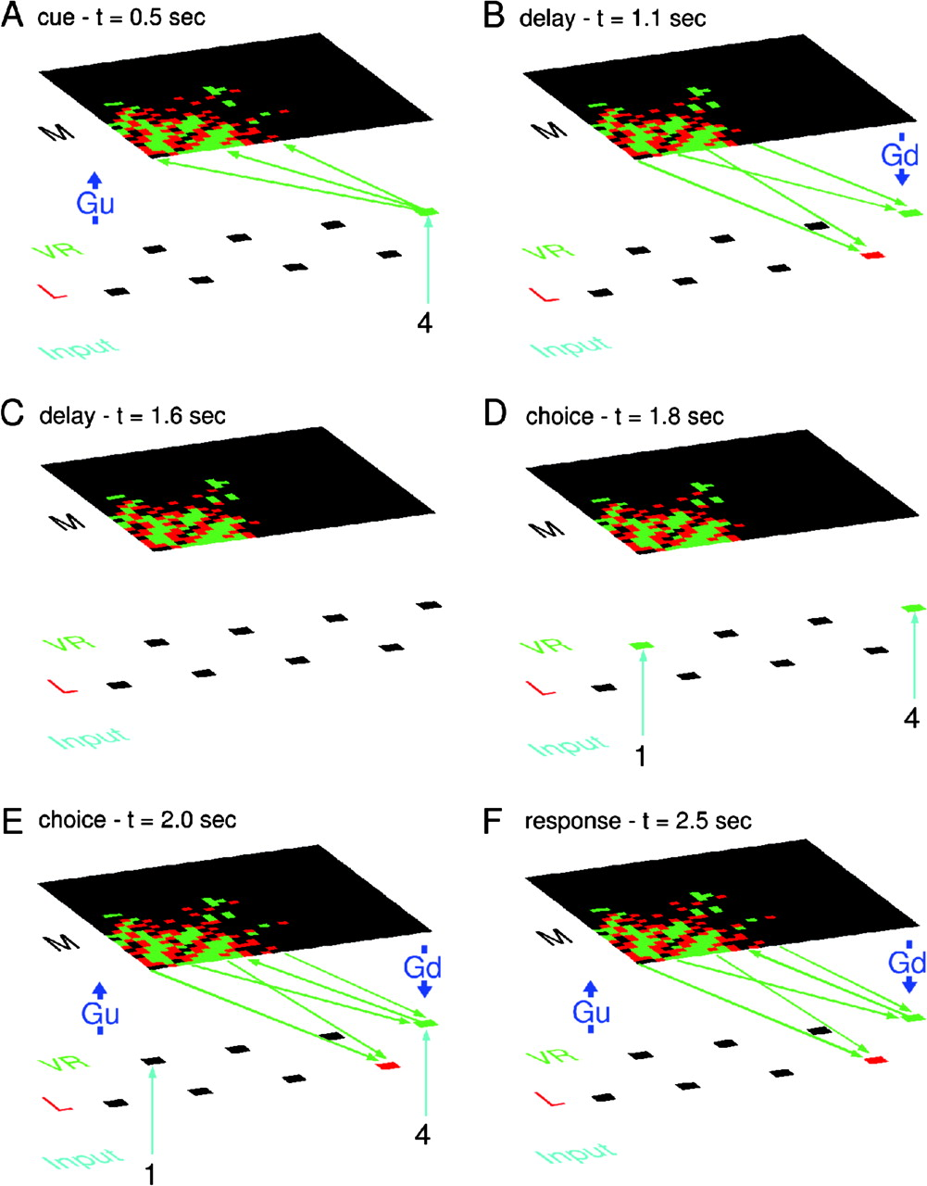
Figure 6. Snapshots of the dynamics of the network at key moments of a trial where image 4 is the sample and target, ...
Notes:
Figure 6. Snapshots of the dynamics of the network at key moments of a trial where image 4 is the sample and target, and image 1 the distractor. In layers M, L and VR, neurons are represented by coloured dots (black, green and red represent silent, firing excitatory and firing inhibitory neurons, respectively). Control activities Gu, Gd and visual inputs are displayed only when active. We only display the most strongly enhanced vertical connections (green arrows).
Unless provided in the caption above, the following copyright applies to the content of this slide: Cerebral Cortex V 15 N 5 © Oxford University Press 2004; all rights reserved

Slide 7
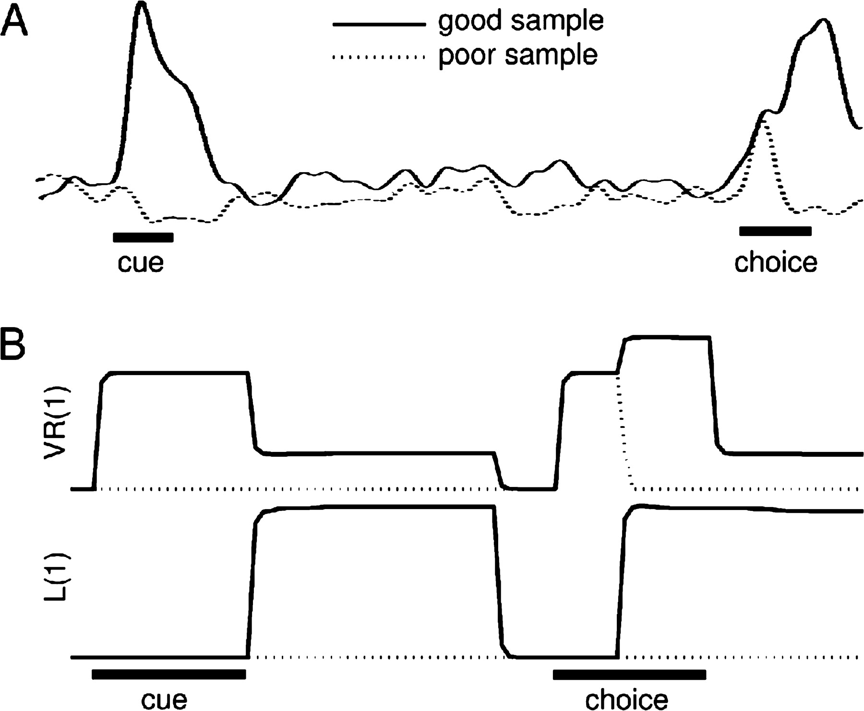
Figure 7. Response of visual areas cells for trials where the preferred stimulus is the target and the distractor. (A) ...
Notes:
Figure 7. Response of visual areas cells for trials where the preferred stimulus is the target and the distractor. (A) Data from Chelazzi et al. (1993) showing that the response of an IT neuron cell during the choice period of a DMS task depends on the sample image (modified from Chelazzi et al. (1993). (B, top) Activation (see text for details) of neuron VR(1) during trials 1 → 1 + 2 and 2 → 2 + 1. (B, bottom) Activation of inhibitory neuron L(1) as simulated in the model (continuous line: 1 → 1 + 2, dotted lined: 2 → 2 + 1).
Unless provided in the caption above, the following copyright applies to the content of this slide: Cerebral Cortex V 15 N 5 © Oxford University Press 2004; all rights reserved

Slide 8
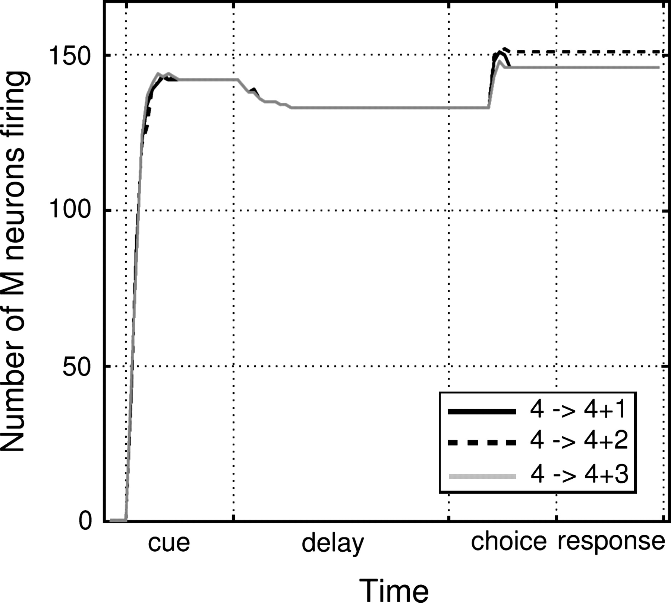
Figure 8. Time variation of the number of firing neurons in layer M during trials with sample image 4 and distractors ...
Notes:
Figure 8. Time variation of the number of firing neurons in layer M during trials with sample image 4 and distractors 1, 2 and 3.
Unless provided in the caption above, the following copyright applies to the content of this slide: Cerebral Cortex V 15 N 5 © Oxford University Press 2004; all rights reserved

Slide 9
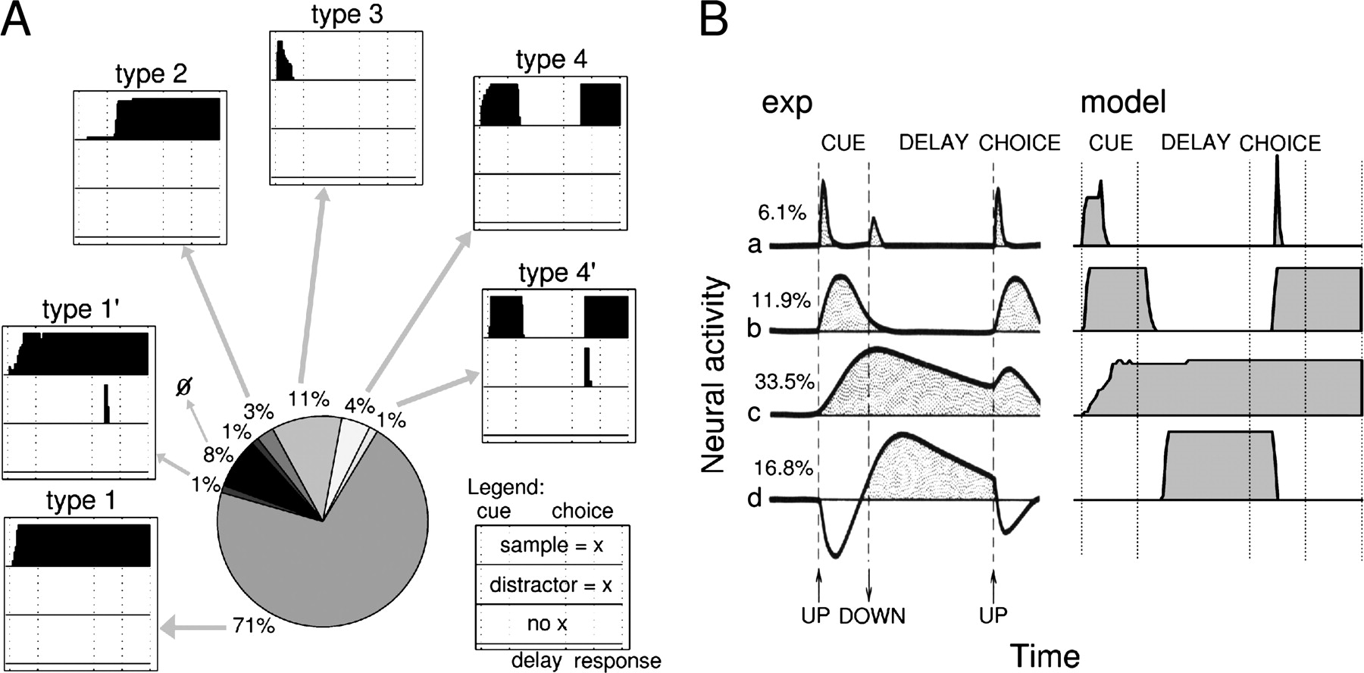
Figure 9. (A) Distribution of M neurons according to their temporal firing pattern after completion of the learning ...
Notes:
Figure 9. (A) Distribution of M neurons according to their temporal firing pattern after completion of the learning phase. Each frame indicates (top) the cell's response when the favourite image x is the sample, (middle) when it is the distractor and (bottom) for other images. The symbol ‘Ø’ indicates cells which do not respond during the task. Almost all neurons respond in a robust way to at most one image; the rest (10 cells or roughly 1%) fire either in an inconsistent way or respond to several images. (B) Comparison of activity of PF cells in the monkey and of units in working layer M. exp: firing pattern of cells recorded in the PF cortex of the monkey while performing the DMS task. Notation ‘up’ and ‘down’ refers to the sliding of a blind used in the experimental device, which was raised and lowered to show and hide objects to the subject (modified from Fuster, 1973). Percentage near each curve represents the proportion of cells falling in each response pattern class. model: activity of M neurons with firing patterns similar to that on exp.
Unless provided in the caption above, the following copyright applies to the content of this slide: Cerebral Cortex V 15 N 5 © Oxford University Press 2004; all rights reserved

Slide 10
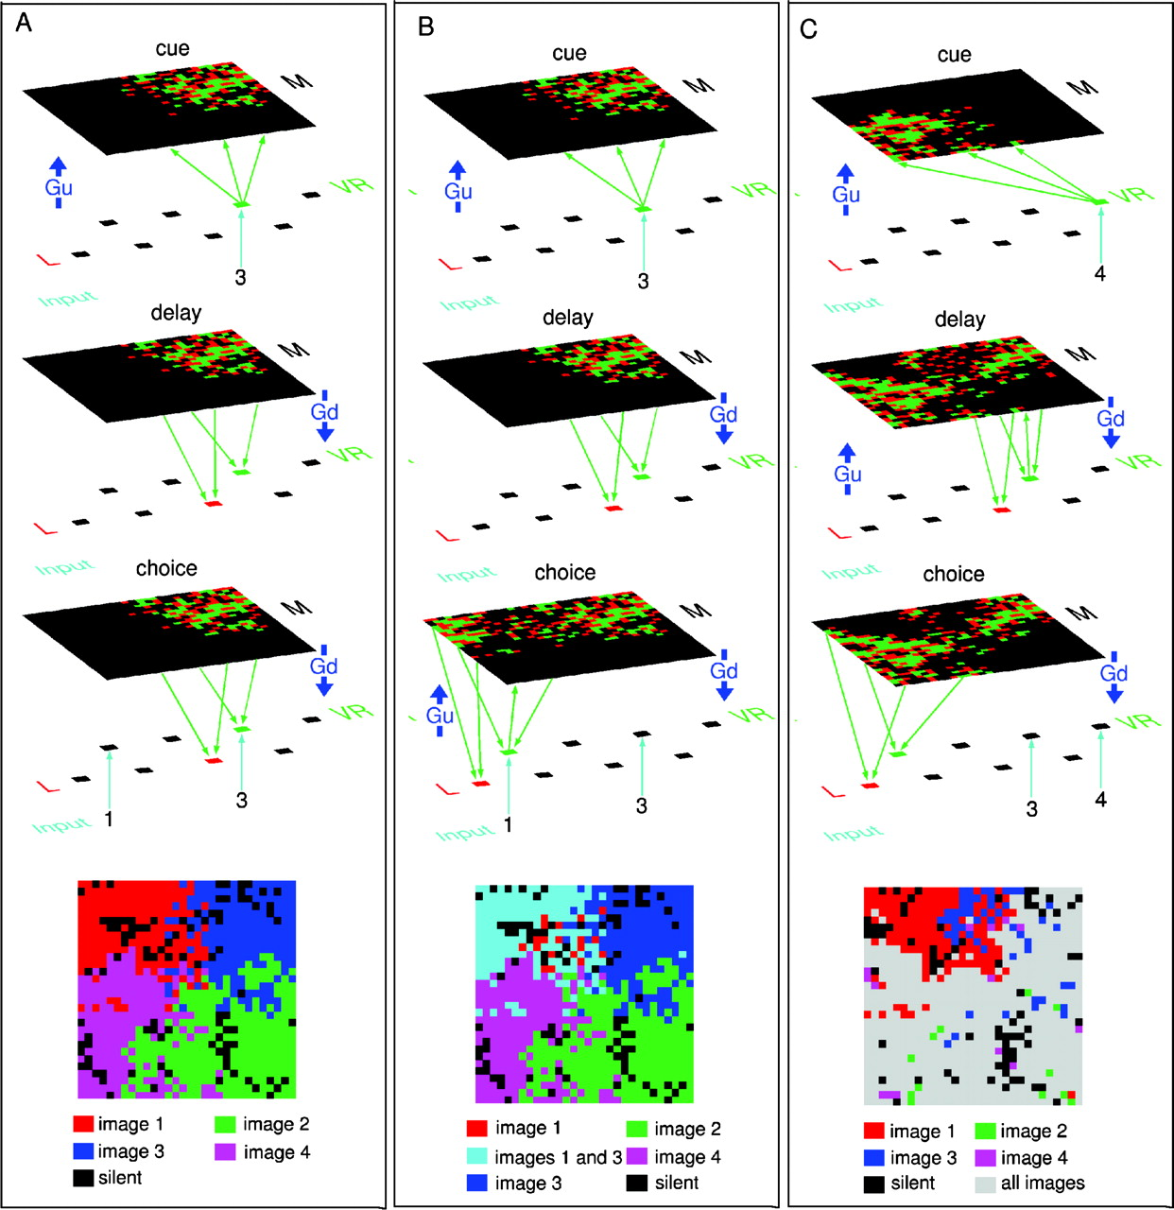
Figure 10. Influence of gating G_{u} on the dynamics and neural segregation of activities for three ...
Notes:
Figure 10. Influence of gating Gu on the dynamics and neural segregation of activities for three instantiations of a network which have identical connectivity, layers M (columns), neuron updating sequences and which are submitted to the same series of trials and stimuli in the phases of learning. (A) System with gating Gu ‘off’ during the delay and choice periods. Shown are snapshots of the system dynamics during cue, delay and choice; bottom seggregation of cells in four groups according to the image they respond to. (B) System with Gu set ‘on’ during the choice period. This variation induces the firing of clusters in M representing both the sample/target and distractor and failure of the trial. Consequently, through Hebbian learning, clusters of cells for images 1 and 3 become associated (bottom). (C) System with gating Gu set ‘on’ during the delay for a different trial than (B). The feedback between layers M and VR now induces multiple associations, and all specialization of cells is lost, as shown at the bottom: most cells in M now fire for all of the images.
Unless provided in the caption above, the following copyright applies to the content of this slide: Cerebral Cortex V 15 N 5 © Oxford University Press 2004; all rights reserved

