Slide 1
Fig. 1 The use of the printed page to reveal the uniformity of migraine scotomas. Left to right: from Jolly (1902); ...
Notes:
Fig. 1 The use of the printed page to reveal the uniformity of migraine scotomas. Left to right: from Jolly (1902); from Gowers (1904); exhibit from the first exhibition of migraine art, from Wilkinson and Robinson, 1985, reproduced with permission of the Migraine Action Association and Boehringer Ingelheim UK Limited.
Unless provided in the caption above, the following copyright applies to the content of this slide: © The Author (2007). Published by Oxford University Press on behalf of the Guarantors of Brain. All rights reserved. For Permissions, please email: journals.permissions@oxfordjournals.org

Slide 2
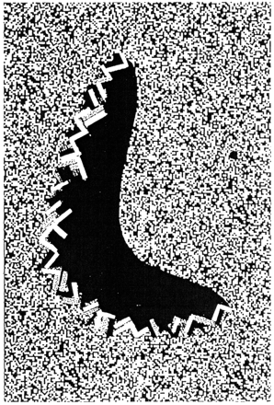
Fig. 2 Display of the scintillating migraine phosphene and its trailing scotoma, as observed on a dynamic random-dot ...
Notes:
Fig. 2 Display of the scintillating migraine phosphene and its trailing scotoma, as observed on a dynamic random-dot noise pattern, from Grüsser and Landis (1991). Reproduced with permission of Palgrave Macmillan.
Unless provided in the caption above, the following copyright applies to the content of this slide: © The Author (2007). Published by Oxford University Press on behalf of the Guarantors of Brain. All rights reserved. For Permissions, please email: journals.permissions@oxfordjournals.org

Slide 3
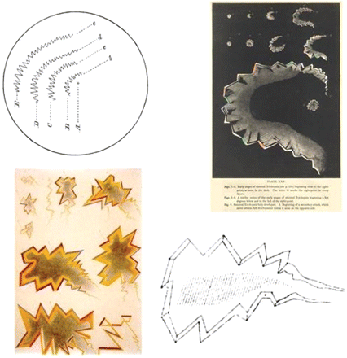
Fig. 3 The 19th century and the first drawings of the fortification spectrum. Upper left: spreading zigzags ...
Notes:
Fig. 3 The 19th century and the first drawings of the fortification spectrum. Upper left: spreading zigzags resembling ‘a Norman arch’—A is at the beginning, and lines Bb, Cc, etc. show the arch as it gradually increases in dimensions and moves peripherally, from Airy (1865). Upper right: the upper two lines of sequences (1–4, 5–6) show the spread of two hallucinations, the white dot, o, being the fixation point; the large figure, 9, shows the fortification pattern in more detail, from Airy (1870). Lower left: a colourful representation of expanding spectra drawn by Babinski's patient, from Babinski (1890). Lower right: Charcot's marginal diagram of a scotoma with a fortification-type outline, from Charcot (1887).
Unless provided in the caption above, the following copyright applies to the content of this slide: © The Author (2007). Published by Oxford University Press on behalf of the Guarantors of Brain. All rights reserved. For Permissions, please email: journals.permissions@oxfordjournals.org

Slide 4
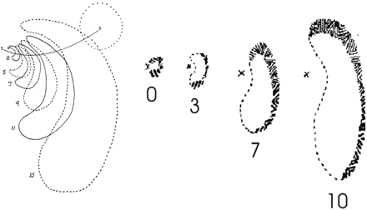
Fig. 4 The first analytical drawings of the spatiotemporal evolution of spreading migraine hallucinations. Left: a ...
Notes:
Fig. 4 The first analytical drawings of the spatiotemporal evolution of spreading migraine hallucinations. Left: a scintillating scotoma, spreading at the intervals shown. The blindspot is shown as the dotted circle, and the fixation point as x; alternate outlines are solid and dotted to avoid confusion; scintillations were confined to the region above the line s-s. Right: successive forms of a scintillating scotoma, mapped at different time intervals as indicated; the fixation point is shown as x. From Lashley (1941). Copyright © 1941 American Medical Association. All rights reserved.
Unless provided in the caption above, the following copyright applies to the content of this slide: © The Author (2007). Published by Oxford University Press on behalf of the Guarantors of Brain. All rights reserved. For Permissions, please email: journals.permissions@oxfordjournals.org

Slide 5
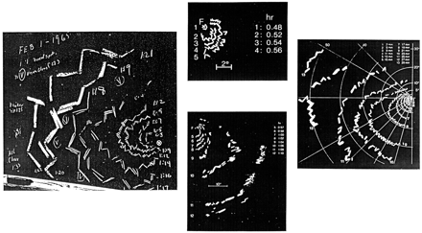
Fig. 5 Self-observed and recorded illustrations during migraine attacks, showing detailed temporospatial ...
Notes:
Fig. 5 Self-observed and recorded illustrations during migraine attacks, showing detailed temporospatial relationships of the hallucinations. Left: drawn by W. S. McCulloch, from Bücking and Baumgartner (1974). Reproduced with kind permission of Springer Science and Business Media. Centre 2 figures, from Grüsser and Landis (1991). Reproduced with permission of Palgrave Macmillan. Right, reprinted from Grüsser O-J (1995). Copyright 1995, with permission from Elsevier.
Unless provided in the caption above, the following copyright applies to the content of this slide: © The Author (2007). Published by Oxford University Press on behalf of the Guarantors of Brain. All rights reserved. For Permissions, please email: journals.permissions@oxfordjournals.org

Slide 6
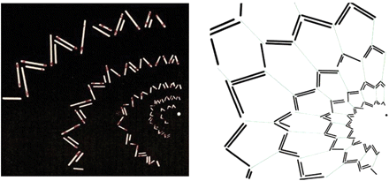
Fig. 6 Left: Redrawn sketch of Richard's wife's spreading fortification spectrum; ordinarily one arc is seen at a ...
Notes:
Fig. 6 Left: Redrawn sketch of Richard's wife's spreading fortification spectrum; ordinarily one arc is seen at a time; the dot is the fixation point. Right: analysis of its component bars, showing the inner angle of the serrations are ∼45° near the centre, increasing to ∼70° at the periphery; the radial lines, which are never seen, have been added to show the postulated underlying honeycomb pattern and hence latticed structure of the visual cortex. From Richards (1971). Reproduced with permission of Jerome Kuhl.
Unless provided in the caption above, the following copyright applies to the content of this slide: © The Author (2007). Published by Oxford University Press on behalf of the Guarantors of Brain. All rights reserved. For Permissions, please email: journals.permissions@oxfordjournals.org

Slide 7
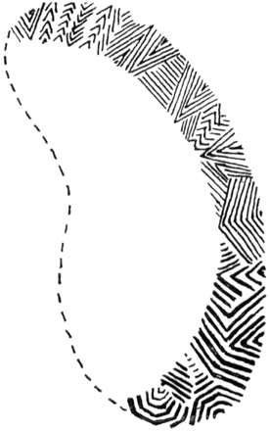
Fig. 7 The scotoma and different components of the fortification outline, with the coarser and more complex features ...
Notes:
Fig. 7 The scotoma and different components of the fortification outline, with the coarser and more complex features represented in the lower part. See text for further details. From Lashley (1941). Copyright © 1941 American Medical Association. All rights reserved.
Unless provided in the caption above, the following copyright applies to the content of this slide: © The Author (2007). Published by Oxford University Press on behalf of the Guarantors of Brain. All rights reserved. For Permissions, please email: journals.permissions@oxfordjournals.org

Slide 8
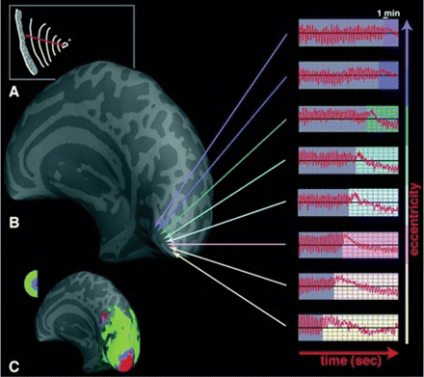
Fig. 8 Spreading suppression of cortical activity during migraine aura, as shown by fMRI. (A) A drawing of the ...
Notes:
Fig. 8 Spreading suppression of cortical activity during migraine aura, as shown by fMRI. (A) A drawing of the progression over 20 min of the scintillating field defect, as described by the patient, with fixation point marked as small cross. (B) The spread of the BOLD signal complex from the posterior pole towards more anterior regions representing the peripheral visual field; MR perturbations develop earlier in the foveal regions than in the periphery, consistent with the progression of the aura from the centre to the periphery. (C) The MR maps of retinotopic eccentricity acquired during interictal scans. See text for further details. From Hadjikhani et al. (2001) Copyright 2001 National Academy of Sciences, USA.
Unless provided in the caption above, the following copyright applies to the content of this slide: © The Author (2007). Published by Oxford University Press on behalf of the Guarantors of Brain. All rights reserved. For Permissions, please email: journals.permissions@oxfordjournals.org

Slide 9
Fig. 9 Computer-generated simulation of the fortification hallucination. From Dahlem et al. (2000). Reproduced with ...
Notes:
Fig. 9 Computer-generated simulation of the fortification hallucination. From Dahlem et al. (2000). Reproduced with permission of Blackwell Publishing.
Unless provided in the caption above, the following copyright applies to the content of this slide: © The Author (2007). Published by Oxford University Press on behalf of the Guarantors of Brain. All rights reserved. For Permissions, please email: journals.permissions@oxfordjournals.org

Slide 10
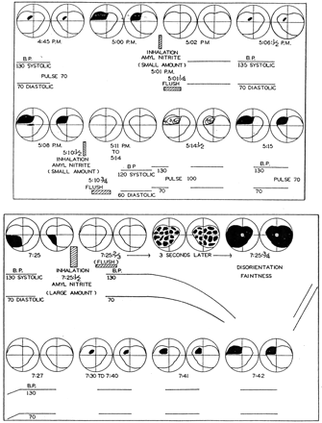
Fig. 10 Cahan's self-observations on his migrainous field defects when inhaling a small (upper figure) or larger ...
Notes:
Fig. 10 Cahan's self-observations on his migrainous field defects when inhaling a small (upper figure) or larger (lower figure) amount of amyl nitrite. In the former experiment, when blood pressure was maintained, the migraine scotoma disappeared, whereas in the latter, when hypotension developed, the scotoma increased. See text for further details. From Schumacher and Wolff (1941). Copyright © 1941 American Medical Association. All rights reserved.
Unless provided in the caption above, the following copyright applies to the content of this slide: © The Author (2007). Published by Oxford University Press on behalf of the Guarantors of Brain. All rights reserved. For Permissions, please email: journals.permissions@oxfordjournals.org

Slide 11
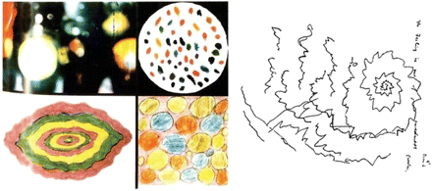
Fig. 11 Illustration as an aid to differential diagnosis. Left: visual hallucinations as depicted by children ...
Notes:
Fig. 11 Illustration as an aid to differential diagnosis. Left: visual hallucinations as depicted by children suffering from occipital seizures, from Panayiotopoulos (1994). Copyright © 1994, BMJ Publishing Group. Right: zigzag lines depicted by an artist illustrating his own hallucinations during mescaline intoxication. From Maclay and Guttmann (1941). Copyright © 1941 American Medical Association. All rights reserved.
Unless provided in the caption above, the following copyright applies to the content of this slide: © The Author (2007). Published by Oxford University Press on behalf of the Guarantors of Brain. All rights reserved. For Permissions, please email: journals.permissions@oxfordjournals.org

