Slide 1
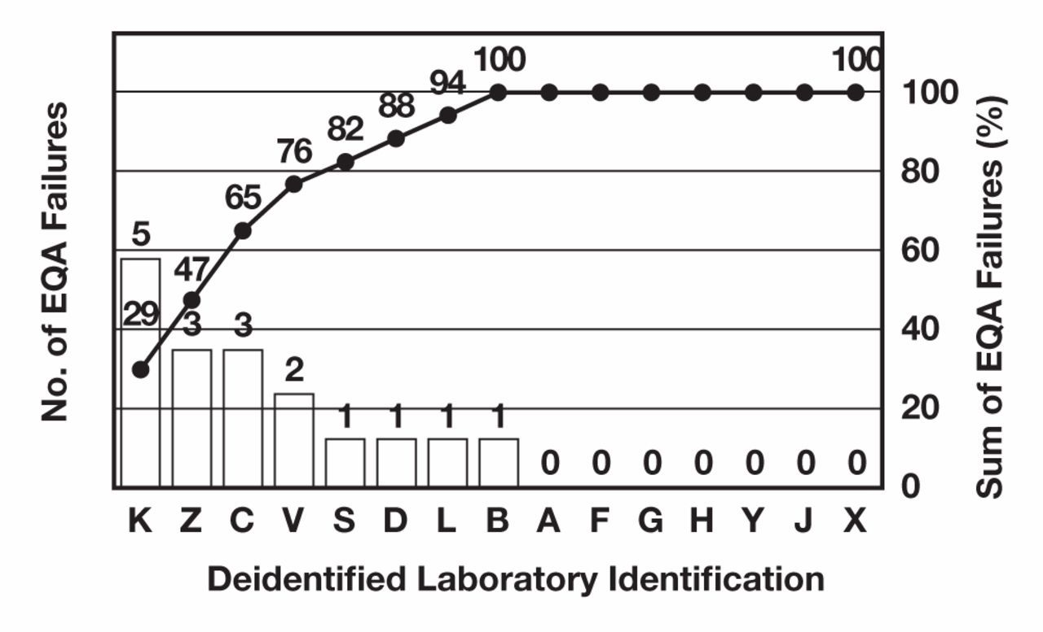
Figure 1 Percentage of all external quality assurance (EQA) survey failures arising at individual laboratories. ...
Notes:
Figure 1 Percentage of all external quality assurance (EQA) survey failures arising at individual laboratories. Laboratory identifiers are deidentified and indicated on the x-axis. The number of EQA failures by each laboratory are denoted by the bar graphs. The aggregate sum of EQA failures (expressed as a percentage) is denoted by the data points on the line graph and corresponds to the right-hand y-axis.
Unless provided in the caption above, the following copyright applies to the content of this slide: © American Society for Clinical Pathology

Slide 2
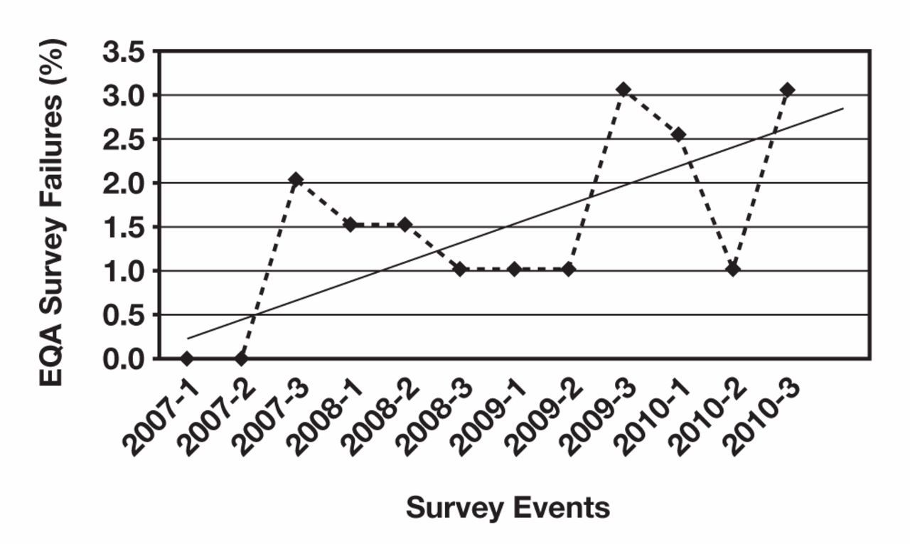
Figure 2 External quality assurance (EQA) survey failure rate over time. The y-axis shows the total number of failures ...
Notes:
Figure 2 External quality assurance (EQA) survey failure rate over time. The y-axis shows the total number of failures in each EQA cycle expressed as a percentage. The solid line is a least-squares fit of the number of failures over time. R2 = 0.4.
Unless provided in the caption above, the following copyright applies to the content of this slide: © American Society for Clinical Pathology

