Slide 1
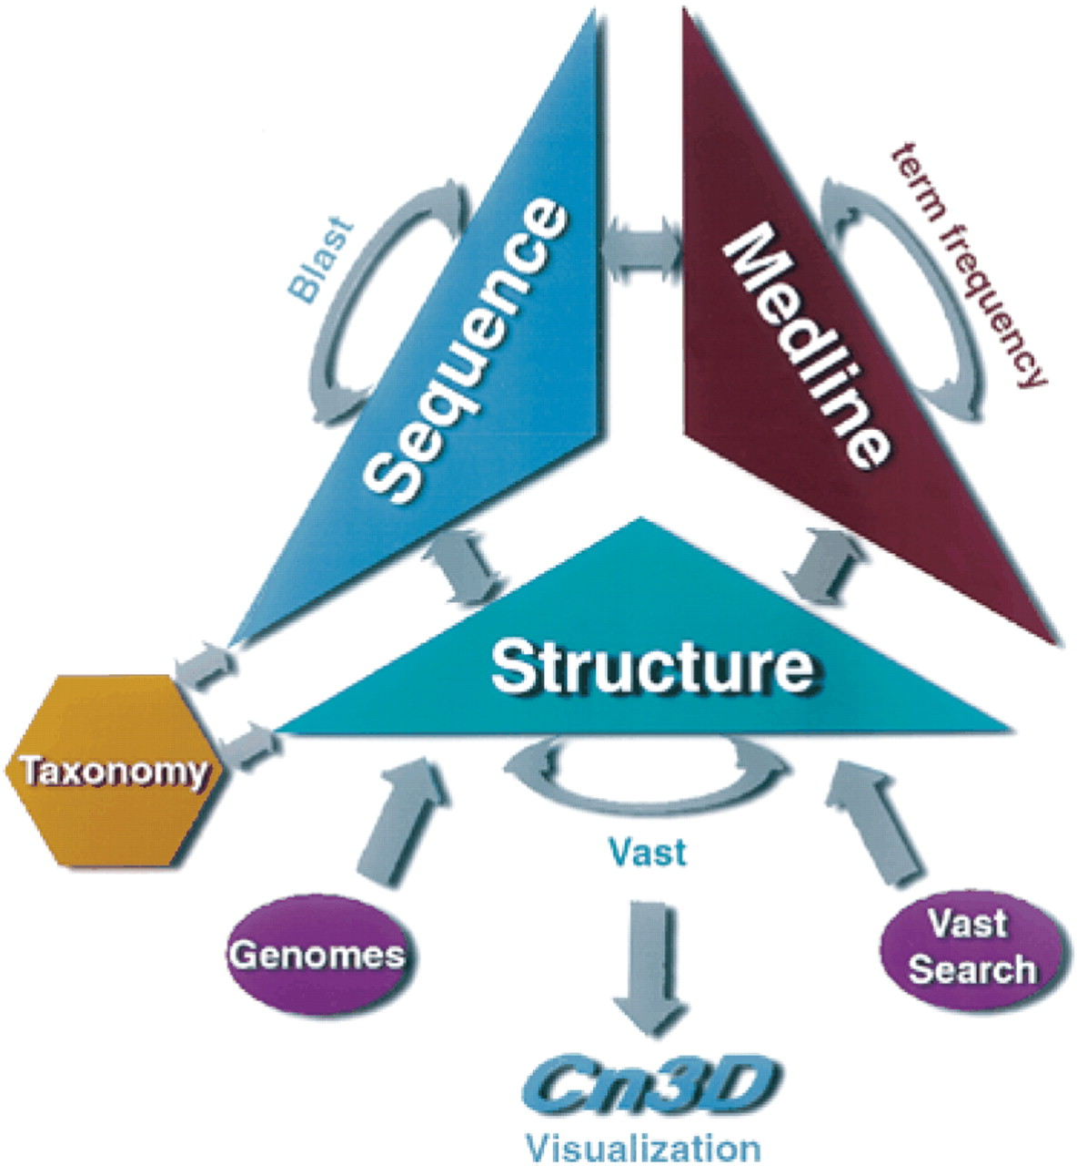
Figure 1. Connections between MMDB and other databases, including the neighboring mechanisms used to relate ...
Notes:
Figure 1. Connections between MMDB and other databases, including the neighboring mechanisms used to relate entries within the same database.
Unless provided in the caption above, the following copyright applies to the content of this slide:

Slide 2
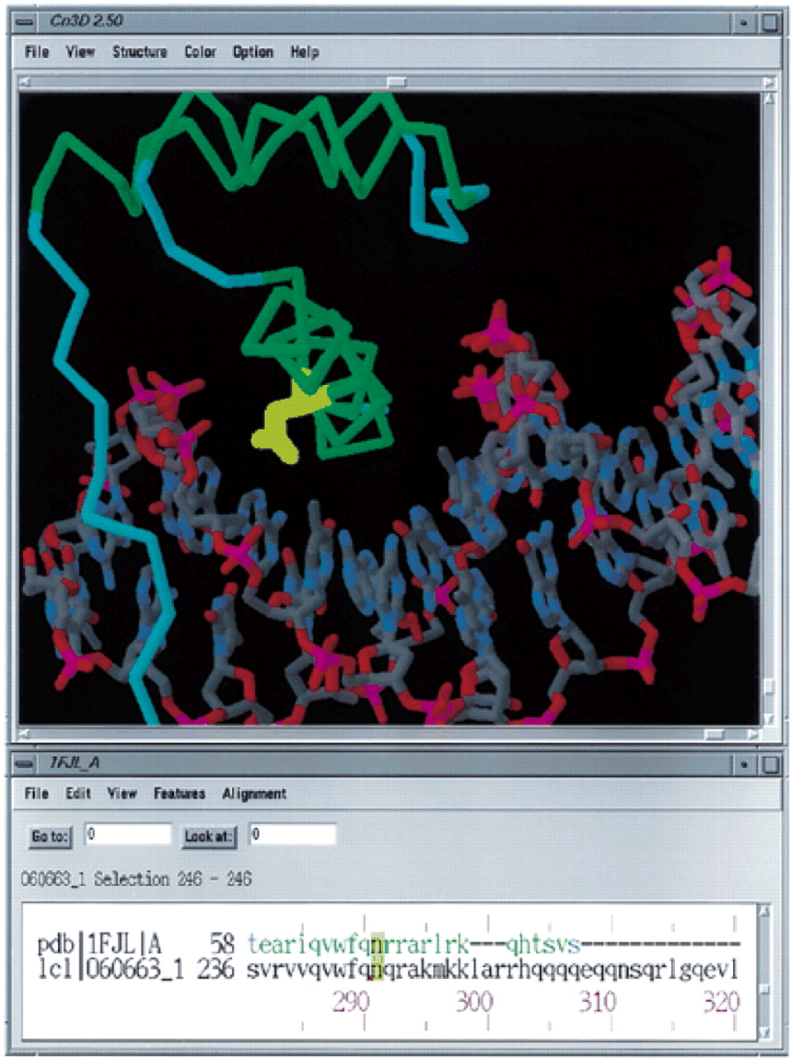
Figure 2. Cn3D image of the Drosophila paired protein and its alignment with human homeobox protein LMX-1.2. ...
Notes:
Figure 2. Cn3D image of the Drosophila paired protein and its alignment with human homeobox protein LMX-1.2. The site of the N→K mutation associated with NPS has been highlighted.
Unless provided in the caption above, the following copyright applies to the content of this slide:

