Slide 1
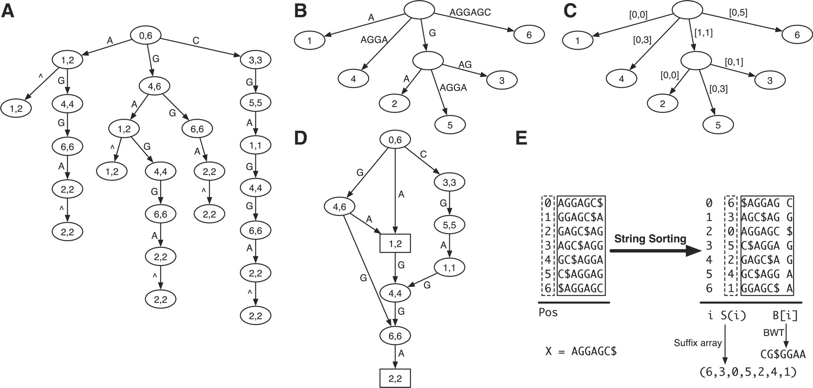
Figure 1: Data structures based on a prefix trie. (A) Prefix trie of string AGGAGC where symbol ⁁ marks the start of ...
Notes:
Figure 1: Data structures based on a prefix trie. (A) Prefix trie of string AGGAGC where symbol ⁁ marks the start of the string. The two numbers in each node give the suffix array interval of the substring represented by the node, which is the string concatenation of edge symbols from the node to the root. (B) Compressed prefix trie by contracting nodes with in- and out-degree both being one. (C) Prefix tree by representing the substring on each edge as the interval on the original string. (D) Prefix directed word graph (prefix DAWG) created by collapsing nodes of the prefix trie with identical suffix array interval. (E) Constructing the suffix array and Burrows–Wheeler transform of AGGAGC. The dollar symbol marks the end of the string and is lexicographically smaller than all the other symbols. The suffix array interval of a substring W is the maximal interval in the suffix array with all suffixes in the interval having W as prefix. For example, the suffix array interval of AG is [1, 2]. The two suffixes in the interval are AGC$ and AGGAGC$, starting at position 3 and 0, respectively. They are the only suffixes that have AG as prefix.
Unless provided in the caption above, the following copyright applies to the content of this slide: © The Author 2010. Published by Oxford University Press. For Permissions, please email: journals.permissions@oxfordjournals.org

Slide 2
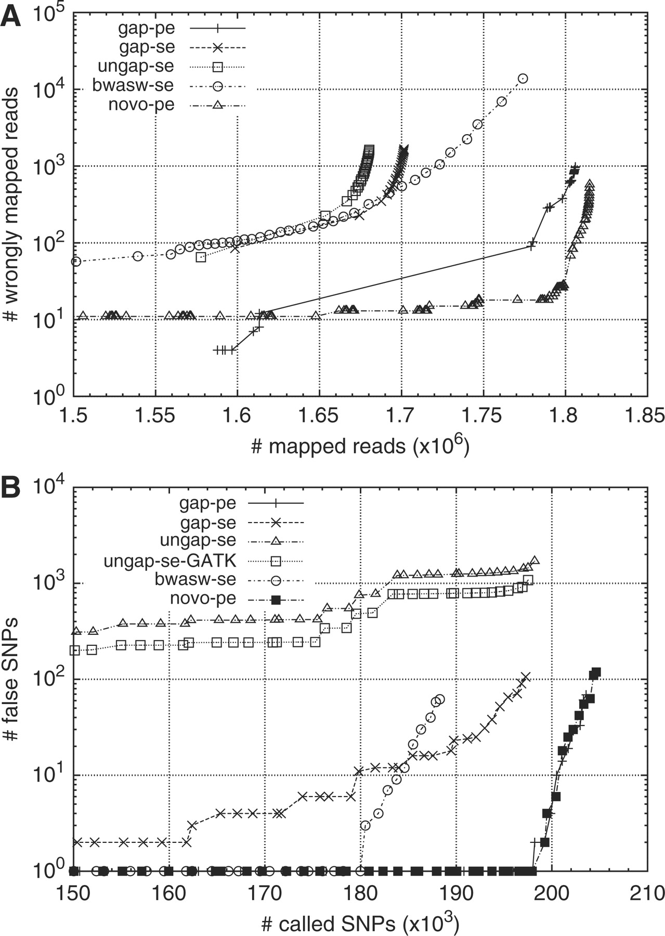
Figure 2: Alignment and SNP call accuracy under different configurations of BWA and Novoalign. (A) Number of misplaced ...
Notes:
Figure 2: Alignment and SNP call accuracy under different configurations of BWA and Novoalign. (A) Number of misplaced reads as a function of the number of mapped reads under different mapping quality cut-off. Reads (108 bp) were simulated from human genome build36 assuming 0.085% substitution and 0.015% indel mutation rate, and 2% uniform sequencing error rate. (B) Number of wrong SNP calls as a function of the number of called SNP under different SNP quality cut-offs. Reads (108 bp) were simulated from chr6 of the human genome and mapped back to the whole genome. SNPs are called and filtered by SAMtools. In both figures, ‘novo-pe’ denotes novoalign alignment; the rest correspond to alignments under different configurations of BWA, where ‘gap-pe’ stands for the gapped paired-end (PE) alignment, ‘gap-se’ for gapped single-end (SE) alignment, ‘ungap-se’ for ungapped SE alignment, ‘bwasw-se’ for BWA-SW SE alignment, and ‘ungap-se-GATK’ for alignment cleaned by the GATK realigner.
Unless provided in the caption above, the following copyright applies to the content of this slide: © The Author 2010. Published by Oxford University Press. For Permissions, please email: journals.permissions@oxfordjournals.org

Slide 3
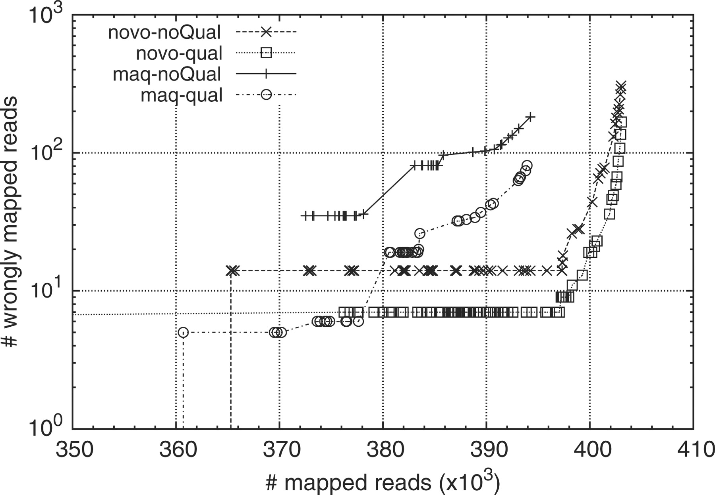
Figure 3: Alignment accuracy of simulated reads with and without base quality. Paired-end reads (51 bp) are simulated ...
Notes:
Figure 3: Alignment accuracy of simulated reads with and without base quality. Paired-end reads (51 bp) are simulated by MAQ from the human genome, assuming 0.085% substitution and 0.015% indel mutation rate. Base quality model is trained from run ERR000589 from the European short read archive. Base quality is not used in alignment for curves with labels ended with ‘-noQual’.
Unless provided in the caption above, the following copyright applies to the content of this slide: © The Author 2010. Published by Oxford University Press. For Permissions, please email: journals.permissions@oxfordjournals.org

Slide 4
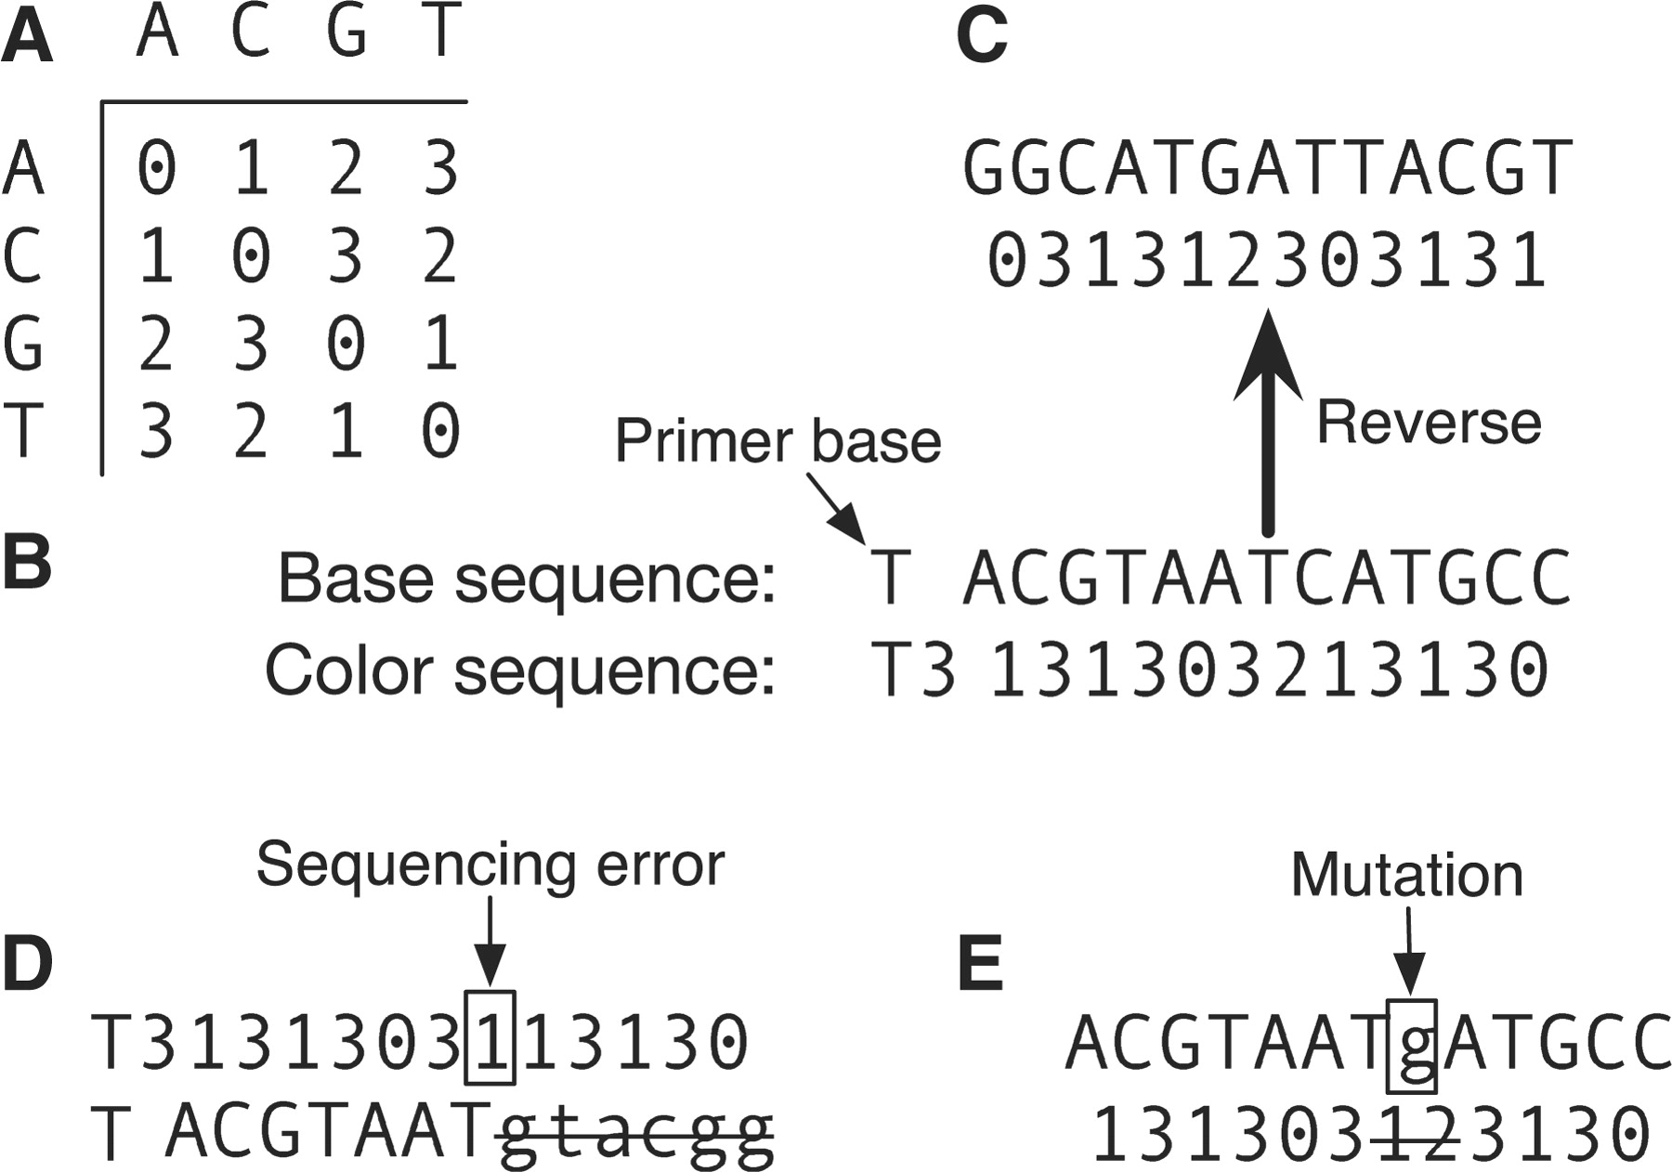
Figure 4: Color-space encoding. (A) Color space encoding matrix. (B) Conversion between base and color sequence. (C) ...
Notes:
Figure 4: Color-space encoding. (A) Color space encoding matrix. (B) Conversion between base and color sequence. (C) The color encoding of the reverse complement of the base sequence is the reverse of the color sequence. (D) A sequencing error leads to contiguous errors when the color sequence is converted to base sequence. (E) A mutation causes two contiguous color changes.
Unless provided in the caption above, the following copyright applies to the content of this slide: © The Author 2010. Published by Oxford University Press. For Permissions, please email: journals.permissions@oxfordjournals.org

Slide 5
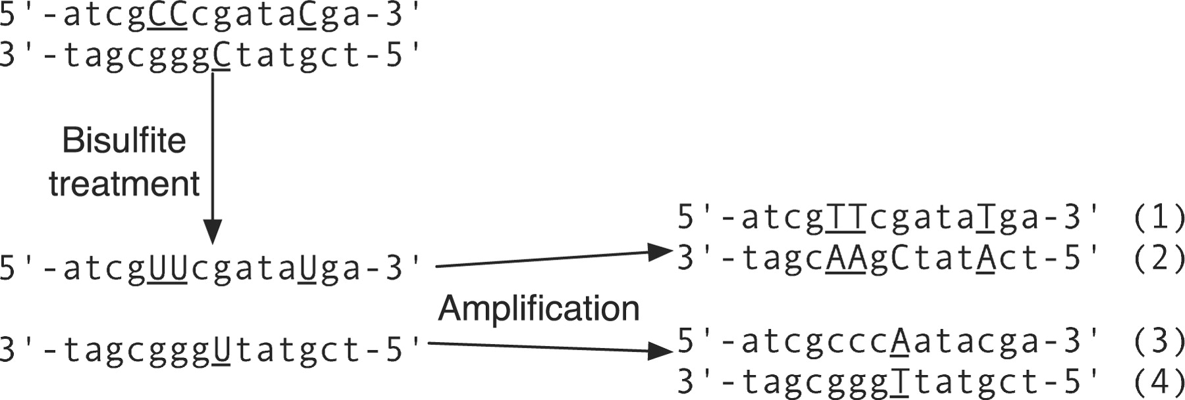
Figure 5: Bisulfite sequencing. Cytosines with underlines are not methylated. Denaturation and bisulfite treatment will ...
Notes:
Figure 5: Bisulfite sequencing. Cytosines with underlines are not methylated. Denaturation and bisulfite treatment will convert these cytosines to uracils. After amplification, four different sequences from the original double-strand DNA result.
Unless provided in the caption above, the following copyright applies to the content of this slide: © The Author 2010. Published by Oxford University Press. For Permissions, please email: journals.permissions@oxfordjournals.org

