Slide 1
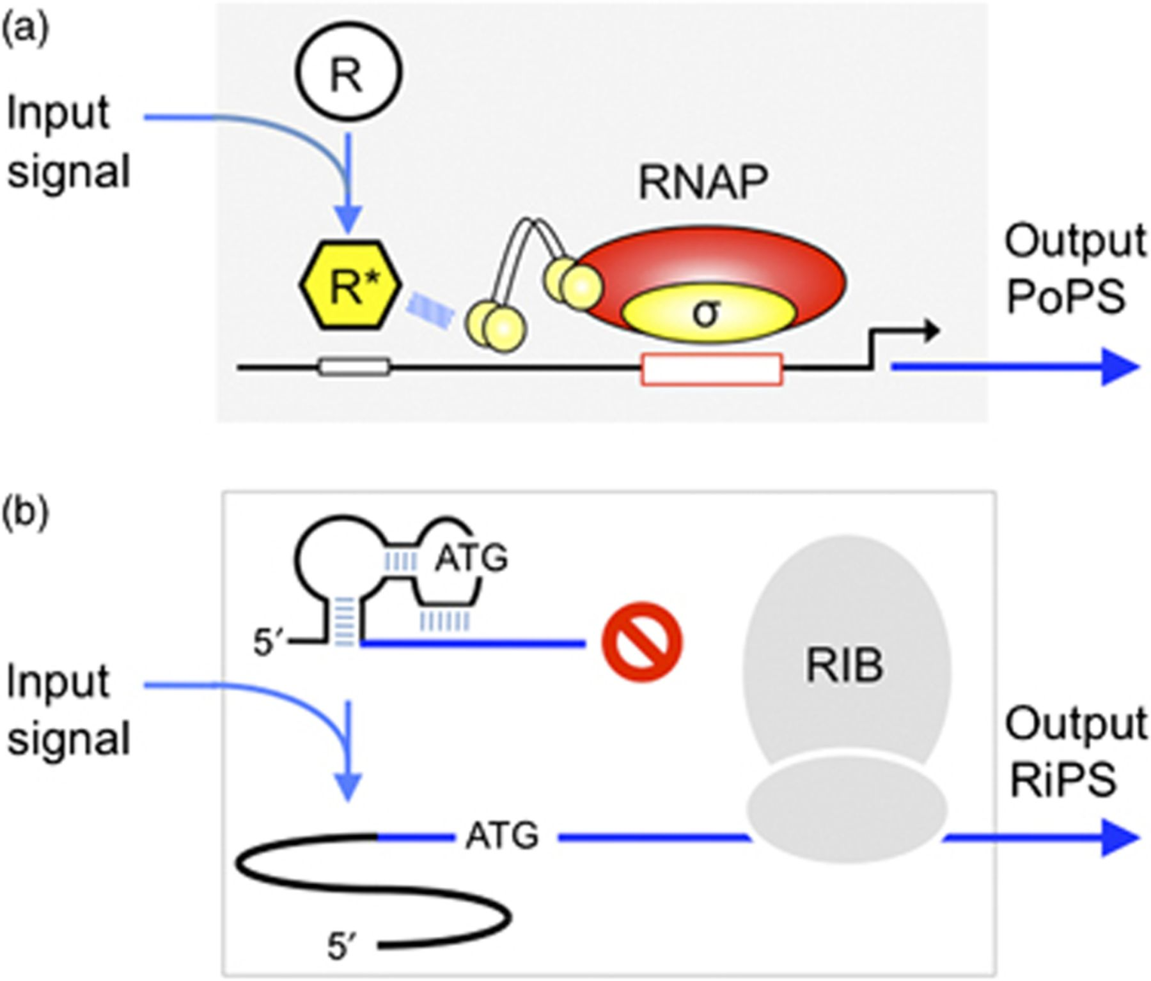
Figure 1 Mechanisms of signal transfer in regulatory nodes. (a) Transcriptional machineries. A given chemical or ...
Notes:
Figure 1 Mechanisms of signal transfer in regulatory nodes. (a) Transcriptional machineries. A given chemical or physical input regulates the activity of a distinct promoter by means of a transcriptional factor that affects the activity of the endogenous RNAP positively or negatively. The output in this case could be described as the number of times that RNAP proceeds with transcription beyond a point of no return [polymerase per second per promoter DNA (PoPS); http://syntheticbiology.org/Abstraction_hierarchy.html; see text]. This parameter can be indirectly measured using a reporter system (Canton et al., 2008; Kelly et al., 2009) and can also be examined using direct methods (Golding et al., 2005; Wang et al., 2009). (b) Riboswitches. Binding of small molecules or exposure to certain physical conditions (e.g. temperature) can change the secondary structure of the 5′ end of an mRNA. Such changes can affect the translation of the downstream gene through various mechanisms (see text). Riboswitches are often divided into two parts: an aptamer (which directly binds the small molecule or senses the signal otherwise) and the expression platform, which undergoes structural changes in response to shifts in the configuration of the aptamer, thereby regulating gene expression. The effect of the riboswitch is that it allows the ribosome to translate the target gene. The operative output is therefore the number of RiPS (ribosomes per second per mRNA molecule), which can be estimated as in the case of PoPS through direct and indirect methods (http://syntheticbiology.org/Abstraction_hierarchy.html). RIB, ribosome.
Unless provided in the caption above, the following copyright applies to the content of this slide: © 2010 Federation of European Microbiological Societies.

Slide 2
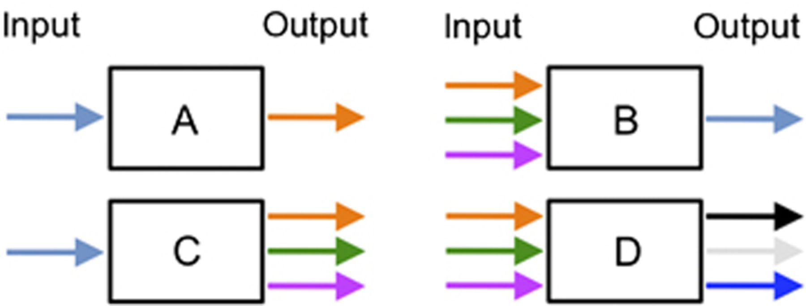
Figure 2 The four types of singular regulatory nodes. Most signal-transfer devices found in prokaryotic regulatory ...
Notes:
Figure 2 The four types of singular regulatory nodes. Most signal-transfer devices found in prokaryotic regulatory networks belong to one of the categories shown. In A, inputs and outputs are unique and therefore they are linked by a simple transfer function, which is direct in the case of activation or reverse in the case of inhibition. Promoters that are regulated by a single activator or repressor belong to this class. The case B is typical of signal integration instances, in which dissimilar inputs are computed into an eventual single output. This is often found in promoters that are subject to control by various transcriptional regulators and other physical (e.g. DNA bending) or chemical (coinducers) stimuli. In the mirror situation indicated in C, it is one signal that induces a large number of responses, as is the case in bacterial regulons, stimulons and sigmulons. Finally, various simultaneous inputs can result in a number of outputs (case D). This more complex scenario can frequently be revealed as a combination of simpler regulatory nodes A–C. Note that the effect of the inputs into the regulatory device can be positive or negative, thereby yielding a large number of combinatorial possibilities.
Unless provided in the caption above, the following copyright applies to the content of this slide: © 2010 Federation of European Microbiological Societies.

Slide 3
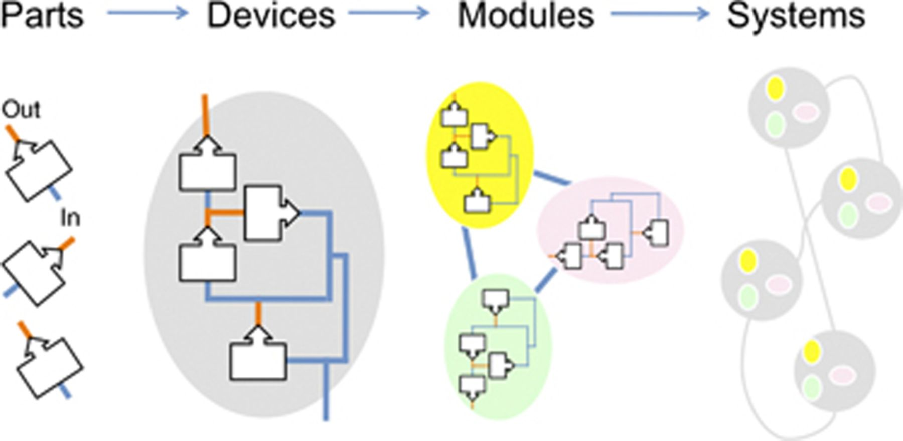
Figure 3 Abstraction hierarchy in the assembly of regulatory networks. Any biological object can be considered as the ...
Notes:
Figure 3 Abstraction hierarchy in the assembly of regulatory networks. Any biological object can be considered as the result of a progression of complexity resulting from the connection of simpler components. The simplest (parts) are those that bear one stand-alone biological activity (a promoter, an enzyme, a regulator) able to translate a defined input (a substrate, an environmental signal) into an output (a product, RNA, an enzyme, another regulator). If such an output can be interpreted as a signal by another biological component, then a combination of parts yields devices that can carry out simple computations of various inputs into one or more outputs (or vice versa). By the same token, modules can be formed that are able to run more complex and autonomous signal computation by merging various devices. Finally, entire consistent systems emerge by connecting modules (Andrianantoandro et al., 2006; Purnick & Weiss, 2009). Note that construction of biological complexity á la carte is at the core of Synthetic Biology, while deconstruction of extant complex biological objects into simpler pieces belongs to the essence of Systems Biology. Yet, both disciplines share the strong quantitative language of Physics and Engineering.
Unless provided in the caption above, the following copyright applies to the content of this slide: © 2010 Federation of European Microbiological Societies.

Slide 4
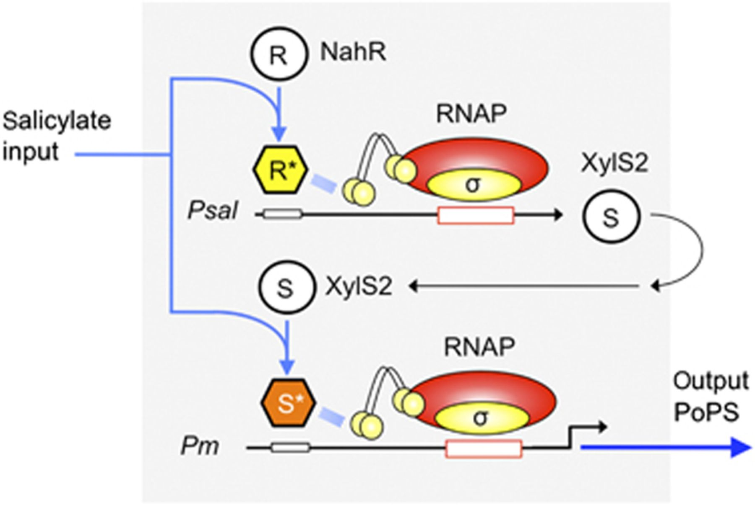
Figure 4 The NahR/XylS2 FFL. The scheme shows the first synthetic regulatory cascade for the amplification of gene ...
Notes:
Figure 4 The NahR/XylS2 FFL. The scheme shows the first synthetic regulatory cascade for the amplification of gene expression reported in the literature (Cebolla et al., 2001). The design included the salicylate-responsive activators NahR of and XylS2 from two Pseudomonas strains and their respective cognate promoters Psal and Pm. The expression of xylS2 was placed under the control of the nahR/Psal system. When cells encounter the common effector of the two regulators, both the increase in the XylS2 concentration and the stimulation of its activity with salicylate act synergistically on the Pm promoter (having PoPS as its output). This type of regulatory layout could be later classified and formalized as a FFL (Mangan & Alon, 2003).
Unless provided in the caption above, the following copyright applies to the content of this slide: © 2010 Federation of European Microbiological Societies.

Slide 5
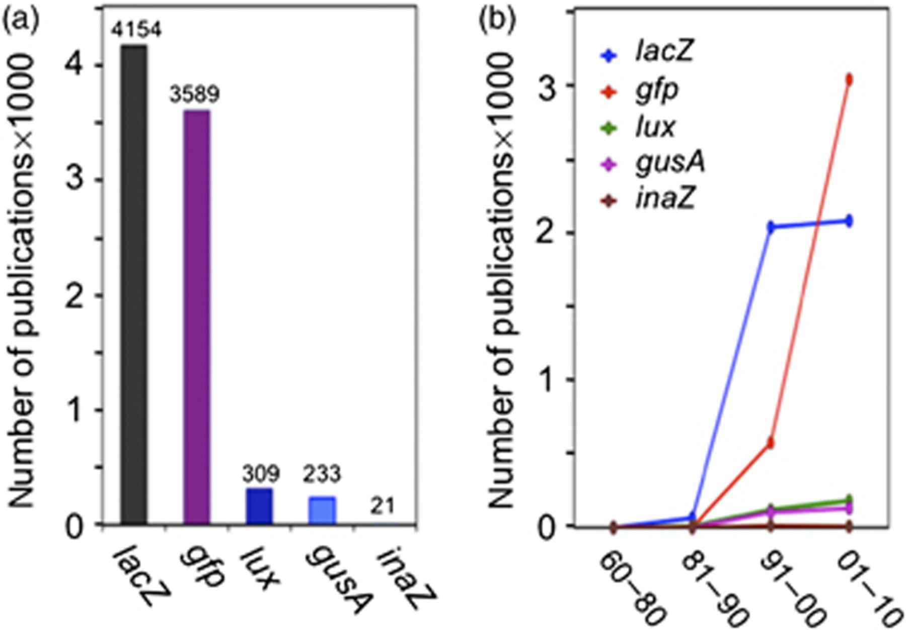
Figure 5 Evolution of the use of different reporter genes. The nonexhaustive surveys shown were conducted on the basis ...
Notes:
Figure 5 Evolution of the use of different reporter genes. The nonexhaustive surveys shown were conducted on the basis of information from PubMed (http://www.ncbi.nlm.nih.gov/sites/entrez) by March 4, 2010. (a) Scientific publications that mention the use of the various reporter genes in their abstracts. (b) Utilization of reporter genes in Molecular Biology and Molecular Genetics. The graph plots the (nonaccumulative) number of scientific publications in recent decades that include in their abstract the names of the reporters shown. Note the exponential trend of gfp as compared with other common reporters.
Unless provided in the caption above, the following copyright applies to the content of this slide: © 2010 Federation of European Microbiological Societies.

