Slide 1
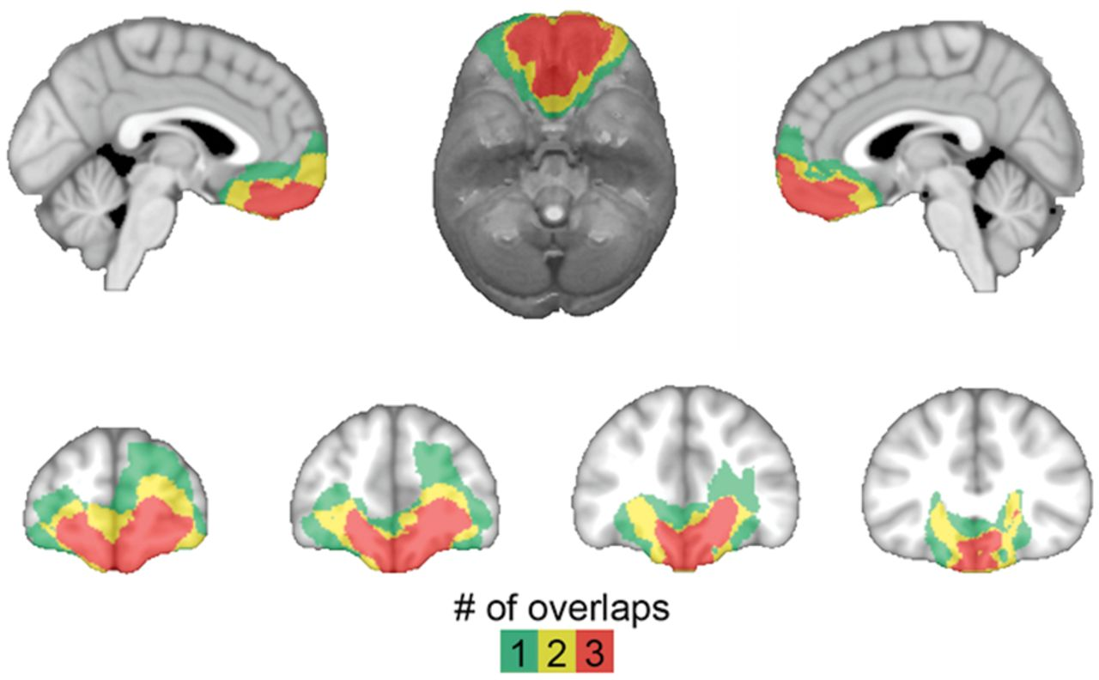
Figure 1 Lesion overlap of ventromedial PFC patients. Colour indicates the number of overlapping lesions at each ...
Notes:
Figure 1 Lesion overlap of ventromedial PFC patients. Colour indicates the number of overlapping lesions at each voxel.
Unless provided in the caption above, the following copyright applies to the content of this slide: © The Author (2014). Published by Oxford University Press on behalf of the Guarantors of Brain. All rights reserved. For Permissions, please email: journals.permissions@oup.com

Slide 2
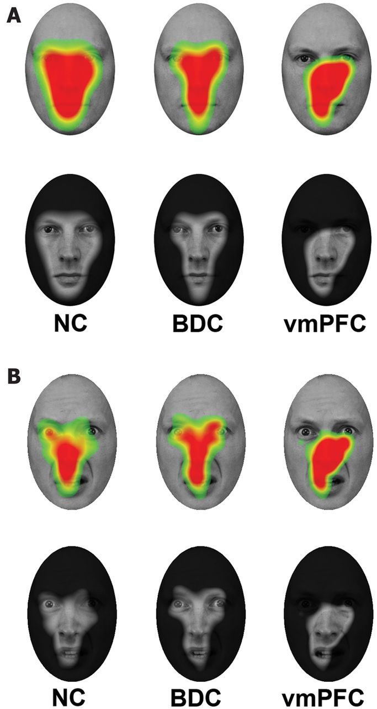
Figure 2 Fixation density maps. (A) Warmer colours (upper row) and transparent regions (lower row) show where fixation ...
Notes:
Figure 2 Fixation density maps. (A) Warmer colours (upper row) and transparent regions (lower row) show where fixation density was greatest across all trials for normal comparison (NC), brain-damaged comparison (BDC), and ventromedial PFC (vmPFC) groups, respectively, superimposed on one of the neutral face stimuli. All groups made similar rates of fixations to the nose and mouth regions, whereas normal comparison and brain-damaged comparison groups fixated more heavily on the eye region than did the ventromedial PFC group. (B) Warmer colours (upper row) and transparent regions (lower row) show where fixation density was greatest when viewing fearful faces for normal comparison, brain-damaged comparison, and ventromedial PFC groups, respectively.
Unless provided in the caption above, the following copyright applies to the content of this slide: © The Author (2014). Published by Oxford University Press on behalf of the Guarantors of Brain. All rights reserved. For Permissions, please email: journals.permissions@oup.com

Slide 3
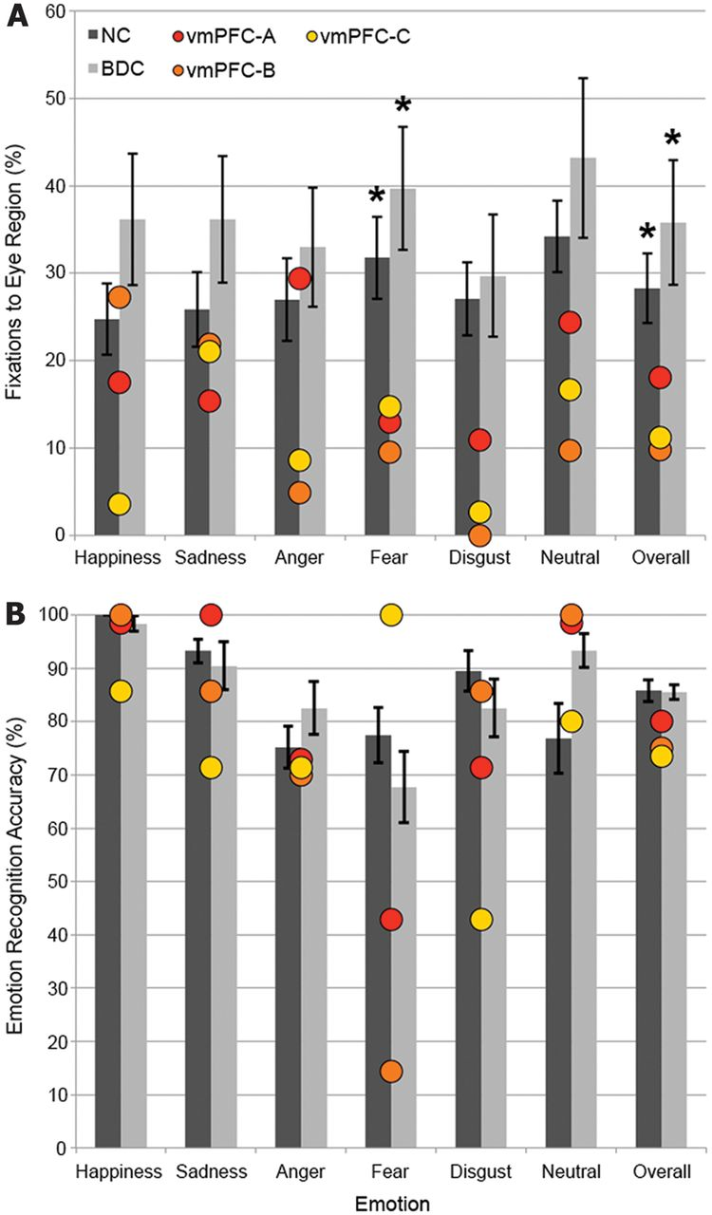
Figure 3 Eye tracking and emotion recognition results. (A) Percentage of fixations to the eye area of faces, with ...
Notes:
Figure 3 Eye tracking and emotion recognition results. (A) Percentage of fixations to the eye area of faces, with ventromedial PFC (vmPFC) patients plotted individually. Red: vmPFC-A, orange: vmPFC-B, yellow: vmPFC-C. (B) Emotion recognition accuracy, with ventromedial PFC patients plotted individually. Error bars indicate standard error of the mean. Differences from ventromedial PFC group: *P < 0.05. NC = normal comparison; BDC = brain-damaged comparison.
Unless provided in the caption above, the following copyright applies to the content of this slide: © The Author (2014). Published by Oxford University Press on behalf of the Guarantors of Brain. All rights reserved. For Permissions, please email: journals.permissions@oup.com

Slide 4
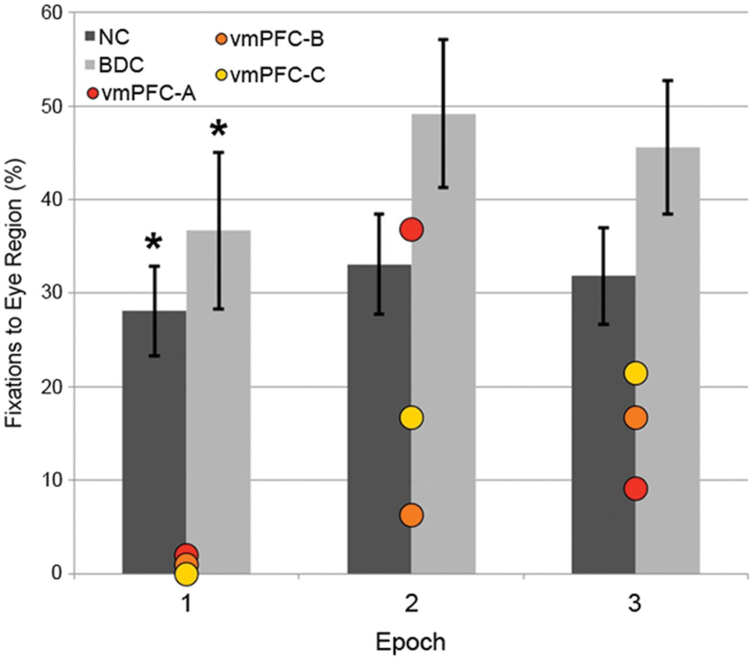
Figure 4 Eye tracking results in 1-s time bins. Percentage of fixations to the eye area of fearful faces during each ...
Notes:
Figure 4 Eye tracking results in 1-s time bins. Percentage of fixations to the eye area of fearful faces during each 1-s epoch of the trial, with ventromedial PFC (vmPFC) patients plotted individually. Red: vmPFC-A, orange: vmPFC-B, yellow: vmPFC-C. Error bars indicate standard error of the mean. Differences from ventromedial PFC group: *P < 0.05. BDC = brain-damaged comparison.
Unless provided in the caption above, the following copyright applies to the content of this slide: © The Author (2014). Published by Oxford University Press on behalf of the Guarantors of Brain. All rights reserved. For Permissions, please email: journals.permissions@oup.com

