Slide 1
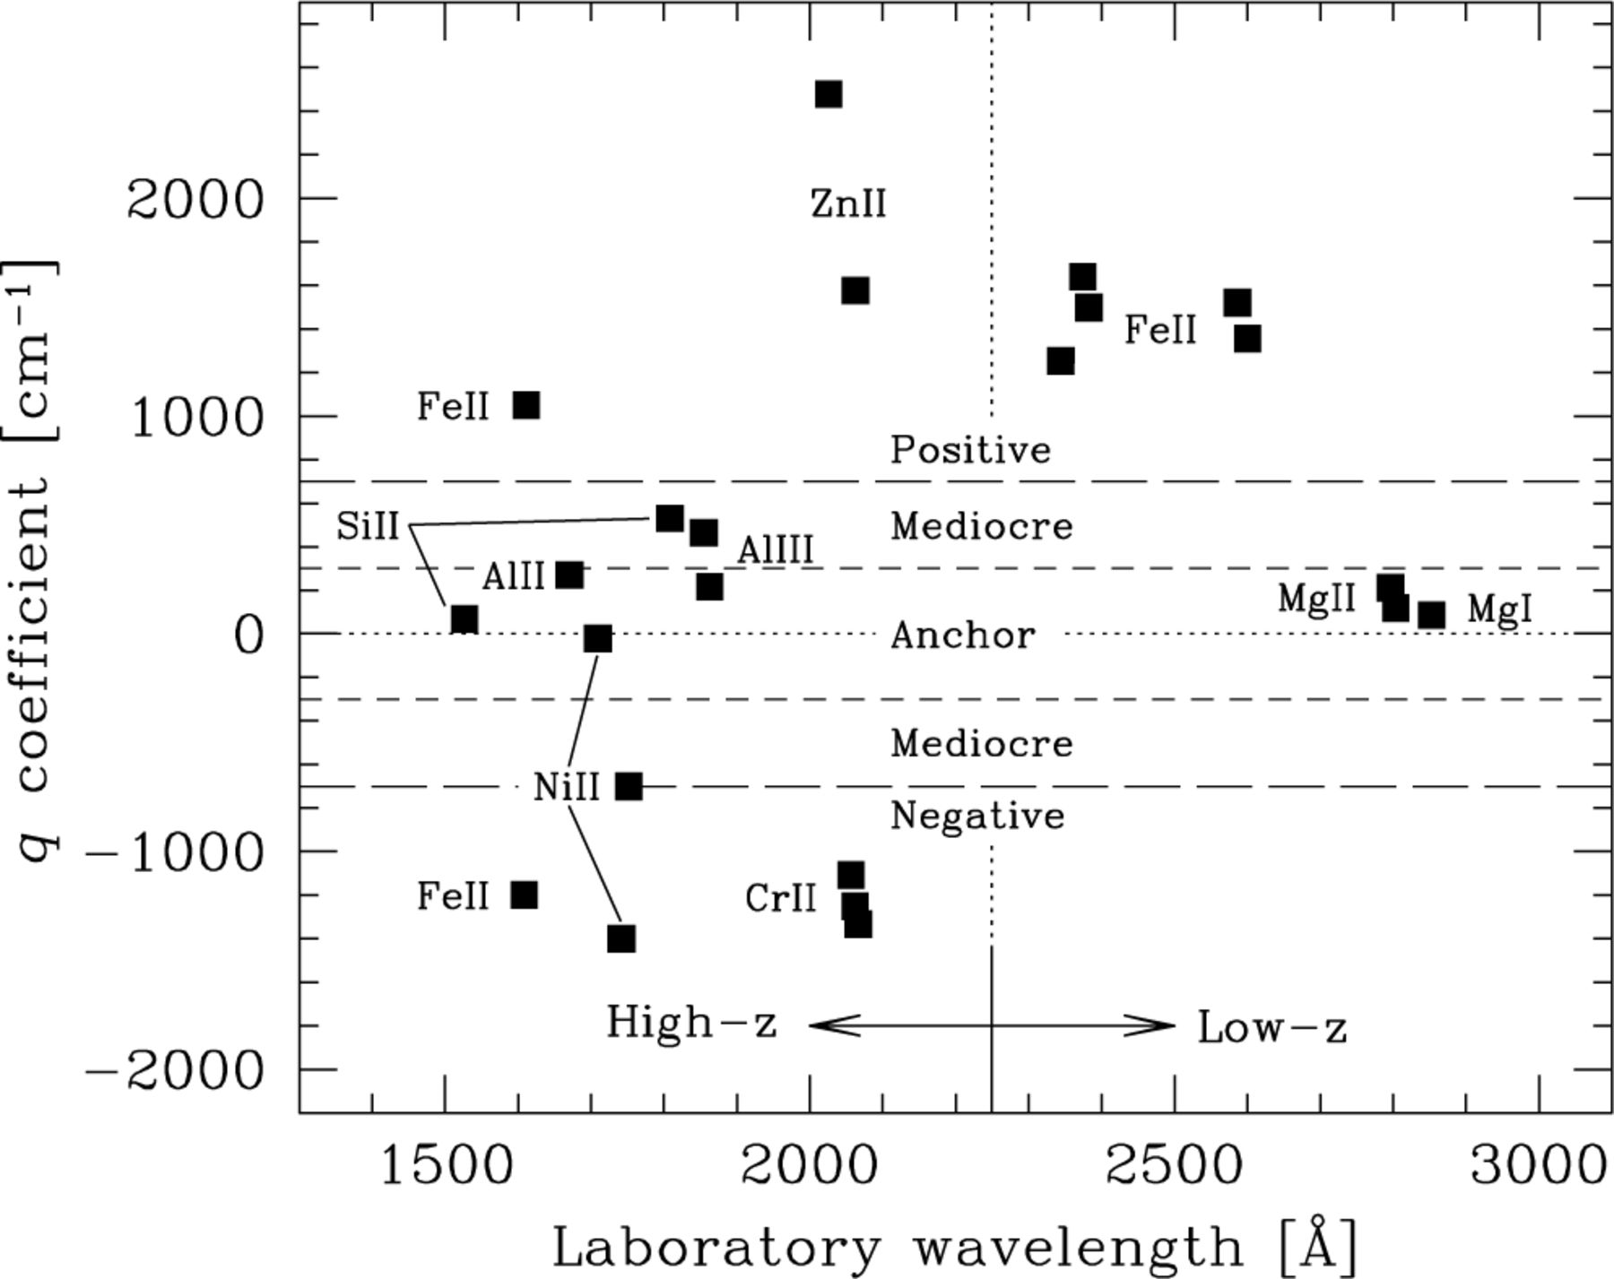
Figure 1. The distribution of q coefficients in (rest) wavelength space for the low- and high-z samples. Note the ...
Notes:
Figure 1. The distribution of q coefficients in (rest) wavelength space for the low- and high-z samples. Note the simple arrangement for the low-z Mg/Fe ii systems: the Mg transitions are used as anchors against which the large, positive shifts in the Fe ii transitions can be measured. Compare this with the complex arrangement for the high-z systems: low-order distortions of the wavelength scale will have a varied and complex effect on Δα/α depending on which transitions are fitted in a given absorption system. In general, the complexity at high z will yield more robust values of Δα/α. For the discussion in Sections 5.7.2 and 5.7.3 we define several different ‘q-types’ as follows: positive-shifters (q≥ 700 cm−1), negative-shifters (q≤−700 cm−1), anchors (|q| < 300 cm−1) and mediocre-shifters (300 ≤|q| < 700 cm−1).
Unless provided in the caption above, the following copyright applies to the content of this slide: © 2003 RAS

Slide 2
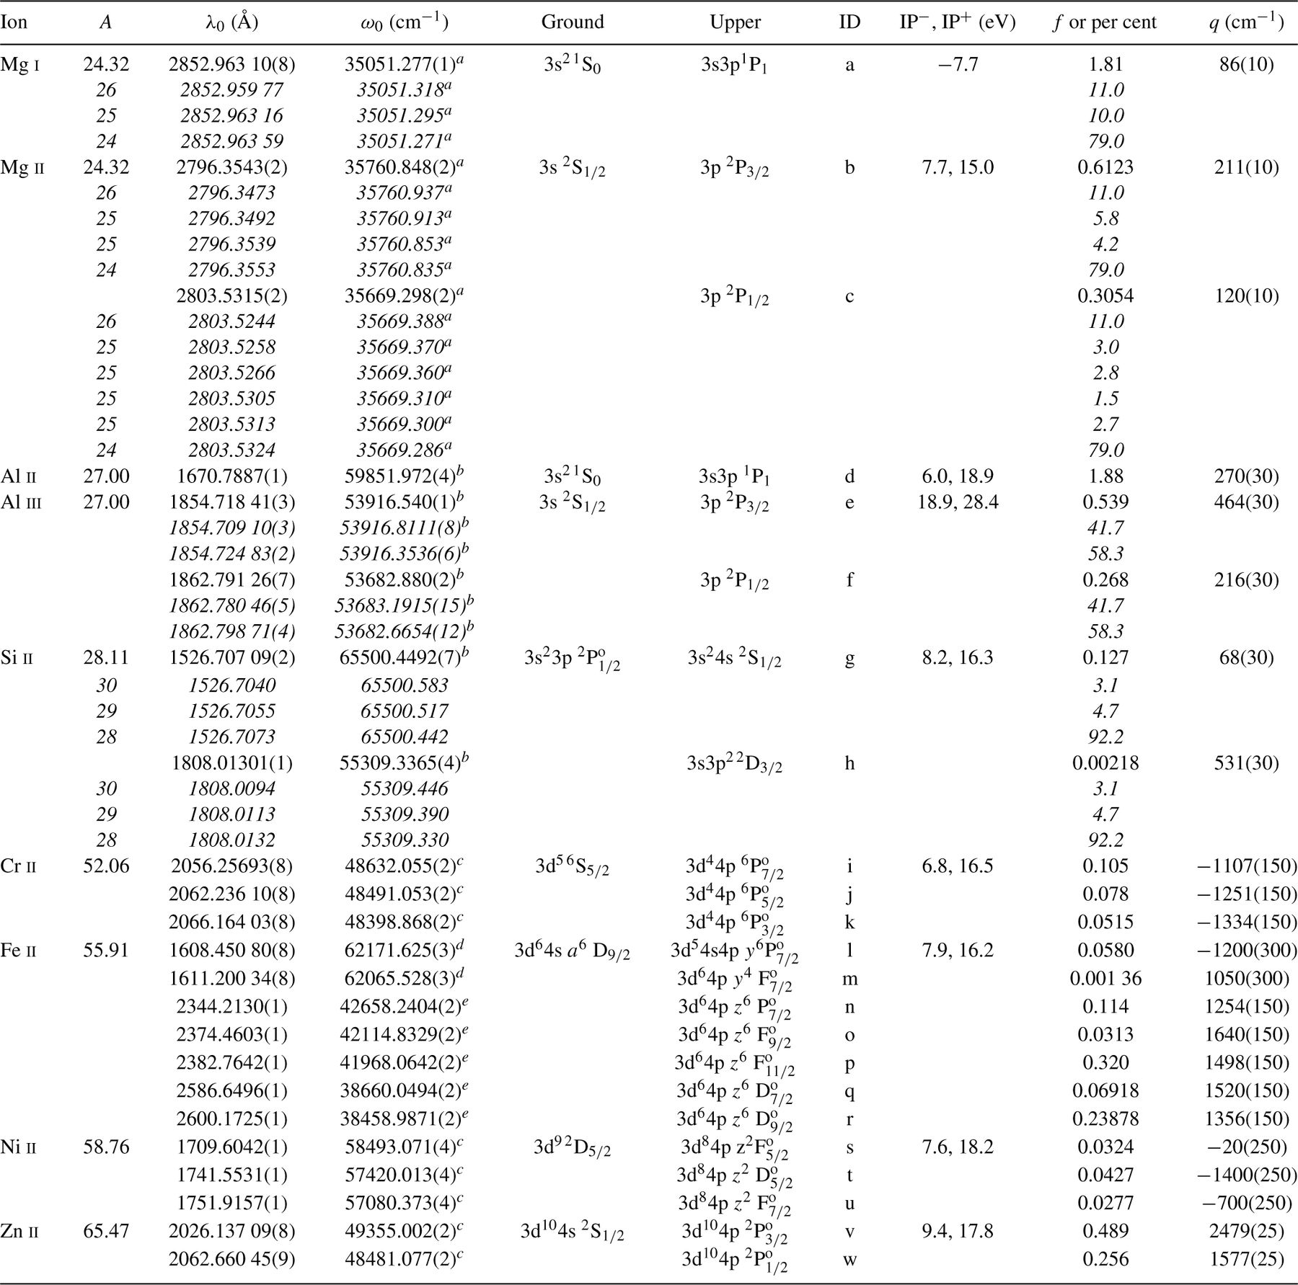
Table 2. Atomic data for the MM transitions in our analysis. Information for isotopic and hyperfine components is ...
Notes:
Table 2. Atomic data for the MM transitions in our analysis. Information for isotopic and hyperfine components is given in italics. Column 2 shows the mass number, A, for each species. The origin of the laboratory wavenumbers (?0) and wavelengths (?0) is summarized in M01a. Columns 5 and 6 show the updated ground and excited state electronic configurations. The ID letters in column 7 are used in Table 3 to indicate the transitions used in our fits to each absorption system. Column 8 shows the ionization potential for the relevant ion, IP+, and for the ion with a unit lower charge, IP−. Column 9 shows the oscillator strengths, ƒ, from the DLA data base4 of Prochaska et al. (2001) or the relative strengths of the isotopic (Rosman & Taylor 1998) or hyperfine components (italics). The q coefficients are from Dzuba et al. (1999a, b, 2001b. 2002) and the uncertainties are discussed in the text. The Si ii, Al ii and Al iii wavenumbers have been scaled from their literature values due to the Norlén/Whaling et al. calibration difference.
Unless provided in the caption above, the following copyright applies to the content of this slide: © 2003 RAS

Slide 3
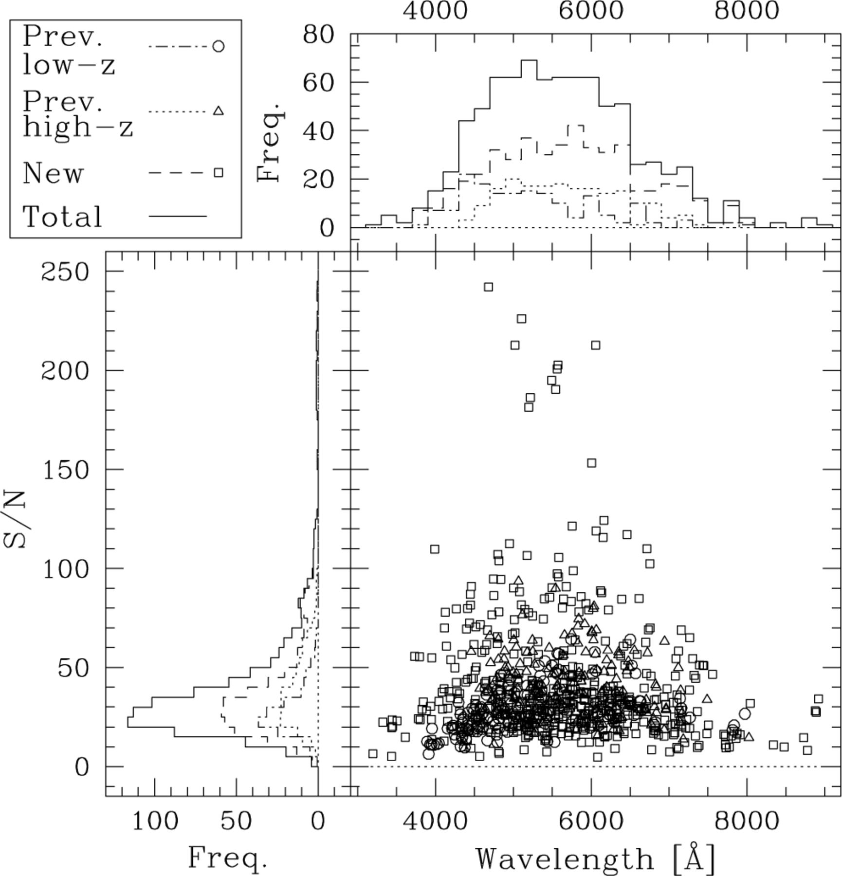
Figure 2. The distribution of S/N ratio and central wavelength for the spectral regions of interest in the previous ...
Notes:
Figure 2. The distribution of S/N ratio and central wavelength for the spectral regions of interest in the previous low-z, previous high-z and new samples.
Unless provided in the caption above, the following copyright applies to the content of this slide: © 2003 RAS

Slide 4
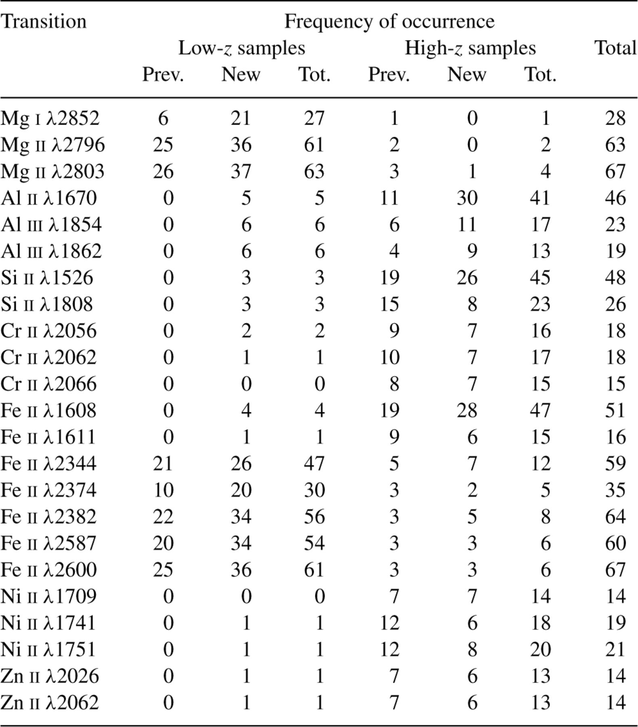
Table 1. The frequency of occurrence for each transition in the different samples of QSO absorbers. For the new ...
Notes:
Table 1. The frequency of occurrence for each transition in the different samples of QSO absorbers. For the new sample, we define low-z as zabs < 1.8 and high-z as zabs > 1.8. The previous low-z sample adheres to this definition but the previous high-z sample does contain three low-z systems. The low-z samples are dominated by the Mg/Fe ii transitions. The high-z systems contain a diverse range of transitions and species but the strong Si ii?1526, Al ii?1670 and Fe ii?1608 transitions are the most common.
Unless provided in the caption above, the following copyright applies to the content of this slide: © 2003 RAS

Slide 5
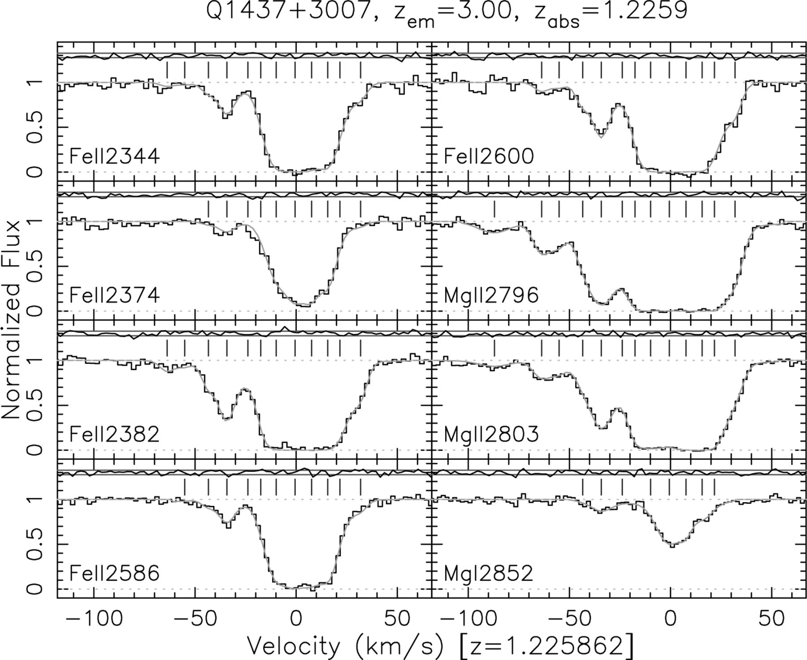
Figure 3. Mg/Fe ii absorption system towards Q1437+3007 at z_{abs}= 1.2259. The data have been normalized by a ...
Notes:
Figure 3. Mg/Fe ii absorption system towards Q1437+3007 at zabs= 1.2259. The data have been normalized by a fit to the continuum and plotted as a histogram. Our Voigt profile fit (solid curve) and the residuals (i.e. [data]–[fit]), normalized to the 1σ errors (horizontal solid lines), are also shown. The tick marks above the continuum indicate individual velocity components. Note the range of linestrengths in Fe ii, facilitating determination of the velocity structure. The large number of Fe ii transitions and the large number of velocity components allows for tight constraints to be placed on Δα/α. The Mg iλ2852 and Fe iiλ2374 transitions allow Δα/α to be constrained by the velocity ≈0 km s−1 components, whereas the Mg ii and remaining Fe ii transitions constrain Δα/α with the velocity ≈−35 km s−1 component. This figure is available in colour in the online version of the journal on Synergy.
Unless provided in the caption above, the following copyright applies to the content of this slide: © 2003 RAS

Slide 6
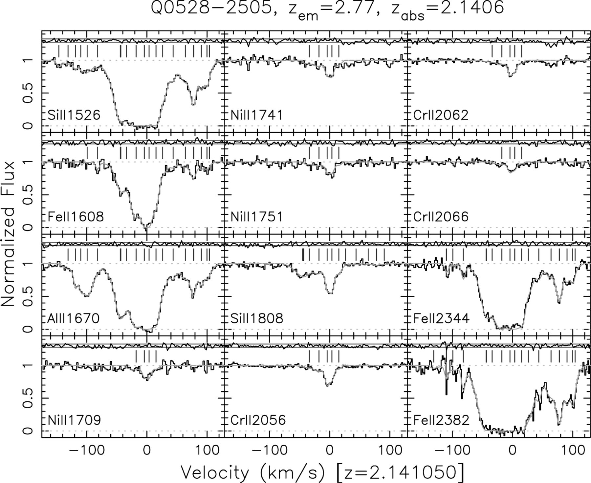
Figure 4. Heavy element absorption lines in the damped Lyman-α system towards Q0528−2505 at z_{abs}= 2.1406. ...
Notes:
Figure 4. Heavy element absorption lines in the damped Lyman-α system towards Q0528−2505 at zabs= 2.1406. The data have been normalized by a fit to the continuum and plotted as a histogram. Our Voigt profile fit (solid curve) and the residuals (i.e. [data]–[fit]), normalized to the 1σ errors (horizontal solid lines), are also shown. The tick marks above the continuum indicate individual velocity components. Note the large range in linestrengths for the different transitions. The velocity structure is well-constrained by Si iiλ1526, Al iiλ1670 and Fe iiλ1608, while the Ni ii and Cr ii transitions are strong enough to constrain Δα/α with the velocity ≈0 km s−1 components. This system is at low enough redshift for the Fe iiλλ2344, 2382 transitions to be detected. These combine with Si iiλ1526, Al iiλ1670 and Fe iiλ1608 to constrain Δα/α with the components at velocity ≈80 km s−1. This figure is available in colour in the online version of the journal on Synergy.
Unless provided in the caption above, the following copyright applies to the content of this slide: © 2003 RAS

Slide 7
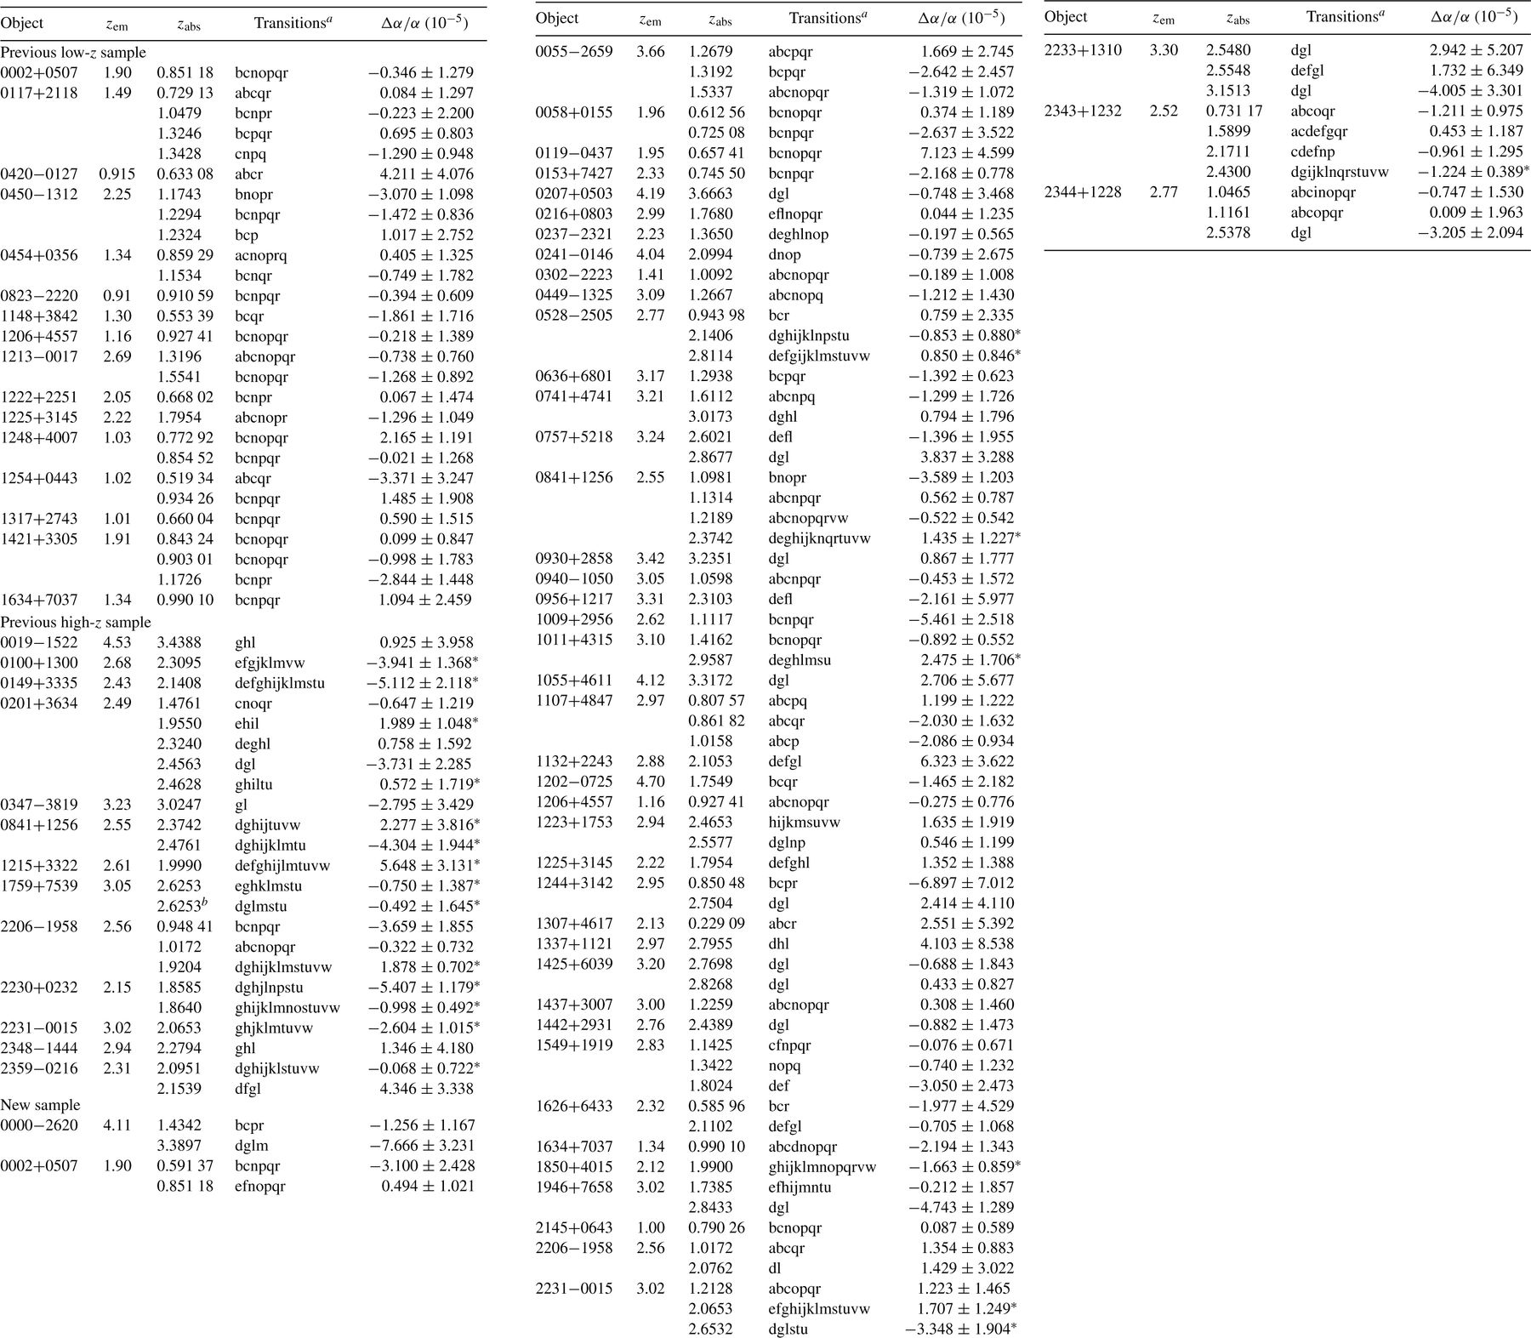
Table 3. The raw results from the ?² minimization procedure. For each absorption system we list the QSO ...
Notes:
Table 3. The raw results from the ?2 minimization procedure. For each absorption system we list the QSO emission redshift, zem, the nominal absorption system redshift, zabs, the transitions fitted and the value of ?a/a with associated 1s statistical error. A ‘*’ after ?a/a indicates systems included in the ‘high-contrast’ sample. An additional random error of 2.09 × 10−5 should be added in quadrature to these systems to form the fiducial sample (see Section 4.2).
Unless provided in the caption above, the following copyright applies to the content of this slide: © 2003 RAS

Slide 8
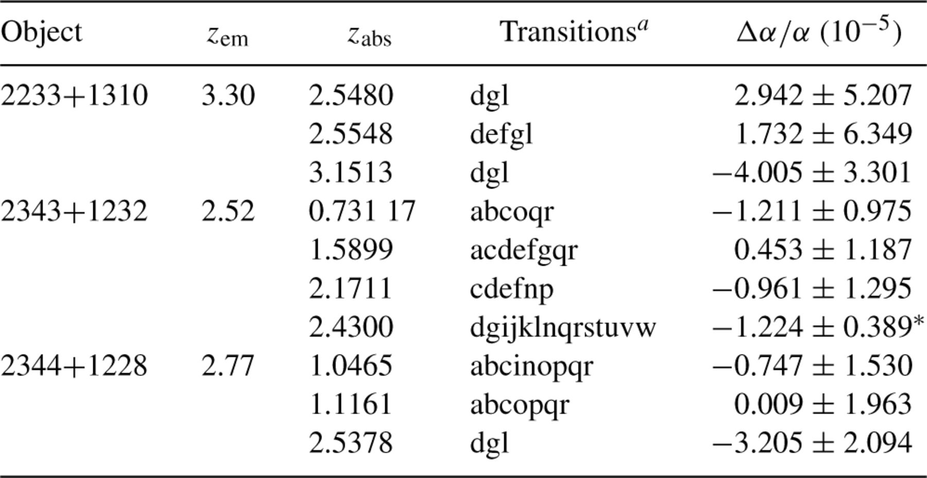
Table 4. Statistics for the raw QSO results and tests for systematic errors. The previous samples are described in ...
Notes:
Table 4. Statistics for the raw QSO results and tests for systematic errors. The previous samples are described in Section 2.1.1. For the new and total samples, ‘low-z’ means zabs < 1.8 and ‘high-z’ means zabs > 1.8. For each sample, < zabs > is the mean absorption redshift, Nabs is the number of absorption systems, 〈?a/a〉w is the weighted mean, 〈?a/a〉 is the unweighted mean, S0 is the significance of the weighted mean (with respect to zero), rms is the root-mean-square deviation from the mean, 〈d(?a/a)〉 is the mean 1s error and ?2? is ?2 per degree of freedom usingw as the model.
Unless provided in the caption above, the following copyright applies to the content of this slide: © 2003 RAS

Slide 9
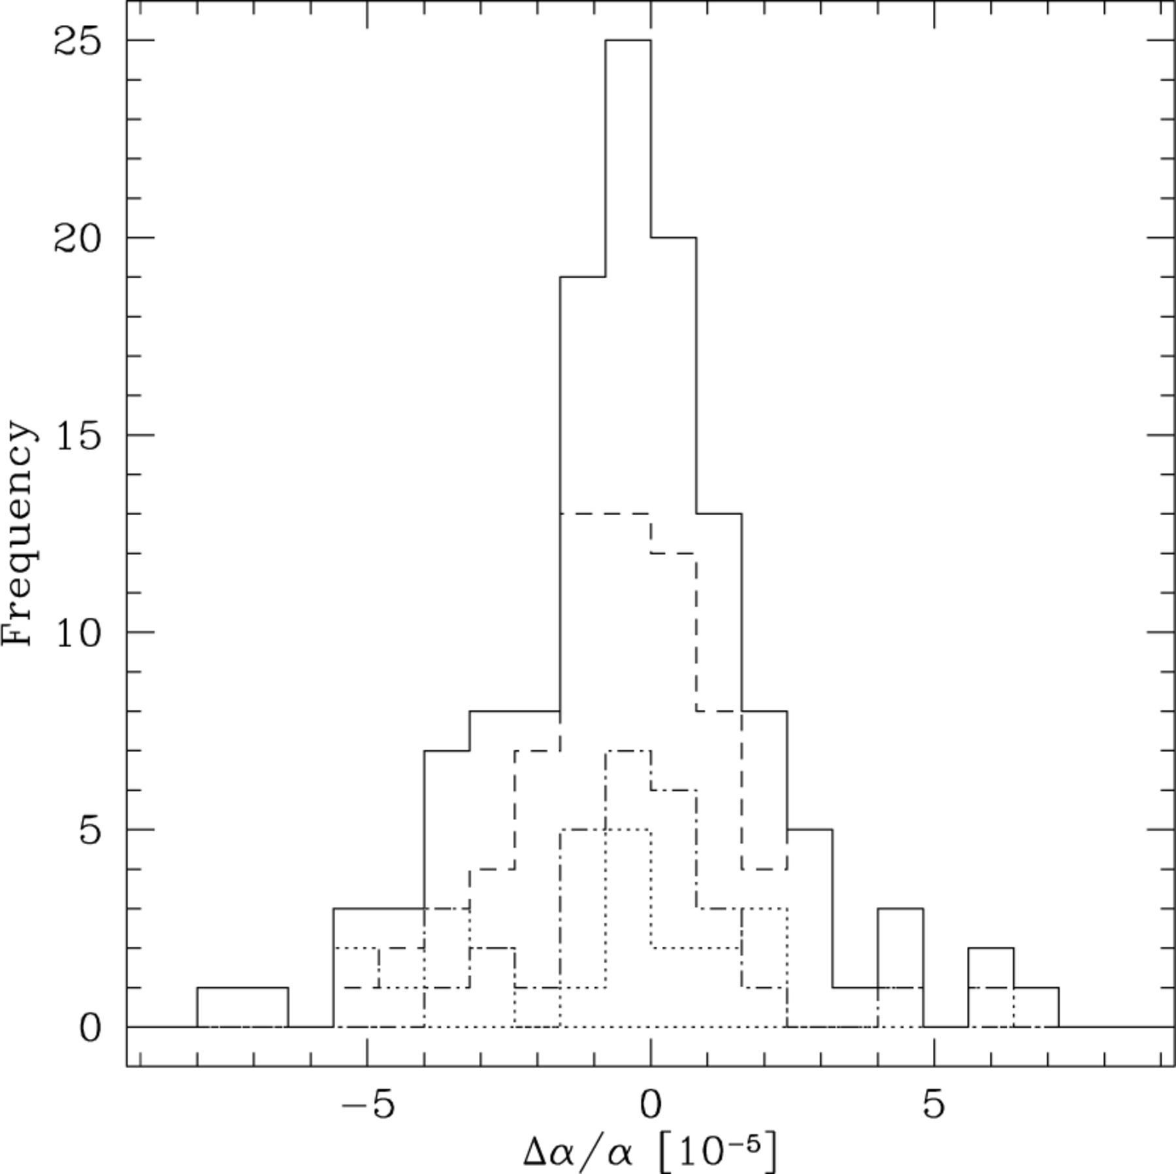
Figure 5. Histograms of raw results from Table 3. The distribution of Δα/α for the previous low-z (dot-dashed line), ...
Notes:
Figure 5. Histograms of raw results from Table 3. The distribution of Δα/α for the previous low-z (dot-dashed line), previous high-z (dotted line) and new (dashed line) samples are shown together with the overall distribution (solid line, binned differently in Fig. 15a).
Unless provided in the caption above, the following copyright applies to the content of this slide: © 2003 RAS

Slide 10
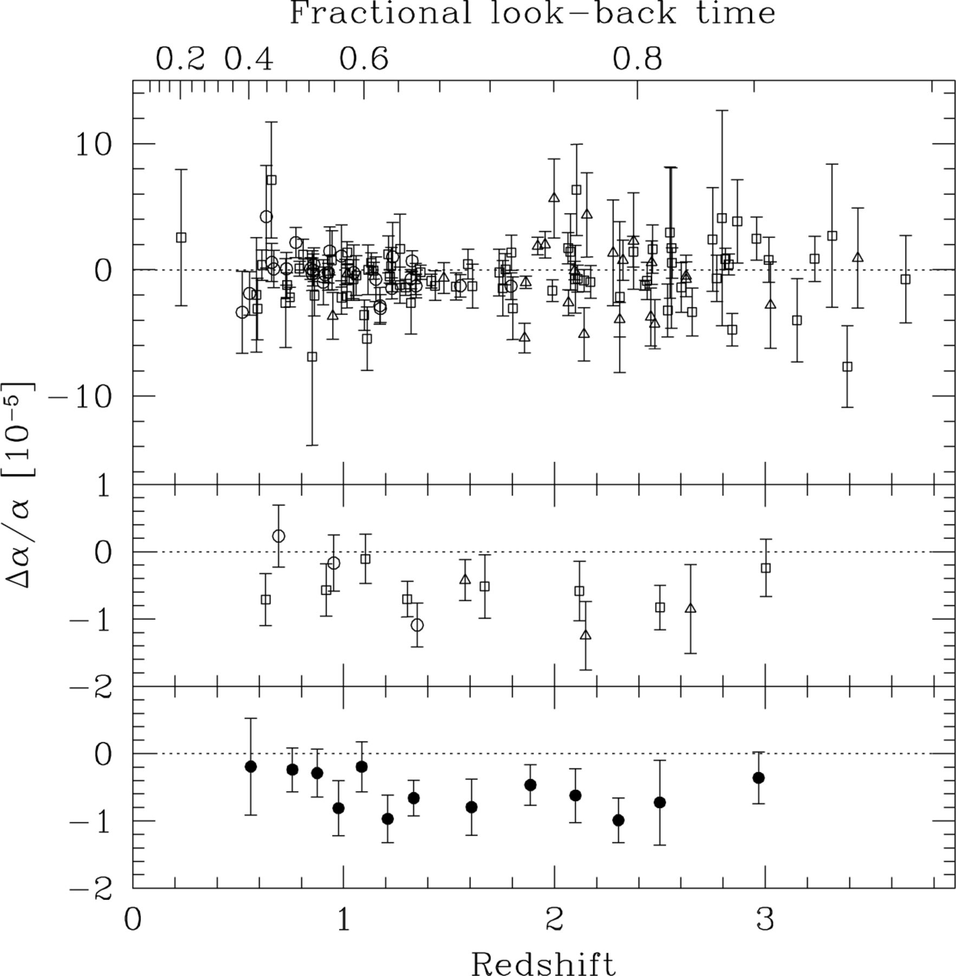
Figure 6. Δα/α versus absorption redshift for the previous low-z (open circles), previous high-z (open triangles) and ...
Notes:
Figure 6. Δα/α versus absorption redshift for the previous low-z (open circles), previous high-z (open triangles) and new (open squares) samples. The upper panel shows the raw results and 1σ error bars. The middle panel shows an arbitrary binning of each sample and the lower panel combines all three samples. The redshifts of the binned points are taken as the mean absorption redshift within each bin and the value of Δα/α is the weighted mean with its associated 1σ error bar. The upper scale is the look-back time to the absorber as a fraction of the age of the Universe (H0= 70 km s−1 Mpc−1, Ωm= 0.3, ΩΛ= 0.7 →t0= 13.47 Gyr).
Unless provided in the caption above, the following copyright applies to the content of this slide: © 2003 RAS

Slide 11
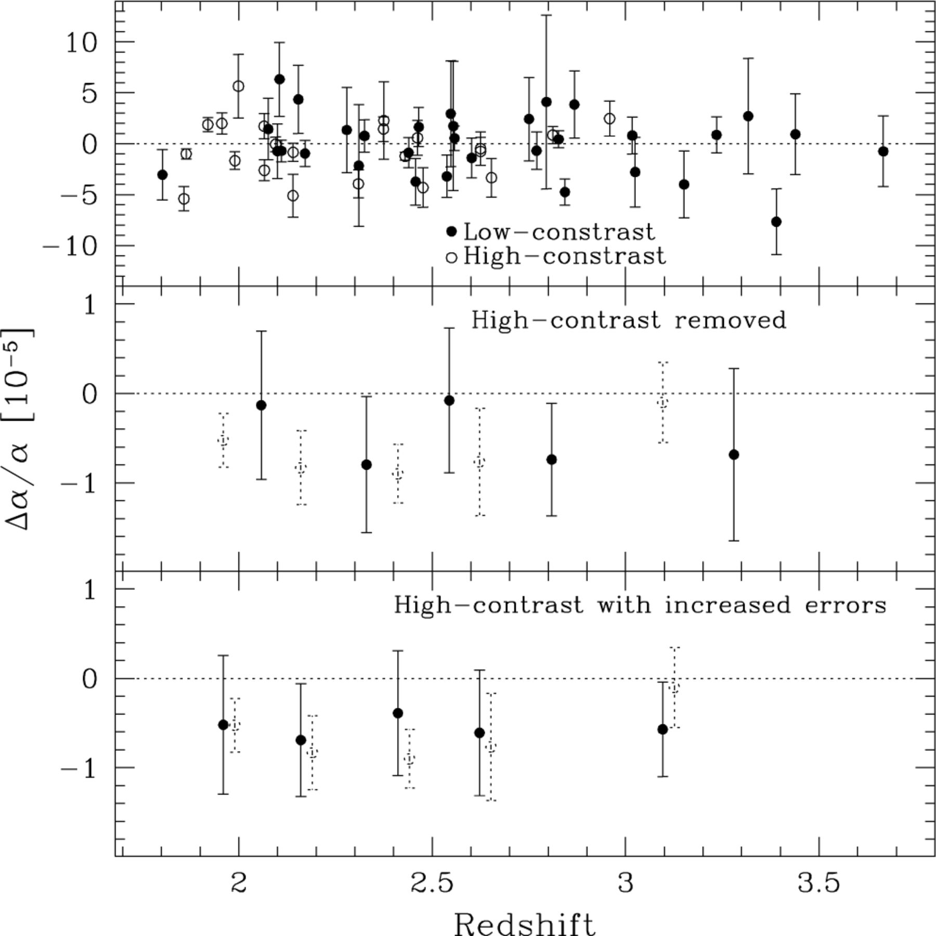
Figure 7. Reducing the extra scatter at high z. The upper panel identifies the ‘high-contrast’ systems, i.e. where any ...
Notes:
Figure 7. Reducing the extra scatter at high z. The upper panel identifies the ‘high-contrast’ systems, i.e. where any of the strong Al ii, Si ii or Feii transitions and any of the weak Cr ii, Ni ii or Zn ii transitions are fitted. These systems are expected to exhibit additional scatter. In the middle panel the high-contrast systems are removed and the binned low-contrast values (solid circles) are compared with the raw values (dotted open circles). In the lower panel the high-contrast error bars have been increased by adding 2.09 × 10−5 in quadrature to the raw errors to match the observed additional scatter. The solid circles are binned values which include the (unaltered) low-contrast systems.
Unless provided in the caption above, the following copyright applies to the content of this slide: © 2003 RAS

Slide 12
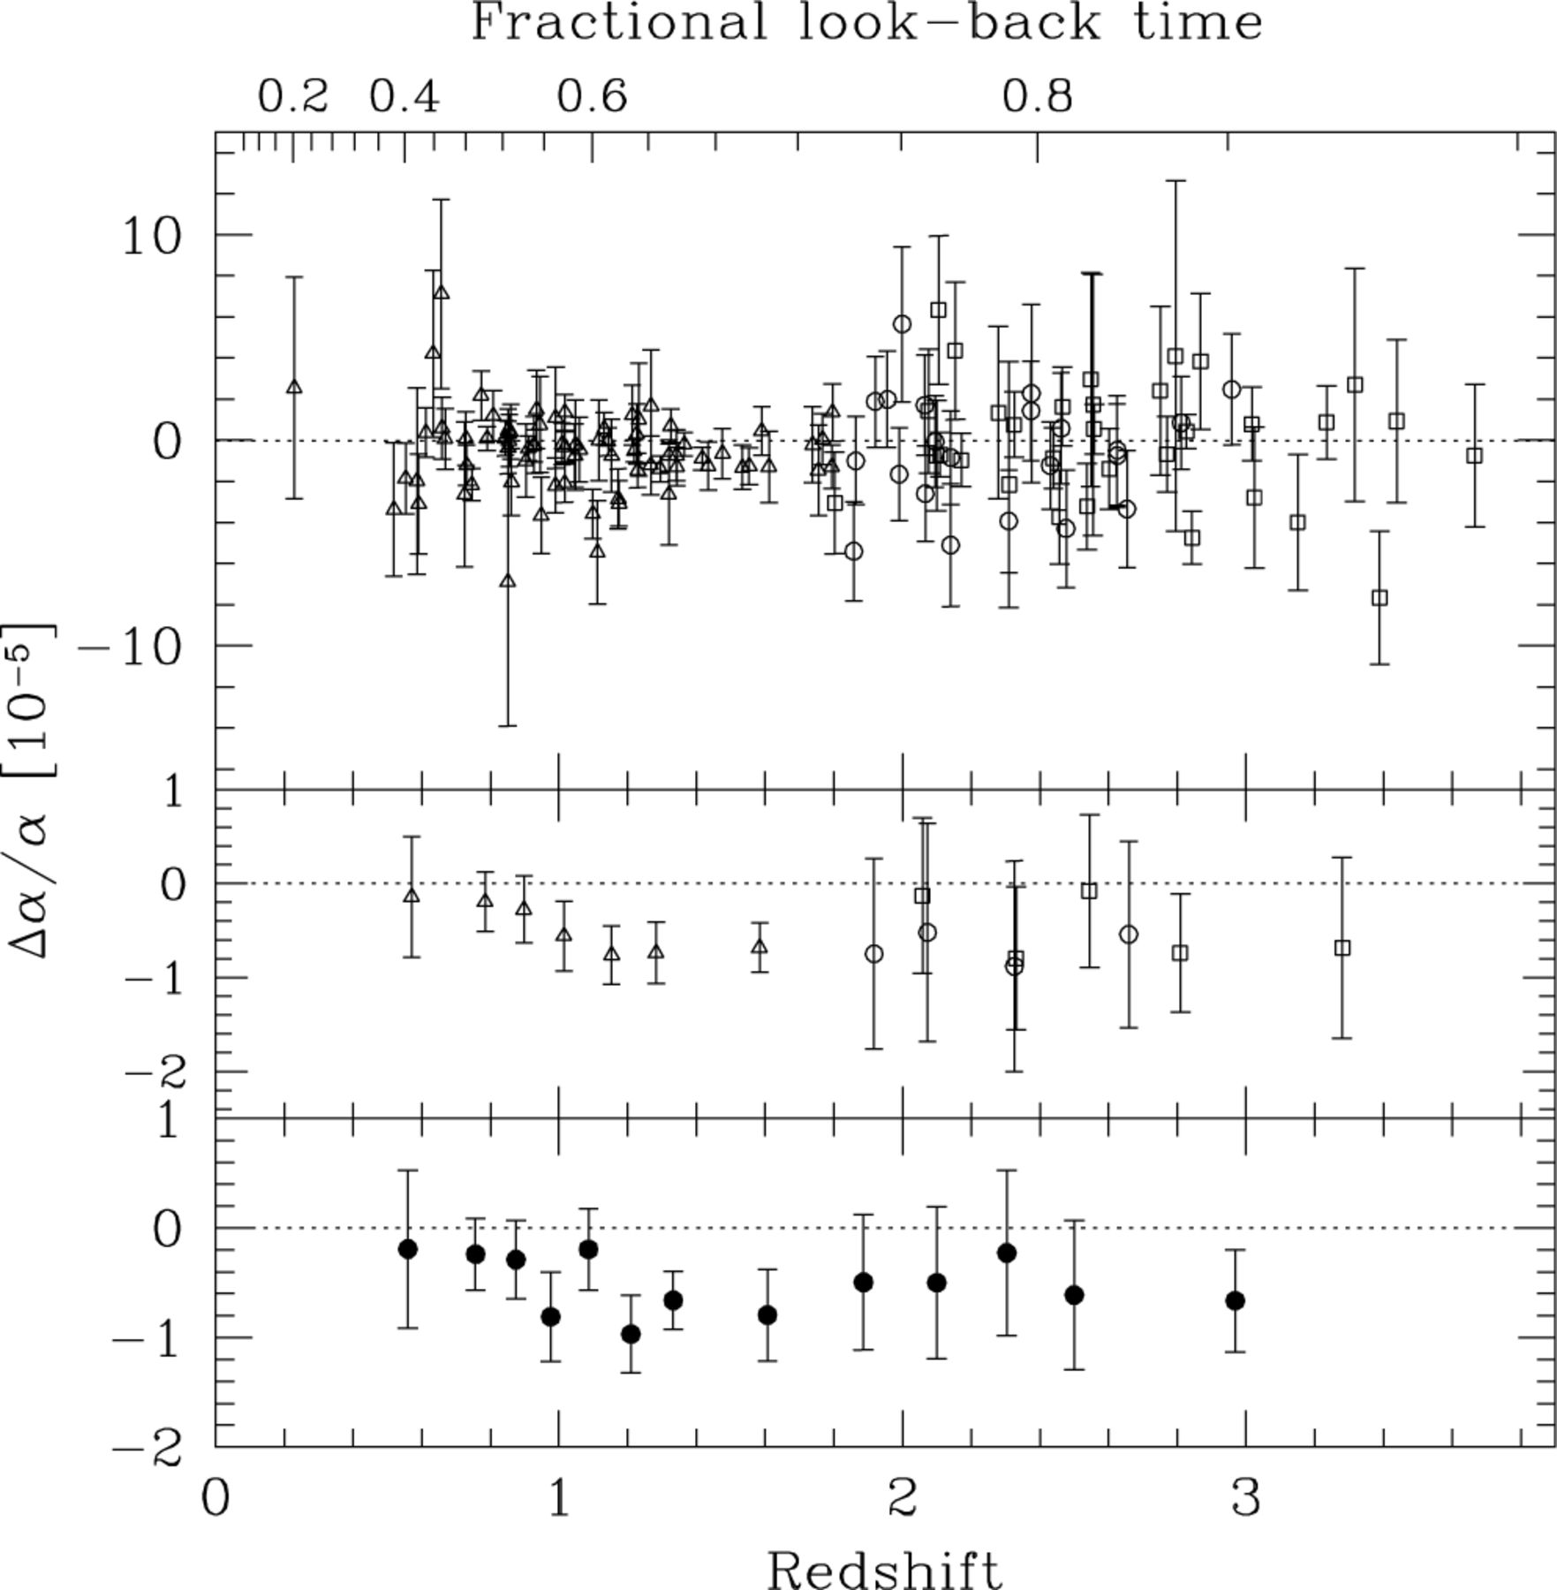
Figure 8. The fiducial sample. The upper panel shows the raw low-z results (solid triangles), the raw values for the ...
Notes:
Figure 8. The fiducial sample. The upper panel shows the raw low-z results (solid triangles), the raw values for the low-contrast sample (open squares) and the high-contrast sample with increased error bars (open circles). The middle panel shows a binning of each sample taken separately while the lower panel bins all samples together. The weighted mean for this fiducial sample is Δα/α= (−0.543 ± 0.116) × 10−5 and is our most robust estimate of Δα/α from the QSO data.
Unless provided in the caption above, the following copyright applies to the content of this slide: © 2003 RAS

Slide 13
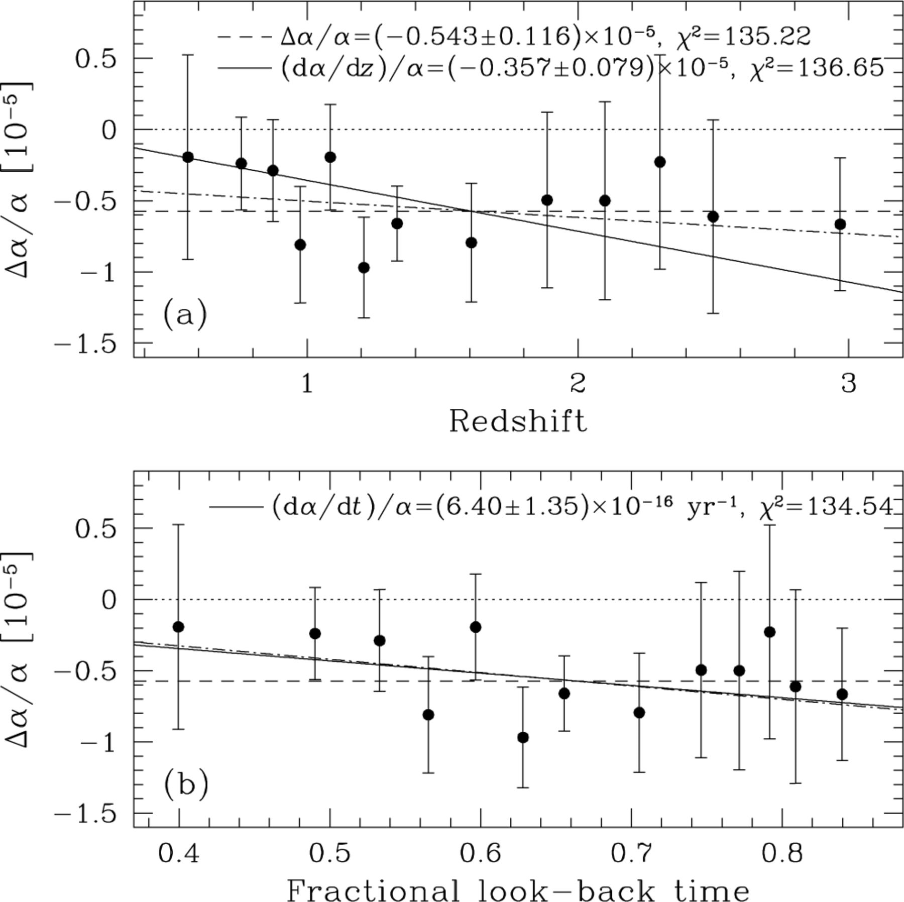
Figure 9. Temporal variation in α. (a) The points are the binned values of Δα/α for the fiducial sample plotted versus ...
Notes:
Figure 9. Temporal variation in α. (a) The points are the binned values of Δα/α for the fiducial sample plotted versus redshift. The dashed line is the weighted mean and the solid line is a fit to the unbinned data fixed to Δα/α= 0 at zabs= 0. The dot-dashed line is a fit with the zabs= 0 value allowed to vary. The values of χ2 indicate that the constant Δα/α model is preferred. (b) Same as (a) but versus fractional look-back time. The values of χ2 indicate that a linear increase in α with time is preferred.
Unless provided in the caption above, the following copyright applies to the content of this slide: © 2003 RAS

Slide 14
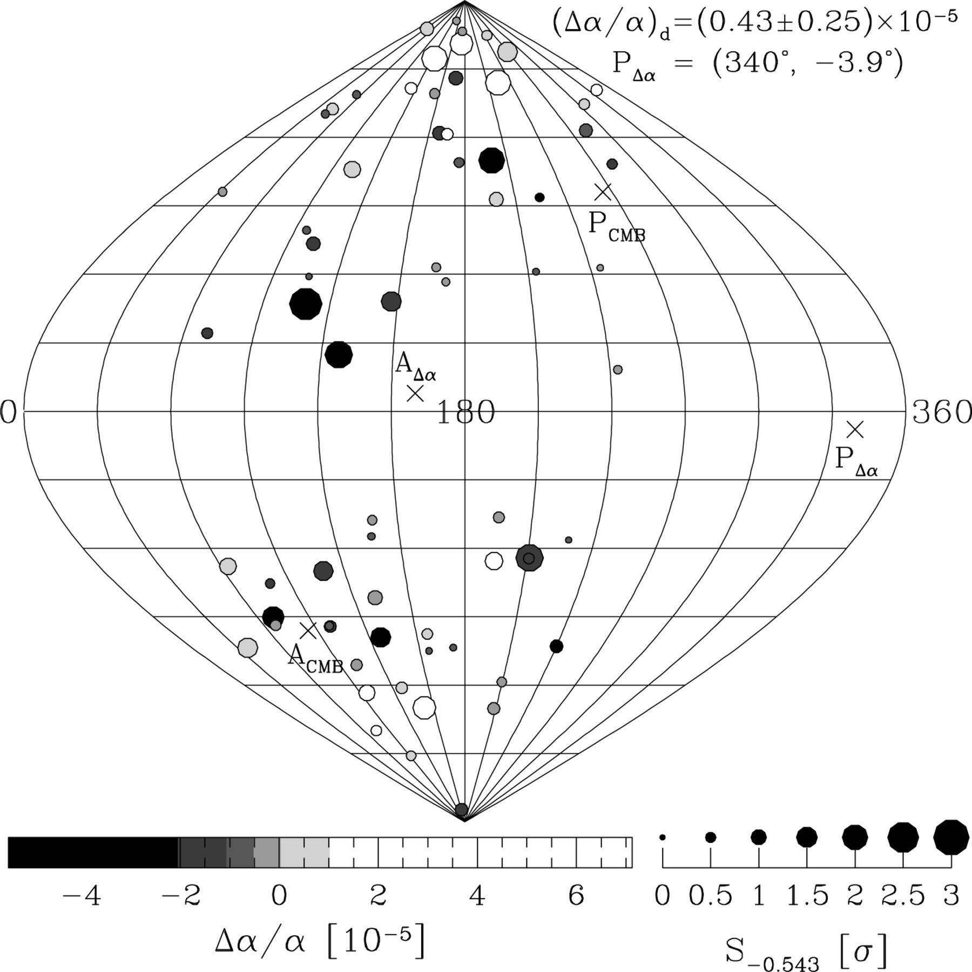
Figure 10. The distribution of Δα/α in Galactic coordinates (l, b). All fiducial values along a single QSO sight-line ...
Notes:
Figure 10. The distribution of Δα/α in Galactic coordinates (l, b). All fiducial values along a single QSO sight-line (i.e. for many absorption clouds and/or repeated, independent QSO observations) are collapsed to a single weighted mean. The value of Δα/α is given by the grey-scale and the size of each point scales with the significance, S−0.543, of the departure from the overall weighted mean of the fiducial sample (equation 9). The best-fitting dipole has an amplitude (Δα/α)d= (0.43 ± 0.25) × 10−5 with its pole and antipole in the directions PΔα and AΔα. However, a bootstrap analysis indicates that the dipole model is preferred over the constant Δα/α model at only the 60 per cent confidence level. We plot the CMB pole and antipole for comparison. (The on-line version of this figure is colour-coded and is also available from). This figure is available in colour in the online version of the journal on Synergy.
Unless provided in the caption above, the following copyright applies to the content of this slide: © 2003 RAS

Slide 15
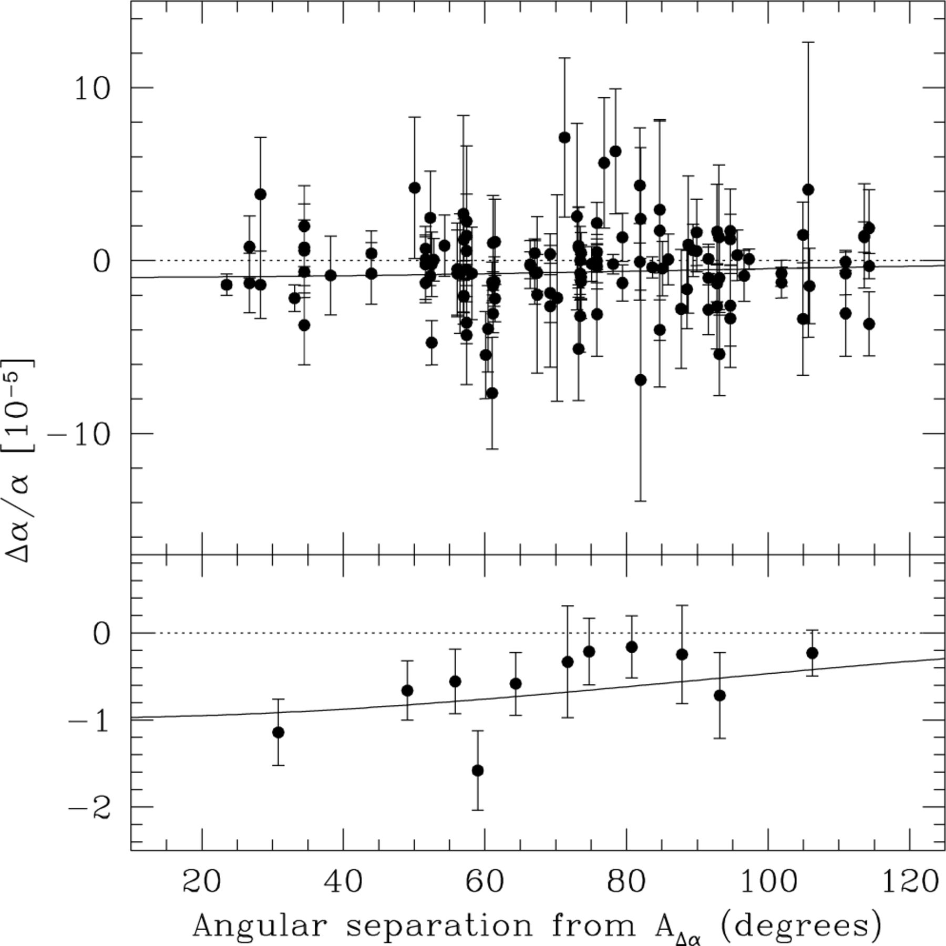
Figure 11. Best-fitting dipole to the angular distribution of Δα/α in Fig. 10. The pole lies in the direction ...
Notes:
Figure 11. Best-fitting dipole to the angular distribution of Δα/α in Fig. 10. The pole lies in the direction PΔα(l, b) = (340°, −3.9°). The upper panel shows the distribution of Δα/α with angular separation from the antipole, AΔα. The lower panel shows a binning of the results. The solid line is the best-fitting cosine with an amplitude (Δα/α)d= (0.43 ± 0.25) × 10−5. However, the limited angular coverage of QSO sightlines clearly undermines confidence in this dipole interpretation.
Unless provided in the caption above, the following copyright applies to the content of this slide: © 2003 RAS

Slide 16
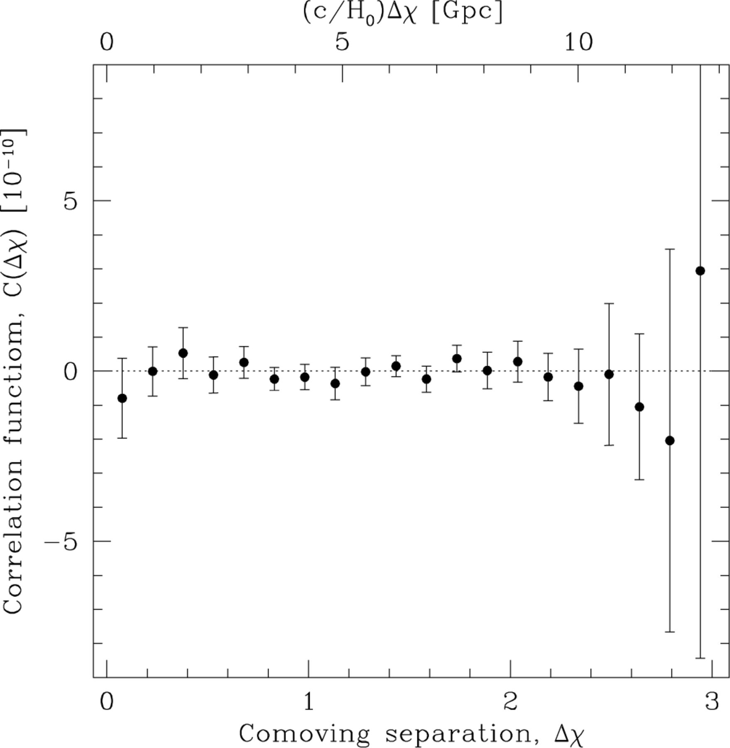
Figure 12. The two-point correlation function for α, C(Δχ), as a function of comoving separation between absorption ...
Notes:
Figure 12. The two-point correlation function for α, C(Δχ), as a function of comoving separation between absorption clouds, Δχ (H0= 70 km s−1 Mpc−1, Ωm= 0.3, ΩΛ= 0.7). The values and errors were obtained with a Monte Carlo technique. However, since each value of Δα/α may contribute to many bins, the bins are not independent.
Unless provided in the caption above, the following copyright applies to the content of this slide: © 2003 RAS

Slide 17
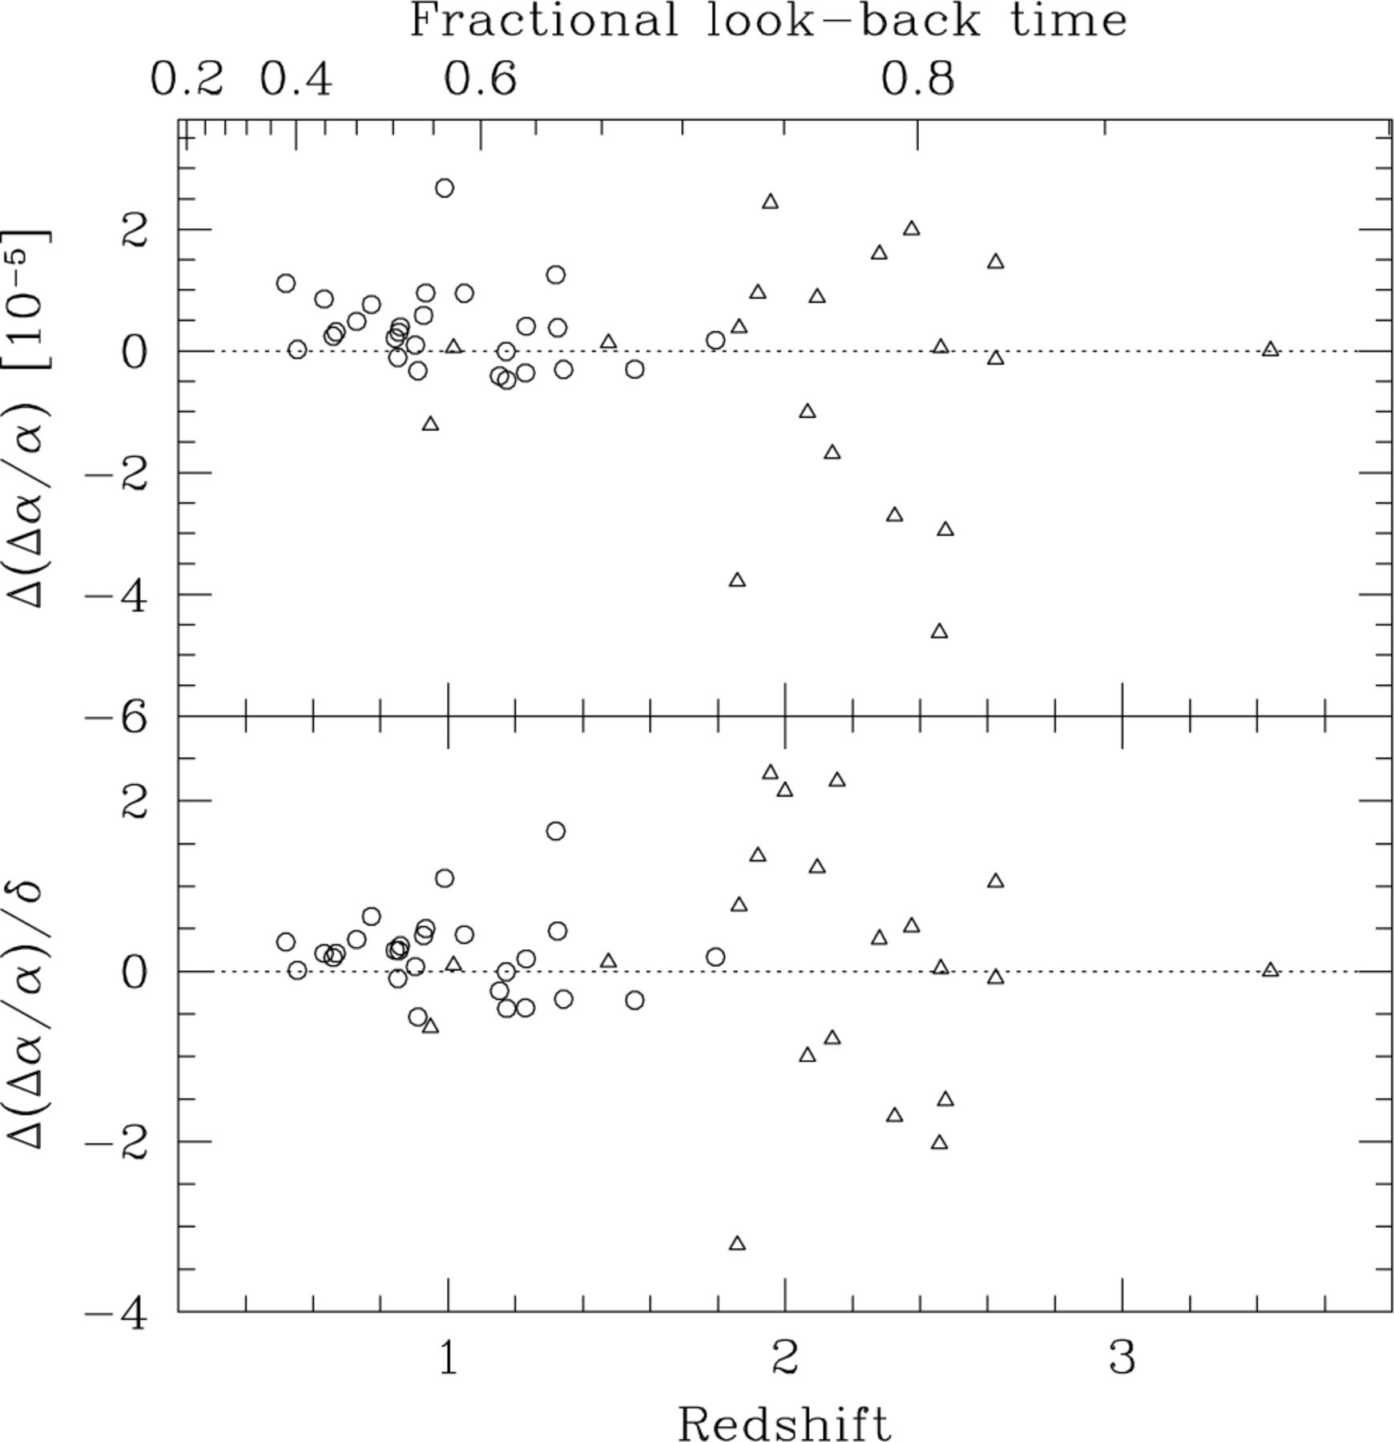
Figure 13. Comparison with previous analysis in M01a. The upper panel compares the raw values of Δα/α found here with ...
Notes:
Figure 13. Comparison with previous analysis in M01a. The upper panel compares the raw values of Δα/α found here with those in M01a [Δ(Δα/α) ≡Δα/α− (Δα/α)M01a] for the previous low-z (open circles) and previous high-z (open triangles) samples. The lower panel shows a measure of the significance of this difference: Δ(Δα/α) normalized by the 1σ error in Table 3. For the low-z data we find a slightly more positive Δα/α on average because the q-coefficients for the λ0 > 2000 Å Fe ii transitions have been revised to slightly higher values. The larger scatter seen in Δ(Δα/α) for the high-z systems is due mainly to the large change in the Fe iiλ1608 q coefficient (see Section 2.2).
Unless provided in the caption above, the following copyright applies to the content of this slide: © 2003 RAS

Slide 18
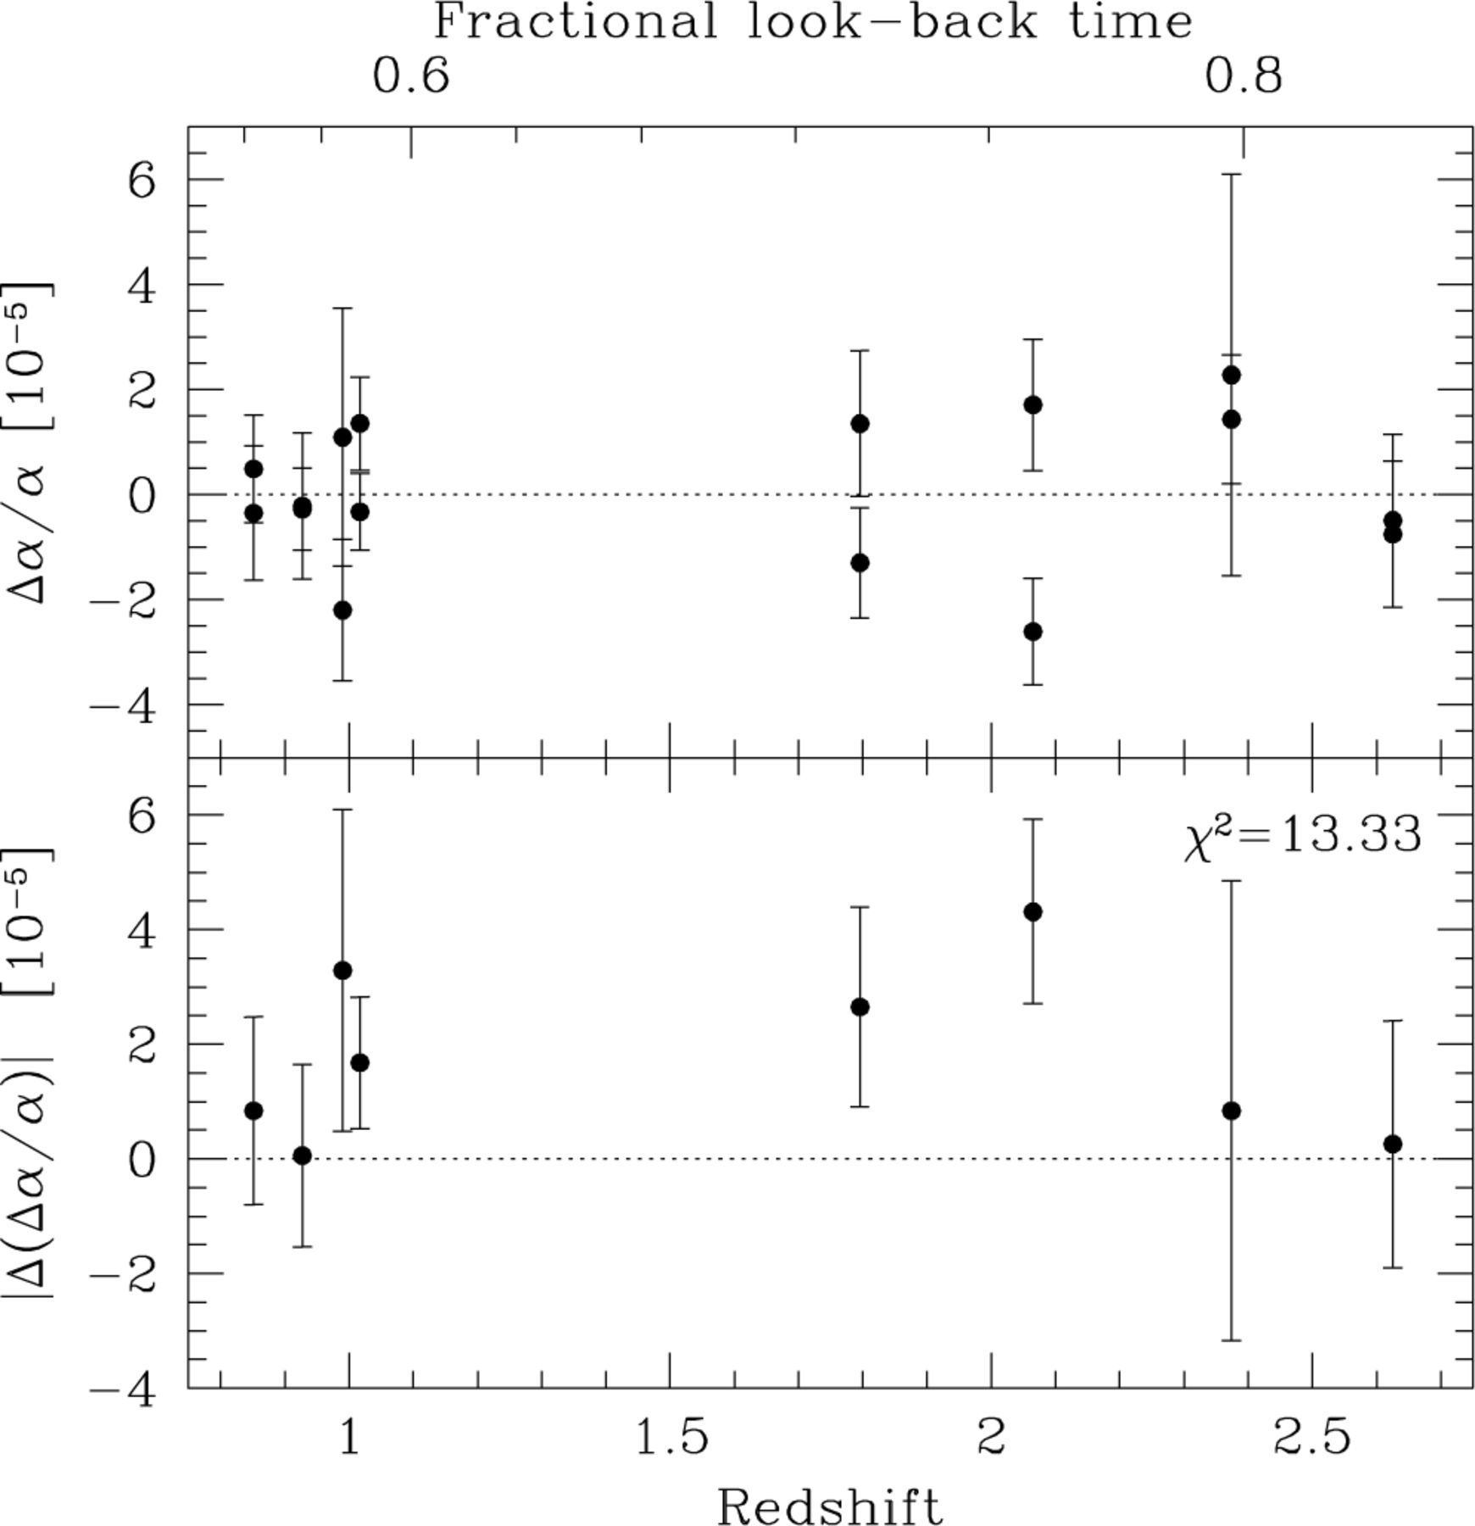
Figure 14. Repeated absorption systems. The upper panel shows the raw values of Δα/α for those systems which have been ...
Notes:
Figure 14. Repeated absorption systems. The upper panel shows the raw values of Δα/α for those systems which have been observed independently by different groups. The absolute difference is shown in the lower panel. For seven degrees of freedom, the indicated value of χ2 will be exceeded 6.4 per cent of the time by chance alone, providing only marginal evidence for significant additional random errors.
Unless provided in the caption above, the following copyright applies to the content of this slide: © 2003 RAS

Slide 19
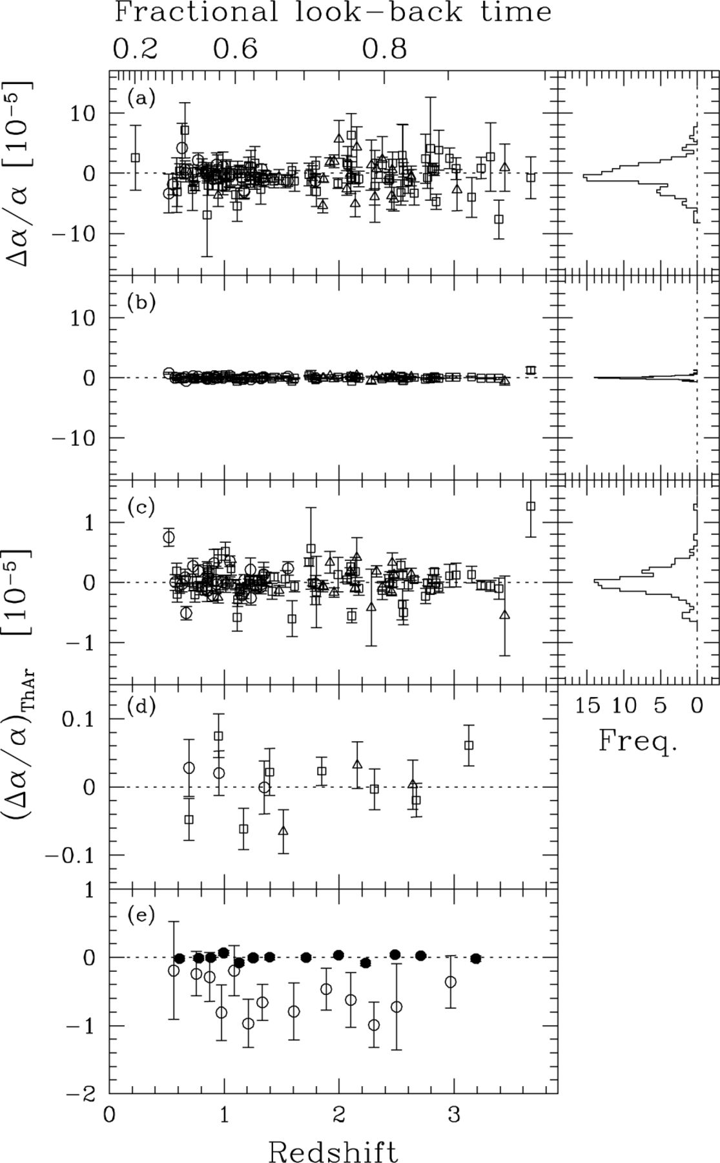
Figure 15. Comparison between the raw QSO results (a) and the ThAr calibration error (b) for the previous low-z (open ...
Notes:
Figure 15. Comparison between the raw QSO results (a) and the ThAr calibration error (b) for the previous low-z (open circles), previous high-z (open triangles) and new (open squares) samples. The (Δα/α)ThAr scale is expanded by a factor of 10 in (c). Panel (d) shows binned values for the three subsamples and (e) compares the binned values for the total ThAr (solid circles) and raw QSO (open circles) samples. The weighted mean of the ThAr results is (Δα/α)ThAr= (0.4 ± 0.8) × 10−7.
Unless provided in the caption above, the following copyright applies to the content of this slide: © 2003 RAS

Slide 20
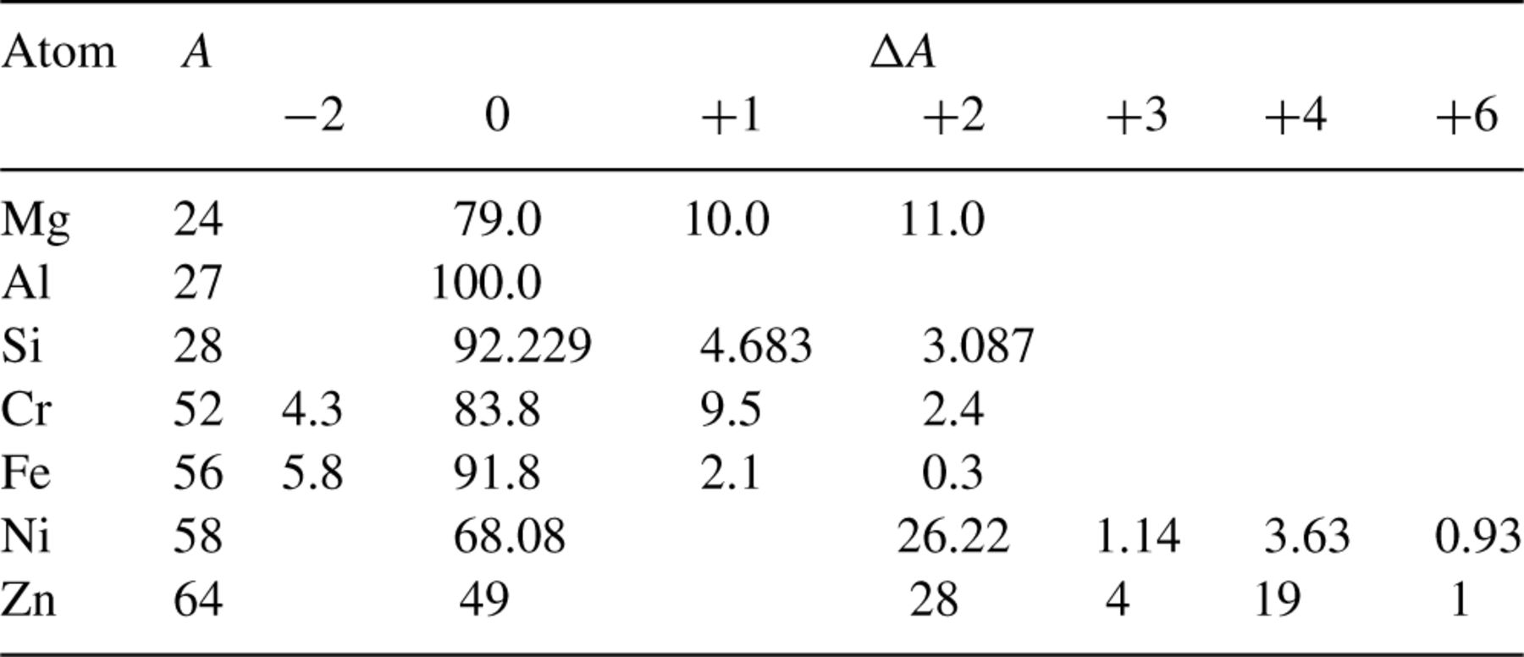
Table 5. The percentage terrestrial isotopic abundances of the atoms used in our analysis (Rosman & Taylor 1998). The ...
Notes:
Table 5. The percentage terrestrial isotopic abundances of the atoms used in our analysis (Rosman & Taylor 1998). The second column shows the mass number, A, of the isotope with the highest abundance and ?A is defined relative to this (negative values represent lighter isotopes).
Unless provided in the caption above, the following copyright applies to the content of this slide: © 2003 RAS

Slide 21
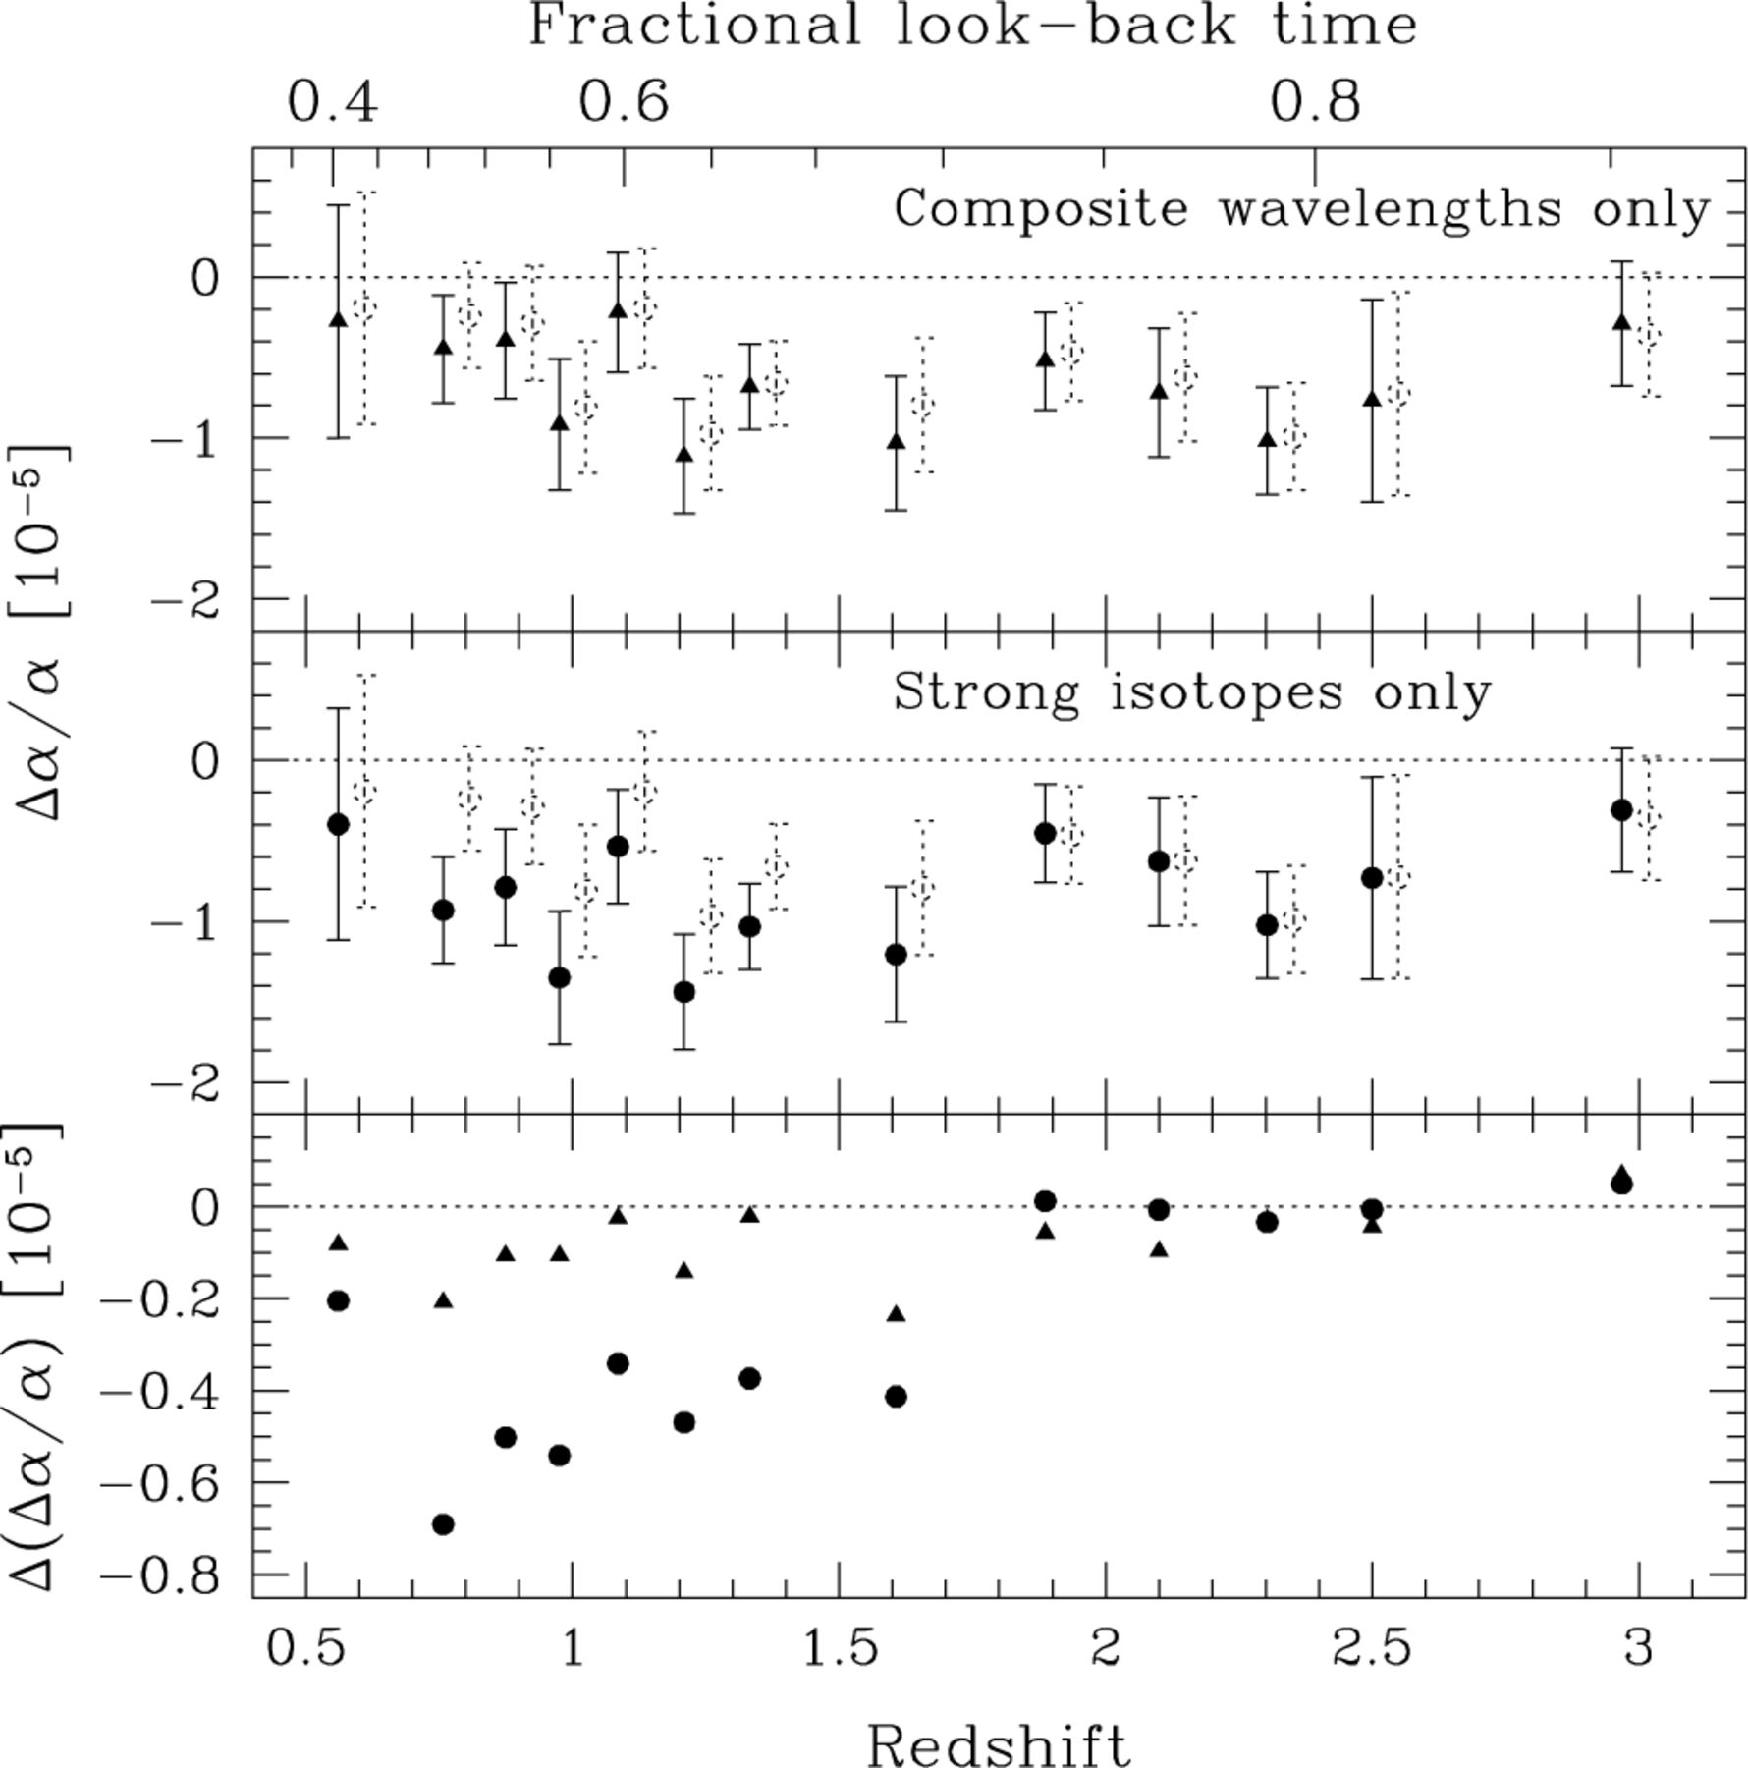
Figure 16. Upper limits on the effects of differential isotopic saturation and isotopic abundance evolution. The top ...
Notes:
Figure 16. Upper limits on the effects of differential isotopic saturation and isotopic abundance evolution. The top panel compares the binned values of Δα/α derived using only the composite laboratory wavelengths (solid triangles) from Table 2 and the values from the raw sample (dotted circles, slightly shifted for clarity). The solid circles in the middle panel are derived using only the isotopic components of the Mg i, Mg ii and Si ii transitions with the highest terrestrial abundance. The lower panel shows the differences between these composite and single isotope values of Δα/α and the values from the raw sample.
Unless provided in the caption above, the following copyright applies to the content of this slide: © 2003 RAS

Slide 22
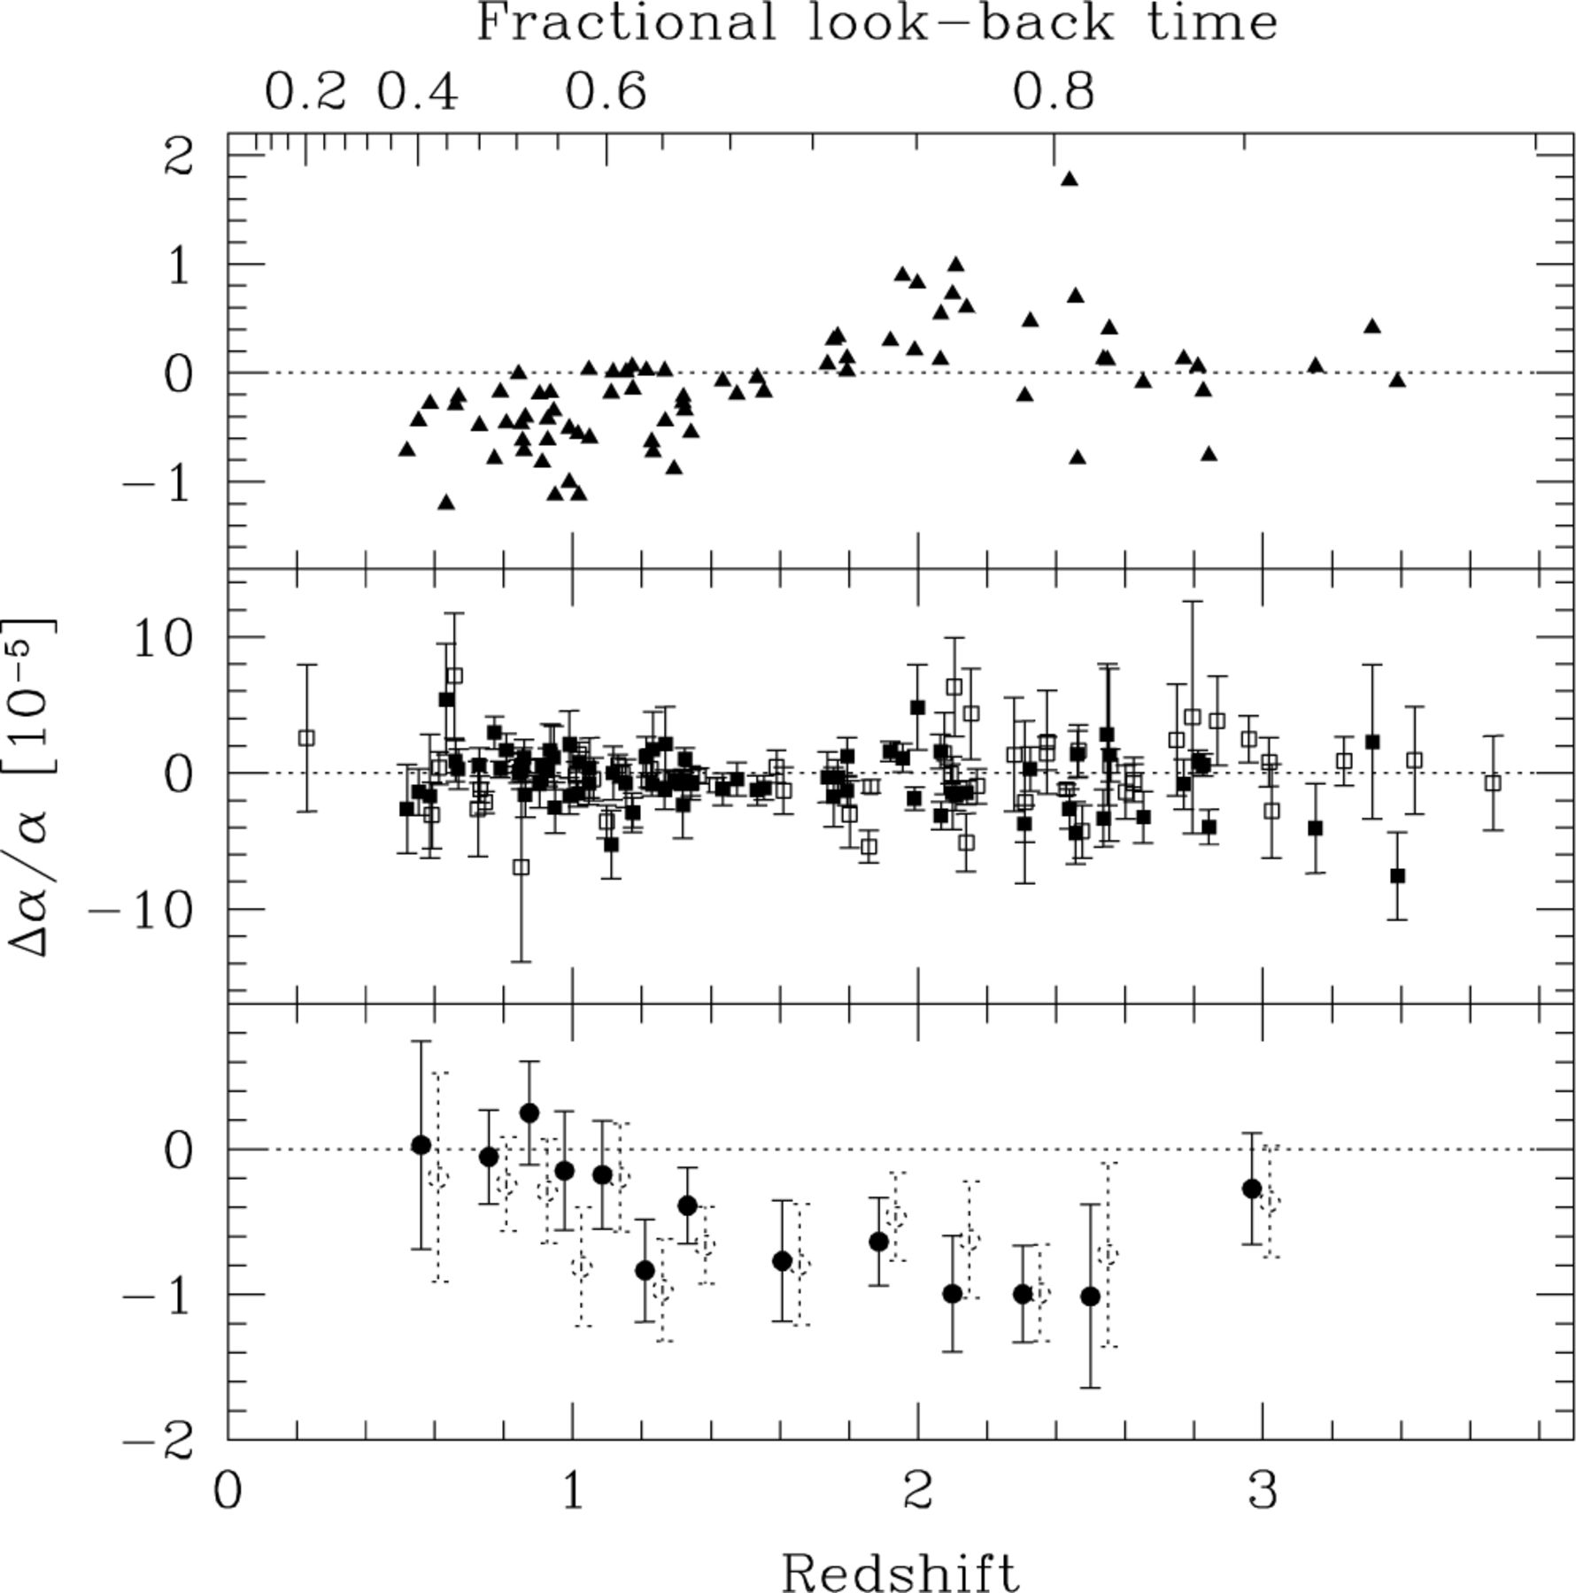
Figure 17. Correcting for potential atmospheric dispersion effects. The upper panel shows values of (Δα/α)_{ad} ...
Notes:
Figure 17. Correcting for potential atmospheric dispersion effects. The upper panel shows values of (Δα/α)ad derived from simulated spectra with our model for atmospheric dispersion applied. We have corrected the relevant raw values of Δα/α in the middle panel (solid squares) which also shows the unaffected raw values (open squares). The lower panel compares the binned values from the middle panel (solid circles) with those of the raw sample (open circles). The new overall weighted mean is Δα/α= (−0.46 ± 0.10) × 10−5.
Unless provided in the caption above, the following copyright applies to the content of this slide: © 2003 RAS

Slide 23
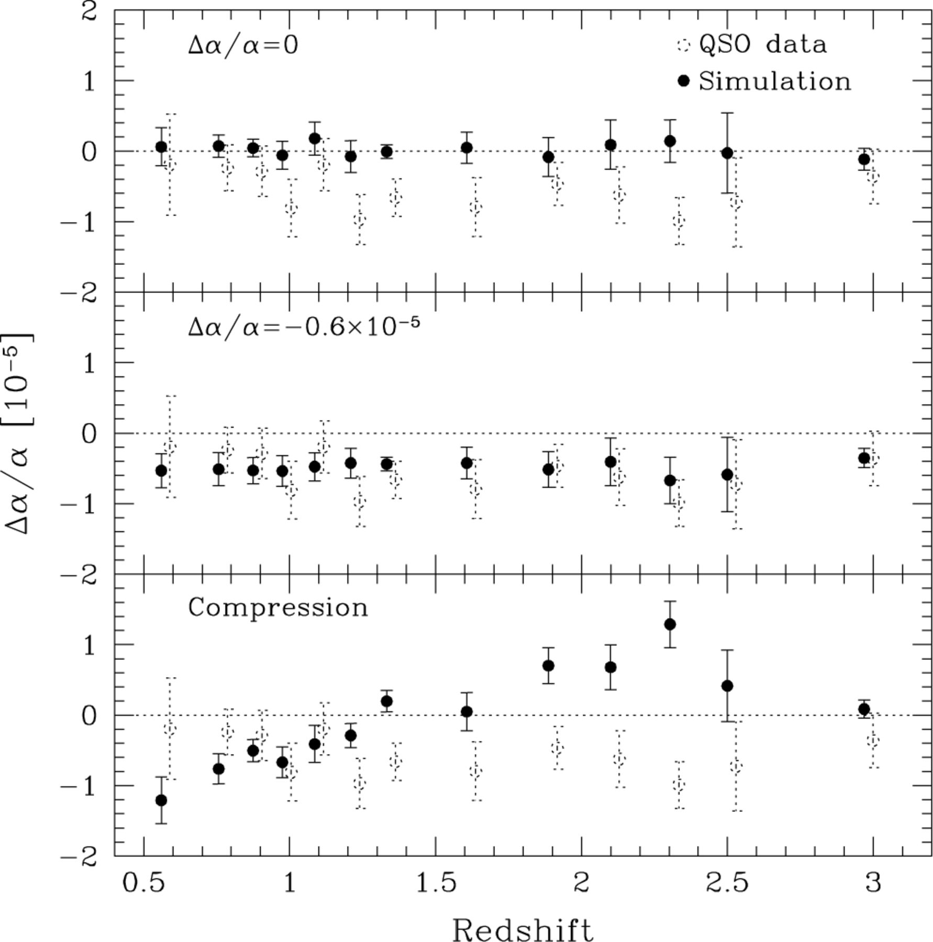
Figure 23. Δα/α from simulations of the QSO spectra. The weighted mean from 20 simulations (solid circles) is compared ...
Notes:
Figure 23. Δα/α from simulations of the QSO spectra. The weighted mean from 20 simulations (solid circles) is compared with the real raw values (dotted circles, shifted for clarity) in each panel. The rms from the simulations is represented by the error bar. The upper panel has no input value of Δα/α whereas Δα/α=−0.6 × 10−5 was introduced into the spectra for the middle panel. Note that we recover the input values and that the rms error bars match the 1σ errors in the real data. A compression was introduced into the spectra for the lower panel (equation 14) to allow interpretation of the high-z compression and q-type removal test results.
Unless provided in the caption above, the following copyright applies to the content of this slide: © 2003 RAS

Slide 24
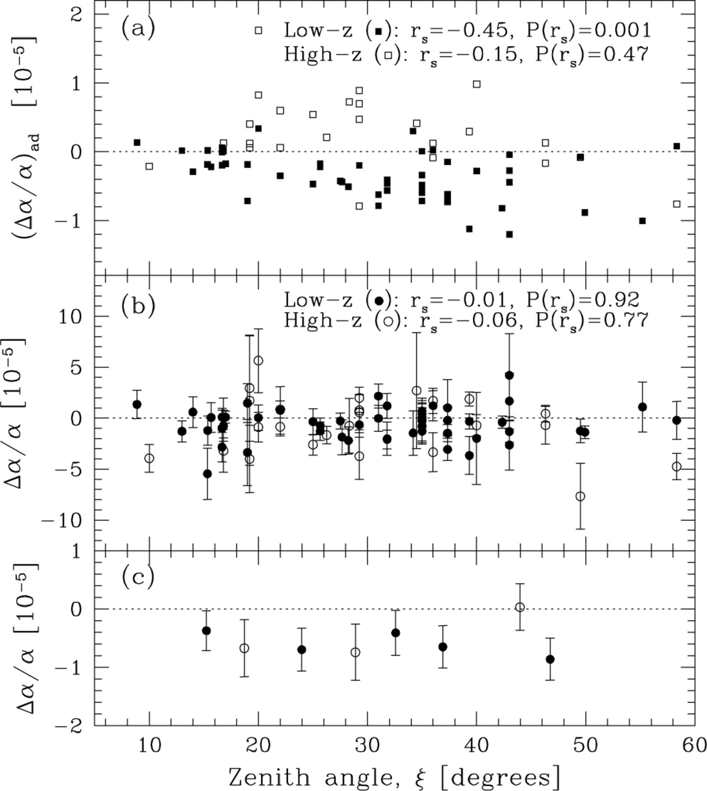
Figure 18. Is Δα/α correlated with zenith angle? (a) The estimates of the effect of atmospheric dispersion on Δα/α as a ...
Notes:
Figure 18. Is Δα/α correlated with zenith angle? (a) The estimates of the effect of atmospheric dispersion on Δα/α as a function of the mean zenith angle, ξ, for each observation. The Spearman rank correlation coefficient, rs, and associated probability, P(rs), indicate a clear anticorrelation for the low-z systems but no clear correlation for the high-z systems. (b) The real raw values of Δα/α. No correlation is seen for either the low- or high-z systems. (c) A binning of the real values to clarify the lack of correlation with ξ.
Unless provided in the caption above, the following copyright applies to the content of this slide: © 2003 RAS

Slide 25
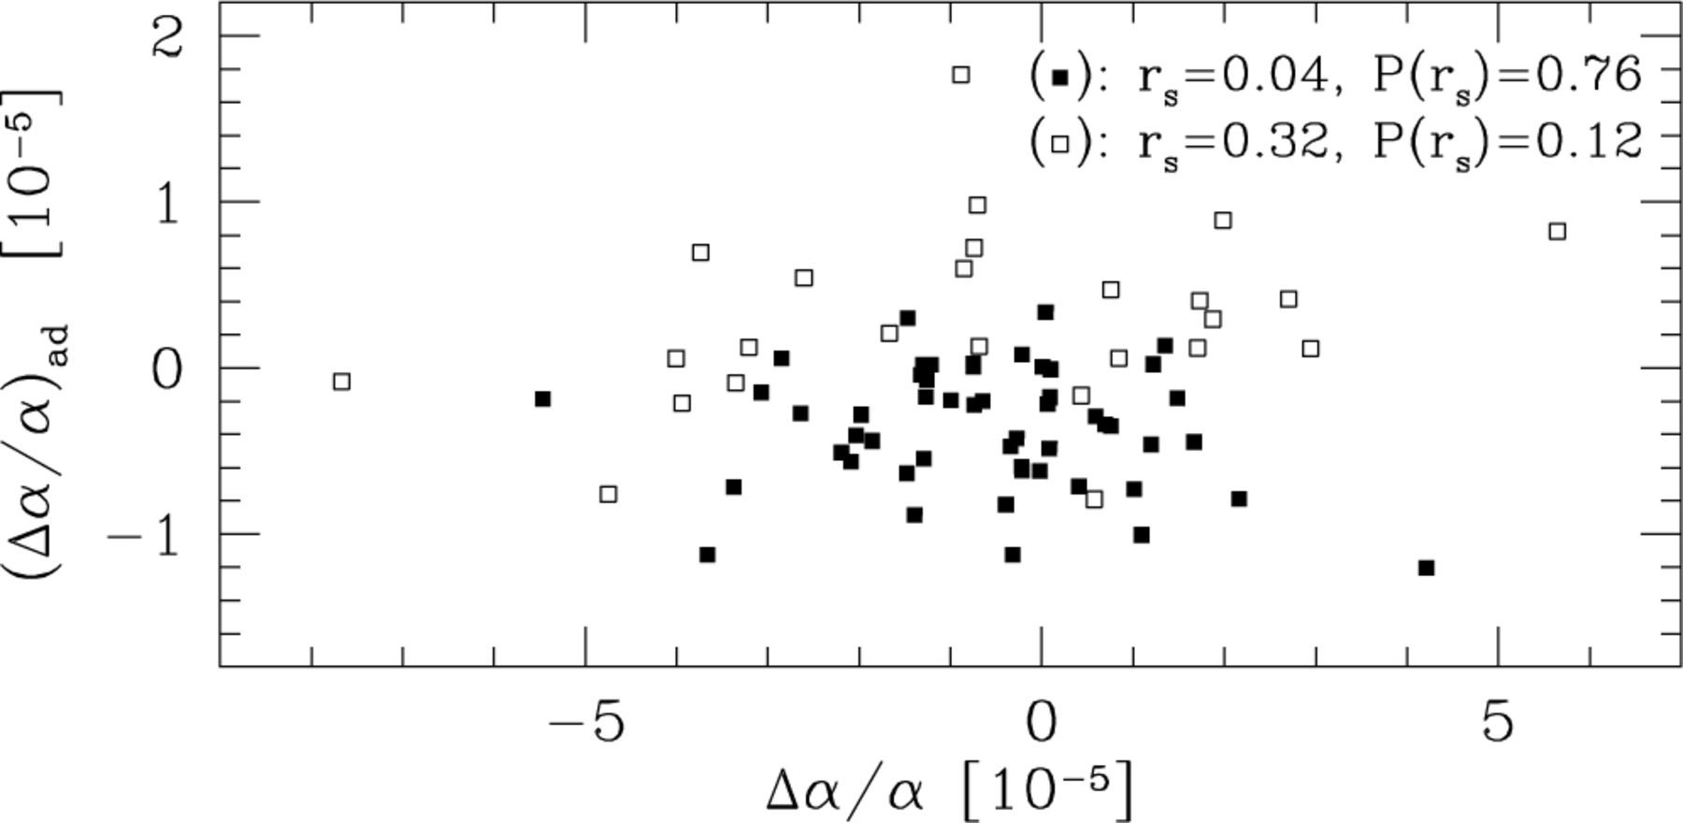
Figure 19. Is (Δα/α)_{ad} correlated with Δα/α? The Spearman rank correlation coefficient and associated ...
Notes:
Figure 19. Is (Δα/α)ad correlated with Δα/α? The Spearman rank correlation coefficient and associated probability indicate no clear correlation for the low-z systems (solid squares). A weak correlation may exist in the high-z systems (open squares) but only at low significance.
Unless provided in the caption above, the following copyright applies to the content of this slide: © 2003 RAS

Slide 26
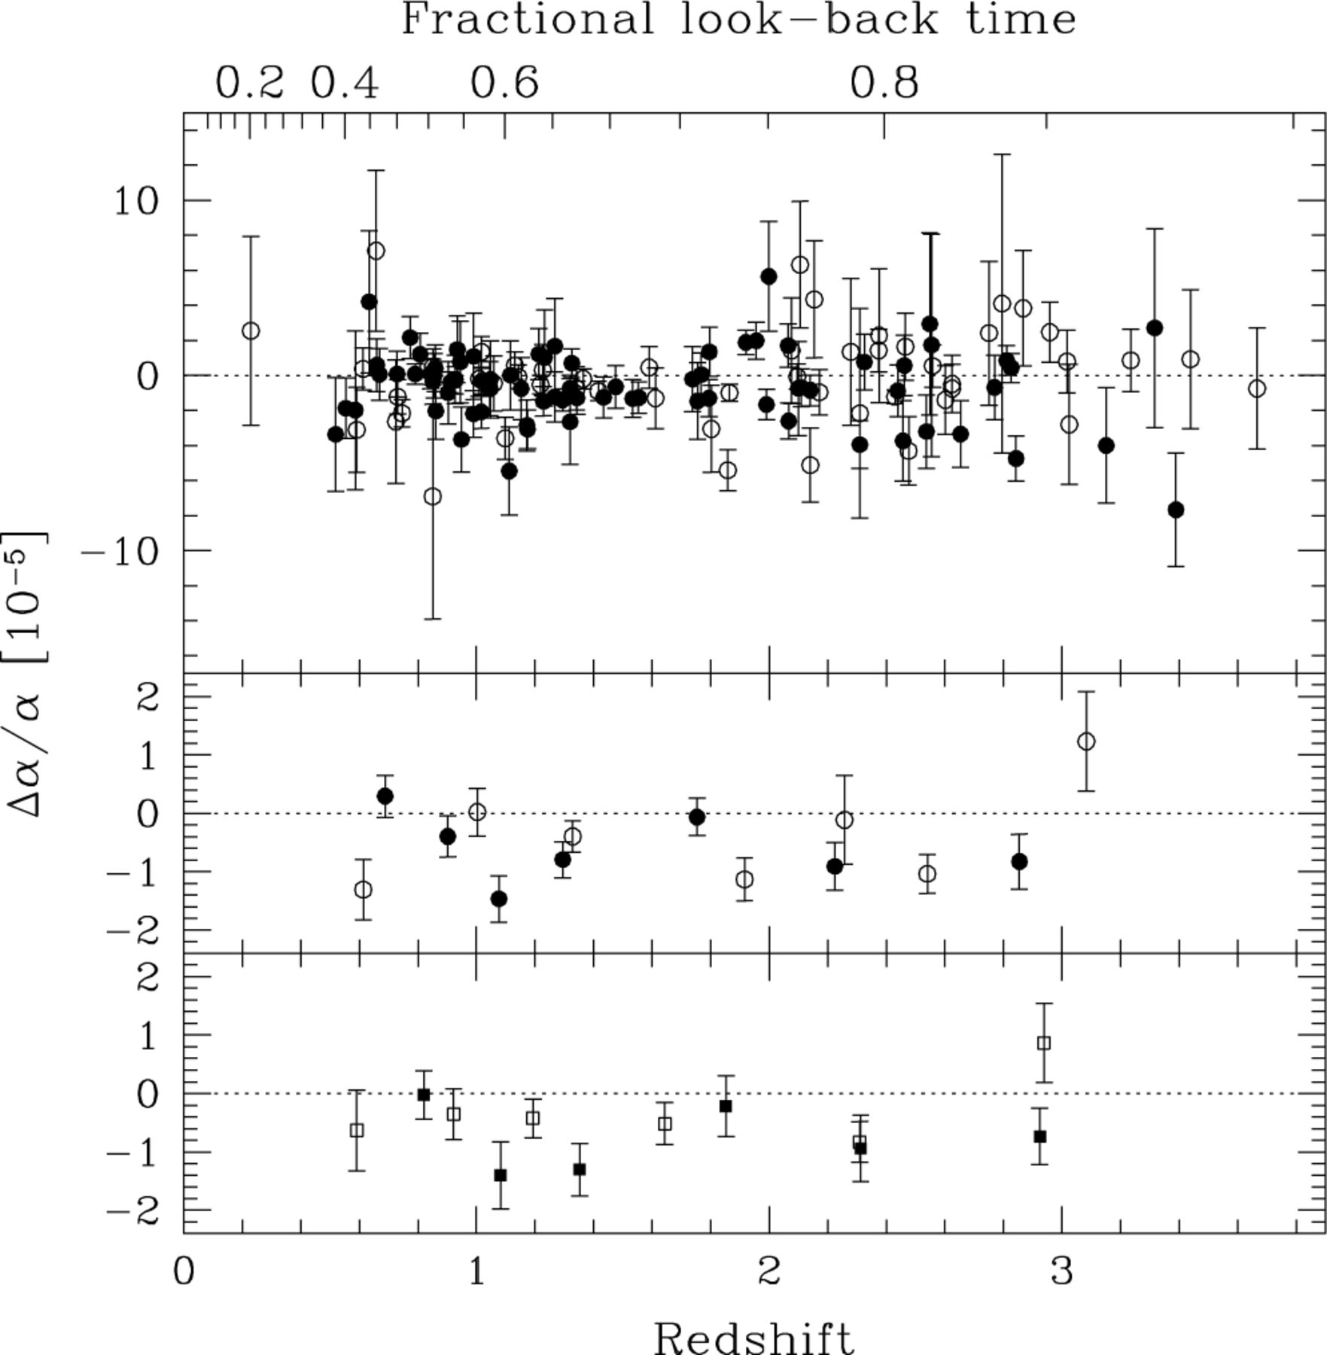
Figure 20. Comparison of the pre- and post-rotator systems. The upper panel compares raw values of Δα/α for the ...
Notes:
Figure 20. Comparison of the pre- and post-rotator systems. The upper panel compares raw values of Δα/α for the pre-rotator (solid circles, 77 points) and post-rotator (open circles, 51 points) samples. The weighted means are consistent: Δα/α= (−0.54 ± 0.14) × 10−5 and Δα/α= (−0.62 ± 0.15) × 10−5, respectively. The middle panel bins the results in the same fashion as for the main results in Fig. 6. We see no evidence for a significant systematic effect due to atmospheric dispersion. The lower panel compares the pre-rotator (solid squares, 39 points) and post-rotator (open squares, 39 points) subsamples of the new sample alone. Again, we see no evidence for the atmospheric dispersion effect. Table 6 presents the weighted mean values of Δα/α.
Unless provided in the caption above, the following copyright applies to the content of this slide: © 2003 RAS

Slide 27
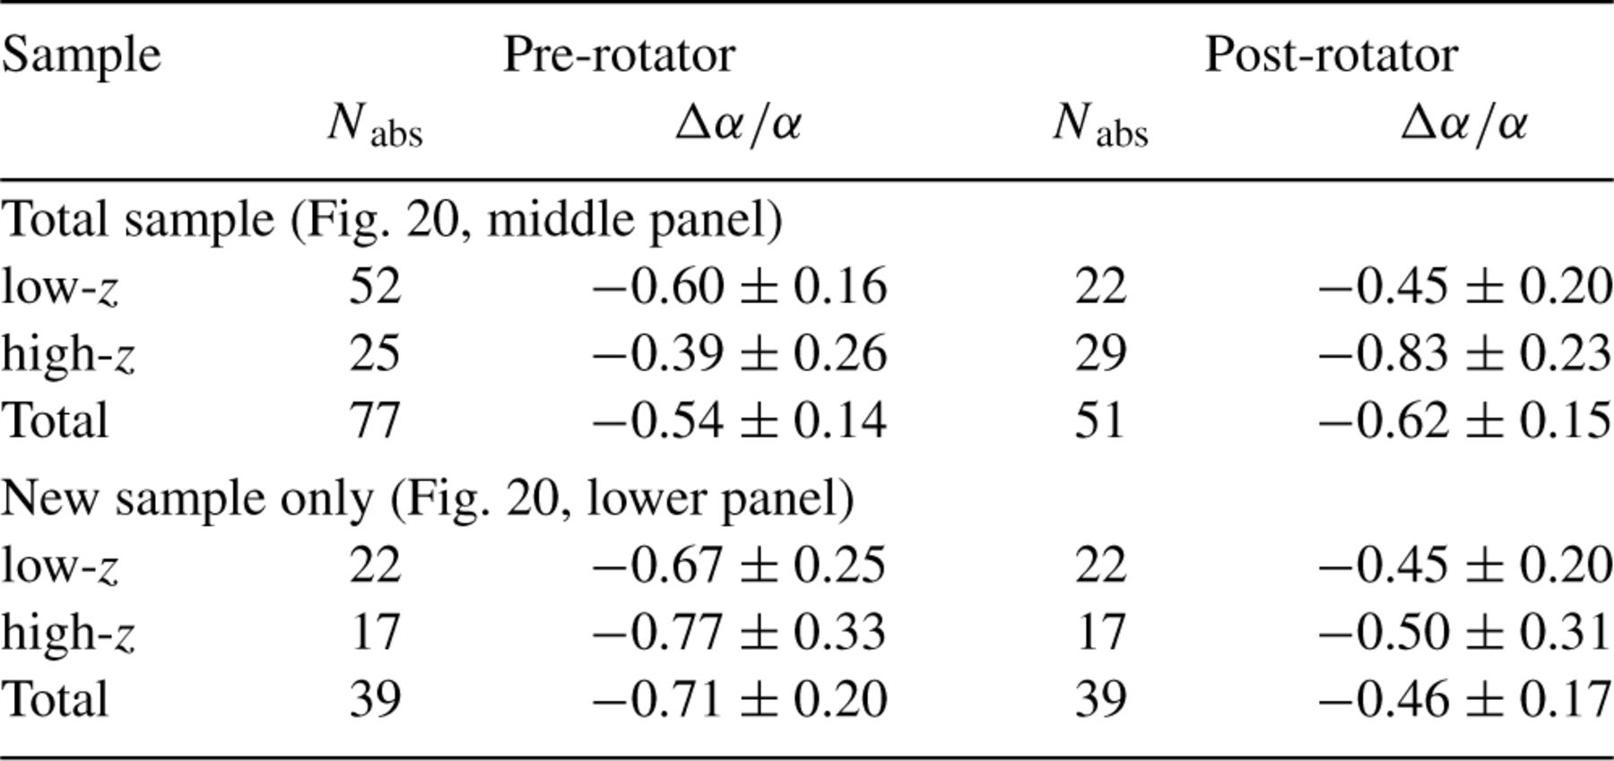
Table 6. Comparison of weighted mean values of α/α for the pre- and post-rotator systems.
Notes:
Table 6. Comparison of weighted mean values of α/α for the pre- and post-rotator systems.
Unless provided in the caption above, the following copyright applies to the content of this slide: © 2003 RAS

Slide 28
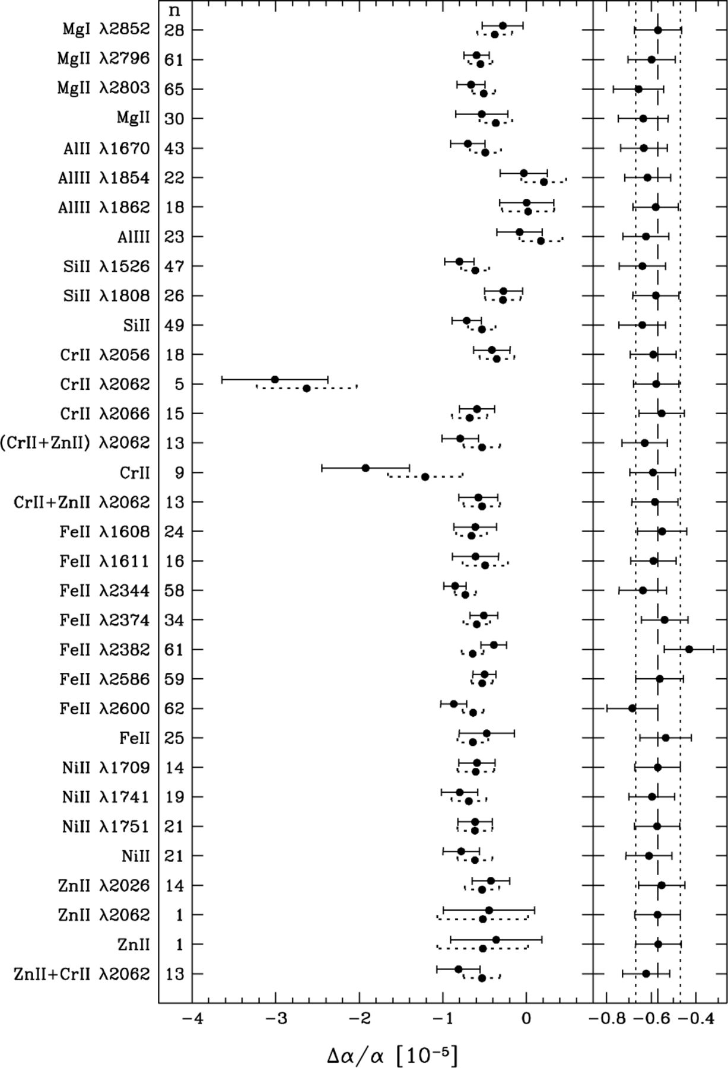
Figure 21. Single transition and species removal. The left-hand panel compares the raw values of Δα/α before (dotted ...
Notes:
Figure 21. Single transition and species removal. The left-hand panel compares the raw values of Δα/α before (dotted error bar) and after (solid error bar) line removal. The transitions or species removed are listed on the left together with the number of systems, n, for which line removal was possible. The right-hand panel shows the impact of line removal on the value of Δα/α for the entire sample. The vertical lines indicate the raw weighted mean value of Δα/α (dashed line) and 1σ error range (dotted lines). Note that some confusion may arise due to the occasional blending of the Cr ii and Zn iiλ2062 lines: ‘(Cr ii+ Zn ii) λ2062’ refers to cases where both transitions had to be removed simultaneously; ‘Cr ii+ Zn iiλ2062’ refers to cases when all Cr ii transitions were removed along with the blended Zniiλ2062 line; a similar definition applies to ‘Zn ii+ Cr iiλ2062’; ‘Cr ii’ and ‘Zn ii’ refer only to removal of the Cr ii and Zn ii species in cases where the Cr ii and Zn iiλ2062 lines were not blended.
Unless provided in the caption above, the following copyright applies to the content of this slide: © 2003 RAS

Slide 29
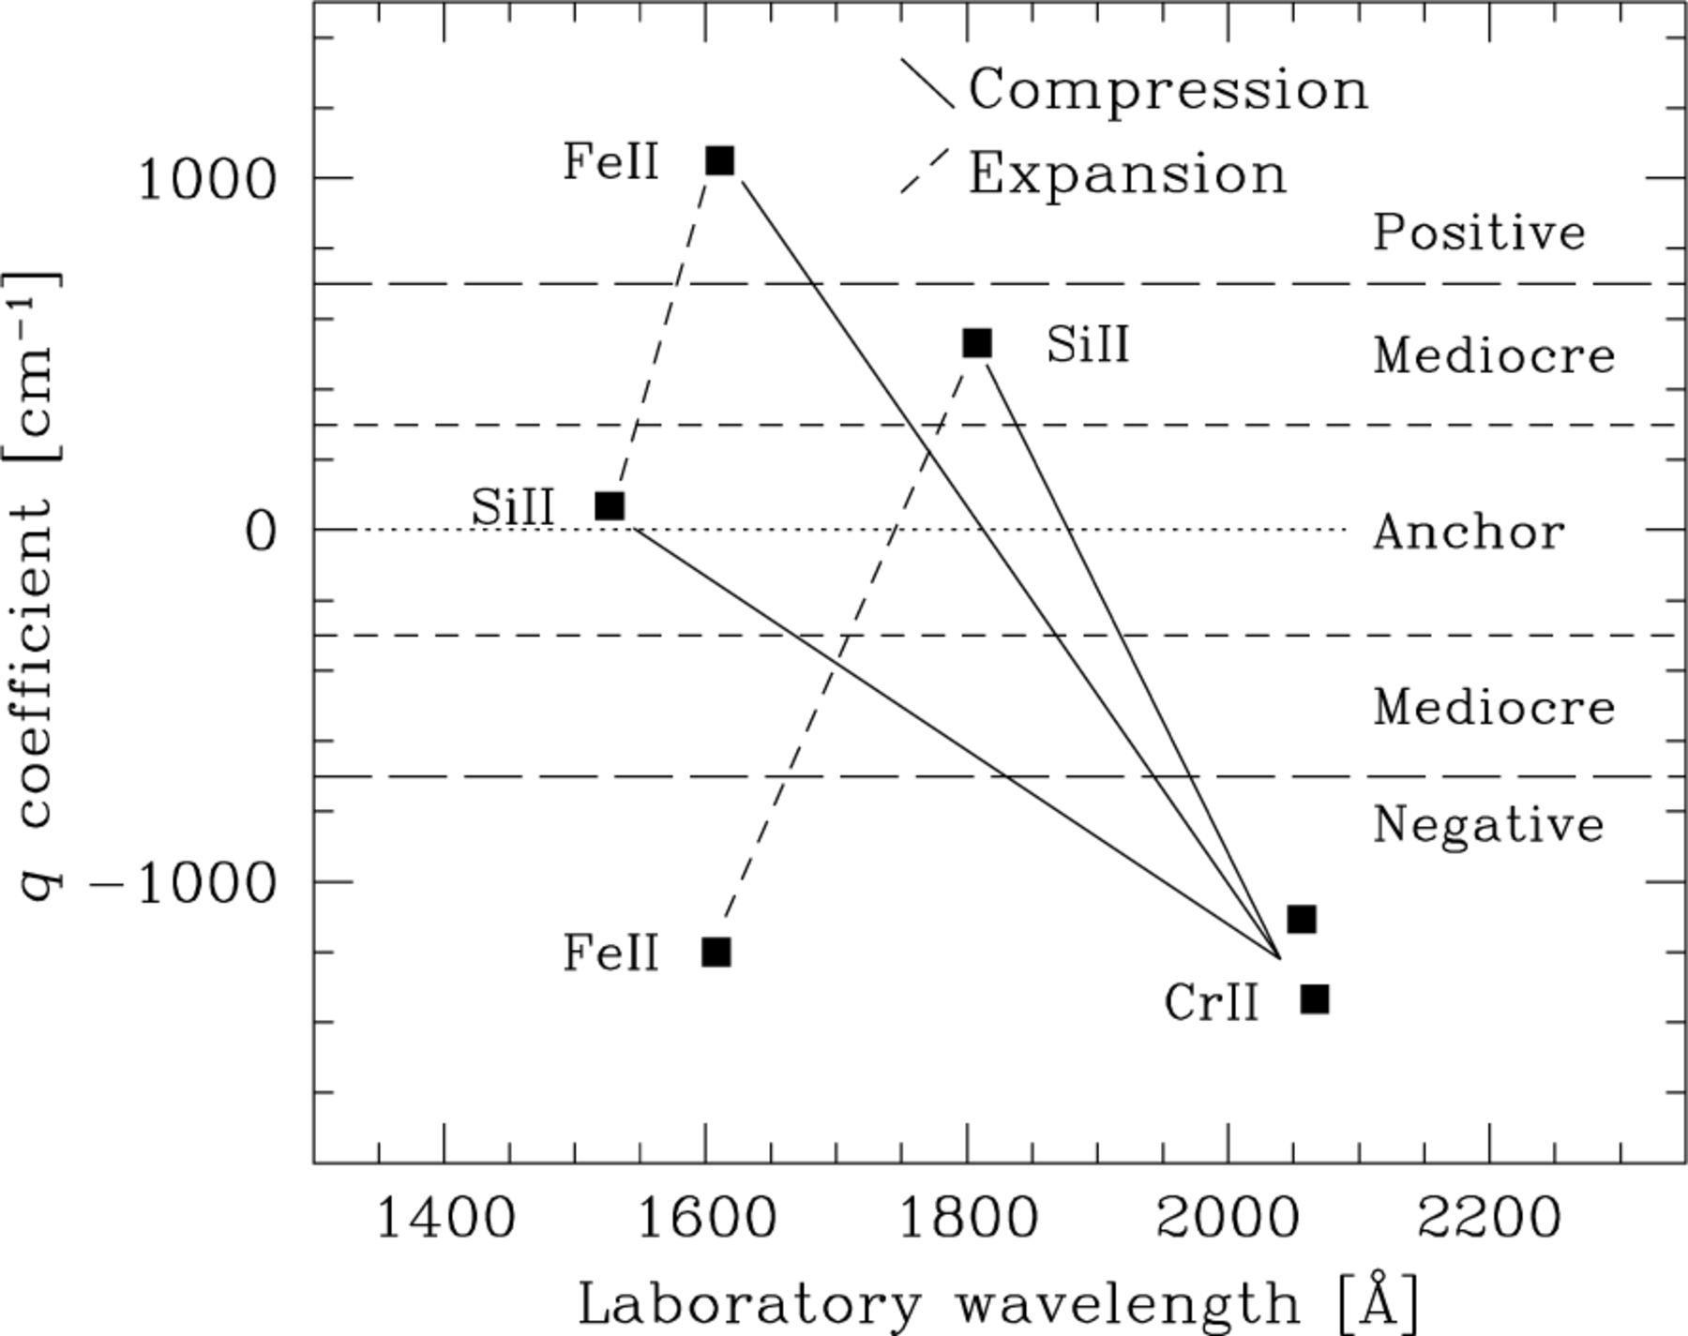
Figure 22. The high-z compression test. A compression of the spectrum will systematically produce Δα/α < 0 in a high-z ...
Notes:
Figure 22. The high-z compression test. A compression of the spectrum will systematically produce Δα/α < 0 in a high-z absorption system if only certain combinations of transitions (solid diagonal lines) are fitted simultaneously. This mimics the situation for the low-z Mg/Fe ii absorption systems and allows us to search for a compression-type systematic effect in the high-z systems. Combinations of transitions which will give Δα/α < 0 for an expansion of the spectrum can be selected in a similar way (dashed diagonal lines).
Unless provided in the caption above, the following copyright applies to the content of this slide: © 2003 RAS

Slide 30
Table 7. Coarse results from the high-z compression test. Columns 4 and 5 show the raw values of the weighted and ...
Notes:
Table 7. Coarse results from the high-z compression test. Columns 4 and 5 show the raw values of the weighted and unweighted mean ?a/a (in units of 10−5) for the relevant absorption systems before removing the transitions. Each absorption system may contribute many times to these values, depending on how many compression/expansion combinations can be formed from the fitted transitions. Columns 6 and 7 give the weighted and unweighted mean after transitions are removed to produce the compression/expansion combinations. Note the large errors in the post-removal unweighted means. Other caveats of interpreting this table are discussed in the text.
Unless provided in the caption above, the following copyright applies to the content of this slide: © 2003 RAS

Slide 31
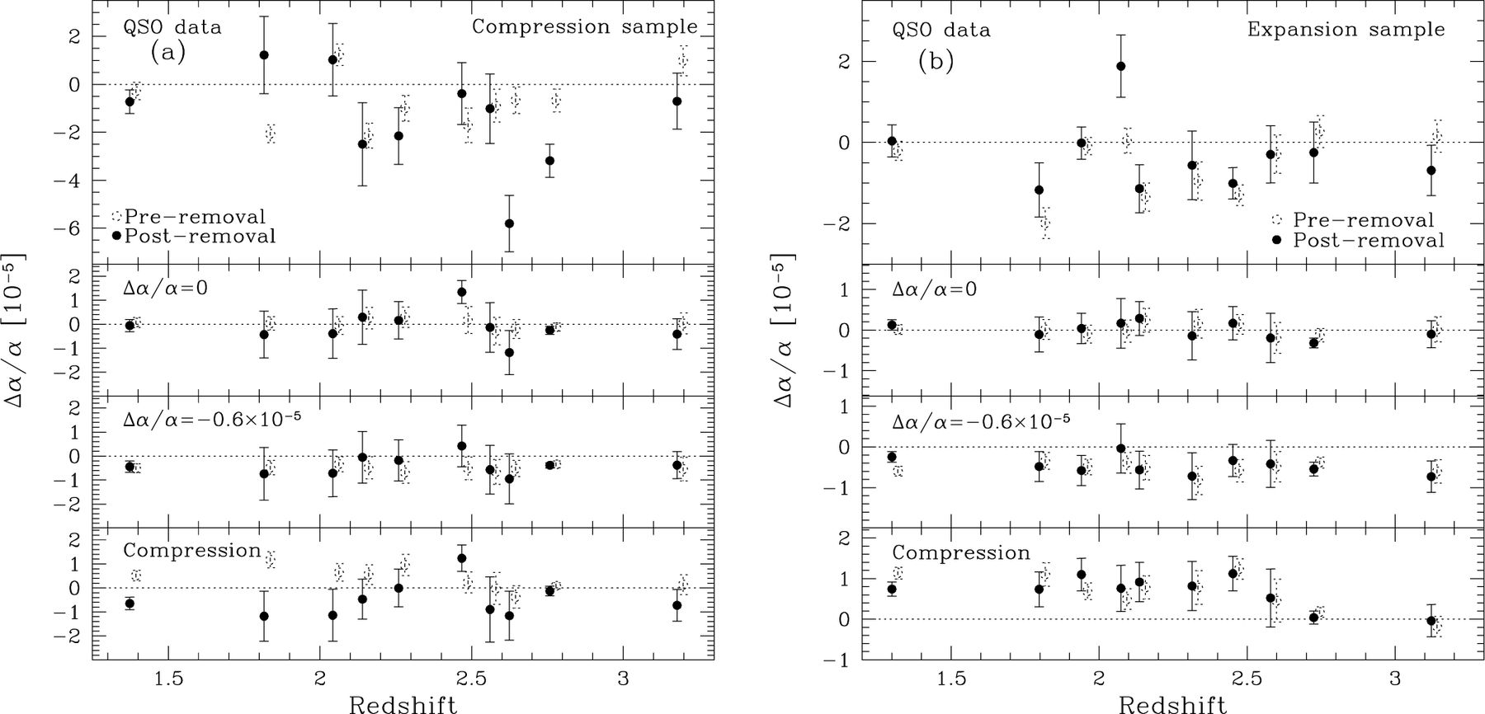
Figure 24. Detailed results of the high-z compression test for the QSO data (upper panels) and simulations (lower three ...
Notes:
Figure 24. Detailed results of the high-z compression test for the QSO data (upper panels) and simulations (lower three panels). The error bars for the simulations represent the rms from 20 synthetic spectra. (a) Compression sample. Each panel shows binned values of Δα/α before and after transitions are removed to form the 76 compression combinations. The bottom panel shows that the compression sample is sensitive to the synthetic compression introduced to the simulated spectra. No clear trend is seen in the real QSO data due to the large scatter in the post-removal values (see the text for discussion). (b) Expansion sample. 126 combinations contribute to the binned values of Δα/α shown. No significant difference is observed between the pre- and post-removal values in any of the simulations. The lower panel implies that the expansion sample is surprisingly insensitive to simple systematic errors. Significant scatter is also observed in the post-removal QSO results.
Unless provided in the caption above, the following copyright applies to the content of this slide: © 2003 RAS

Slide 32
Table 8. Coarse results of the high-z q-type removal test. Columns 3 and 4 show the raw weighted and unweighted mean ...
Notes:
Table 8. Coarse results of the high-z q-type removal test. Columns 3 and 4 show the raw weighted and unweighted mean values of ?a/a (in units of 10−5) for the 26 relevant absorption systems before removing the transitions (the first three rows necessarily have the same value). Columns 5 and 6 give the weighted and unweighted mean after transitions of the specified q-type are removed. Note that the pre- and post-removal values of ?a/a and the 1s errors are not independent of each other. Also note the large errors in the post-removal unweighted means. A detailed comparison must refer to simulations of the QSO data (see Fig. 25).
Unless provided in the caption above, the following copyright applies to the content of this slide: © 2003 RAS

Slide 33
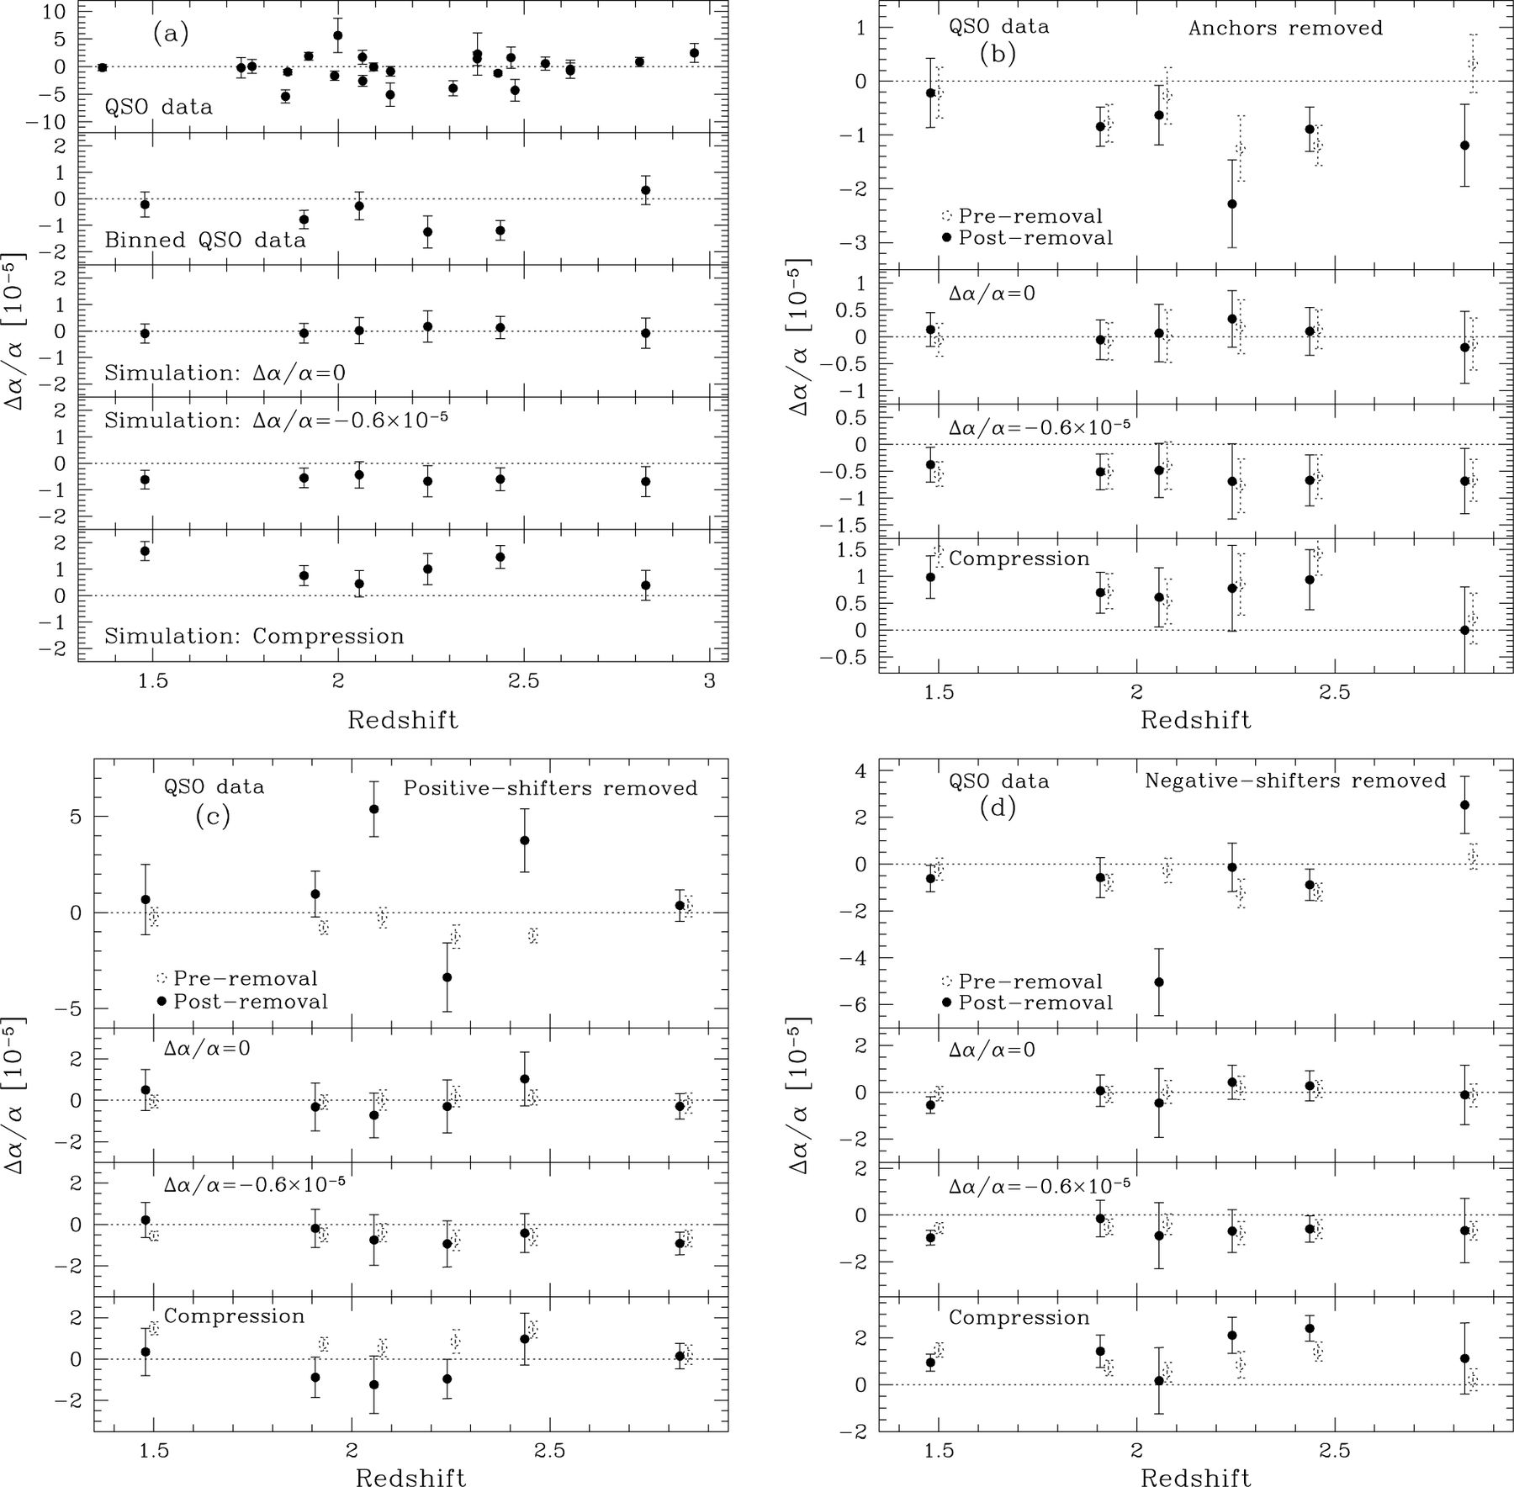
Figure 25. Detailed results of the high-zq-type removal test for the QSO data and simulations (lower three panels). The ...
Notes:
Figure 25. Detailed results of the high-zq-type removal test for the QSO data and simulations (lower three panels). The error bars for the simulations represent the rms from 20 synthetic spectra. (a) The upper panel shows the values of Δα/α for the 26 systems comprising the q-type sample, i.e. those with at least one anchor, positive- and negative-shifter. These data are binned in the next panel. The lower three panels show the weighted mean values of Δα/α for the different simulations. These values and the binned QSO data are shown as dotted circles in (b)–(d). (b) Anchors removed. The synthetic spectra with artificial compression (lower panel) indicate that removing the anchors should not affect Δα/α significantly, even when distortions of the wavelength scale are present. The QSO values also show little deviation after line removal but some extra scatter may exist. (c) and (d) Positive- and negative-shifters removed. Although the compression simulation reveals a significant change in Δα/α upon line-removal, the extra scatter in the post-removal QSO data precludes a firm conclusion concerning the presence of systematic effects (see the text for a discussion).
Unless provided in the caption above, the following copyright applies to the content of this slide: © 2003 RAS

