Slide 1
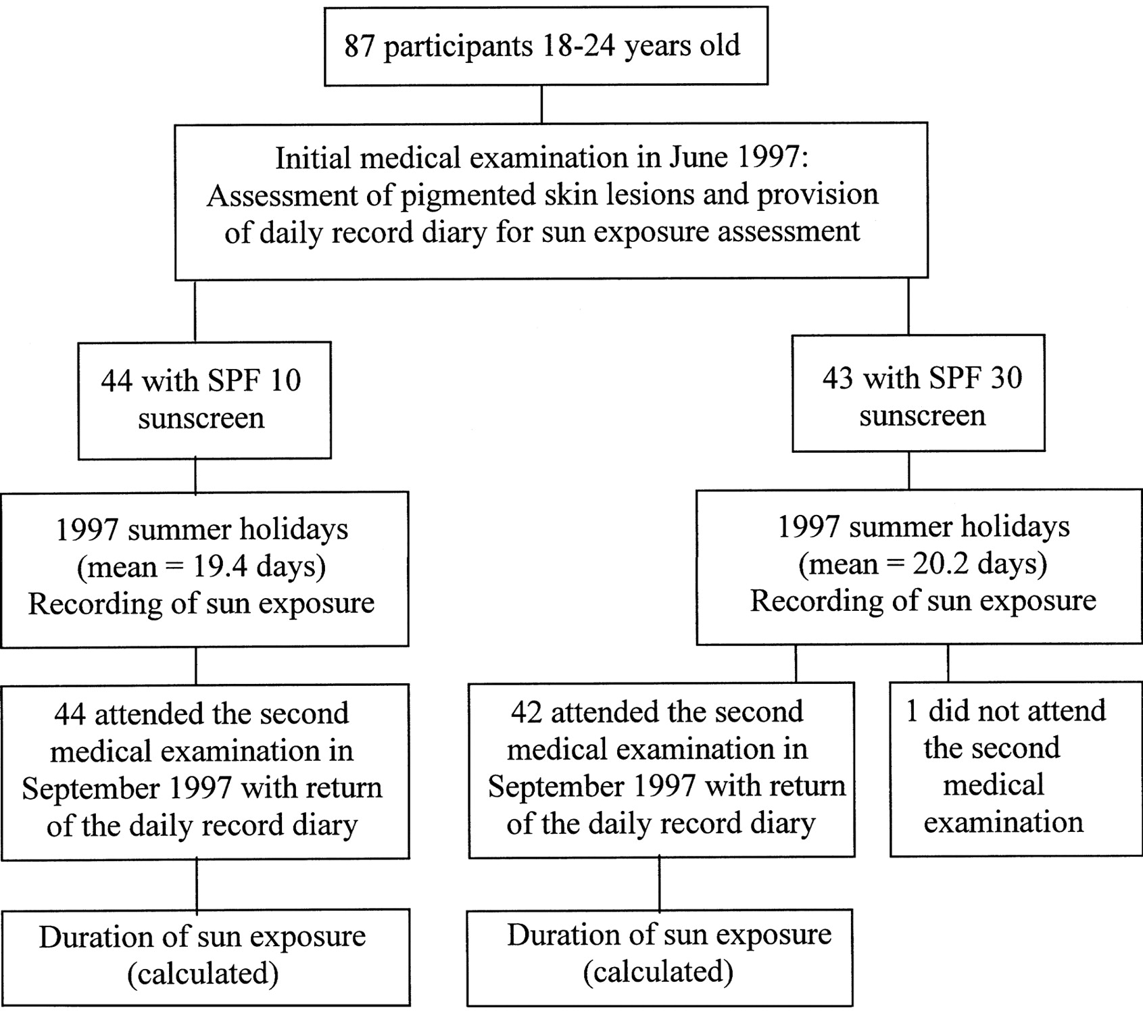
Fig. 1. Trial design.
Notes:
Fig. 1. Trial design.
Unless provided in the caption above, the following copyright applies to the content of this slide: Oxford University Press

