Slide 1
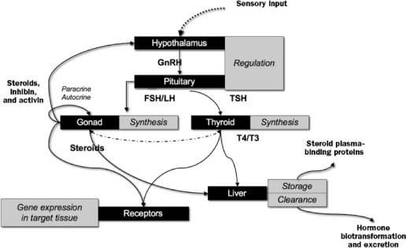
Figure 1. Schematic representation of the hypothalamo-pituitary-gonad/thyroid axis. Circulating hormones interact with ...
Notes:
Figure 1. Schematic representation of the hypothalamo-pituitary-gonad/thyroid axis. Circulating hormones interact with receptors in target tissues throughout the body, altering gene expression profiles. Plasma steroid and thyroid hormone concentrations are also affected by plasma-binding proteins, synthesized by the liver, as well as hepatic biotransformation and clearance. It is worth noting that the alligator's endocrine system is nearly identical to that of the human and other mammals, making it an effective sentinel of potential environmental and human health concerns.
Unless provided in the caption above, the following copyright applies to the content of this slide: © 2008 American Institute of Biological Sciences.

Slide 2
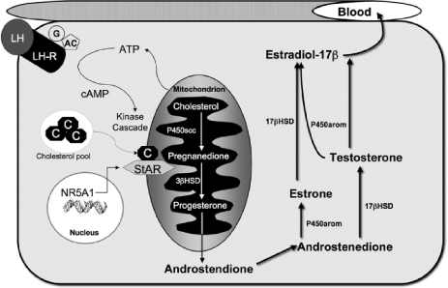
Figure 2. A representative model of vertebrate steroidogenesis, including the initial steps that occur in the ...
Notes:
Figure 2. A representative model of vertebrate steroidogenesis, including the initial steps that occur in the mitochondria. A gonadotropin, such as luteinizing hormone (LH) is delivered via the blood and binds to a specific membrane receptor (LH-R) that is associated with a guinine nucleotide-binding protein–adenyl cyclase (AC) complex. This complex generates a second messenger, cAMP, that activates a kinase cascade and enzyme activity associated with steroidogenesis. Initial stages of steroidogenesis occur in the mitochondria following NR5A1-induced production of steroid acute regulatory (StAR) protein. StAR is essential for the transport of cholesterol across the mitochondial membrane. Cholesterol is then modified by enzyme action both within the mitochondria and in the smooth endoplasmic reticulum of the cytoplasm to generate steroid hormones that are released into the blood. Enzymes: P450scc, P450 side chain cleavage; 3ßHSD, 3ß hydroxysteroid dehydrogenase; 17ßHSD, 17ß hydroxysteroid dehydrogenase; P450arom, P450 aromatase. Abbreviation: ATP, adenosine-5'-triphosphate.
Unless provided in the caption above, the following copyright applies to the content of this slide: © 2008 American Institute of Biological Sciences.

Slide 3
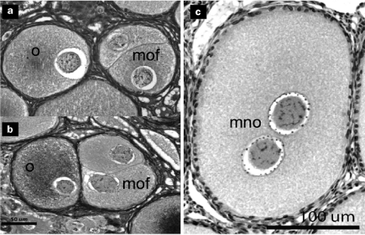
Figure 3. Photomicrographs of normal and multioocytic ovarian follicles (a, b) and a multinuclear oocyte (c) from ...
Notes:
Figure 3. Photomicrographs of normal and multioocytic ovarian follicles (a, b) and a multinuclear oocyte (c) from juvenile American alligators. Multioocytic (polyovular) follicles have been reported from females alligators from Lake Apopka, Florida, as well as from female caiman treated with various estrogenic contaminants. Abbreviations: o, oocyte; mof, multioocytic follicle; mno, multinuclear oocyte. Photomicrographs: Brandon C. Moore, University of Florida.
Unless provided in the caption above, the following copyright applies to the content of this slide: © 2008 American Institute of Biological Sciences.

Slide 4
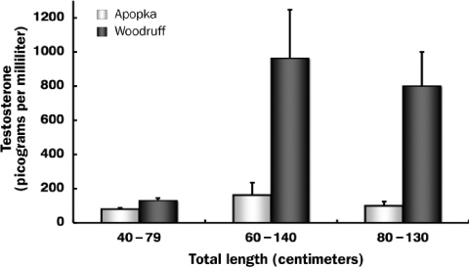
Figure 4. Plasma testosterone concentrations in size-matched juvenile male alligators from Lakes Woodruff NWR and Lake ...
Notes:
Figure 4. Plasma testosterone concentrations in size-matched juvenile male alligators from Lakes Woodruff NWR and Lake Apopka. Bars represent means ± the standard error of the mean. At all juvenile body sizes represented, males from Lake Apopka have significantly lower plasma testosterone concentrations than do those from Lake Woodruff NWR. Data are from Guillette and colleagues (1999b) and Crain and colleagues (1998).
Unless provided in the caption above, the following copyright applies to the content of this slide: © 2008 American Institute of Biological Sciences.

Slide 5
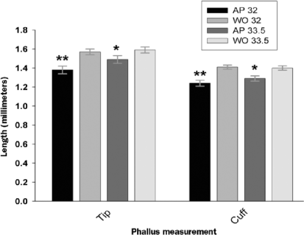
Figure 5. Phallus cuff diameter and tip length of male neonatal alligators from Lake Apopka (AP) and Lake Woodruff ...
Notes:
Figure 5. Phallus cuff diameter and tip length of male neonatal alligators from Lake Apopka (AP) and Lake Woodruff (WO). Bars represent least-square means adjusted for snout-to-vent length ± the standard error of the mean, and asterisks denote significant differences between lakes within an incubation temperature. One asterisk indicates p ≤ 0.05; two asterisks indicate p ≤ 0.005. The data are taken from Milnes and colleagues (2005b).
Unless provided in the caption above, the following copyright applies to the content of this slide: © 2008 American Institute of Biological Sciences.

Slide 6
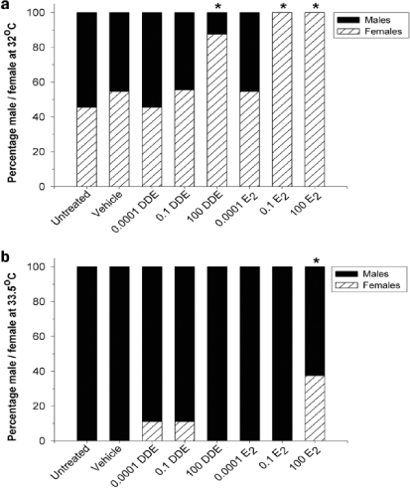
Figure 6. Sex ratios of alligators exposed in ovo to p,p'-DDE or estradiol-17ß and incubated at 32°C or 33.5°C. ...
Notes:
Figure 6. Sex ratios of alligators exposed in ovo to p,p'-DDE or estradiol-17ß and incubated at 32°C or 33.5°C. Treatments are reported in parts per billion wet egg mass. Asterisks denote a significant difference between treatment and the control and vehicle groups. The data are taken from Milnes and colleagues (2005a).
Unless provided in the caption above, the following copyright applies to the content of this slide: © 2008 American Institute of Biological Sciences.

Slide 7
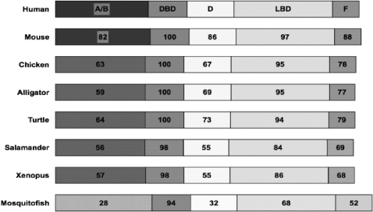
Figure 7. Comparison of human ESR1 (ERα) protein with estrogen receptors of representative vertebrate species. The ...
Notes:
Figure 7. Comparison of human ESR1 (ERα) protein with estrogen receptors of representative vertebrate species. The functional A/B to F domains are schematically represented with percentage similarities of sequence presented. Note the high sequence similarity (values at or close to 100%) between human, mouse, chicken, and alligator for the DNA-binding (DBD) and ligand-binding (LBD) domains.
Unless provided in the caption above, the following copyright applies to the content of this slide: © 2008 American Institute of Biological Sciences.

