Slide 1
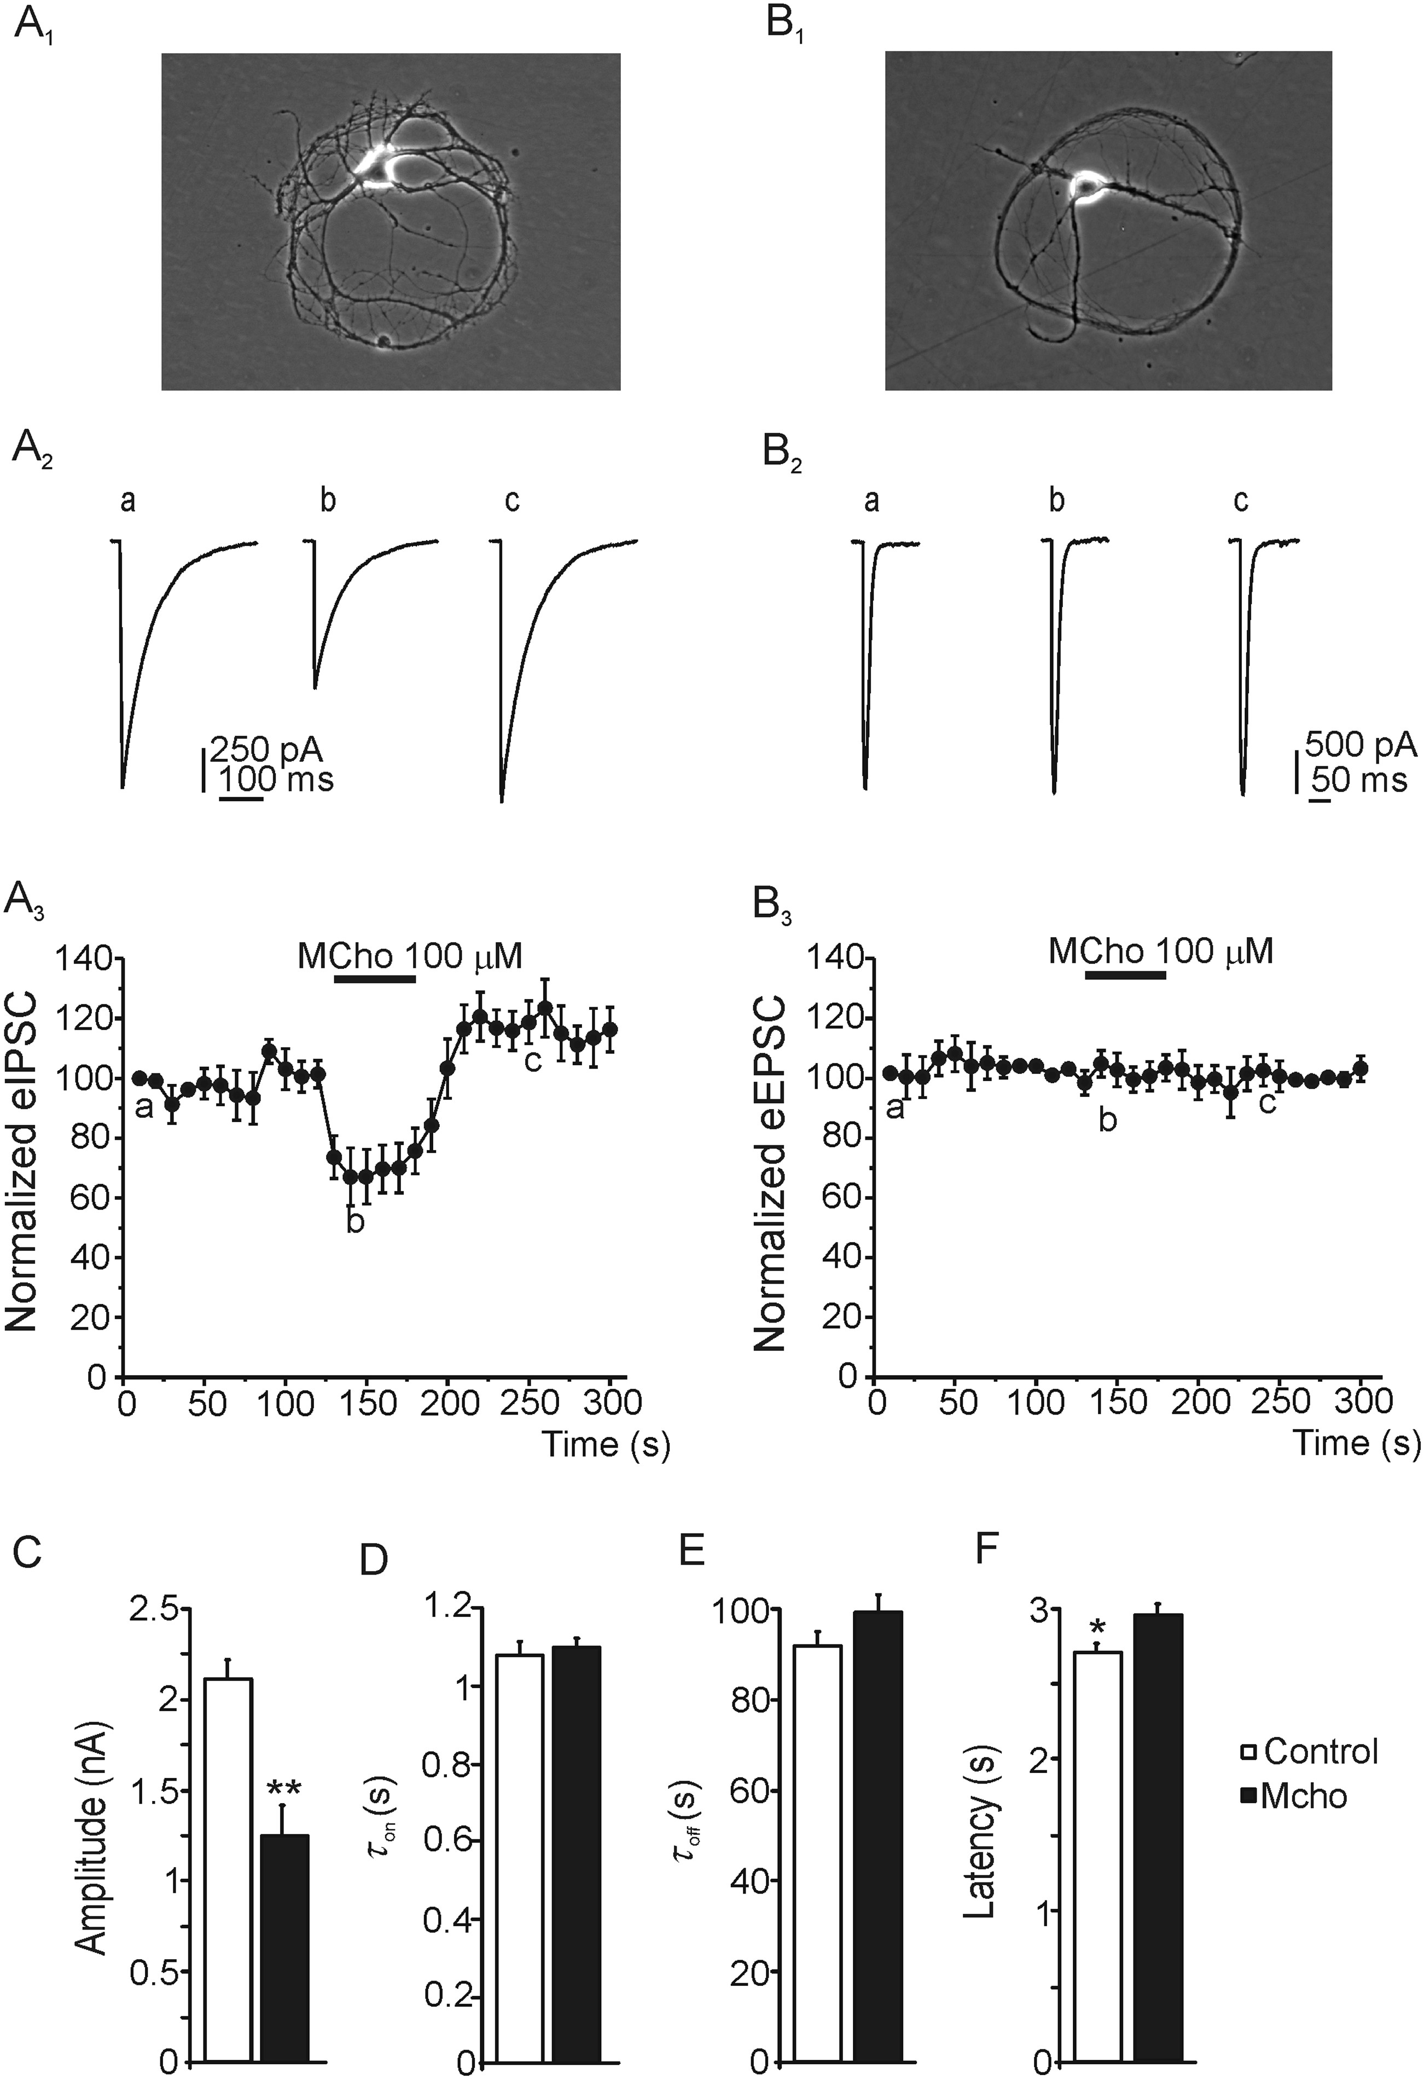
Figure 1. Selective muscarinic modulation of GABAergic synapses. (A₁ and B₁) Images of ...
Notes:
Figure 1. Selective muscarinic modulation of GABAergic synapses. (A1 and B1) Images of hippocampal interneuron (A1) and pyramidal neuron (B1) forming autaptic contacts. (A2 and B2) Representative ePSCs recorded (holding potential = −70 mV) in response to stimuli separated by 10 s, in the control (a), on methacholine (MCho) (b), and after recovery (c) in GABAergic (A2) or glutamatergic (B2) neurons. (A3 and B3) Time courses of the eIPSC (A3) and eEPSC (B3) amplitude elicited by the stimulation. Note that methacholine applied as indicated by the top horizontal bar only decreased the inhibitory current amplitude that was fully recovered following methacholine washout. Averaged eIPSC amplitude C, time constant of activation D and deactivation E, and synaptic delay F according to the experimental conditions described. Data are mean ± SEM of 8 neuron evaluated. *P < 0.05, **P < 0.01.
Unless provided in the caption above, the following copyright applies to the content of this slide: © The Author 2013. Published by Oxford University Press. All rights reserved. For Permissions, please e-mail: journals.permissions@oup.com

Slide 2
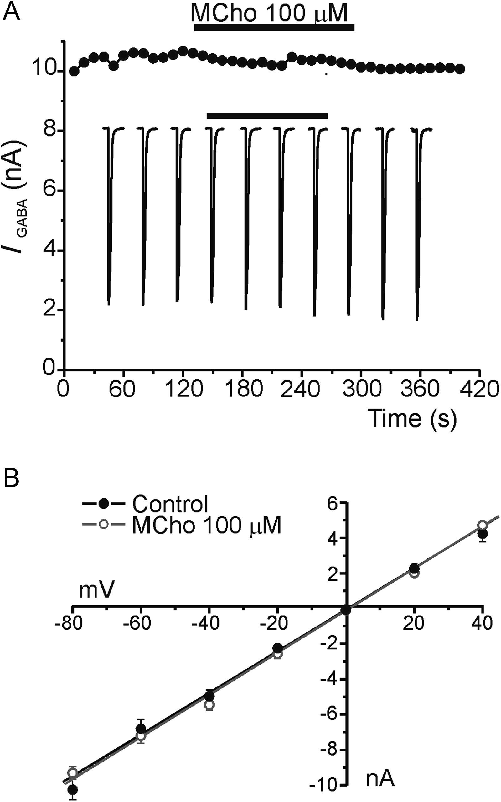
Figure 2. Effect of mAChRs activation on GABA-evoked currents. (A) Time course of I_{Cl} evoked by exogenous ...
Notes:
Figure 2. Effect of mAChRs activation on GABA-evoked currents. (A) Time course of ICl evoked by exogenous GABA (100 μM, 500-ms pulses) applied at 10-s intervals, in the control and during a 100-μM methacholine perfusion (top horizontal bar). Insets: original traces of GABA-evoked currents under the conditions described (n = 19). (B) GABA evoked currents amplitude versus holding potential relationship fitting by linear regression, in the control (filled circles) and on methacholine (empty circles) (n = 11). Data are means ± SEM. **P < 0.01.
Unless provided in the caption above, the following copyright applies to the content of this slide: © The Author 2013. Published by Oxford University Press. All rights reserved. For Permissions, please e-mail: journals.permissions@oup.com

Slide 3
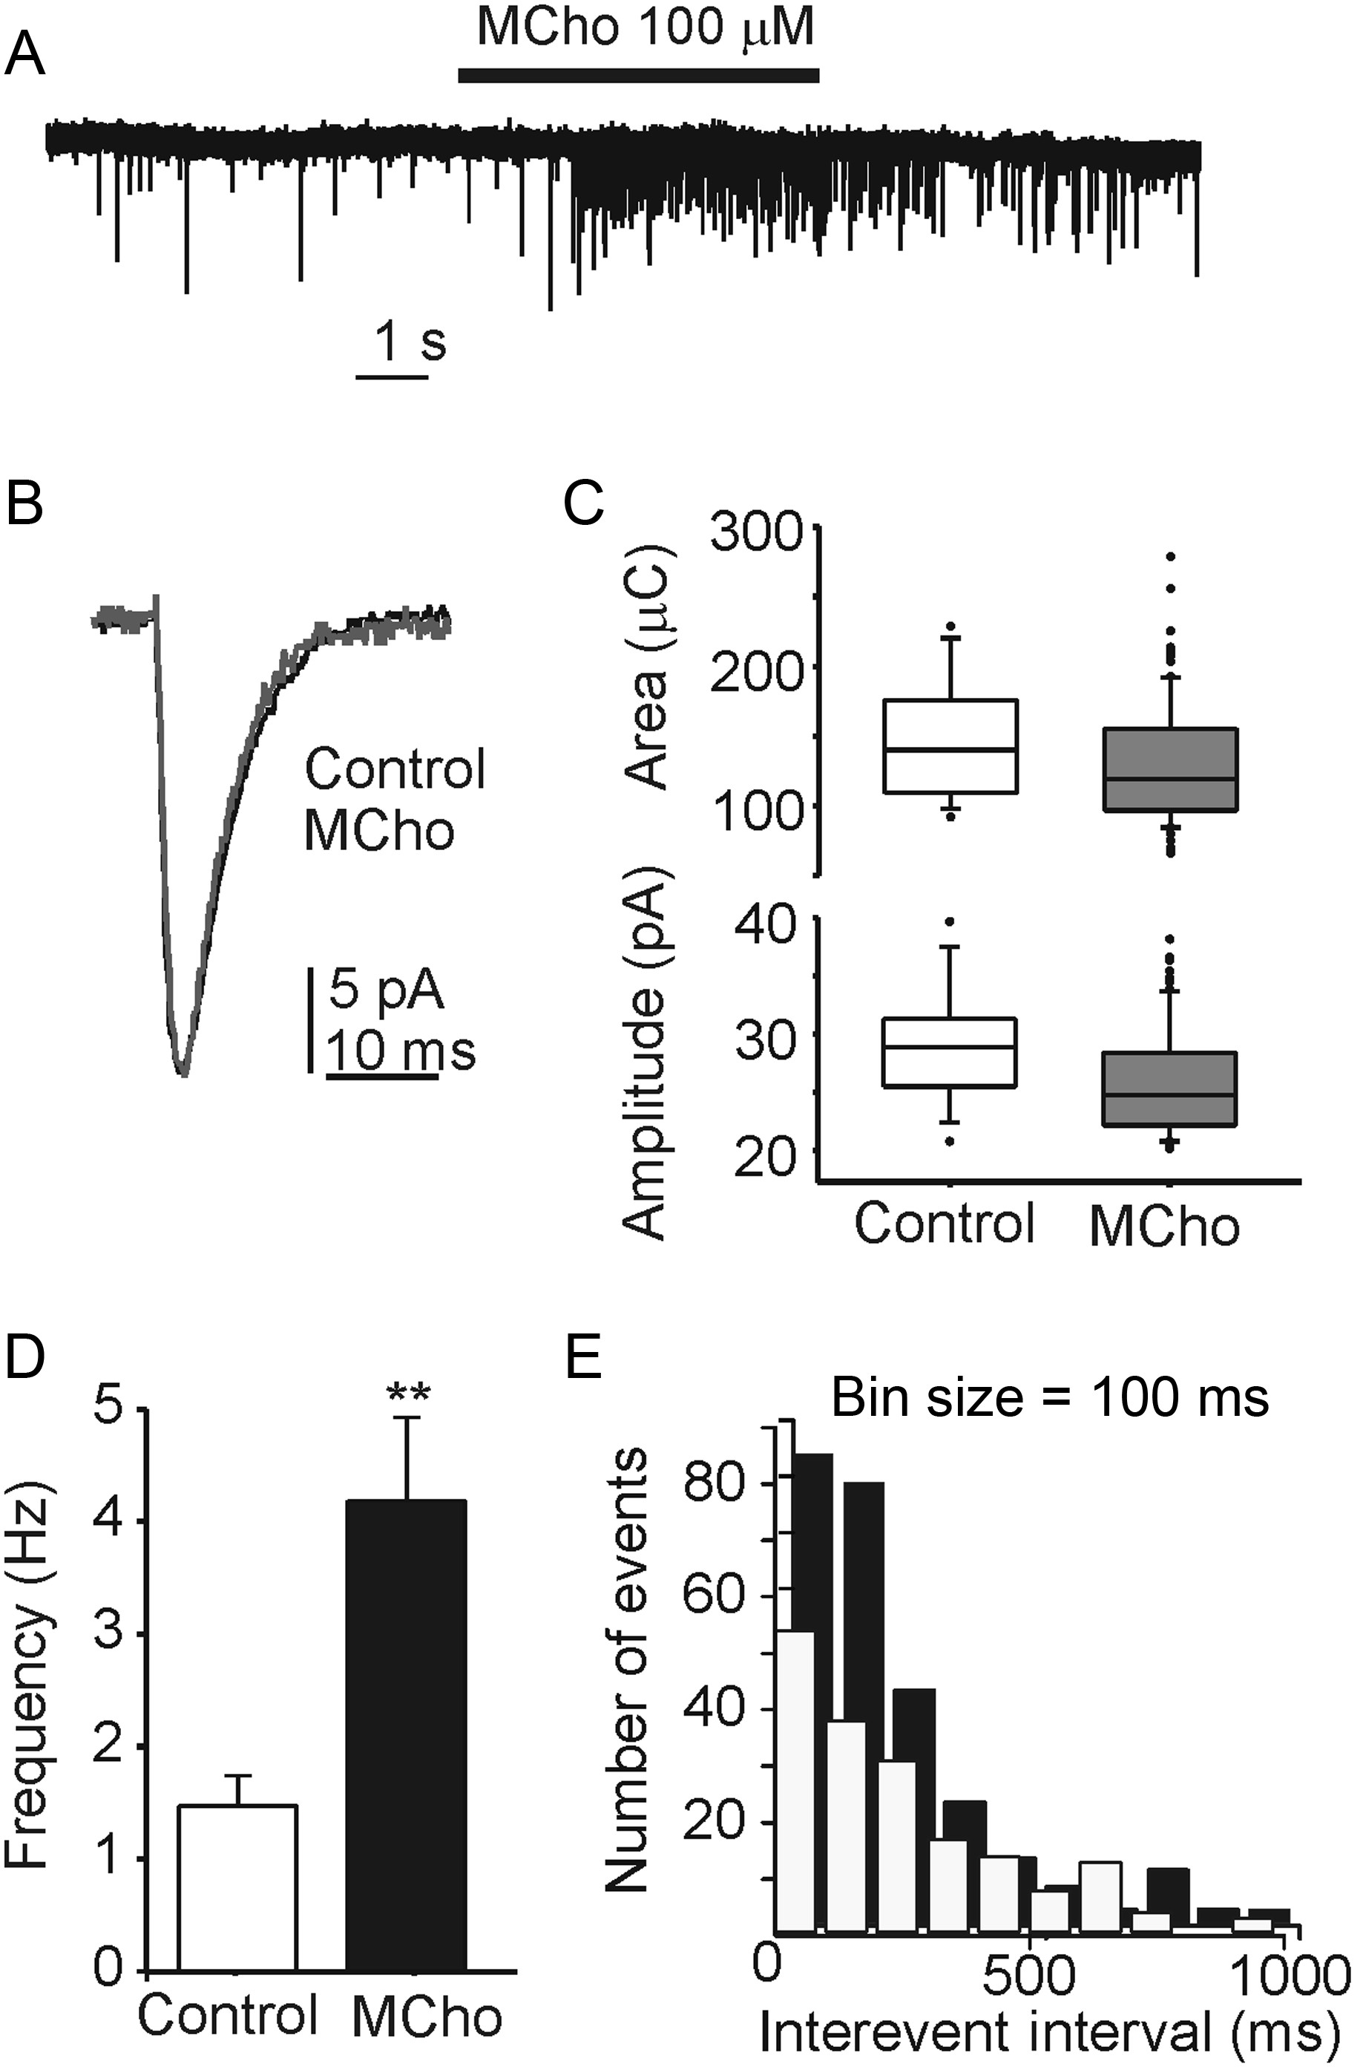
Figure 3. Frequency of miniature inhibitory postsynaptic currents was enhanced by methacholine. (A) Representative ...
Notes:
Figure 3. Frequency of miniature inhibitory postsynaptic currents was enhanced by methacholine. (A) Representative recording of mIPSCs under control conditions and in the presence of methacholine for the time indicated by the top horizontal bar. (B) Averaged traces of mIPSCs under control conditions and during methacholine application. (C) Averaged data of mIPSC amplitude (top panel) and area (bottom panel). The box plot represents the median and the quartiles (the lower quartile is the 25th percentile and the upper quartile is the 75th percentile), with a line from the lower quartile to the minimum point and another line from the upper quartile to the maximum point. The points represent the outlier data not included in the statistical analysis. (D) Averaged data of the frequency of quantal events for mIPSCs recorded under the conditions described. Note the enhancement during the methacholine application. Data are mean ± SEM of 11 neurons. **P < 0.01. (E) Frequency histogram of quantal events for mIPSCs recorded in the conditions indicated. Note the enhancement during the methacholine application at short interevents intervals (MCho, black columns).
Unless provided in the caption above, the following copyright applies to the content of this slide: © The Author 2013. Published by Oxford University Press. All rights reserved. For Permissions, please e-mail: journals.permissions@oup.com

Slide 4
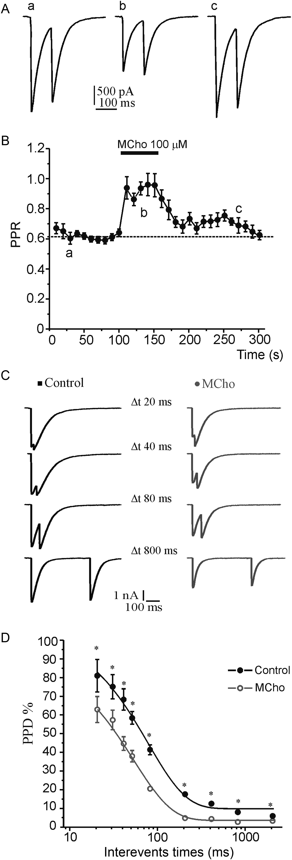
Figure 4. Effect of mAChRs activation on the PPD. (A) Representative eIPSCs recorded in response to paired stimuli ...
Notes:
Figure 4. Effect of mAChRs activation on the PPD. (A) Representative eIPSCs recorded in response to paired stimuli separated by 100 ms and repeated every 10 s, in the control (a), during application of methacholine (b), and after washout (c). (B) Time course of PPR (I2/I1) over consecutive responses, as indicated in A. Note that methacholine, applied as indicated by the top horizontal bar, enhanced the PPR that recover to control values after methacholine washout. (C) eIPSCs recorded in the control (left) and during methacholine perfusion (right), in response to paired stimuli separated by the indicated IPIs (▵t). (D) The mean PPD was plotted as a function of the IPI (20, 30, 40, 50, 80, 200, 400, 800, and 2000 ms) and fitted by an exponential function (control, filled circles and methacholine, empty circles). Data are mean ± SEM of 15–16 neurons evaluated.
Unless provided in the caption above, the following copyright applies to the content of this slide: © The Author 2013. Published by Oxford University Press. All rights reserved. For Permissions, please e-mail: journals.permissions@oup.com

Slide 5
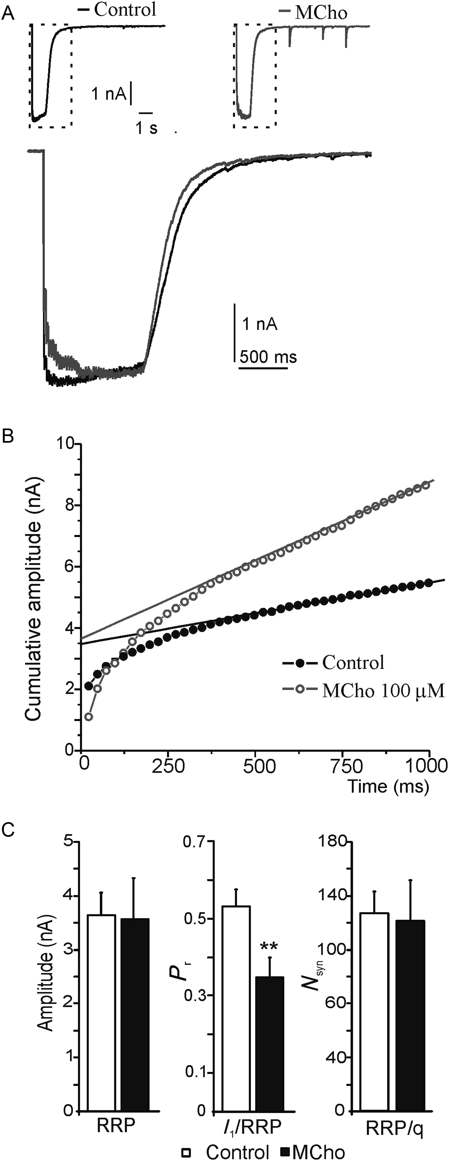
Figure 5. mAChRs activation enhanced the P_{r}, but did not affect the RRP size. (A) Representative recordings ...
Notes:
Figure 5. mAChRs activation enhanced the Pr, but did not affect the RRP size. (A) Representative recordings during a train of 40 stimuli at 40 Hz in single control and methacholine-treated neurons. (B) Cumulative eIPSC amplitude profile. To estimate the cumulative eIPSC amplitude before steady-state depression (RRP), data points in the range of 0.4–1 s were fitted by linear regression and back-extrapolated to time 0 (control, filled circles and methacholine, empty circle). (C) The size of RRP (left), the calculated Pr (middle), and the number of SVs (Nsyn) forming the RRP (right) are shown as mean ± SEM (control, empty bars and methacholine-treated, filled bars) (n = 11). **P < 0.01 versus control, Student's t-test.
Unless provided in the caption above, the following copyright applies to the content of this slide: © The Author 2013. Published by Oxford University Press. All rights reserved. For Permissions, please e-mail: journals.permissions@oup.com

Slide 6
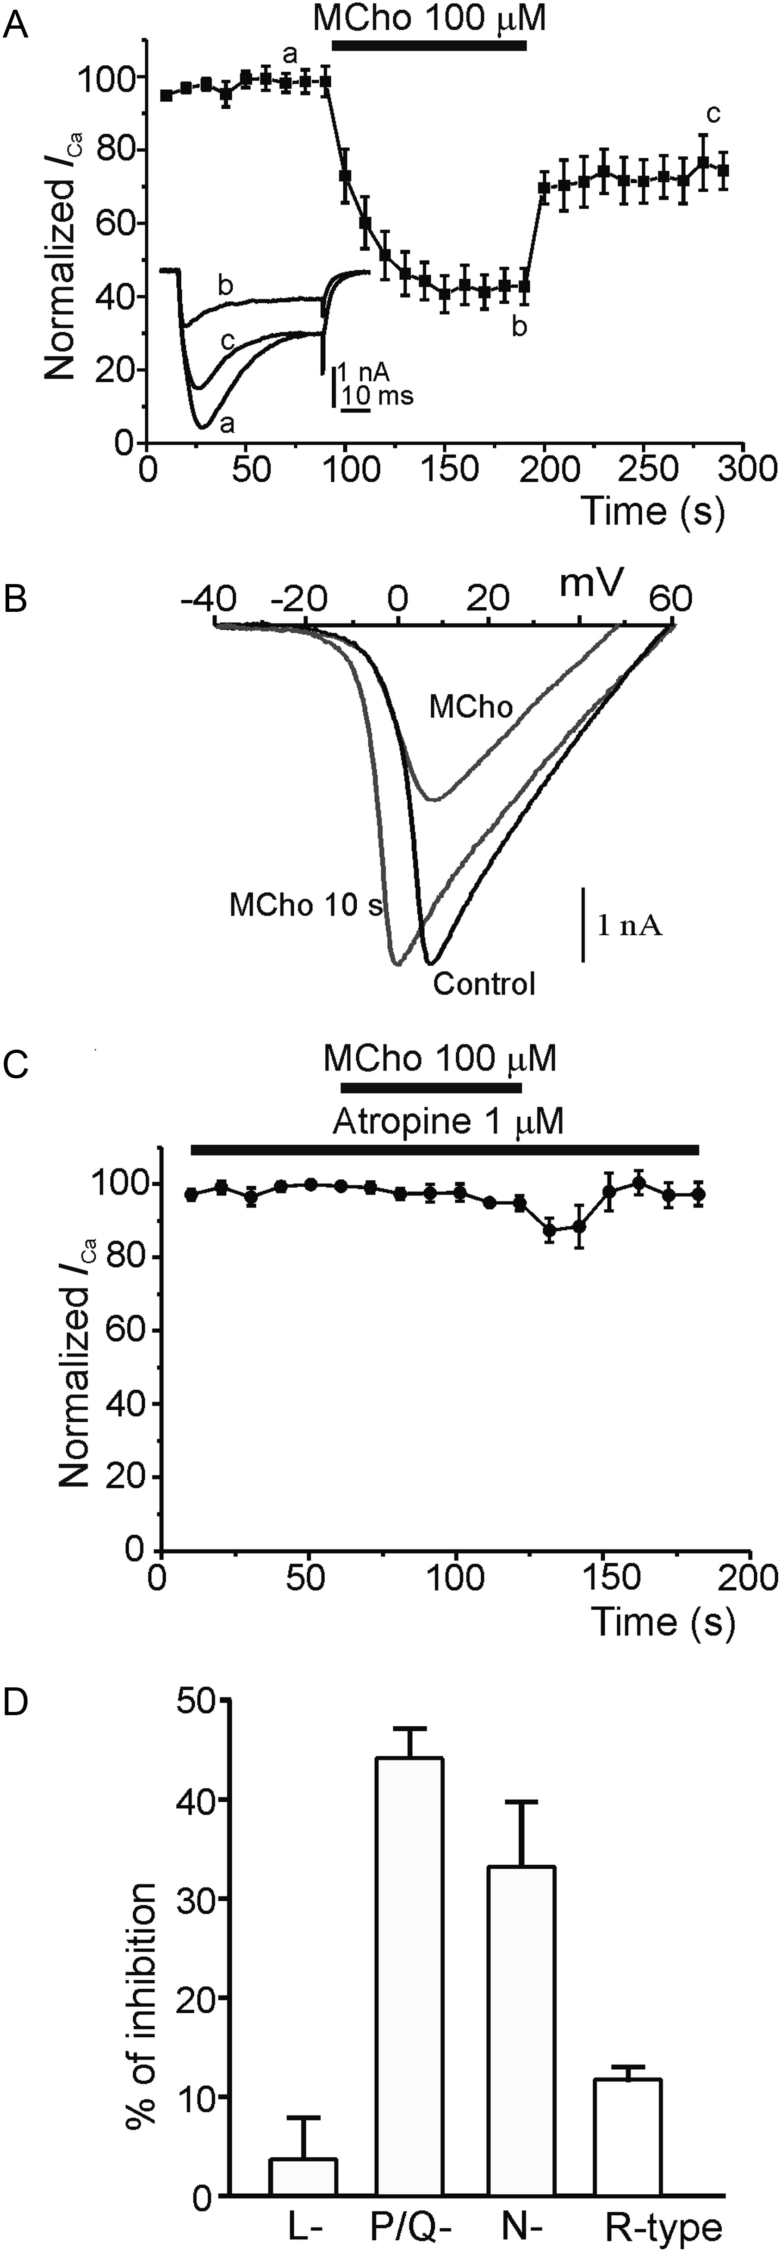
Figure 6. Blocking effects of methacholine on VGCCs. (A) Averaged time course of the somatic calcium current evoked by ...
Notes:
Figure 6. Blocking effects of methacholine on VGCCs. (A) Averaged time course of the somatic calcium current evoked by 50 ms depolarizing test pulses to 0 mV from holding potential of −70 mV applied at 10-s intervals in 10 mM Ca2+. Note the progressive decrement in the current amplitude evoked by methacholine (top horizontal bar). The amplitude of the initial ICa peak was normalized to 100% in each individual neuron tested. Inset shows original current traces obtained at the times indicated by the letters. The data are mean ± SEM (n = 8). (B) ICa is plotted as a function of a potential. The I/V curves were obtained under control conditions, after a 10-s application of methacholine (100 μM, MCho 10 s), and 1 min after methacholine perfusion (MCho). Neurons voltage-clamped at −70 mV were stimulated with a 100-ms depolarizing ramp to +60 mV at 10-s intervals. Note that application of the muscarinic agonist induced a clear negative shift of ICa. (C) The same protocol shown in A was repeated in the presence of atropine (1 μM). (D) Averaged depression exerted by methacholine on the individual calcium channels subtypes. The data are mean ± SEM (n = 6–12).
Unless provided in the caption above, the following copyright applies to the content of this slide: © The Author 2013. Published by Oxford University Press. All rights reserved. For Permissions, please e-mail: journals.permissions@oup.com

Slide 7
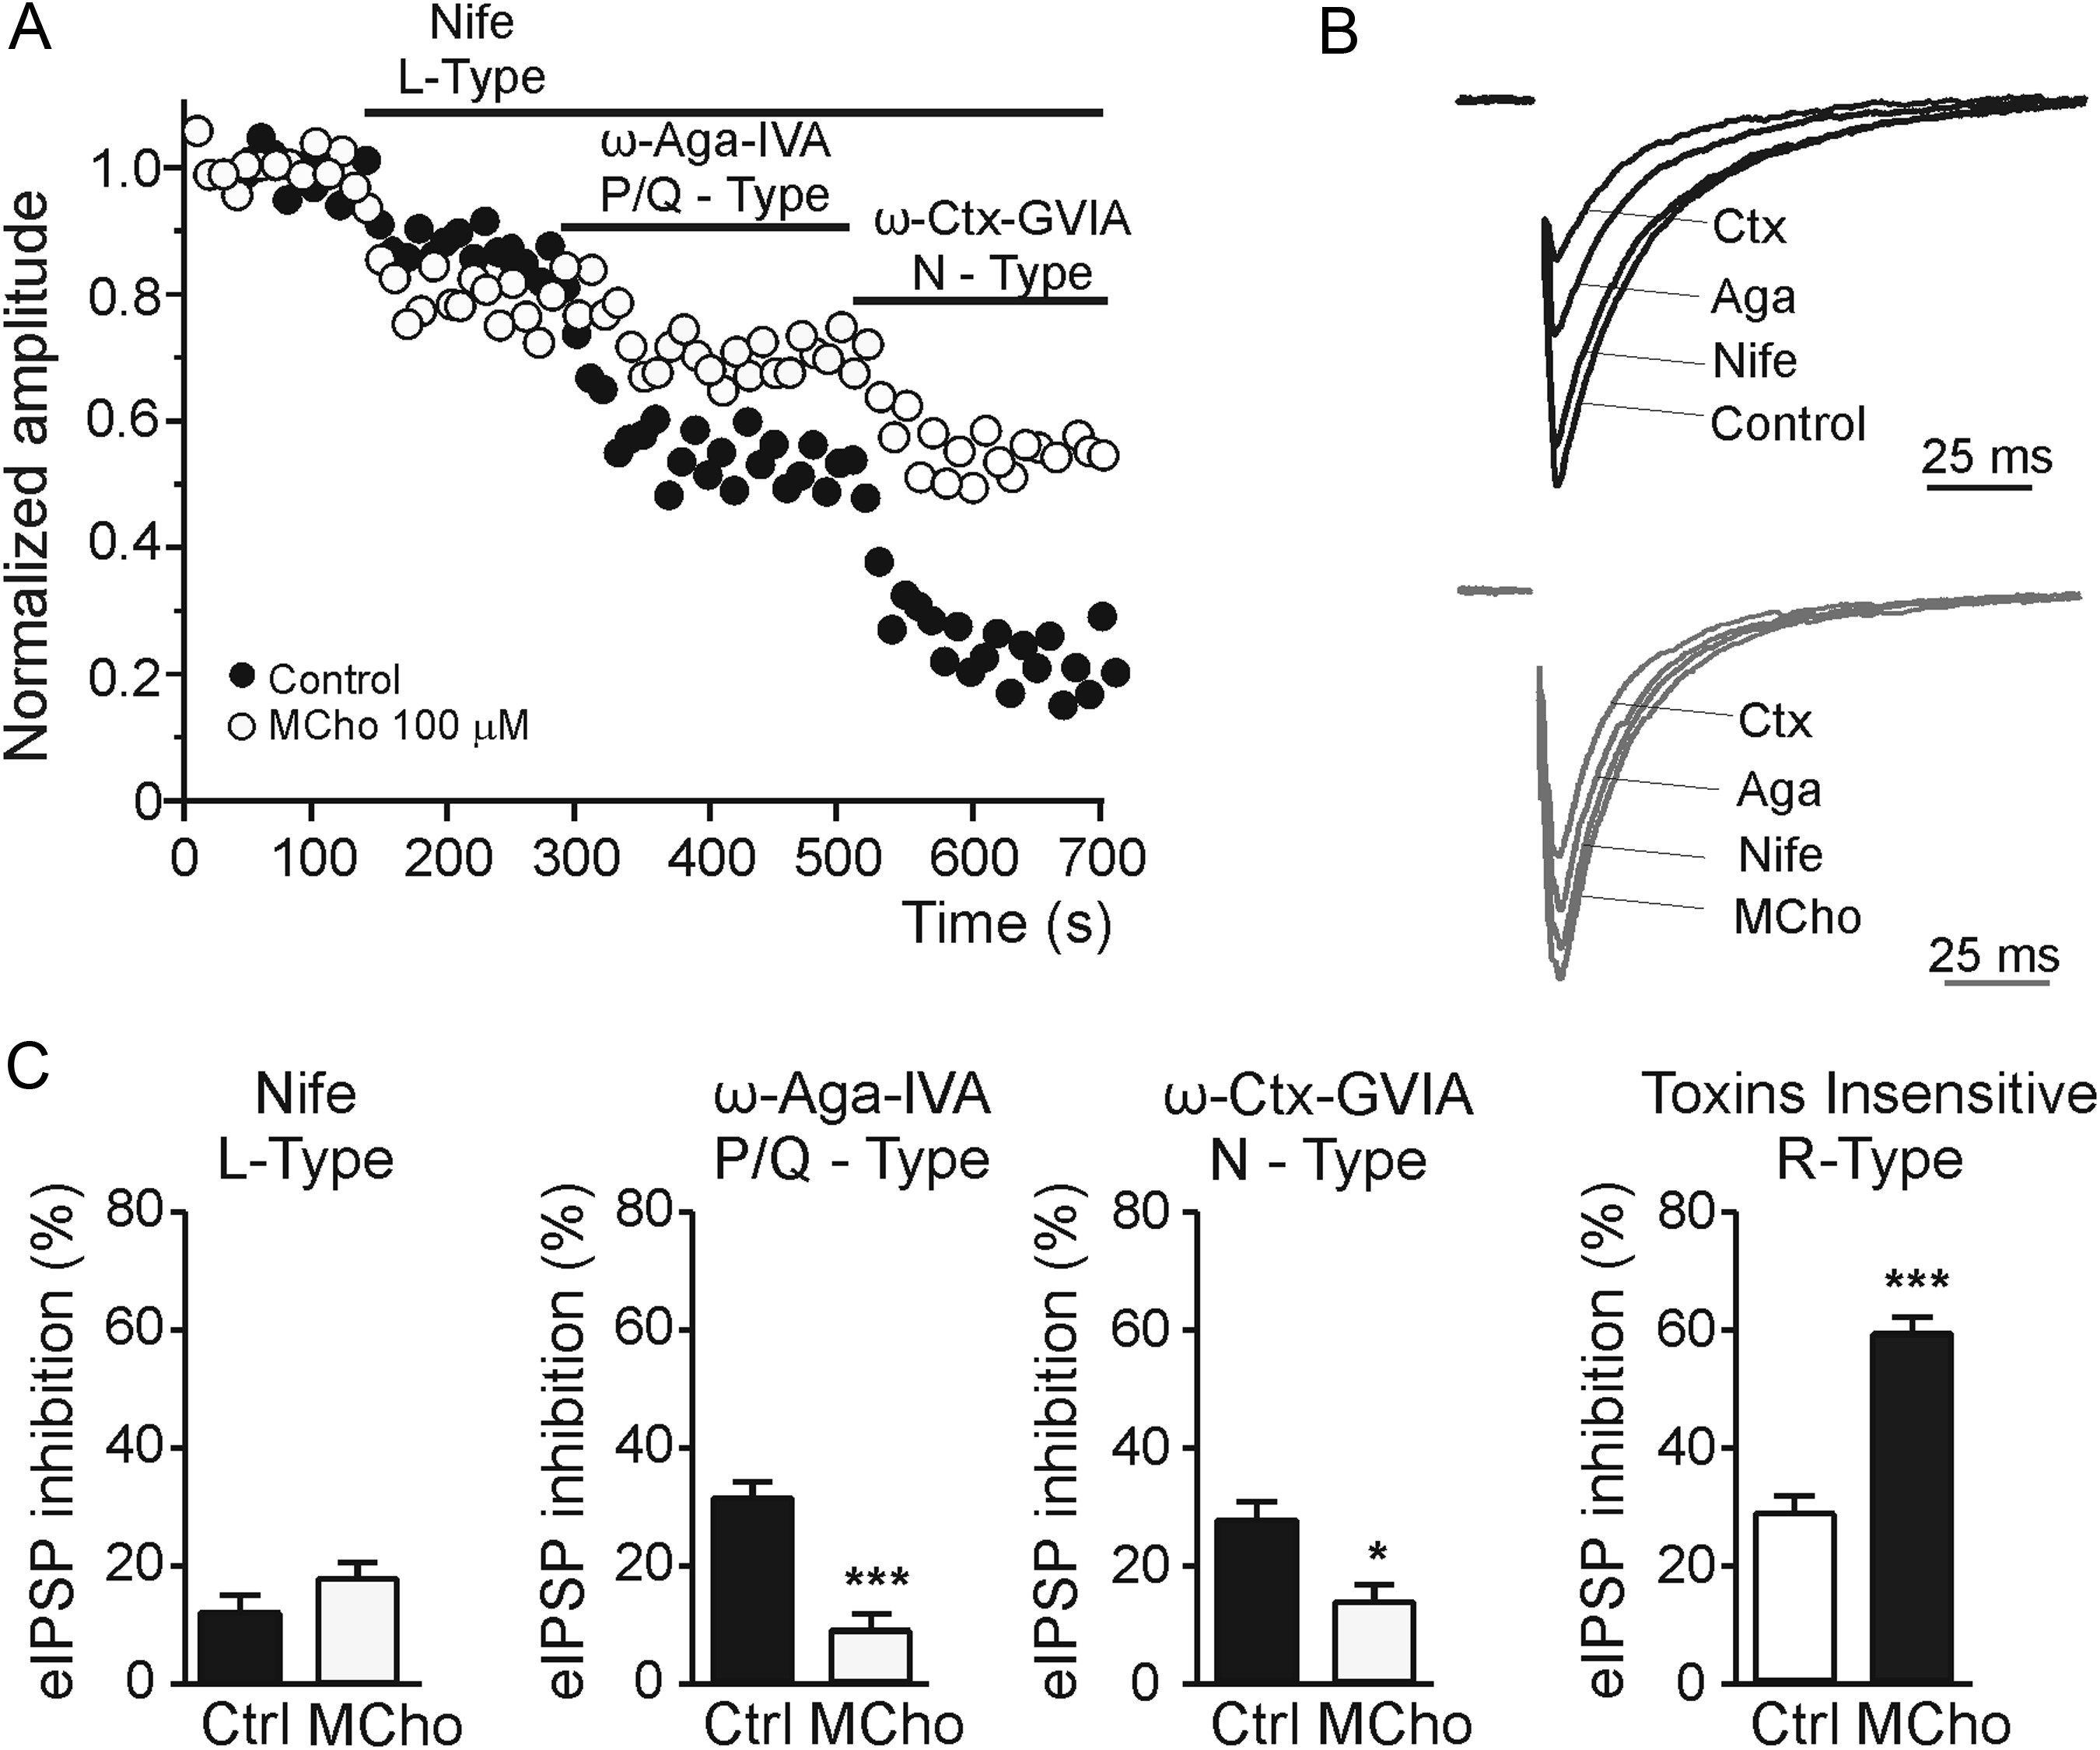
Figure 7. Pharmacological dissection of the inhibition exerted by methacholine on presynaptic Ca²⁺ channel ...
Notes:
Figure 7. Pharmacological dissection of the inhibition exerted by methacholine on presynaptic Ca2+ channel types supporting eIPSCs. (A) Time course of the normalized eIPSC amplitude in control (filled circles) and methacholine-treated (empty circles) neurons. 3 μM nifedipine, 2 μM ω-agatoxin IVA, and 1 μM ω-conotoxin GVIA were applied during the time indicated by the top horizontal bars. (B) Representative eIPSCs recorded during sequential application of the different calcium channel blockers in control condition (top panel) and in the presence of methacholine (bottom panel). (C) Mean percentage contribution of different Ca2+ channel subtypes to eIPSCs, estimated by separately applying the 3 Ca2+ antagonists on control (filled bars) and methacholine-treated neurons (empty bars). Data are mean ± SEM (n = 6). *P < 0.05; ***P < 0.001 versus controls.
Unless provided in the caption above, the following copyright applies to the content of this slide: © The Author 2013. Published by Oxford University Press. All rights reserved. For Permissions, please e-mail: journals.permissions@oup.com

Slide 8
Figure 8. Effect of methacholine on the synaptic depression induced by a short tetanic stimulation. (A) Time course of ...
Notes:
Figure 8. Effect of methacholine on the synaptic depression induced by a short tetanic stimulation. (A) Time course of normalized mean eIPSCs amplitude during a train of 40 stimuli at 40 Hz, in both the control and in methacholine-treated neurons (n = 11) fitted to a double exponential function (control, filled circles and methacholine, empty circles). (B) The time course of synaptic depression was fitted to a biexponential curve: I = $(A_{\rm fast} \times e^{ - t/{\rm tau}_{\rm f} } + A_{\rm slow} \times e^{ - t/{\rm tau}_{\rm s} } ) + \hbox{Iss}$. Plot histograms showing averaged τfast, τslow, and Iss for control (empty bars) and methacholine-treated (filled bars) neurons. (C) Representative eIPSCs elicited at 0.1 Hz, before and after a brief tetanization. (D) Mean normalized eIPSC amplitude (0.1 Hz) observed in control (filled circles) and methacholine-treated (empty circles) neurons undergoing a short stimulation train (arrowhead, 1 s at 40 Hz). Post-tetanic single eIPSCs elicited at 0.1 Hz were normalized to the pretetanic eIPSC level. (E) Averaged PPR obtained immediately before (b) and after (a) the short tetanic stimulation. Note that tetanization of the presynaptic neuron does not modified the PPR. Data are mean ± SEM of paired data (n = 10).
Unless provided in the caption above, the following copyright applies to the content of this slide: © The Author 2013. Published by Oxford University Press. All rights reserved. For Permissions, please e-mail: journals.permissions@oup.com

Slide 9
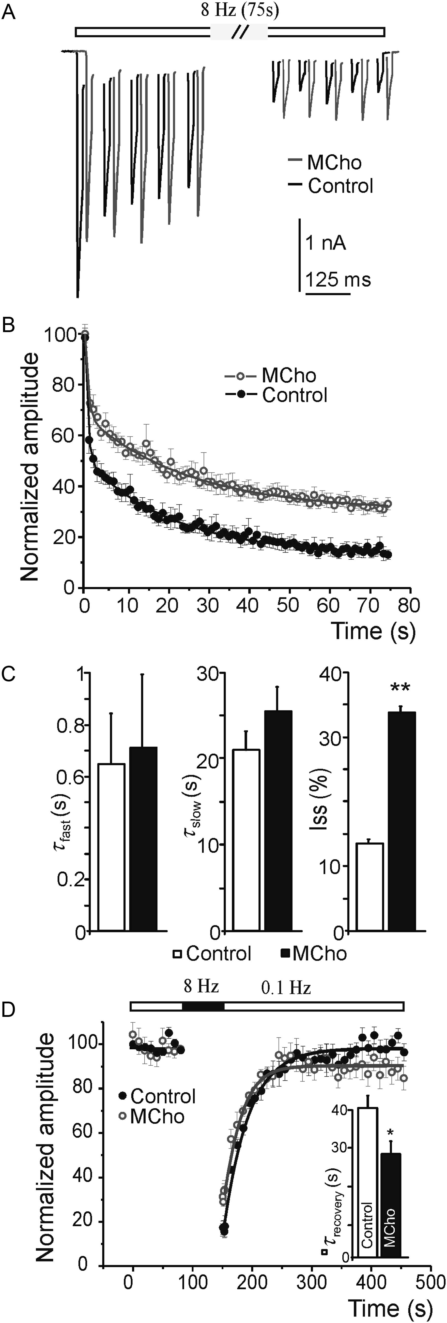
Figure 9. Methacholine reduced the rate of synaptic depression induced by a long-lasting stimulation and accelerated ...
Notes:
Figure 9. Methacholine reduced the rate of synaptic depression induced by a long-lasting stimulation and accelerated the recovery from depression. (A) Representative eIPSCs traces activated by a train stimulation applied at 8 Hz lasting 75 s in control conditions and during methacholine perfusion. (B) Time course of averaged synaptic depression for both control and methacholine-treated neurons. The data were normalized to the amplitude of the first eIPSC in the train. (C) The time course of synaptic depression was fitted to a biexponential curve: I = $(A_{{\rm fast}} \times e^{ - t/{\rm tau}_{\rm f} } + A_{\rm slow} \times e^{ - t/{\rm tau}_{\rm s} } ) + \hbox{Iss}$. Plot histograms showing averaged τfast and τslow in control and methacholine-treated neurons. (D) Time course of the eIPSC amplitude recovery (0.1 Hz) after tetanization (75 s at 8 Hz) (arrowhead) of the presynaptic neuron. The data were normalized to the mean eIPSC amplitude preceding the train application. Time courses of the eIPSC recovery were fitted to a monoexponential curves and in the inset shows the averaged τ of recovery in both control and methacholine-treated neurons. Data are mean ± SEM of 7 neurons evaluated. **P < 0.01, *P < 0.01 versus control, Student's t-test (paired t-test for Iss).
Unless provided in the caption above, the following copyright applies to the content of this slide: © The Author 2013. Published by Oxford University Press. All rights reserved. For Permissions, please e-mail: journals.permissions@oup.com

