Slide 1
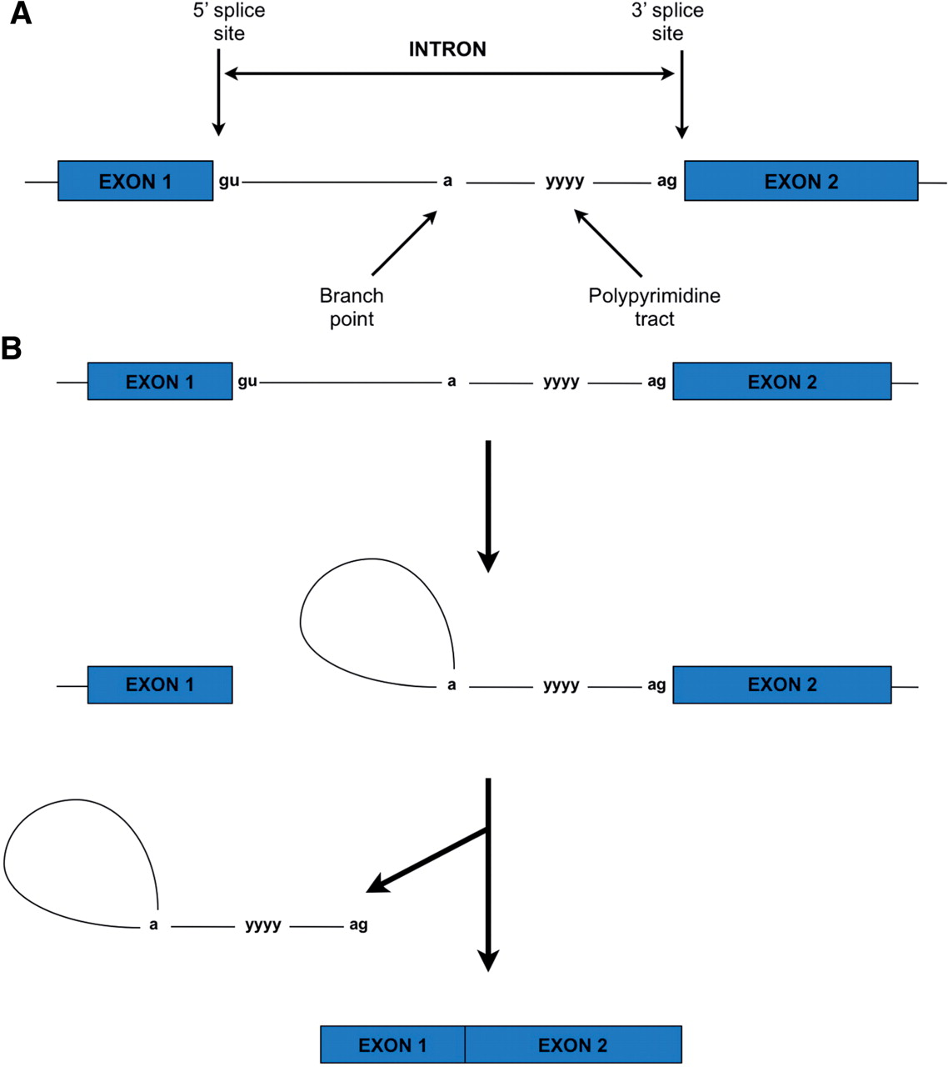
Figure 1: The basic splicing process. (A) Exons are represented by boxes and introns by lines. The invariant GU and AG ...
Notes:
Figure 1: The basic splicing process. (A) Exons are represented by boxes and introns by lines. The invariant GU and AG nucleotide sequences of the 5′ and 3′-splice sites are shown. Also shown is the branch point (A) and the nearby polypyrimidine tract (YYYY). (B) The first transesterification reaction creates a lariat structure joined at the branch point. The second transesterification reaction releases the lariat intron and ligates the exons together.
Unless provided in the caption above, the following copyright applies to the content of this slide: © The Author 2011. Published by Oxford University Press. All rights reserved. For permissions, please email: journals.permissions@oup.com

Slide 2
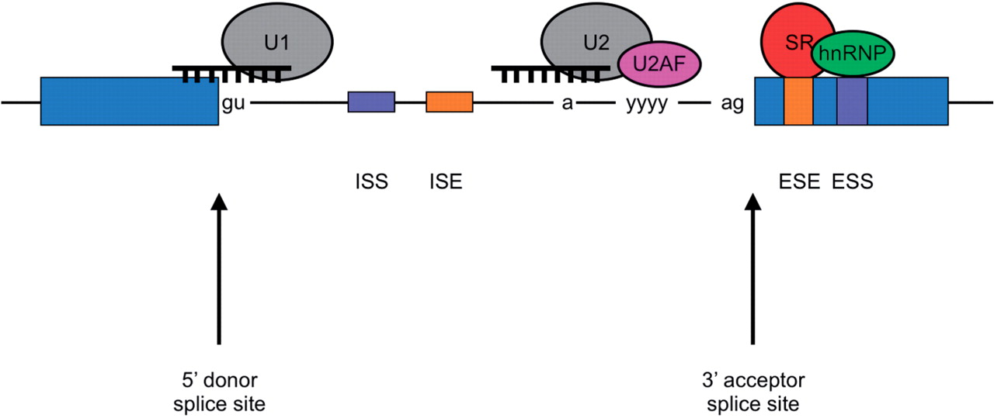
Figure 2: Control elements regulating splicing. U1 and U2 snRNPs bind via complementary base pairing to loose consensus ...
Notes:
Figure 2: Control elements regulating splicing. U1 and U2 snRNPs bind via complementary base pairing to loose consensus sequences at the 5' splice site and branch point respectively. U2AF (U2 auxillary factor) recognizes and binds to the polypyrimidine tract and facilitates correct U2 binding. SR proteins bind to ESEs and increase splice site use, while hnRNPs bind to ESSs and exert a negative effect on splice site use. Other splicing factor proteins bind to intronic splicing enhancers (ISEs) and silencers (ISSs).
Unless provided in the caption above, the following copyright applies to the content of this slide: © The Author 2011. Published by Oxford University Press. All rights reserved. For permissions, please email: journals.permissions@oup.com

Slide 3
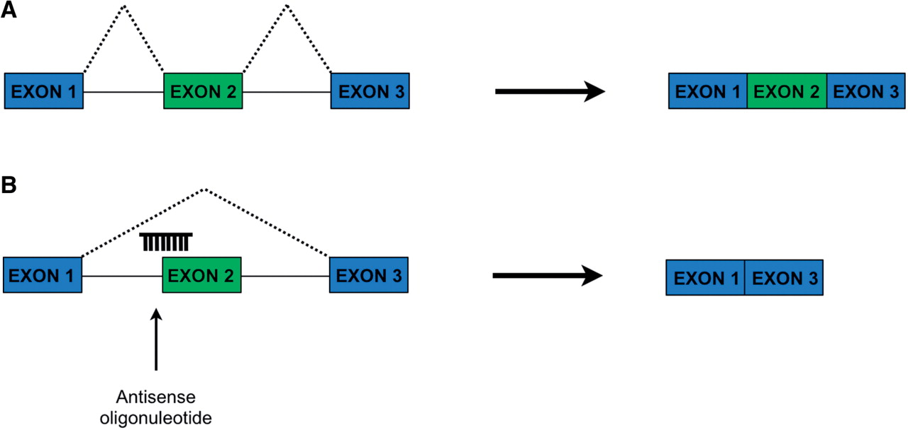
Figure 3: The principle of exon skipping using AONs. (A) In the top figure, consecutive exons are spliced together ...
Notes:
Figure 3: The principle of exon skipping using AONs. (A) In the top figure, consecutive exons are spliced together through recognition of consecutive 5′- and 3′-splice sites. (B) In the bottom panel, an AON hybridizes to the 3′-splice site of the first intron, preventing its recognition by the splicing machinery. Instead, the next available 3′-splice site (in the following intron) is used, resulting in exclusion of the intervening exon. AONs may be targeted to other regulatory sequences such as ESEs, ESSs, ISEs or ISSs in order to achieve the desired effect.
Unless provided in the caption above, the following copyright applies to the content of this slide: © The Author 2011. Published by Oxford University Press. All rights reserved. For permissions, please email: journals.permissions@oup.com

Slide 4
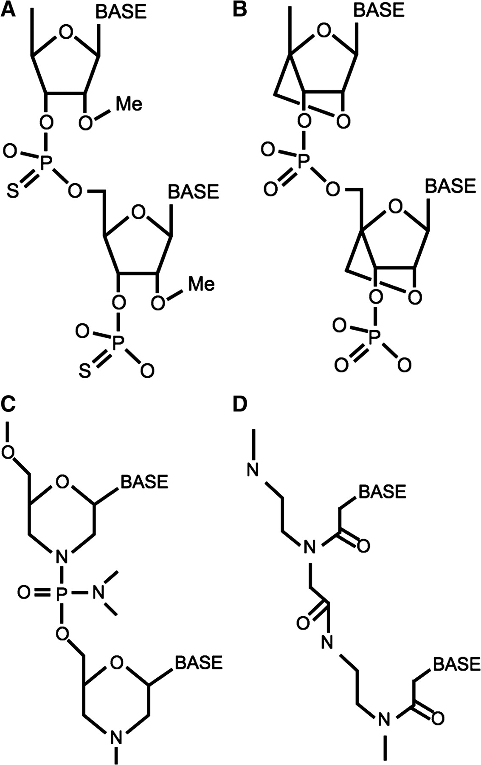
Figure 4: Chemical structures of commonly used AONs. (A) 2'-O-methyl phosphorothioates. This chemistry resembles RNA ...
Notes:
Figure 4: Chemical structures of commonly used AONs. (A) 2'-O-methyl phosphorothioates. This chemistry resembles RNA but has a methyl group at the 2'-O position and has a phosphorothioate rather than a phosphate group linking the ribose molecules. (B) LNAs. This closely resembles RNA but incorporates an extra carbon linker between the 2'-O and the 4' carbon. (C) PMOs. The ribose molecules are replaced by morpholine ring moieties and the phosphodiester bonds are replaced by phosphorodiamidate linkers. (D) PNAs. The entire sugar–phosphate backbone structure has been replaced by a repeating aminoethylglycine backbone and acetyl linkers carry the bases.
Unless provided in the caption above, the following copyright applies to the content of this slide: © The Author 2011. Published by Oxford University Press. All rights reserved. For permissions, please email: journals.permissions@oup.com

Slide 5
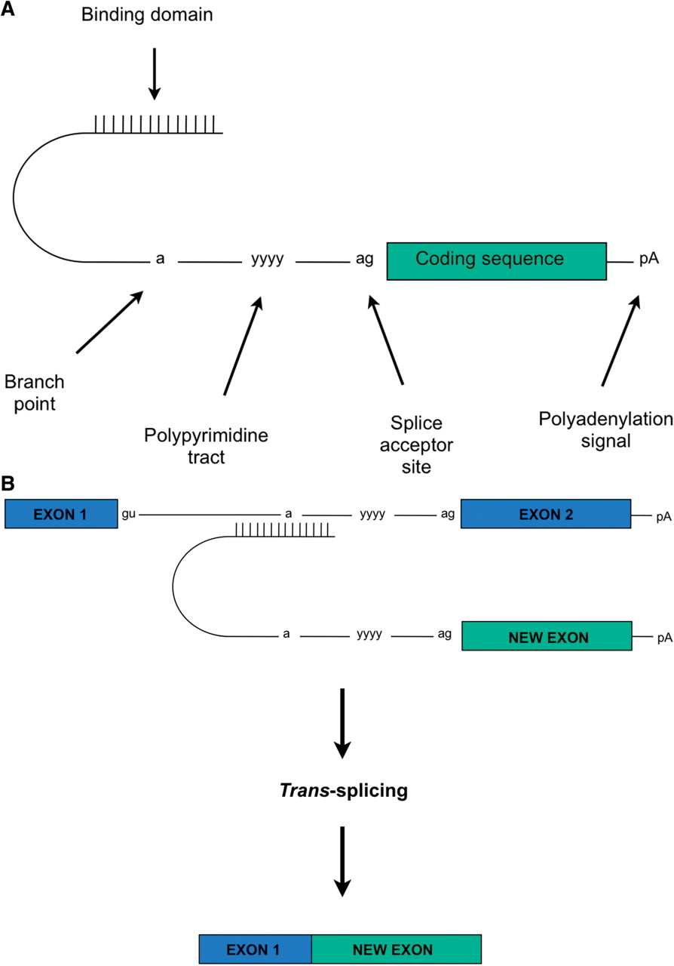
Figure 5: Trans-splicing. (A) Example of a pre-trans-splicing molecule (PTM). (B) The binding domain of the PTM ...
Notes:
Figure 5: Trans-splicing. (A) Example of a pre-trans-splicing molecule (PTM). (B) The binding domain of the PTM hybridizes to its target pre-mRNA. Strong splice sites within the PTM encourage preferential trans-splicing to generate a ‘reprogrammed’ mRNA.
Unless provided in the caption above, the following copyright applies to the content of this slide: © The Author 2011. Published by Oxford University Press. All rights reserved. For permissions, please email: journals.permissions@oup.com

