Slide 1
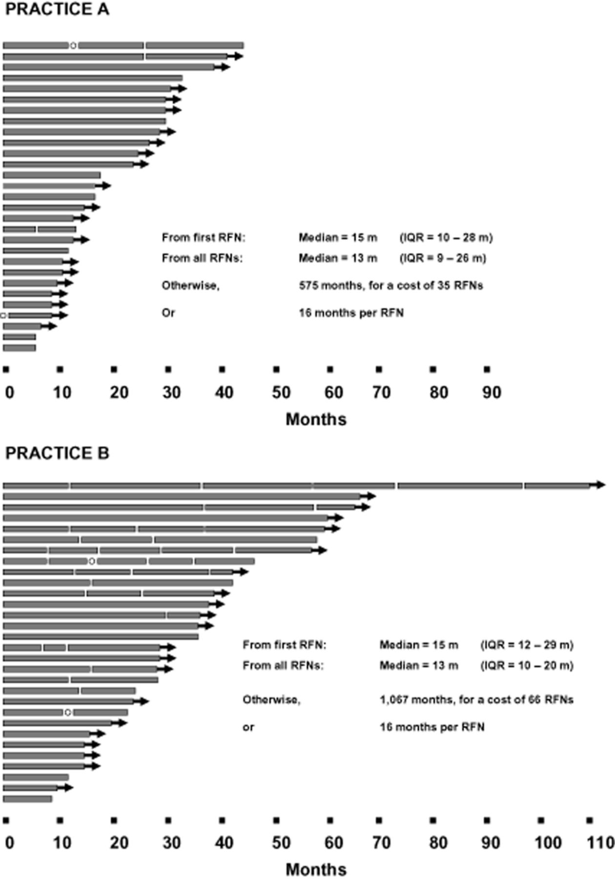
Figure 1 Duration of relief reported by patients treated with lumbar radiofrequency neurotomy. Each line represents ...
Notes:
Figure 1 Duration of relief reported by patients treated with lumbar radiofrequency neurotomy. Each line represents one patient. Each bar indicates the duration of relief following a single treatment. Interruptions indicate that relief ceased, followed by repeat treatment. Arrowheads indicate that complete relief was continuing at the time of follow-up. Circles indicate an RFN that was not successful. The insets summarize the statistical parameters of each set of outcomes. IQR = interquartile range; RFN = radiofrequency neurotomy.
Unless provided in the caption above, the following copyright applies to the content of this slide: © 2013 American Academy of Pain Medicine

