Slide 1
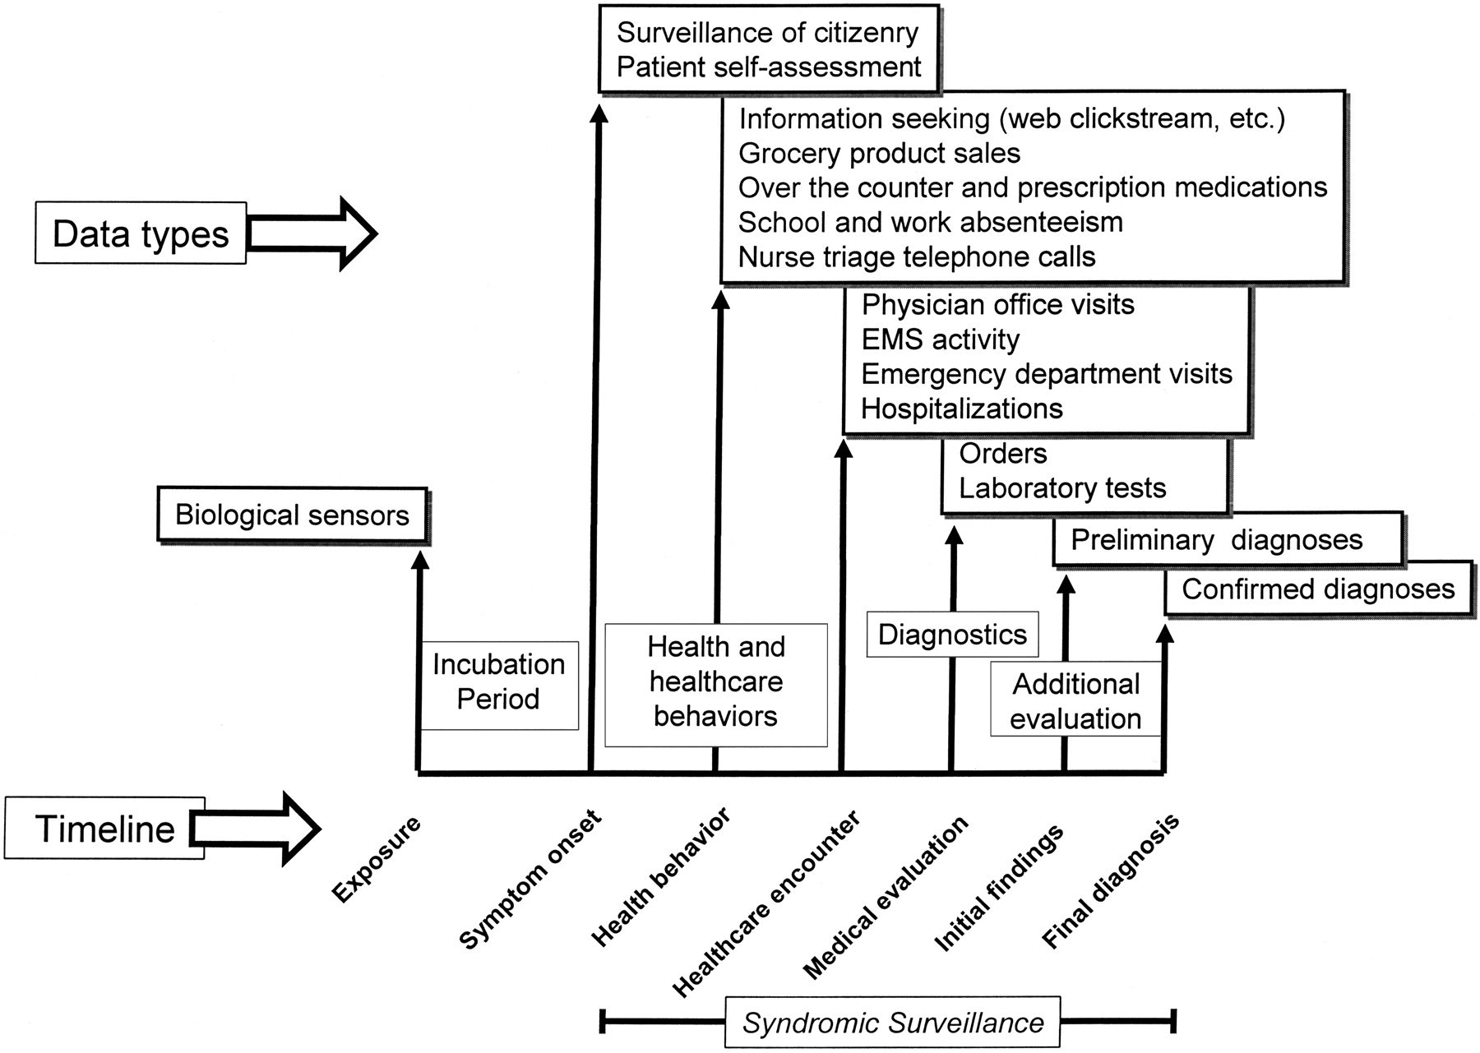
Figure 1 A progression of useful data sources as related to the underlying infection and associated behaviors.
Notes:
Figure 1 A progression of useful data sources as related to the underlying infection and associated behaviors.
Unless provided in the caption above, the following copyright applies to the content of this slide: American Medical Informatics Association

Slide 2
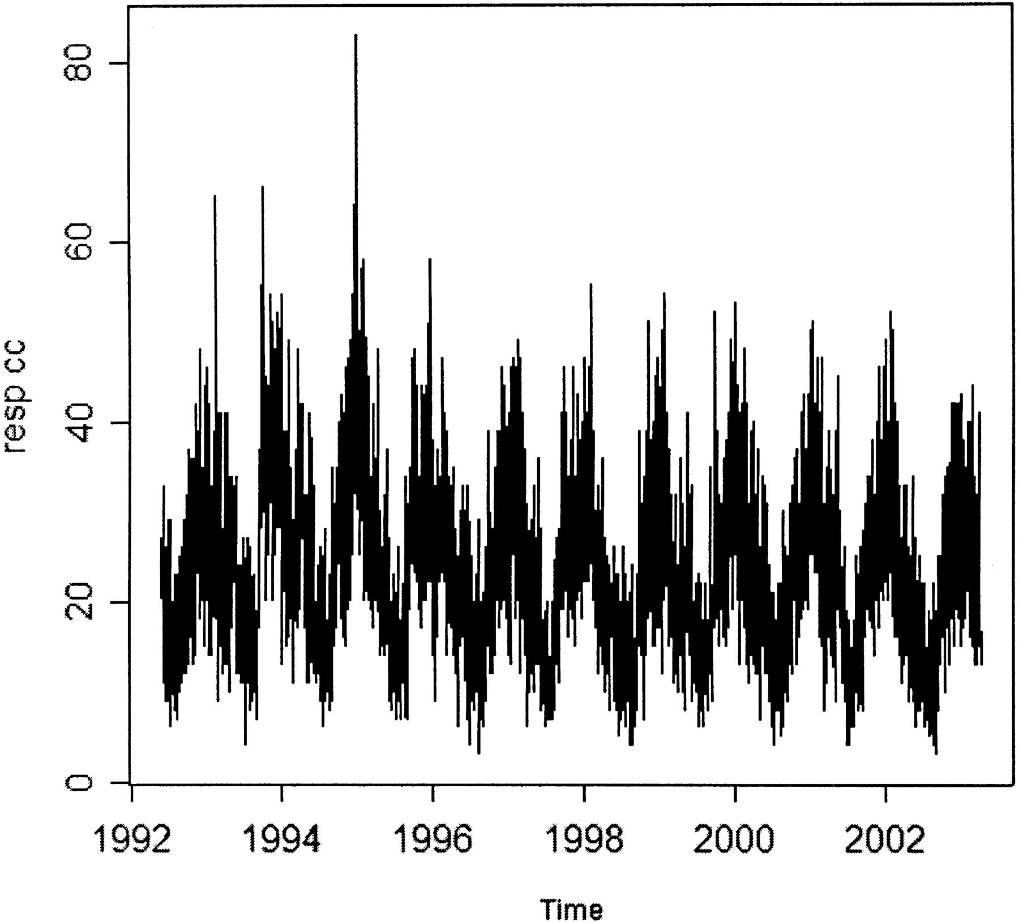
Figure 2 Daily rates of emergency department visits for respiratory syndromes as tracked by the AEGIS system at ...
Notes:
Figure 2 Daily rates of emergency department visits for respiratory syndromes as tracked by the AEGIS system at Children's Hospital Boston from 1992 until early 2003.
Unless provided in the caption above, the following copyright applies to the content of this slide: American Medical Informatics Association

