Slide 1
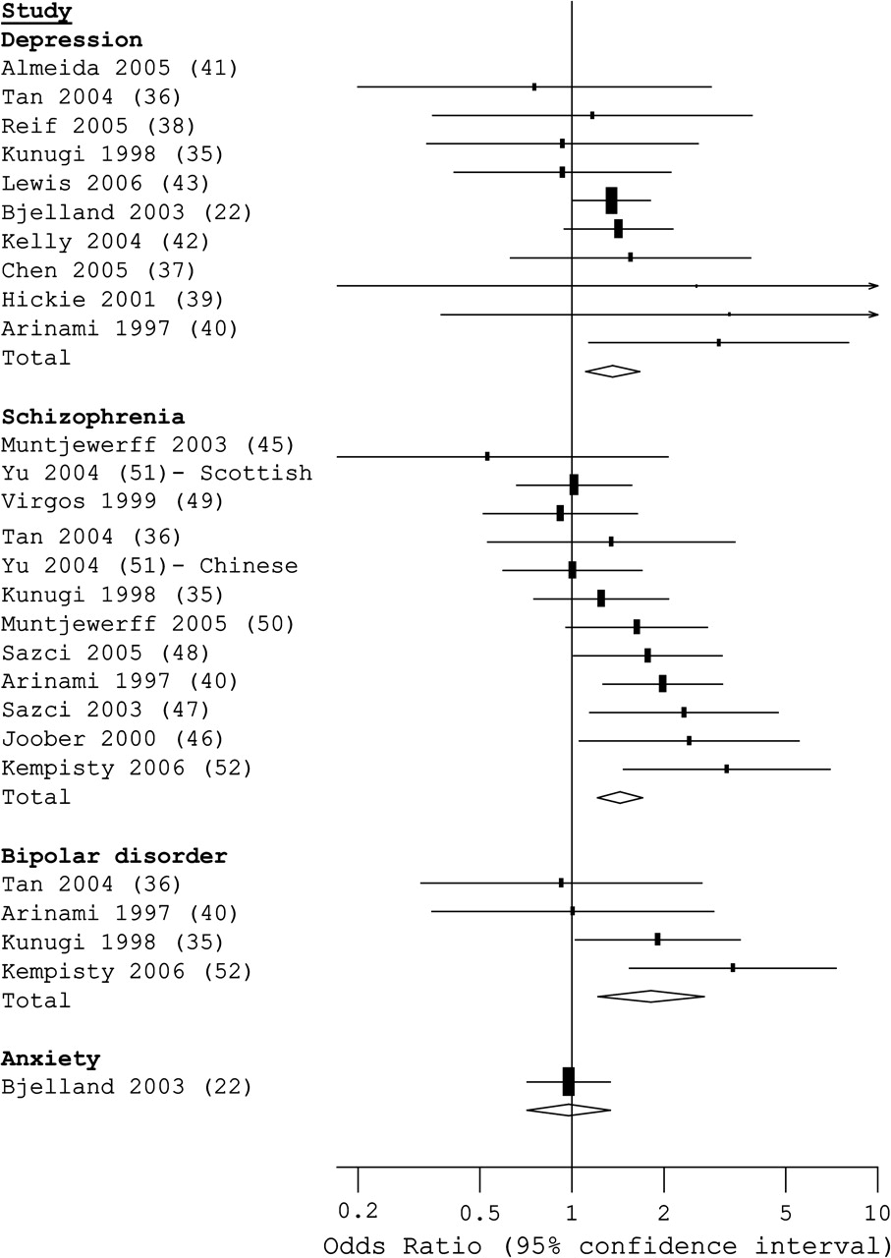
FIGURE 1 Results from fixed-effects meta-analysis of homozygous (TT vs. CC) genotypes of the methylenetetrahydrofolate ...
Notes:
FIGURE 1 Results from fixed-effects meta-analysis of homozygous (TT vs. CC) genotypes of the methylenetetrahydrofolate reductase (MTHFR) C677T polymorphism and psychiatric disorders. Reference numbers are given in parentheses. For study details and locations, see tables 1 and 2.
Unless provided in the caption above, the following copyright applies to the content of this slide: American Journal of Epidemiology Copyright © 2006 by the Johns Hopkins Bloomberg School of Public Health All rights reserved; printed in U.S.A.

Slide 2
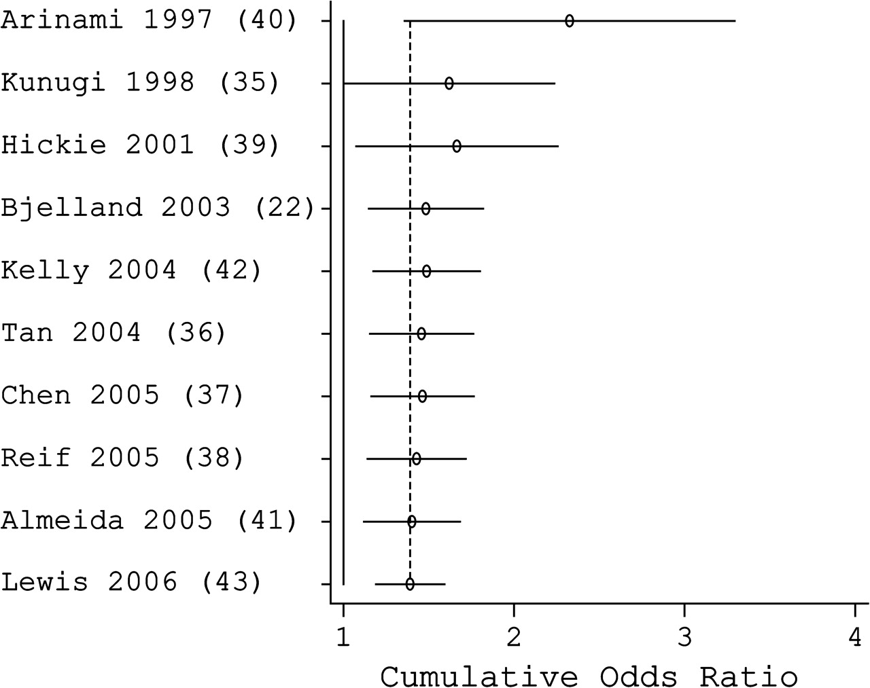
FIGURE 2 Results from cumulative fixed-effects meta-analysis of homozygous (TT vs. CC) genotypes of the ...
Notes:
FIGURE 2 Results from cumulative fixed-effects meta-analysis of homozygous (TT vs. CC) genotypes of the methylenetetrahydrofolate reductase (MTHFR) C677T polymorphism in depressed and nondepressed populations, by year of publication. Reference numbers are given in parentheses. For study details and locations, see tables 1 and 2.
Unless provided in the caption above, the following copyright applies to the content of this slide: American Journal of Epidemiology Copyright © 2006 by the Johns Hopkins Bloomberg School of Public Health All rights reserved; printed in U.S.A.

Slide 3
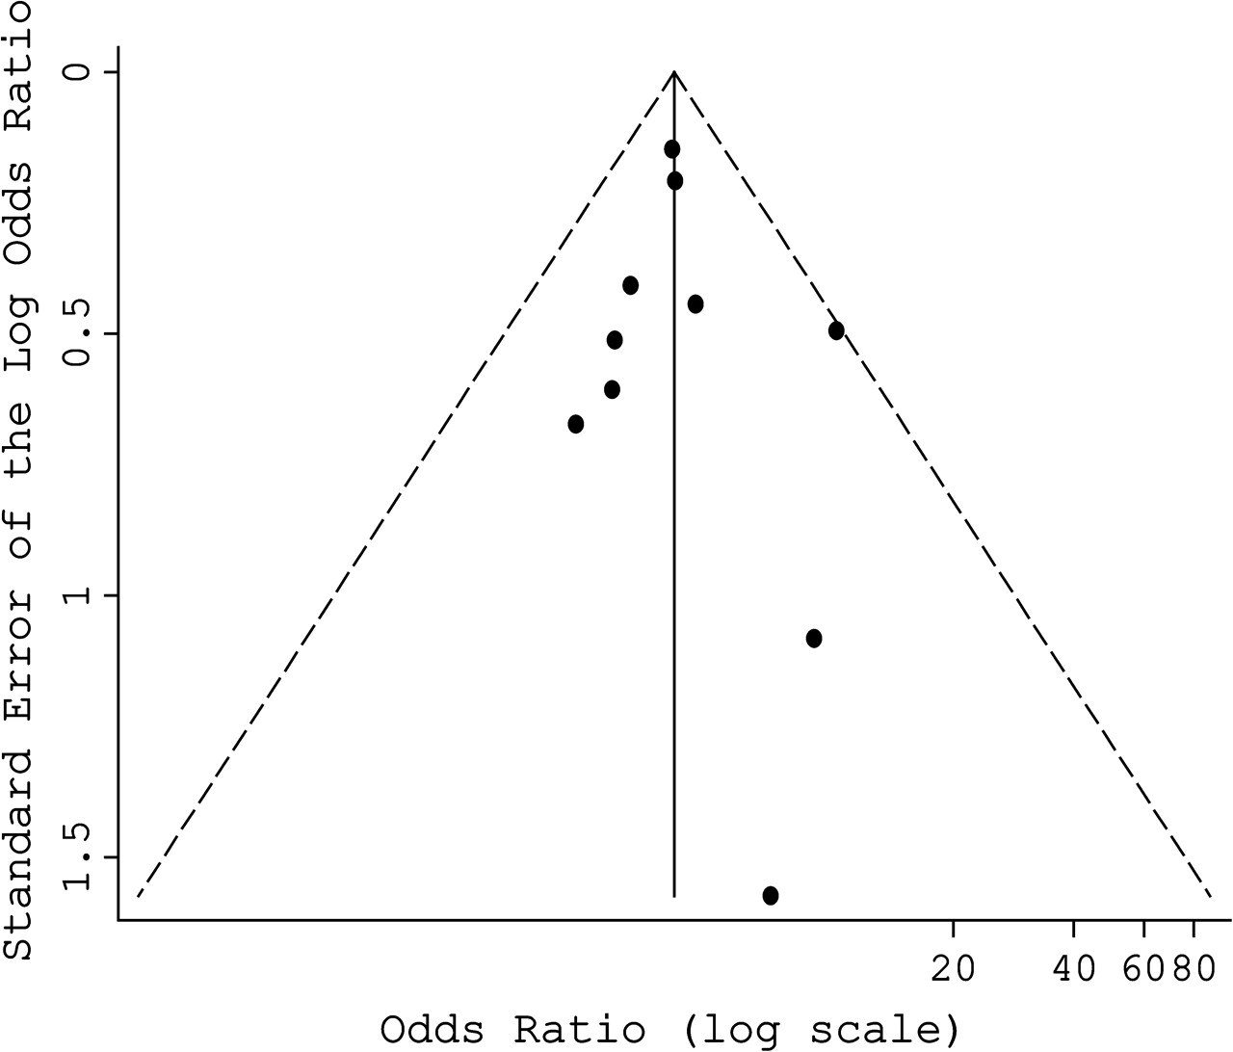
FIGURE 3 Funnel plot of effect size versus inverse standard error for homozygous (TT vs. CC) genotypes of the ...
Notes:
FIGURE 3 Funnel plot of effect size versus inverse standard error for homozygous (TT vs. CC) genotypes of the methylenetetrahydrofolate reductase (MTHFR) C677T polymorphism in depressed and control populations.
Unless provided in the caption above, the following copyright applies to the content of this slide: American Journal of Epidemiology Copyright © 2006 by the Johns Hopkins Bloomberg School of Public Health All rights reserved; printed in U.S.A.

Slide 4
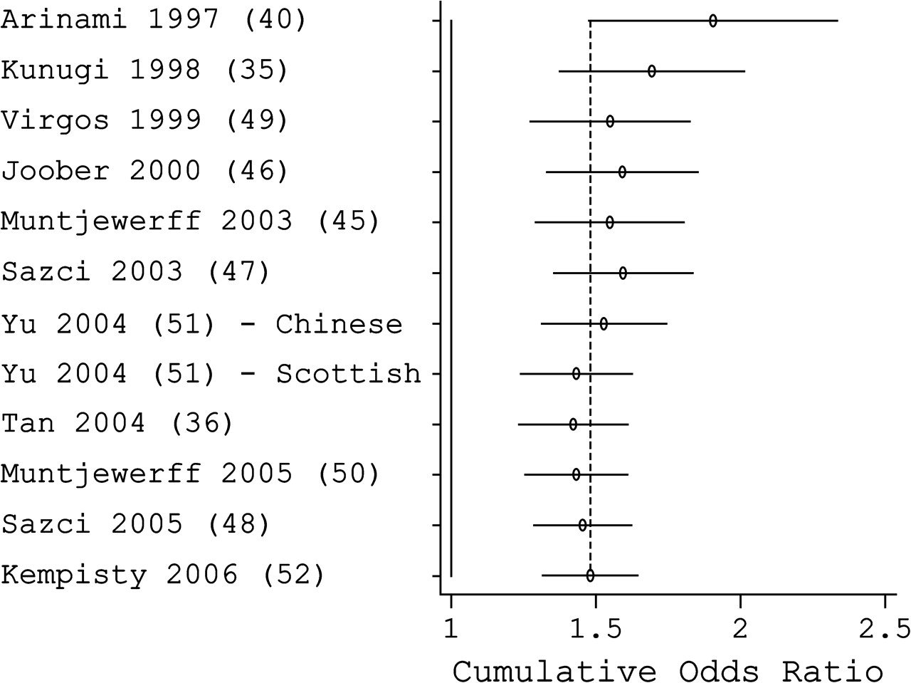
FIGURE 4 Results from cumulative fixed-effects meta-analysis of homozygous (TT vs. CC) genotypes of the ...
Notes:
FIGURE 4 Results from cumulative fixed-effects meta-analysis of homozygous (TT vs. CC) genotypes of the methylenetetrahydrofolate reductase (MTHFR) C677T polymorphism in persons with schizophrenia and control populations, by year of publication. Reference numbers are given in parentheses. For study details and locations, see tables 1 and 2.
Unless provided in the caption above, the following copyright applies to the content of this slide: American Journal of Epidemiology Copyright © 2006 by the Johns Hopkins Bloomberg School of Public Health All rights reserved; printed in U.S.A.

