Slide 1
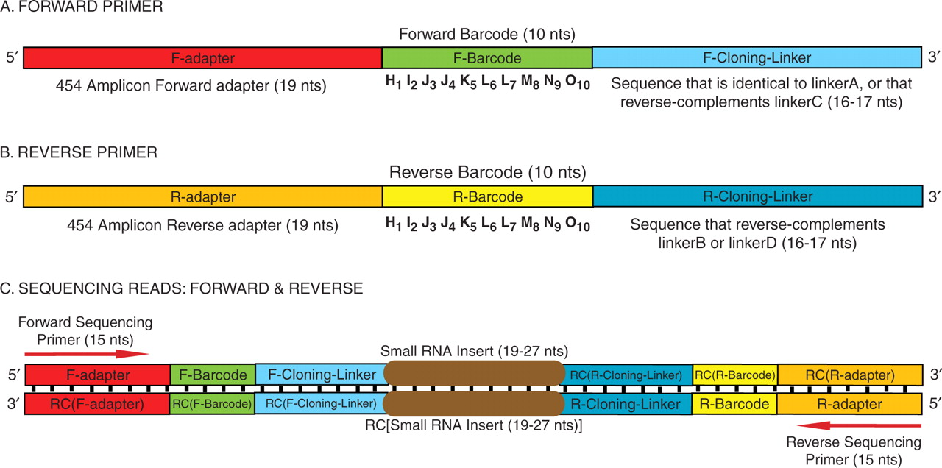
Figure 1. Design of forward and reverse primers. The synthesized primers are 45–46 nt long. ( A and B ) The template ...
Notes:
Figure 1. Design of forward and reverse primers. The synthesized primers are 45–46 nt long. ( A and B ) The template for the primers is: 454-Adapter:: Barcode:: Linker-Primer. Individual specifications for forward and reverse barcodes are also indicated. ( C ) Diagrammatic representation of the GS20 forward and reverse sequencing reads. ‘RC’ stands for Reverse Complement. Teeth denote base pairing.
Unless provided in the caption above, the following copyright applies to the content of this slide: © 2007 The Author(s)This is an Open Access article distributed under the terms of the Creative Commons Attribution Non-Commercial License (http://creativecommons.org/licenses/by-nc/2.0/uk/) which permits unrestricted non-commercial use, distribution, and reproduction in any medium, provided the original work is properly cited.

Slide 2
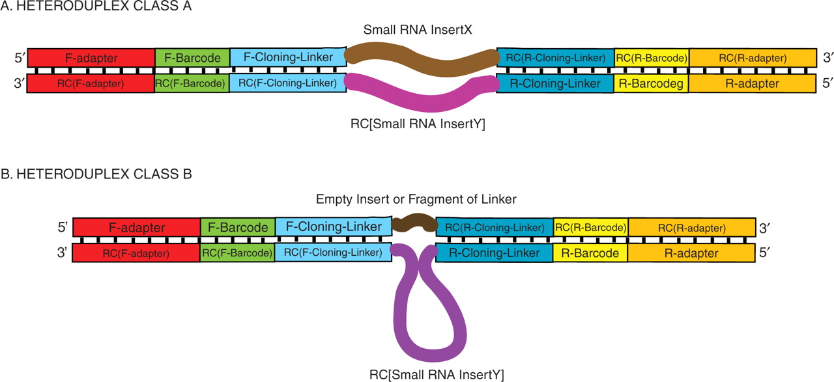
Figure 2. A diagrammatic representation of heteroduplexes that may be formed in an amplified pool. ( A ) ...
Notes:
Figure 2. A diagrammatic representation of heteroduplexes that may be formed in an amplified pool. ( A ) Heteroduplexes formed between molecules from the same sample that have the same barcode, but different RNA inserts (X and Y). ( B ) Heteroduplexes formed between molecules with RNA inserts and molecules with no RNA inserts (or with fragments of linkers as inserts). Formation of these unusual duplexes may be facilitated by the 45–46 nt complementarity at either end of the insert. Thus, three types of molecules may be present during later stages of PCR: single-stranded, perfectly double stranded ( Figure 1 C) and heteroduplexes (shown here). The ratio of the three species is determined by the number of PCR cycles. As in Figure 1, ‘RC’ stands for Reverse Complement, and teeth denote base pairing.
Unless provided in the caption above, the following copyright applies to the content of this slide: © 2007 The Author(s)This is an Open Access article distributed under the terms of the Creative Commons Attribution Non-Commercial License (http://creativecommons.org/licenses/by-nc/2.0/uk/) which permits unrestricted non-commercial use, distribution, and reproduction in any medium, provided the original work is properly cited.

Slide 3
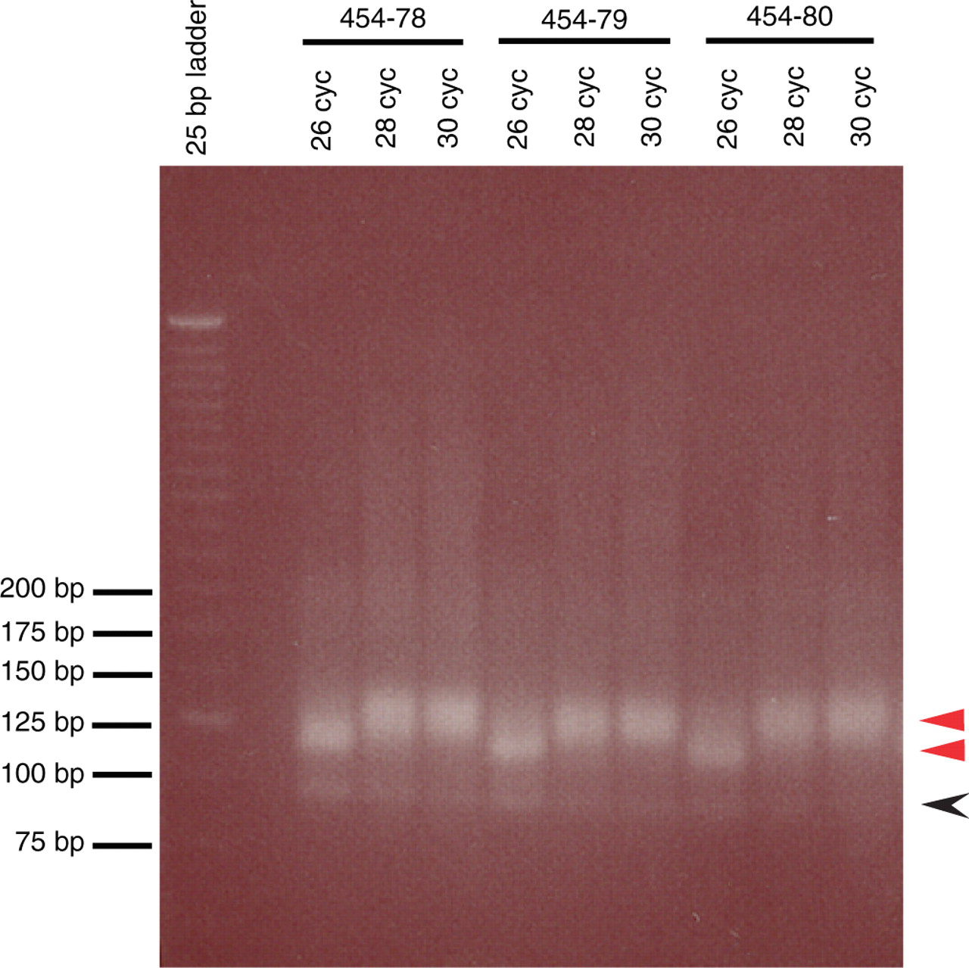
Figure 3. Visualizing the nature of amplified products from various cycles of PCR. With an increase in cycle number ...
Notes:
Figure 3. Visualizing the nature of amplified products from various cycles of PCR. With an increase in cycle number (twenty cycles of an initial round of PCR followed by six, eight or ten cycles of a second round of PCR), there is an evident shift in mobility of PCR products that contain a small RNA insert. Effect of PCR cycle number on three different samples is shown, stressing the importance of titrating the total number of DNA amplification cycles, to avoid saturation of the PCR amplification. Red arrows represent the two sizes of the insert-containing PCR products. PCR products without small RNA inserts migrate as faint bands between 75 and 100 bp (black arrow).
Unless provided in the caption above, the following copyright applies to the content of this slide: © 2007 The Author(s)This is an Open Access article distributed under the terms of the Creative Commons Attribution Non-Commercial License (http://creativecommons.org/licenses/by-nc/2.0/uk/) which permits unrestricted non-commercial use, distribution, and reproduction in any medium, provided the original work is properly cited.

