Slide 1
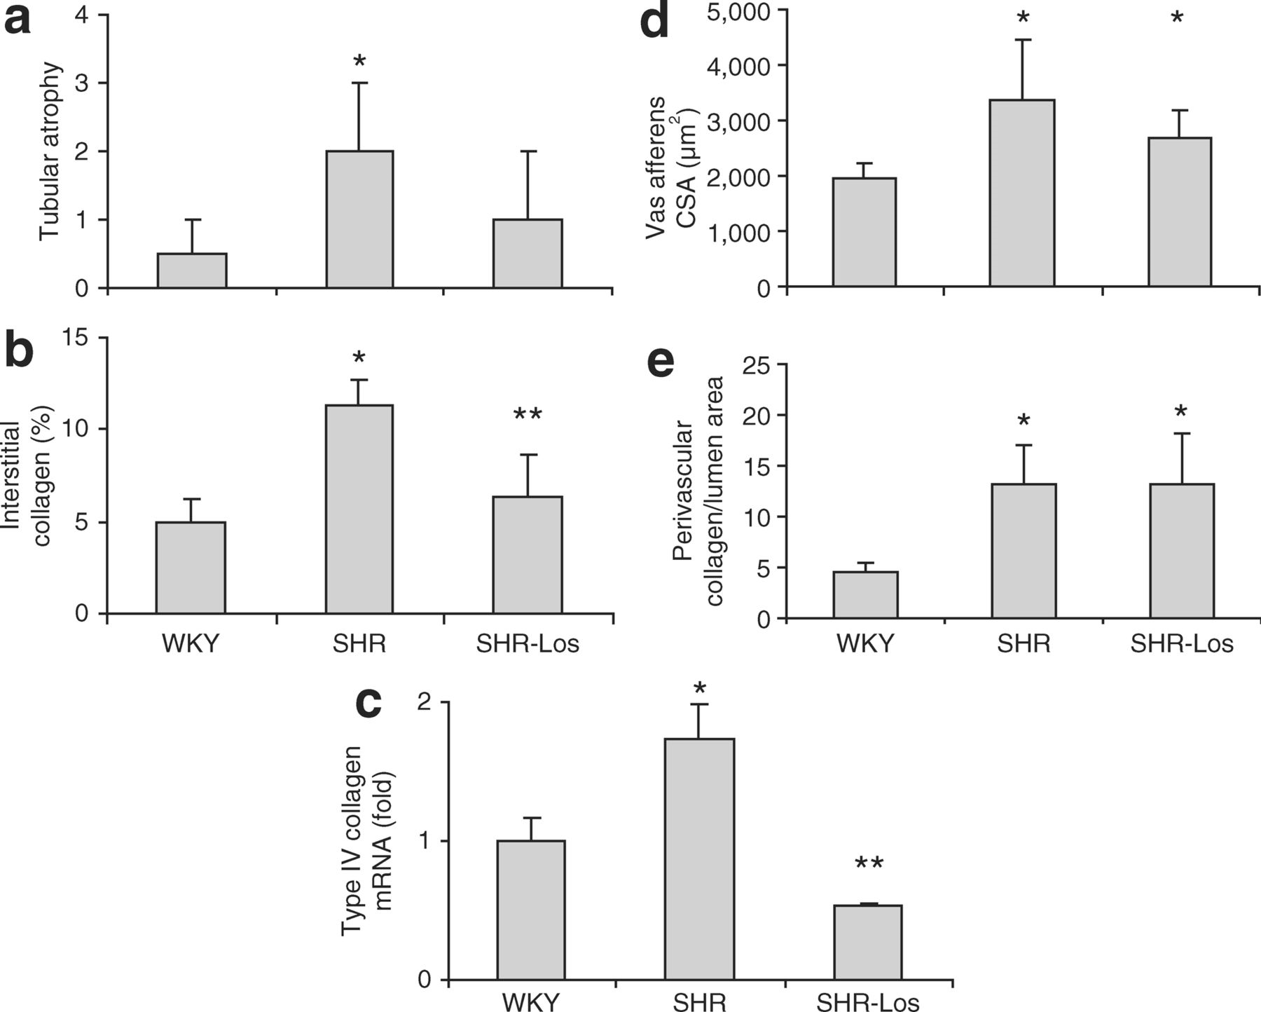
Figure 5. Selective renal target organ damage in advanced age after transient losartan treatment. (a) Tubular atrophy ...
Notes:
Figure 5. Selective renal target organ damage in advanced age after transient losartan treatment. (a) Tubular atrophy (median and range), (b) tubulointerstitial collagen deposition and (c) type IV collagen deposition were reduced in transiently treated as compared to untreated spontaneously hypertensive rats (SHRs). In the renal vasculature no treatment effects were seen on (d) cross-sectional area (CSA) and (e) their perivascular collagen deposition. *P < 0.05 compared to WKY, **P < 0.05 SHR-Los compared to SHRs (WKY: n = 8, SHRs: n = 7, SHR-Los: n = 8).
Unless provided in the caption above, the following copyright applies to the content of this slide: © American Journal of Hypertension, Ltd. 2008

Slide 2
Figure 4. Tubulo-interstitial characteristics at the juxtamedullary junction in 72-week-old rats. (a) 72-week-old WKY ...
Notes:
Figure 4. Tubulo-interstitial characteristics at the juxtamedullary junction in 72-week-old rats. (a) 72-week-old WKY rats demonstrate homogenous tubular tissue, while SHRs (b) are characterized by tubular atrophy and dilatation. SHR-Los (c) show these characteristics to less degree. Original magnification ×100.
Unless provided in the caption above, the following copyright applies to the content of this slide: © American Journal of Hypertension, Ltd. 2008

Slide 3
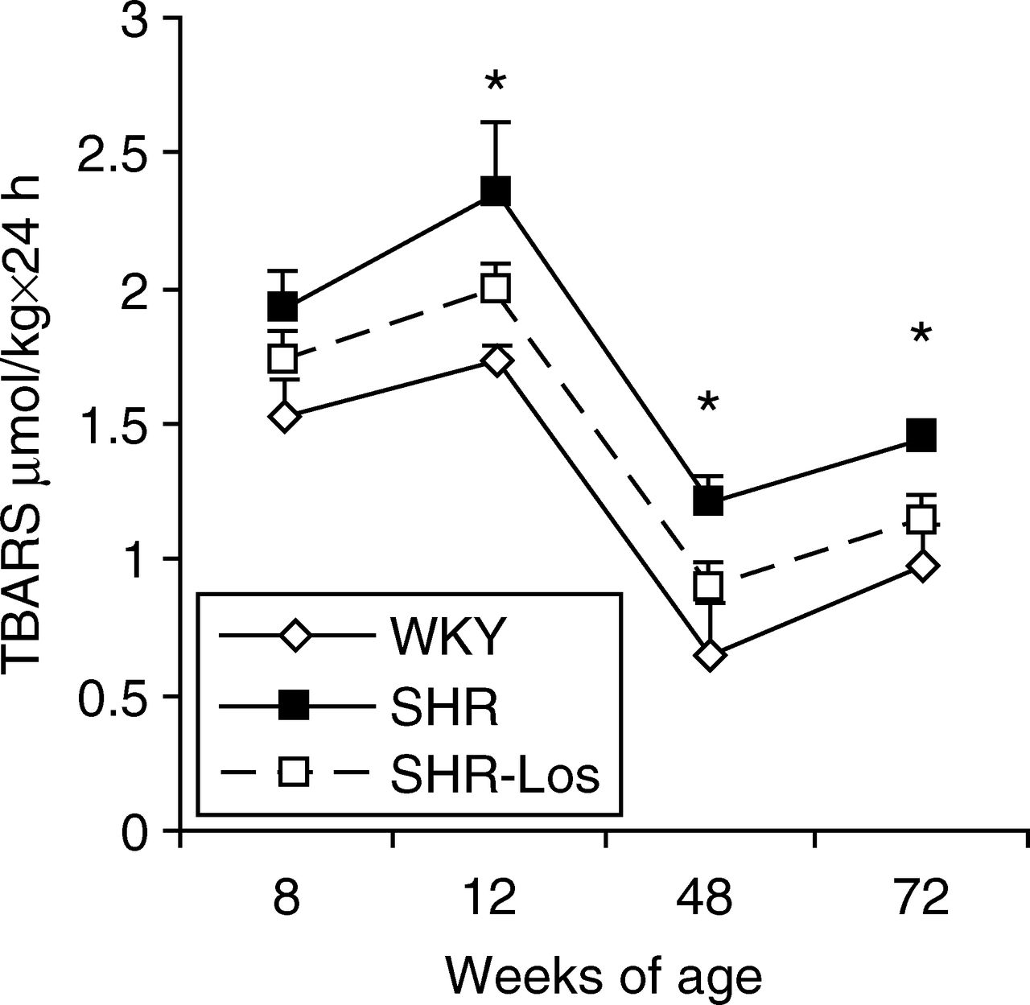
Figure 3. Urinary excretion of TBARS. Urinary excretion of TBARS as marker for lipid peroxidation is reduced throughout ...
Notes:
Figure 3. Urinary excretion of TBARS. Urinary excretion of TBARS as marker for lipid peroxidation is reduced throughout the observation period in spontaneously hypertensive rats (SHRs)-Los as compared to untreated SHRs. *P < 0.05 SHR-Los compared to SHRs at the age of 12, 48, and 72 weeks. (WKY: n = 8, SHRs: n = 7, SHR-Los: n = 8).
Unless provided in the caption above, the following copyright applies to the content of this slide: © American Journal of Hypertension, Ltd. 2008

