Slide 1
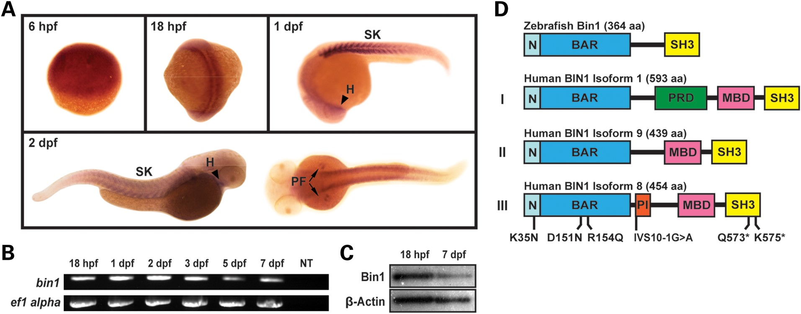
Figure 1. Bin1 gene expression in early zebrafish development. (A) Whole-mount in situ hybridization in wild-type ...
Notes:
Figure 1. Bin1 gene expression in early zebrafish development. (A) Whole-mount in situ hybridization in wild-type embryos at 6 hpf, 18 hpf, 1 dpf, and 2 dpf confirm that bin1 is expressed in zebrafish cardiac and skeletal muscle. Heart (H); somites (SK); pectoral fin (PF). (B) RT-PCR of wild-type zebrafish cDNA shows that bin1 gene expression peaks at ∼1–2 dpf during the first week of development. Non-template control (NT). (C) Total Bin1 protein levels decrease and reflect decreased amounts of bin1 transcript between 18 hpf and 7 dpf. β-Actin was used as the loading control. (D) Protein structure of zebrafish Bin1 and of selected human BIN1 isoforms: (I) brain-enriched, longest isoform of human BIN1; (II) ubiquitous BIN1 isoform 9 lacking the PI-binding domain encoded by exon 11; (III) muscle-specific BIN1 isoform 8 containing the PI-binding domain. All six known human CNM2 mutations are indicated. Mutation nomenclature is based on isoform 1 (NP_ 647593.1), with the exception of c.IVS10-1G>A, which is named based on isoform 8 (NP_004296.1) in accordance with its original report (19). N-terminal amphipathic helix (N); BIN1/Amphiphysin/Rvs167 domain (BAR); phosphoinositide-binding domain (PI); proline-rich domain (PRD); Myc-binding domain (MBD); Src homology 3 domain (SH3).
Unless provided in the caption above, the following copyright applies to the content of this slide: © The Author 2014. Published by Oxford University Press. All rights reserved. For Permissions, please email: journals.permissions@oup.com

Slide 2
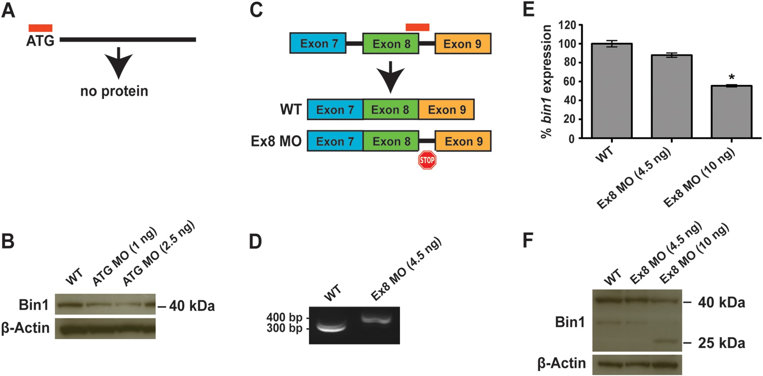
Figure 2. MO-based knockdown of bin1 results in loss of protein function and mRNA mis-splicing. (A and B) ...
Notes:
Figure 2. MO-based knockdown of bin1 results in loss of protein function and mRNA mis-splicing. (A and B) Translation-blocking MO (ATG MO) results in reduced levels of Bin1 protein as shown by western blot. (C) Splice-blocking MO (Ex8 MO) causes an intron containing putative stop codons to be retained. (D) RT-PCR confirms presence of lengthened bin1 transcript in bin1 Ex8 MO-injected morphants compared with wild-type controls. (E) Quantitative RT-PCR (primers targeting exon 10 boundary) demonstrates that full-length bin1 expression decreases with increasing concentrations of Ex8 MO. (F) Western blot shows that Ex8 MO results in a truncated form of Bin1 protein at higher concentrations. All MO analyses described here were performed with 3 dpf zebrafish larvae.
Unless provided in the caption above, the following copyright applies to the content of this slide: © The Author 2014. Published by Oxford University Press. All rights reserved. For Permissions, please email: journals.permissions@oup.com

Slide 3
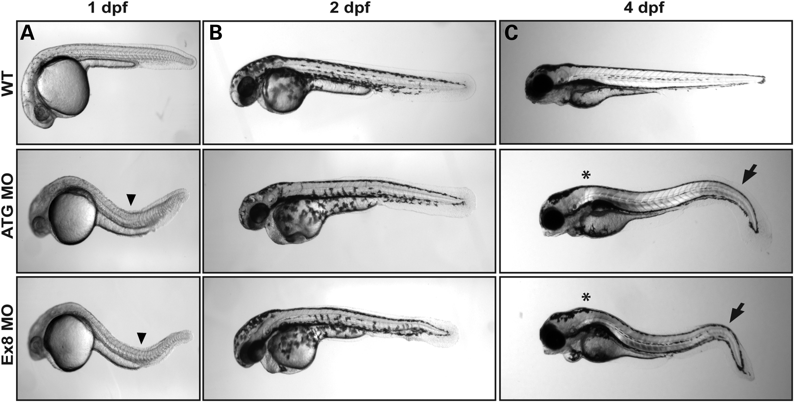
Figure 3. Bin1-deficiency leads to gross morphological abnormalities in zebrafish larvae. (A) Manually dechorionated ...
Notes:
Figure 3. Bin1-deficiency leads to gross morphological abnormalities in zebrafish larvae. (A) Manually dechorionated wild-type control embryos straighten quickly, whereas bin1 morphants begin to exhibit dorsal curvature as early as 1 dpf (arrowheads). (B and C) The bin1 morphant phenotype is highly reproducible throughout early development using two independent MOs targeting different regions of the zebrafish bin1 gene. Wild-type controls show normal morphology by 4 dpf, whereas bin1 morphants injected with translation-blocking ATG MO or splice-blocking Ex8 MO are S-shaped in appearance with pronounced kyphosis (asterisks) and bent tails (arrows).
Unless provided in the caption above, the following copyright applies to the content of this slide: © The Author 2014. Published by Oxford University Press. All rights reserved. For Permissions, please email: journals.permissions@oup.com

Slide 4
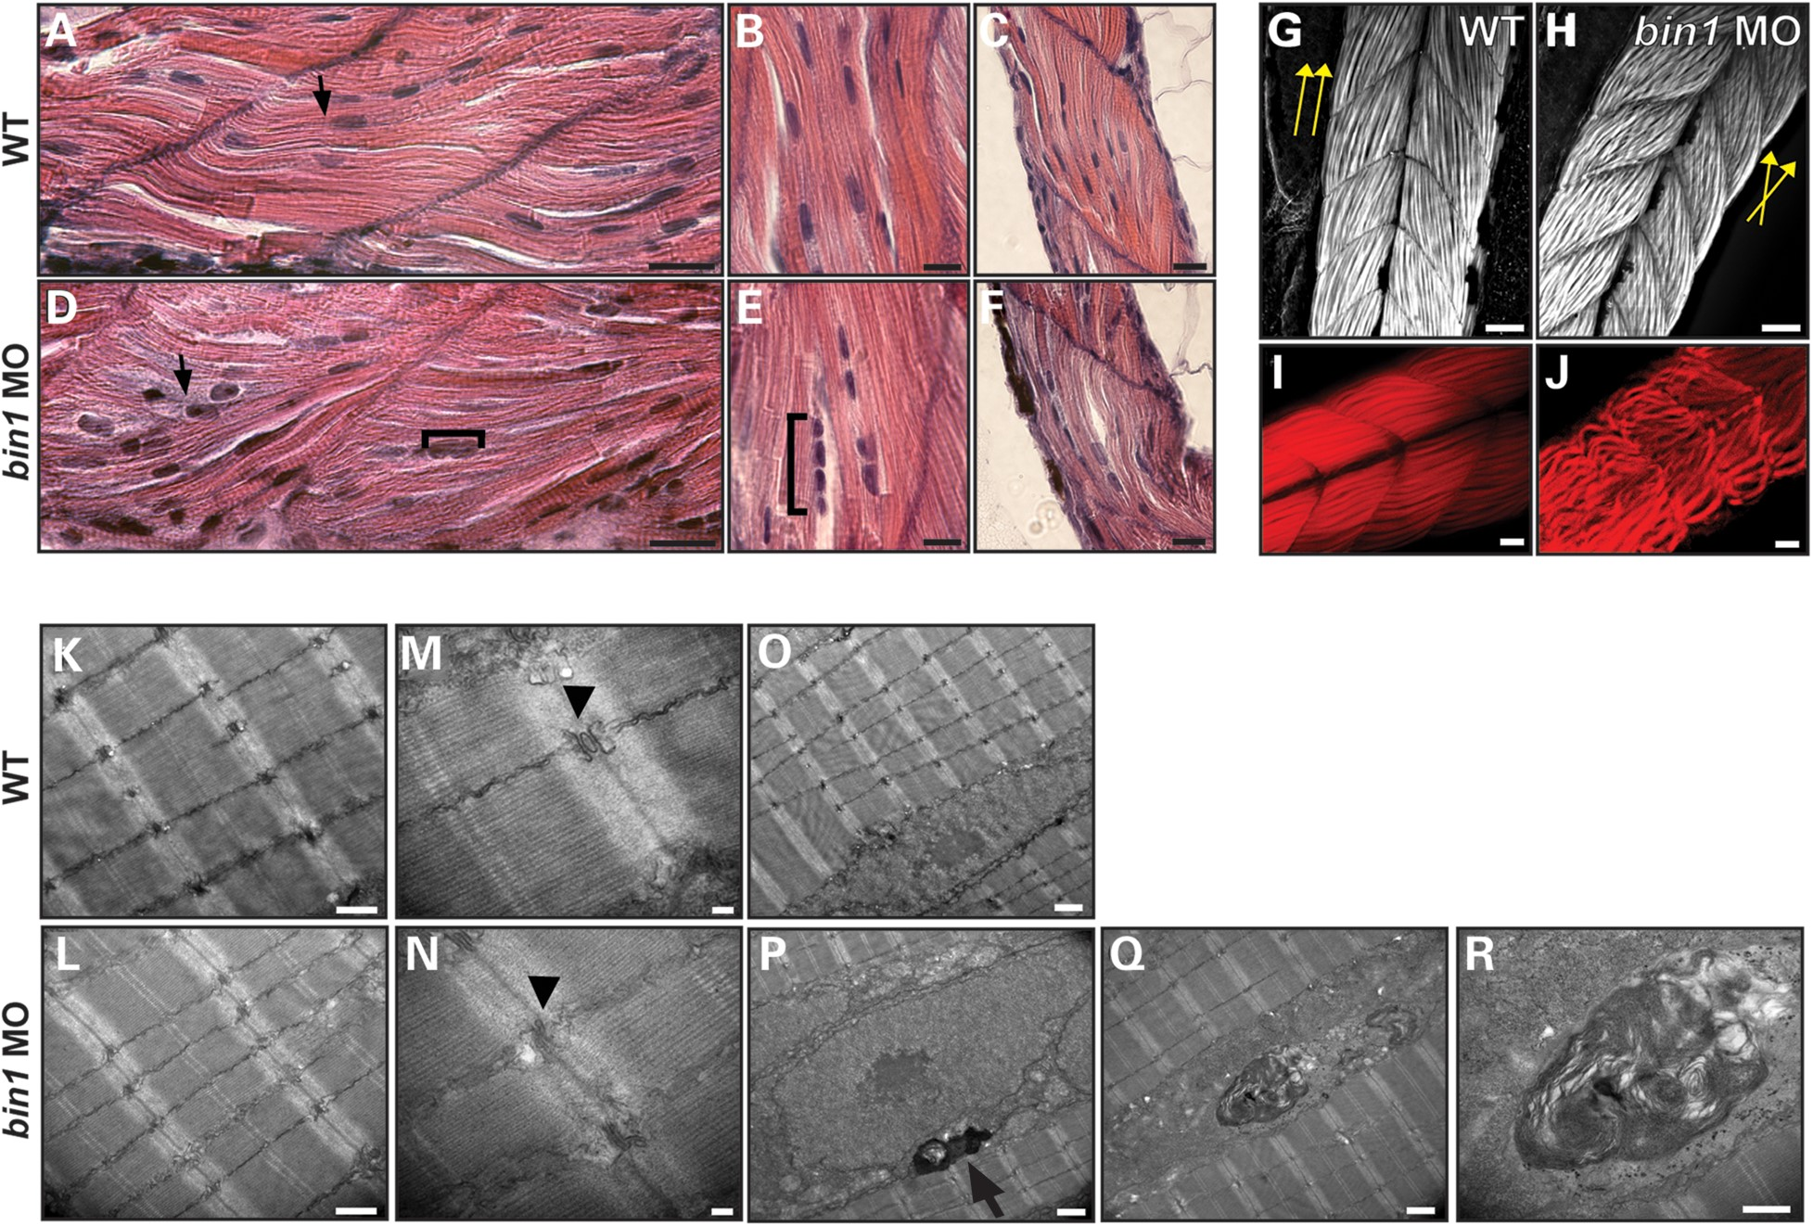
Figure 4. Bin1-deficient zebrafish display similar histopathology and ultrastructural defects as human CNM2. (A–F) H&E ...
Notes:
Figure 4. Bin1-deficient zebrafish display similar histopathology and ultrastructural defects as human CNM2. (A–F) H&E stained longitudinal myofibers from 4 dpf bin1 morphant larvae and wild-type controls. Myonuclei from bin1 morphants are prominently mislocalized, rounded, and grouped (brackets). Morphant myonuclei also appear large and contain discrete, darkly staining nucleoli (arrows). Conversely, wild-type controls have singular, elongated myonuclei located at the fiber periphery. (G and H) Z-stacked images of wild-type and bin1 morphant skeletal muscle captured using confocal laser scanning microscopy following whole-mount immunostaining with fluorophore-conjugated phalloidin. Bin1 morphant myofibers appear mildly disorganized at 3 dpf compared with wild-type controls. General directions of myofibers are indicated for each type of embryo (yellow arrows). (I and J) Myofiber disorganization in bin1 morphants becomes more apparent with individual image planes (no Z-stack). (K–N) Transmission electron micrographs of 4 dpf zebrafish larvae reveal that the fraction of abnormal triads in wild-type skeletal muscle is significantly lower than in bin1 morphants (arrowheads; see also Fig. 7 C and E). (P) Unusual membranous structures are commonly observed in the perinuclear regions of bin1 morphants (arrow) but are absent in wild-type controls. (Q and R) Higher magnifications of a representative membranous structure. At least three embryos from three independent injections were processed and examined for all histochemical and electron micrograph analyses. Scale bars: (A–J) 10 μm, (K–R) 500 nm.
Unless provided in the caption above, the following copyright applies to the content of this slide: © The Author 2014. Published by Oxford University Press. All rights reserved. For Permissions, please email: journals.permissions@oup.com

Slide 5
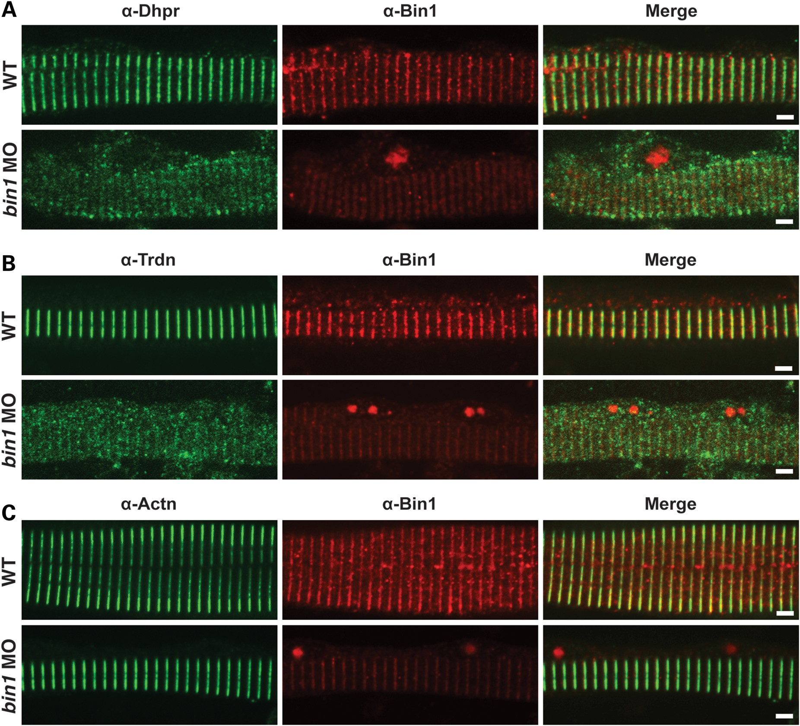
Figure 5. Triad markers are disrupted in Bin1 deficiency. Double label immunofluorescence on 3 dpf isolated myofibers. ...
Notes:
Figure 5. Triad markers are disrupted in Bin1 deficiency. Double label immunofluorescence on 3 dpf isolated myofibers. (A) Bin1 is localized in a striated pattern similar to the dihydropyridine receptor (Dhpr), a known T-tubule marker, in wild-type zebrafish (top). Loss of Bin1 disrupts normal Dhpr localization (bottom). (B and C) Expression patterns of alternative triad markers, such as triadin (Trdn), are perturbed in Bin1 deficiency. Localizations of non-triad muscle proteins, such as alpha-actinin (Actn), appear unaffected. Images are representative of 20 myofibers analyzed from each of three independent experiments. Scale bars: 20 μm.
Unless provided in the caption above, the following copyright applies to the content of this slide: © The Author 2014. Published by Oxford University Press. All rights reserved. For Permissions, please email: journals.permissions@oup.com

Slide 6
Figure 6. Calcium signaling is impaired in bin1 morphants. (A) Representative example of a 3 dpf wild-type embryo ...
Notes:
Figure 6. Calcium signaling is impaired in bin1 morphants. (A) Representative example of a 3 dpf wild-type embryo mosaically expressing an α-actin-driven GCaMP3-EGFP Ca2+ reporter in skeletal muscle. (B and C) Calcium propagation through the trunk region is diminished in bin1 morphants compared with wild-type controls following KCl treatment (see also Supplementary Material, Movies S5 and S6). Individual frames shown depict the time point at which EGFP fluorescence is most widespread throughout the analyzed region of skeletal muscle. (D) Peak Ca2+ release is decreased in bin1 morphant relative to wild-type myofibers expressing GCaMP3-EGFP (WT: 3.8 ± 0.4 RFU; bin1 MO: 1.8 ± 0.2 RFU; n > 12 myofibers). Significance was determined by Student's t-test, P < 0.01. Relative fluorescence units (RFU) = peak fluorescence across each GCaMP3–EGFP expressing myofiber minus baseline fluorescence divided by baseline fluorescence. Scale bars: (A) 200 μm, (B and C) 25 μm.
Unless provided in the caption above, the following copyright applies to the content of this slide: © The Author 2014. Published by Oxford University Press. All rights reserved. For Permissions, please email: journals.permissions@oup.com

Slide 7
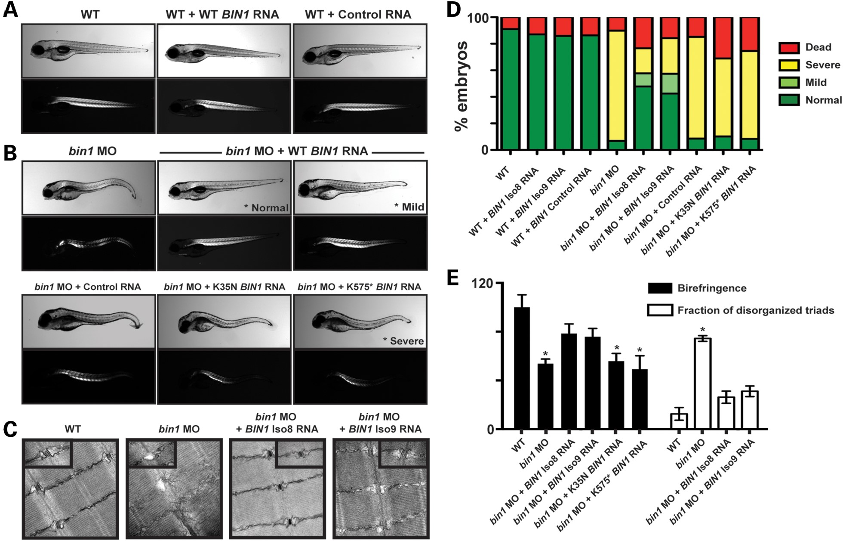
Figure 7. Overexpression of human BIN1 mRNA in bin1 MO-injected morphants. (A) Wild-type control larvae (4 dpf) are ...
Notes:
Figure 7. Overexpression of human BIN1 mRNA in bin1 MO-injected morphants. (A) Wild-type control larvae (4 dpf) are unaffected by overexpression of BIN1 or control mRNA (top panel: live larvae in normal light; bottom panel: same larvae in polarized light). (B) Morphology and organized musculature is fully or partially restored to 4 dpf bin1 morphants upon overexpression of human wild-type BIN1 mRNA. Isoform 8 (Iso8) and isoform 9 (Iso9) BIN1 transcripts show similar rescue as quantified in D and E. In contrast, human BIN1 mRNA containing pathogenic CNM2 mutations K35N or K575* completely fails to rescue the bin1 morphant phenotype. (C) Electron microscopy shows normal structure of skeletal muscle triads in bin1 morphant fish rescued with either BIN1 Iso8 or Iso9 mRNA but disorganized triads in zebrafish embryos injected only with ATG MO. (D) Quantification of morphological changes in 4 dpf wild-type and bin1 morphants observed with mRNA overexpression. Representative images of living phenotypes specified in the color legend are starred in B. (E) Quantification of birefringence and fraction of disorganized triads in 4 dpf wild-type controls and bin1 morphants observed with mRNA overexpression. Birefringence data were calculated by dividing the mean intensity of five posterior somites by the selected area of the fish (ImageJ), and normalizing the percentage values to wild-type controls (WT: 100 ± 10.2%; bin1 MO: 53.8 ± 3.7%; bin1 MO + Iso8 RNA: 78.4 ± 7.9%; bin1 MO + Iso9 RNA: 75.8 ± 6.9%; bin1 MO + K35N RNA: 55.7 ± 6.4%; bin1 MO + K575* RNA: 49.2 ± 11.0%; Student's t-test, P < 0.01). Fifteen images were quantified per clutch of embryos for all birefringence experiments (n = 15). Triad fractions were calculated as the percentage ratio of abnormal triads to the total number of triads counted (WT: 12.5 ± 5.2%, n = 96; bin1 MO: 74.4 ± 2.3%, n = 129; bin1 MO + Iso8 RNA: 26.2 ± 5.0%, n = 151; bin1 MO + Iso9 RNA: 31.1 ± 4.3%, n = 161). Significance was determined by Student's t-test, P < 0.01. Three independent experiments were performed for all rescue studies.
Unless provided in the caption above, the following copyright applies to the content of this slide: © The Author 2014. Published by Oxford University Press. All rights reserved. For Permissions, please email: journals.permissions@oup.com

