Slide 1
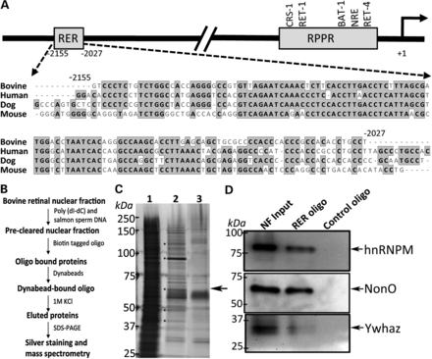
Figure 1. Isolation of RER-binding proteins from bovine retina. (A) Proximal and distal elements in the bovine ...
Notes:
Figure 1. Isolation of RER-binding proteins from bovine retina. (A) Proximal and distal elements in the bovine rhodopsin promoter and conservation (shaded region) of the distal RER in mammals. CRS-1, RET-1, BAT-1, NRE and RET-4 are cis-elements within RPPR. (B) A schema for purifying RER-bound proteins from bovine retina. (C) Silver-stained SDS–PAGE gel showing the proteins that bound to rhodopsin RER or the control oligonucleotide. Lanes: 1, input nuclear fraction (10 μg); 2, RER-bound proteins; and 3, control oligonucleotide-bound proteins. Asterisks indicate the protein bands submitted for mass spectrometry. NonO (55 kDa) is indicated by the arrow. (D) Validation of NonO and NonO-interacting proteins. Immunoblots of RER and control oligonucleotide-bound fractions were probed with anti-NonO, anti-hnRNP M and anti-Ywhaz antibodies. Arrows indicate the respective protein bands.
Unless provided in the caption above, the following copyright applies to the content of this slide: Published by Oxford University Press 2013. This work is written by (a) US Government employee(s) and is in the public domain in the US.

Slide 2
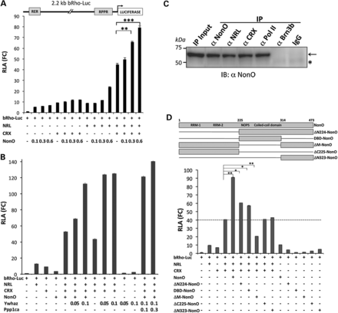
Figure 2. NonO and NonO interactors enhance rhodopsin promoter activity synergistically with NRL and CRX. (A) ...
Notes:
Figure 2. NonO and NonO interactors enhance rhodopsin promoter activity synergistically with NRL and CRX. (A) Luciferase reporter assays showing transactivation of the bovine rhodopsin promoter by NonO. HEK293 cells were co-transfected with 2.2 kb bovine rhodopsin promoter driving firefly luciferase reporter (0.2 μg) and increasing concentrations (0.1–0.6 μg) of NonO, alone or in combination with 0.1 μg of NRL, CRX or both. CMV-renilla (0.001 μg) was used as transfection control to normalize firefly luciferase activity. RLA indicates relative luciferase activity compared with the mock vector control, and FC is fold change. All experiments were carried out in triplicate. Student's t-test was performed using Prism software v5, and P-values < 0.05 were considered significant. Two asterisks show P < 0.05 and three P < 0.01. (B) Transactivation of the rhodopsin promoter activity by NonO interactors. Ywhaz (0.05 and 0.1 μg) and Ppp1ca (0.1 μg) were co-transfected with NRL, CRX and NonO. Other details are similar to (A). (C) Co-immunoprecipitation of NonO with NRL, CRX and Pol II from bovine retinal nuclear extract. Anti-NonO, anti-NRL, anti-CRX, anti-Pol II or anti-Brn3b (Pou4f2) antibodies were used for immunoprecipitation. IgG was used as control. Immunoblot of immunoprecipitated samples was probed with anti-NonO antibody. The arrow indicates NonO and the asterisk IgG heavy chain. (D) DNA-binding domain of NonO is required for enhancer activity. NonO deletion mutants used in the study (above). NOPS, no on or off transient A/paraspeckle; RRM, RNA-recognition motif. Evaluation of NonO domains for enhancer activity (below). HEK293 cells were co-transfected with 2.2 kb bovine rhodopsin promoter driving firefly luciferase reporter (0.2 μg) and 0.6 μg of NonO deletion mutant alone or together with 0.1 μg each of NRL and CRX, as indicated. Dashed line represents the fold change (FC) of rhodopsin promoter activity in the presence of NRL and CRX. RLA (FC) represents fold change relative to the mock vector control. All experiments were done in triplicate. Student's t-test was used for statistical analysis.
Unless provided in the caption above, the following copyright applies to the content of this slide: Published by Oxford University Press 2013. This work is written by (a) US Government employee(s) and is in the public domain in the US.

Slide 3
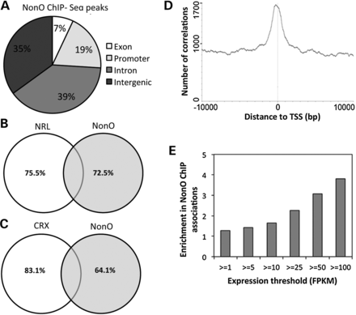
Figure 3. Genome-wide occupancy of NonO by ChIP-Seq. (A) Venn diagram showing the percentage of NonO ChIP-seq peak ...
Notes:
Figure 3. Genome-wide occupancy of NonO by ChIP-Seq. (A) Venn diagram showing the percentage of NonO ChIP-seq peak distribution in different genomic regions. (B) Overlap of NonO ChIP-seq peaks with Nrl ChIP-seq peaks. (C) Overlap of NonO ChIP-seq peaks with Crx ChIP-seq peaks. (D) The correlation of global NonO ChIP-seq peaks with TSS. (E) The correlation of NonO ChIP-seq peaks with global expression levels. The NonO-associated genes were grouped based on the levels of expression (as indicated by FPKM values) from RNA-seq data obtained from adult mouse retina. Enrichment score was calculated as a ratio of NonO-associated genes within each group to the total number of NonO genes. Highly expressed genes (FPKM > 25) show 2-fold or more enrichment among NonO-bound genes at P < 0.01.
Unless provided in the caption above, the following copyright applies to the content of this slide: Published by Oxford University Press 2013. This work is written by (a) US Government employee(s) and is in the public domain in the US.

Slide 4
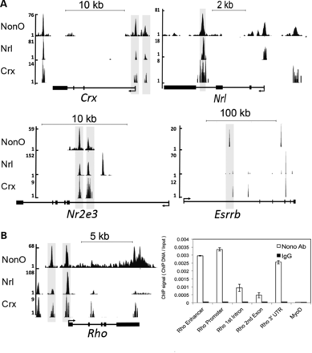
Figure 4. Visualization of NonO ChIP-seq peaks on rod-expressed genes and their correlation with Nrl and Crx ChIP-seq ...
Notes:
Figure 4. Visualization of NonO ChIP-seq peaks on rod-expressed genes and their correlation with Nrl and Crx ChIP-seq peaks. (A) NonO ChIP-seq peaks at transcription factor genes expressed in rod photoreceptors—Crx, Nrl, Nr2e3 and Esrrb. Gene structures are shown below the peaks. (B) NonO Chip-seq peaks at the rhodopsin promoter (left), and validation of different NonO peak regions in rhodopsin by ChIP-qPCR (right). A genomic DNA region of MyoD (non-retinal gene) was used as a negative control.
Unless provided in the caption above, the following copyright applies to the content of this slide: Published by Oxford University Press 2013. This work is written by (a) US Government employee(s) and is in the public domain in the US.

Slide 5
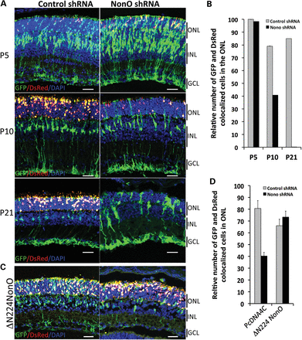
Figure 5. NonO knockdown leads to rod photoreceptor death. (A) Temporal effect of shRNA on transfected photoreceptors. ...
Notes:
Figure 5. NonO knockdown leads to rod photoreceptor death. (A) Temporal effect of shRNA on transfected photoreceptors. The bovine rhodopsin promoter (2.2 kb) driving DsRed (Rho-DsRed) and either control or NonO shRNA-GFP construct expressing both shRNA and GFP were co-transfected in P0 mouse retina by in vivo electroporation. Expression of reporter genes was assessed in P5, P10 and P21 retina. All transfected cells expressing either shRNA are green, but only rods among those transfected cells would express rhodopsin promoter driven DsRed and are red. Nuclei were stained with DAPI. Left and right panels show results of control and NonO shRNA, respectively. White arrowheads indicate GFP and DsRed double-positive cells. ONL, outer nuclear layer of photoreceptors; INL, inner nuclear layer; GCL, ganglion cell layer. Scale bar: 20 μm. (B) A bar graph showing quantification of the relative number of DsRed (transfected rods) and GFP (total number of transfected cells) positive cells that remain in the ONL at P5, P10 and P21. (C) Rescue of NonO knockdown induced rod death by ΔN224-NonO. Neonatal pups were co-electroporated with Rho-DsRed, ΔN224-NonO and either NonO shRNA-GFP or control-shRNA-GFP. Retinas were harvested at P10 and examined for GFP and DsRed reporter expression in the ONL. Other details are same as in (A). (D) A bar graph showing quantification of the relative number of DsRed and GFP-positive cells that remain in the ONL at P10.
Unless provided in the caption above, the following copyright applies to the content of this slide: Published by Oxford University Press 2013. This work is written by (a) US Government employee(s) and is in the public domain in the US.

Slide 6
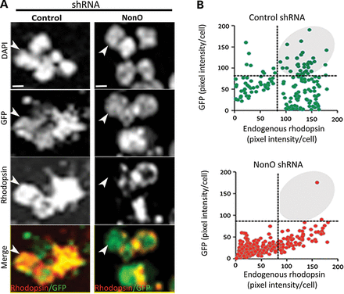
Figure 6. NonO knockdown decreases endogenous rhodopsin expression in in vivo transfected rods. (A) Rhodopsin staining ...
Notes:
Figure 6. NonO knockdown decreases endogenous rhodopsin expression in in vivo transfected rods. (A) Rhodopsin staining in dissociated retinal cells transfected in vivo with control or NonO shRNA-GFP. Mouse retinas, electroporated at P0 with either control or NonO shRNA-GFP construct, were isolated at P7, and the dissociated cells were immunostained for endogenous rhodopsin. Left and right panels indicate results from control and NonO shRNA-GFP, respectively. Green fluorescence of GFP indicates total number of transfected cells, whereas red shows rhodopsin staining. Nuclei are stained with DAPI. Arrowheads indicate the transfected cells (GFP-positive) that show reduced rhodopsin in NonO shRNA panel compared with control. Scale bar: 20 μm. (B) Quantification of rhodopsin positive cells among the total transfected cells. Total number of pixels in each cell was calculated using ImageJ software for endogenous rhodopsin and for GFP (from A). Scatter plots were generated for control-shRNA-GFP (above) and NonO shRNA-GFP (below) transfected cells. Three-independent experiments were performed with five animals in each set. The data presented here are from one representative experiment.
Unless provided in the caption above, the following copyright applies to the content of this slide: Published by Oxford University Press 2013. This work is written by (a) US Government employee(s) and is in the public domain in the US.

Slide 7
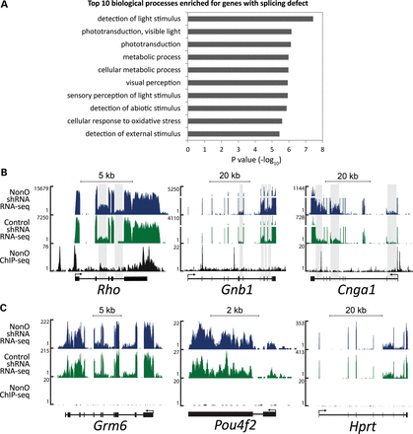
Figure 7. NonO knockdown causes splicing defects in phototransduction genes. (A) Top 10 biological processes enriched ...
Notes:
Figure 7. NonO knockdown causes splicing defects in phototransduction genes. (A) Top 10 biological processes enriched among genes that exhibit splicing defect upon NonO knockdown. Phototransduction genes are overrepresented. (B and C) RNA-seq results of P8 mouse retina transfected with NonO shRNA-GFP (blue) or control shRNA-GFP (green) and NonO occupancy in the wild-type P28 retina (black). Increased intron inclusion is apparent in a subset of phototransduction genes, such as rhodopsin (Rho), Gnb1 and Cnga1. Intronic regions with splicing defects are indicated with gray shades (B). Non-photoreceptor genes with no splicing defect by NonO knockdown (C); these are exemplified by Grm6 (bipolar neurons), Pou4f2 (ganglion cells) and Hprt (housekeeping). Two independent experiments were performed with different litters in each set. The data presented here are from one representative experiment.
Unless provided in the caption above, the following copyright applies to the content of this slide: Published by Oxford University Press 2013. This work is written by (a) US Government employee(s) and is in the public domain in the US.

Slide 8
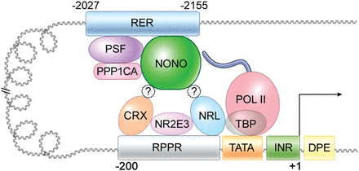
Figure 8. A schematic representation of RPPR- and RER-bound transcriptional regulatory proteins in the rhodopsin ...
Notes:
Figure 8. A schematic representation of RPPR- and RER-bound transcriptional regulatory proteins in the rhodopsin promoter-enhancer region. RER-bound transcriptional complexes containing NonO are proposed to interact with RPPR proteins (including NRL and/or CRX) by chromosomal looping and enhance the recruitment of basic transcription machinery (including RNA Pol II) to the rhodopsin promoter.
Unless provided in the caption above, the following copyright applies to the content of this slide: Published by Oxford University Press 2013. This work is written by (a) US Government employee(s) and is in the public domain in the US.

