Slide 1
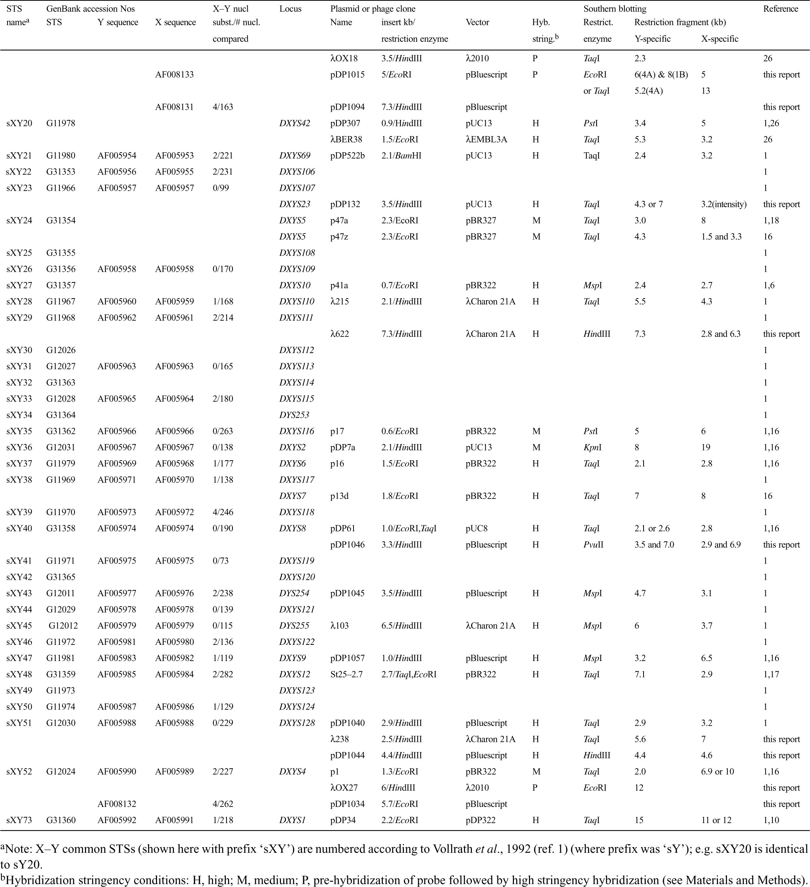
Table 1 Xq21–Yp DNA loci studied
Notes:
Table 1 Xq21–Yp DNA loci studied
Unless provided in the caption above, the following copyright applies to the content of this slide: © 1998 Oxford University Press

Slide 2
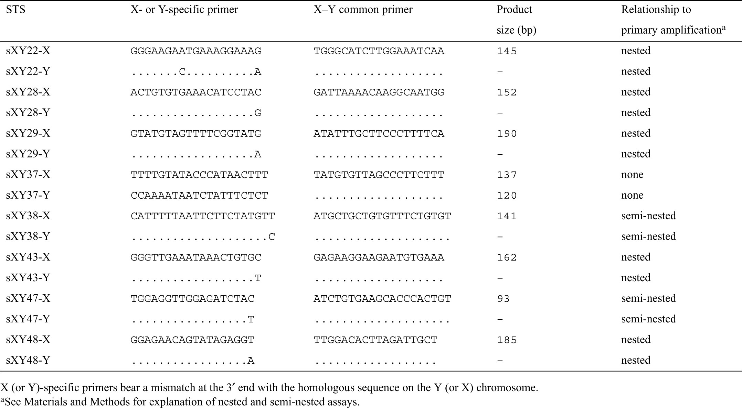
Table 2 X- or Y-specific PCR assays at X–Y homologous loci
Notes:
Table 2 X- or Y-specific PCR assays at X–Y homologous loci
Unless provided in the caption above, the following copyright applies to the content of this slide: © 1998 Oxford University Press

Slide 3
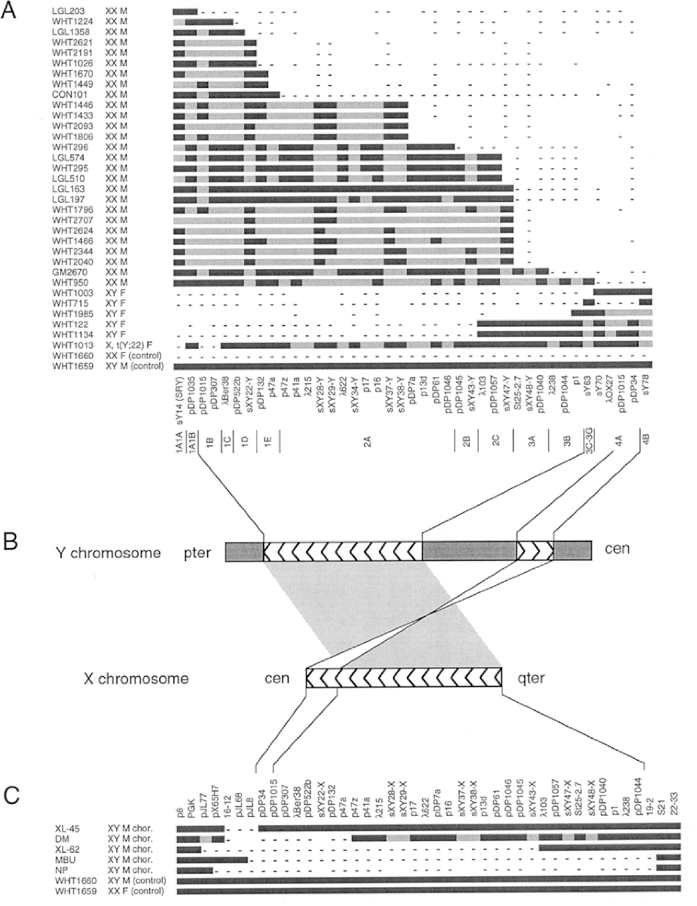
Figure 1 Deletion mapping of homologous sequences on Yp and Xq21. (A) Deletion map of Yp (after Figure 2 of Vollrath ...
Notes:
Figure 1 Deletion mapping of homologous sequences on Yp and Xq21. (A) Deletion map of Yp (after Figure 2 of Vollrath et al., 1992, where some of this data was previously presented). Along the left border are listed 33 individuals carrying part but not all of Yp; most are XX males (‘XX M’) or XY females (‘XY F’). Along the bottom are listed Y-DNA markers whose presence or absence was assessed by PCR (marker names beginning with ‘sY’ or ‘sXY’) or Southern blotting. Most DNA markers used are described in Table 1; see reference (1) for details of markers not described in Table 1. Below the markers are listed deletion intervals 1A1A (just proximal to the pter pseudoautosomal region) through 4B (contains centromere). The body of the figure presents experimental data and inferences: experimentally demonstrated presence of a locus in an individual is indicated by a black segment; inferred presence (by interpolation) is indicated by a gray segment; experimentally demonstrated absence is indicated by a minus. Within an interval, the order of loci has not been determined by deletion mapping. (B) Cartoon depicting homology between two segments of Yp and a single contiguous segment of Xq21. See also the previous work of Sargent and colleagues (20) and Mumm and colleagues (15). Herringbone shading denotes X–Y homologous regions. Dark shading denotes Y-specific regions. (C) Deletion map of Xq21. The individuals with Xq21 deletions are XY males with choroideremia and, in some cases, additional disorders caused by nullisomy for this region of the X chromosome. Most DNA markers used are described in Table 1; see reference (56) for details of markers not described in Table 1. Some data have been published previously; see references (57–61).
Unless provided in the caption above, the following copyright applies to the content of this slide: © 1998 Oxford University Press

Slide 4
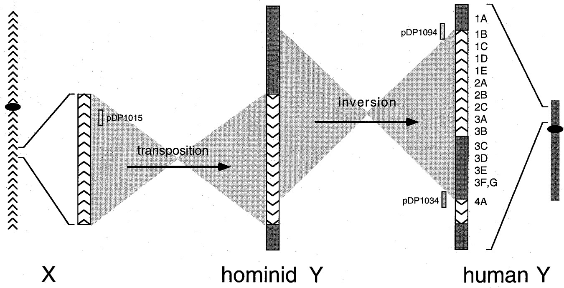
Figure 2 Cartoon of transposition from Xq21 to Yp and subsequent inversion on Yp, both of which are hypothesized to ...
Notes:
Figure 2 Cartoon of transposition from Xq21 to Yp and subsequent inversion on Yp, both of which are hypothesized to have occurred during hominid evolution. The transposed region and inverted region, which partially overlap, are highlighted. Herringbone shading denotes X-homologous regions, and their polarity. Dark shading denotes Y-specific regions. Deletion intervals on modern human Y are numbered at the right. In interval 4A of modern human Y, the predicted polarity of X-homologous sequences with respect to Ycen and Ypter has been confirmed by radiation hybrid mapping (T. Sawai-Kawaguchi, C. Tilford, H. Skaletsky and D.C.Page, unpublished results). Also indicated are origins of three plasmids for which partial restriction maps and nucleotide sequences are shown in Figure 4. Not drawn to scale.
Unless provided in the caption above, the following copyright applies to the content of this slide: © 1998 Oxford University Press

Slide 5
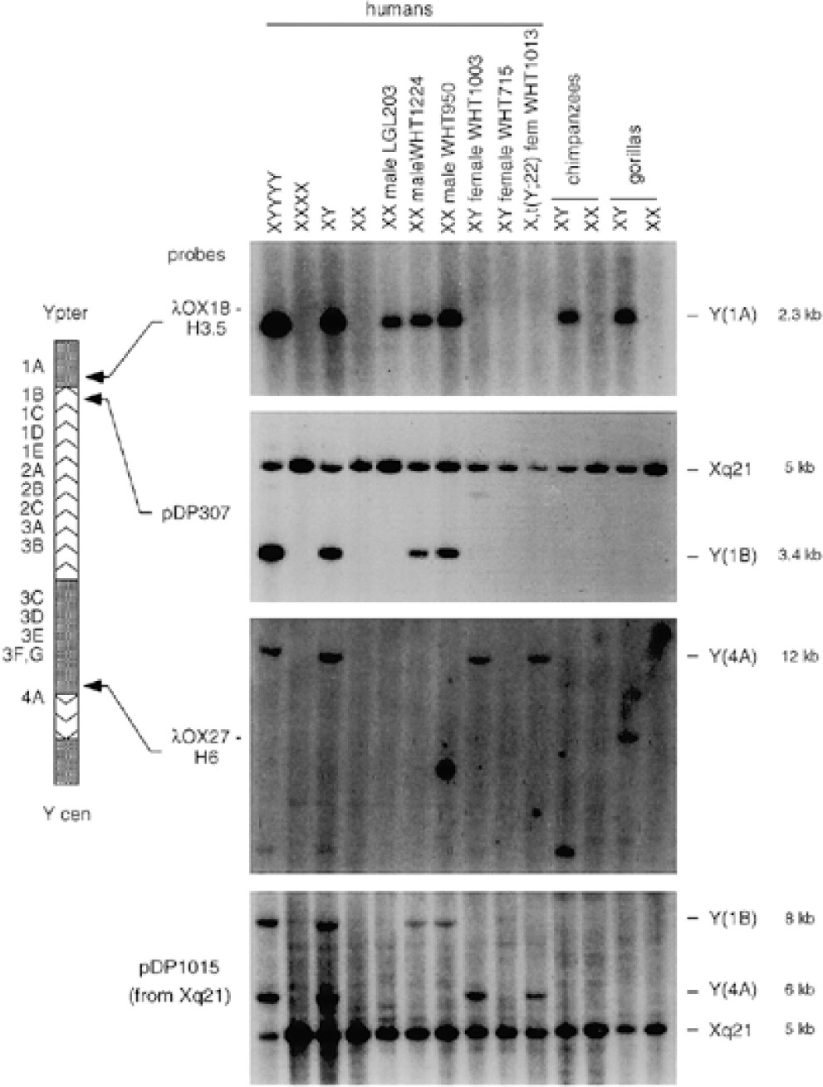
Figure 3 Y- and X-derived DNA probes hybridized to Southern blots of human, chimpanzee and gorilla genomic DNAs. To ...
Notes:
Figure 3 Y- and X-derived DNA probes hybridized to Southern blots of human, chimpanzee and gorilla genomic DNAs. To the left of the autoradiograms are listed four probes, three derived from Yp (cartoon shaded and labeled as in Figures 1 and 2) and one derived from the homologous region of Xq21. To the right of the autoradiograms are listed Y or X origins of hybridizing fragments, the Y deletions intervals to which they map (if applicable) and their sizes. The four autoradiograms were generated using genomic DNAs digested with (from top to bottom) TaqI, PstI, EcoRI and EcoRI. Note that in the case of λOX27-H6, the size of the male-specific restriction fragment detected differs between humans, chimpanzees and gorillas.
Unless provided in the caption above, the following copyright applies to the content of this slide: © 1998 Oxford University Press

Slide 6
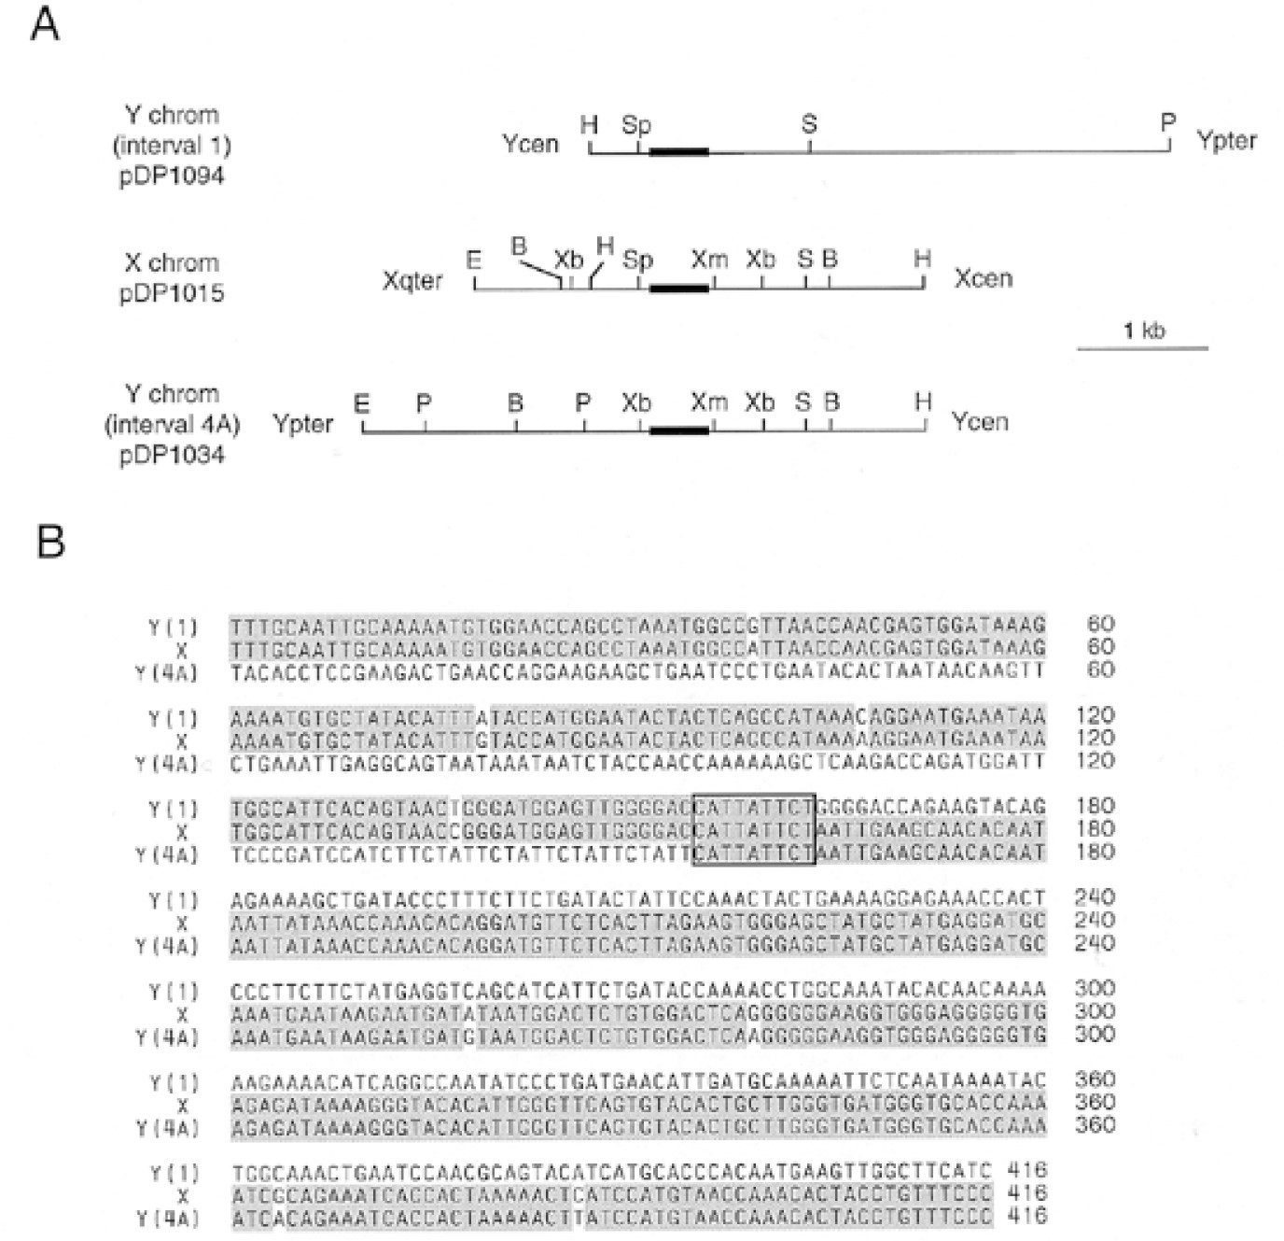
Figure 4 Defining Yp inversion breakpoints by (A) restriction mapping and (B) nucleotide sequence analysis of ...
Notes:
Figure 4 Defining Yp inversion breakpoints by (A) restriction mapping and (B) nucleotide sequence analysis of partially homologous portions of Y interval 1 (plasmid pDP1094), the X chromosome (plasmid pDP1015) and Y interval 4A (plasmid pDP1034). (A) Both Yp inversion breakpoints fall within sequences homologous to an SpeI-XmnI fragment on the X chromosome: the SpeI site is shared with Y interval 1, and the XmnI site is shared with Y interval 4A. Restriction site abbreviations: B, BamHI; H, HindIII; P, PstI; R, EcoRI; S, SacI; Sp, SpeI; Xb, XbaI; Xm, XmnI. Only portions of inserts of pDP1094, pDP015 and pDP1034 are shown; thick lines indicate 416 bp regions whose sequences are shown in (B). (B) Nucleotide sequences. Regions of pairwise nucleotide sequence identity are shaded; the 9 bp region of identity among all three sequences is boxed. GenBank accession numbers: pDP1094, AF008131; pDP1015, AF008133; pDP1034, AF008132.
Unless provided in the caption above, the following copyright applies to the content of this slide: © 1998 Oxford University Press

Slide 7
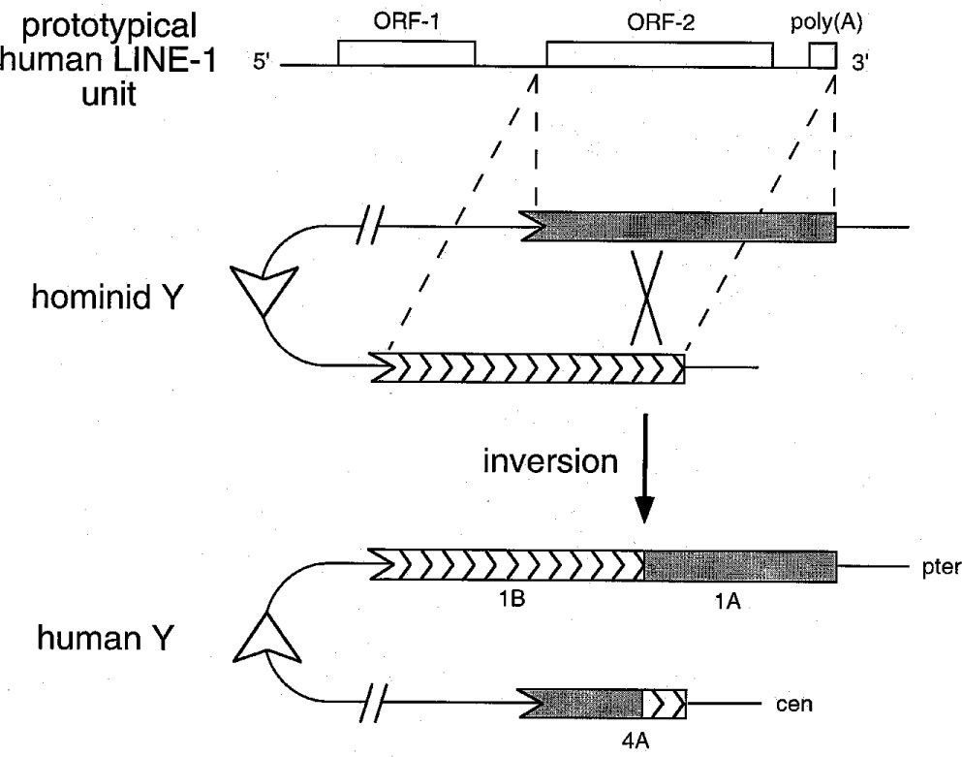
Figure 5 Recombination between LINE-1 elements generated Yp inversion. At the top is schematically diagrammed a ...
Notes:
Figure 5 Recombination between LINE-1 elements generated Yp inversion. At the top is schematically diagrammed a full-length, prototypical human LINE-1 element, showing the location of two long open reading frames (ORFs) and the polyadenylated tail. Below is shown a model of inversion, involving recombination between two LINE-1 repeats aligned out of register, as indicated. Note that only a few hundred base pairs surrounding the recombination breakpoints have been sequenced (Figure 4B), and thus the LINE-1 elements involved were not necessarily full length. Deletion intervals on modern human Y chromosome are indicated.
Unless provided in the caption above, the following copyright applies to the content of this slide: © 1998 Oxford University Press

