Slide 1
Fig. 4. Camalexin detection in leaves of 2-week-old seedlings of the wild type (WT), and vtc and cad2 mutants of ...
Notes:
Fig. 4. Camalexin detection in leaves of 2-week-old seedlings of the wild type (WT), and vtc and cad2 mutants of Arabidopsis thaliana. Plants were either sprayed with 0.02% (v/v) Silwet L-77 (–) or 10 mM silver nitrate in 0.02% (v/v) Silwet L-77 (+). The arrow indicates camalexin.
Unless provided in the caption above, the following copyright applies to the content of this slide: © The Author [2008]. Published by Oxford University Press [on behalf of the Society for Experimental Biology]. All rights reserved. For Permissions, please e-mail: journals.permissions@oxfordjournals.org

Slide 2
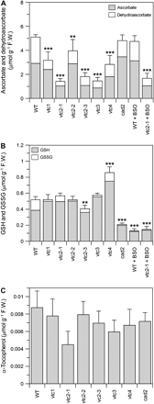
Fig. 1. Ascorbate and dehydroascorbate (A), glutathione (GSH) and oxidized glutathione (GSSG) (B), and α-tocopherol ...
Notes:
Fig. 1. Ascorbate and dehydroascorbate (A), glutathione (GSH) and oxidized glutathione (GSSG) (B), and α-tocopherol (C) concentrations in leaves of 2-week-old seedlings of the wild type (WT), and vtc and cad2 mutants of Arabidopsis thaliana. WT and vtc2-1 plants were also grown on 0.5 mM D,L-buthionine-[S,R]-sulphoximine (BSO). Error bars are means ±SD, n=3. Mean values which differed significantly from the WT control treatment were determined by a post hoc least significant difference test (*P <0.05; **P <001; ***P <0.001).
Unless provided in the caption above, the following copyright applies to the content of this slide: © The Author [2008]. Published by Oxford University Press [on behalf of the Society for Experimental Biology]. All rights reserved. For Permissions, please e-mail: journals.permissions@oxfordjournals.org

Slide 3
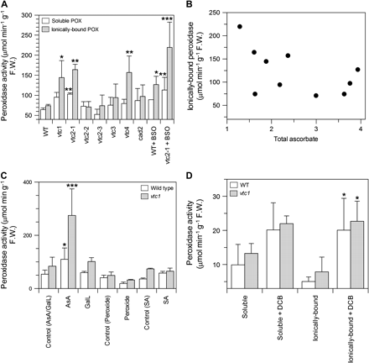
Fig. 2. (A) Soluble and ionically bound peroxidase activity in leaves of 2-week-old seedlings of the wild type (WT), ...
Notes:
Fig. 2. (A) Soluble and ionically bound peroxidase activity in leaves of 2-week-old seedlings of the wild type (WT), and vtc and cad2 mutants of Arabidopsis thaliana. WT and vtc2-1 plants were also grown on 0.5 mM D,L-buthionine-[S,R]-sulphoximine (BSO). (B) The relationship between total ascorbate concentration and ionically bound peroxidase activity across all strains and treatments shown in A (r= –0.61, P <0.05). (C) The effect of 24 h exposure to ascorbate (10 mM for 2 d), L-galactonolactone (10 mM for 2 d), hydrogen peroxide (50 mM for 1 d), and salicylic acid (1 mM for 1 d) on ionically bound peroxidase activity in WT and vtc1 A. thaliana. The control for the ascorbate treatment is also the control for L-galactonolactone. (D) The effect of 2,6-dichlorobenzonitrile (DCB, 5 μM for 2 d) on soluble and ionically bound peroxidase activity in leaves of WT and vtc1 A. thaliana. Error bars are means ±SD, n=3. Mean values which differed significantly from the WT control treatment were determined by a post hoc least significant difference test (*P <0.05; **P <001; ***P <0.001).
Unless provided in the caption above, the following copyright applies to the content of this slide: © The Author [2008]. Published by Oxford University Press [on behalf of the Society for Experimental Biology]. All rights reserved. For Permissions, please e-mail: journals.permissions@oxfordjournals.org

Slide 4
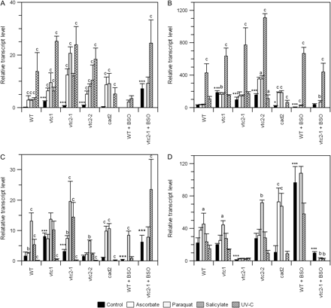
Fig. 3. The relative transcript levels of (A) endochitinase, (B) PR1, (C) PR2, and (D) GST6 in 2-week-old Arabidopsis ...
Notes:
Fig. 3. The relative transcript levels of (A) endochitinase, (B) PR1, (C) PR2, and (D) GST6 in 2-week-old Arabidopsis thaliana vtc and cad2 mutants determined by qPCR. Wild-type (WT) and vtc2-1 plants were also grown on 0.5 mM D,L-buthionine-[S,R]-sulphoximine (BSO) to inhibit GSH synthesis. Additionally, untreated controls of each strain were compared with the following treatments: ascorbic acid (10 mM for 24 h), UV-C radiation (44 kJ m−2 s−1 over 30 min followed by 24 h recovery), salicylic acid (1 mM for 24 h), and paraquat (10 nM for 24 h). The mean relative transcript level ±SD of three replicates is shown. The relative transcript data are heteroscedastic and were log transformed before analysis of variance. Mean values which differed significantly were determined by a post hoc least significant difference test. Asterisks indicate significant differences between mutants, compared with the WT in the control treatment (*P <0.05; **P <0.01; ***P <0.001). Letters indicate differences between controls and each treatment for each mutant and BSO treatment (a=P <0.05; b=P <001; c=P <0.001).
Unless provided in the caption above, the following copyright applies to the content of this slide: © The Author [2008]. Published by Oxford University Press [on behalf of the Society for Experimental Biology]. All rights reserved. For Permissions, please e-mail: journals.permissions@oxfordjournals.org

