Slide 1
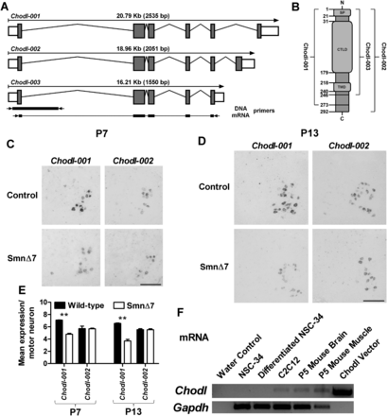
Figure 1. NSC-34 cells provide a good model for exploring Chodl dysregulation in SMA mouse motor neurons. (A) In mouse, ...
Notes:
Figure 1. NSC-34 cells provide a good model for exploring Chodl dysregulation in SMA mouse motor neurons. (A) In mouse, Chodl encodes three isoforms (Chodl-001 ENSMUST00000023568; Chodl-002 ENSMUST00000069148; Chodl-003 ENSMUST00000114216) that share exons 1–5 but terminate in different 3′ terminal exons and 3′ UTRs (not to scale). The locations of primer sets used in Figure S1 and part F of this figure are labelled below Chodl-003. (B) Protein structure of the three Chodl isoforms based on information from Ensembl and SMART (smart.embl-heidelberg.de, accessed 30 September 2013) (not to scale). All three proteins possess an N-terminal signal peptide, a C-type lectin-like domain, a transmembrane domain and a short cytoplasmic tail at the C-terminus that differs between the three isoforms. Numbers represent amino acid position. (C and D) In situ hybridization experiments performed at early (P7, C) and late (P13, D) symptomatic stages of disease confirm the reduced expression of Chodl-001 in SMA mouse spinal motor neurons compared with wild-type control mice with relative sparing of Chodl-002. Chodl-003 expression was undetectable (data not shown). Scale bars = 200 μm. (E) Quantification of the average in situ signal intensity per motor neuron indicates that Chodl-001 expression is significantly reduced in SMA mouse spinal motor neurons at both time-points, whereas Chodl-002 levels remain unaffected. P = 0.0058, Kruskal–Wallis test. **P < 0.01, Dunn's multiple comparison test. (F) Chodl expression is below detection in undifferentiated and differentiated (4 days) NSC-34 cells as assessed by RT-PCR with glyceraldehyde 3-phosphate dehydrogenase (Gapdh, ENSMUSG00000057666) as the loading control. Chodl expression was detected in mouse myoblastic C2C12 cells and P5 mouse brain and skeletal muscle. See also Supplementary Material, Figure S1.
Unless provided in the caption above, the following copyright applies to the content of this slide: © The Author 2013. Published by Oxford University Press. All rights reserved. For Permissions, please email: journals.permissions@oup.com

Slide 2
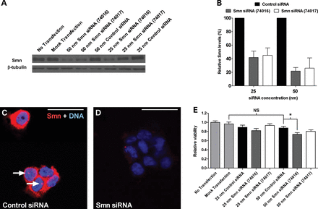
Figure 2. siRNAs targeting Smn decrease protein levels leading to reduced cell viability. (A) A representative western ...
Notes:
Figure 2. siRNAs targeting Smn decrease protein levels leading to reduced cell viability. (A) A representative western blot showing that Smn (ENSMUSG00000021645) siRNAs 74016 and 74017 reduced Smn protein levels 72 h post-transfection. (B) Densitometric analysis of western blots from three independent experiments reveals that at 25 and 50 nM, Smn siRNAs reduced Smn protein levels to ≈40 and 20% of control, respectively. (C and D) Representative immunofluorescence images depicting cells treated with control (C) and Smn (D) siRNAs. Arrows point to Smn-enriched nuclear foci likely to be Cajal bodies or gems, indicating the specificity of the antibody for Smn. Scale bars = 30 μm. (D) At 50 nM, Smn siRNA 74016 significantly reduced cell viability in an MTT assay compared with control siRNA. Three data points per condition were collected from each of three independent experiments. P < 0.001, one-way ANOVA. NS, not significant. *P < 0.05, Bonferroni's multiple comparison test. See also Supplementary Material, Figures S2 and S3.
Unless provided in the caption above, the following copyright applies to the content of this slide: © The Author 2013. Published by Oxford University Press. All rights reserved. For Permissions, please email: journals.permissions@oup.com

Slide 3
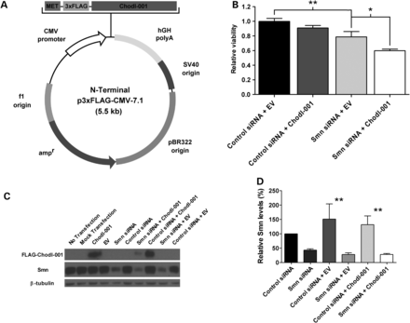
Figure 3. Chodl-001 expression exacerbates the viability defect caused by Smn depletion. (A) A map of the ...
Notes:
Figure 3. Chodl-001 expression exacerbates the viability defect caused by Smn depletion. (A) A map of the p3×FLAG-CMV-7.1 vector used to express Chodl-001. The size of the vector with insert is ≈5.5 kb. Figure adapted from the Sigma website (http://www.sigmaaldrich.com/catalog/product/sigma/e7533, accessed 30 September 2013). (B) Chodl-001 expression in Smn-depleted cells exacerbates the viability defect caused by Smn knockdown at 96 h post-transfection. Two data points per condition were collected from each of six independent experiments. P < 0.001, one-way ANOVA. (C) A representative western blot showing successful reduction of endogenous Smn, and expression of Chodl-001. An antibody against FLAG was used to detect Chodl-001 because the three Chodl antibodies tested were insensitive to the mouse protein (data not shown). (D) Densitometric analysis of western blots from five independent experiments reveals that the effect of Chodl-001 in Smn-depleted cells is independent of a further decrease in Smn. P < 0.001, one-way ANOVA. *P < 0.05, **P < 0.01, Bonferroni's multiple comparison test. See also Supplementary Material, Figures S4–S6.
Unless provided in the caption above, the following copyright applies to the content of this slide: © The Author 2013. Published by Oxford University Press. All rights reserved. For Permissions, please email: journals.permissions@oup.com

Slide 4
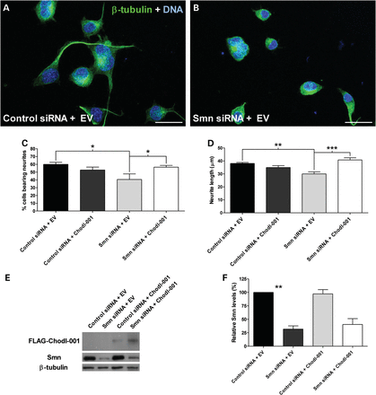
Figure 4. Chodl-001 improves neurite defects caused by Smn depletion. (A and B) Representative images of NSC-34 cells ...
Notes:
Figure 4. Chodl-001 improves neurite defects caused by Smn depletion. (A and B) Representative images of NSC-34 cells in 3% (v/v) serum differentiation media with normal (A) and depleted (B) Smn levels. Scale bars = 30 μm. (C) When Smn levels are normal, Chodl expression has no effect on the percentage of cells bearing neurites 96 h post-transfection; however, in Smn-depleted cells, Chodl-001 significantly rescued the defect caused by Smn knockdown. Percentages were calculated for one to three replicates per condition from each of three independent experiments. At least five replicates were included for each condition. P = 0.0375, one-way ANOVA. (D) Chodl-001 expression rescued neurite length in Smn-depleted cells. Mean lengths were calculated for one to three replicates per condition from each of three independent experiments. At least five replicates were included for each condition. P < 0.001, one-way ANOVA. (E) A representative western blot showing successful Smn depletion and FLAG detection. Chodl-001 was expressed at similar levels between treatments. (F) Densitometric analysis of western blots from three independent experiments reveals that differences in Smn levels do not account for the differential effects of Chodl on neurite outgrowth. P = 0.0077, Kruskal–Wallis test. *P < 0.05, **P < 0.01, ***P < 0.001, Bonferroni's/Dunn's multiple comparison test. See also Supplementary Material, Figure S8.
Unless provided in the caption above, the following copyright applies to the content of this slide: © The Author 2013. Published by Oxford University Press. All rights reserved. For Permissions, please email: journals.permissions@oup.com

Slide 5
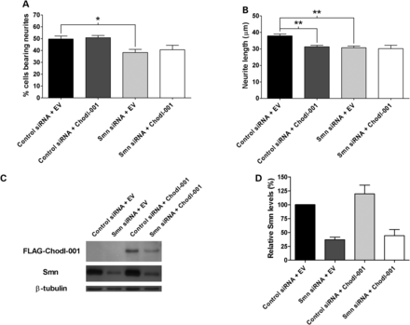
Figure 5. Fine-tuning of Chodl levels is important for neurite outgrowth. (A and B) Doubling the concentration of ...
Notes:
Figure 5. Fine-tuning of Chodl levels is important for neurite outgrowth. (A and B) Doubling the concentration of Chodl-001 abrogates the rescue effect in Smn-depleted cells on the percentage of neurite-bearing cells (A), and neurite length (B) 96 h post-transfection. In cells with normal Smn levels, the increased amount of Chodl-001 exacerbates the associated length deficiency observed at the lower concentration (B). A, P = 0.0083; B, P = 0.0022, one-way ANOVA. (C) A representative western blot showing successful Smn depletion and FLAG detection. Chodl was expressed at similar levels between treatments. (D) Densitometric analysis of western blots from three independent experiments reveals that differences in Smn levels do not account for the differential effects of Chodl-001 on neurite outgrowth. P = 0.0342, Kruskal–Wallis test. *P < 0.05, **P < 0.01, Bonferroni's multiple comparison test. See also Supplementary Material, Figure S7.
Unless provided in the caption above, the following copyright applies to the content of this slide: © The Author 2013. Published by Oxford University Press. All rights reserved. For Permissions, please email: journals.permissions@oup.com

Slide 6
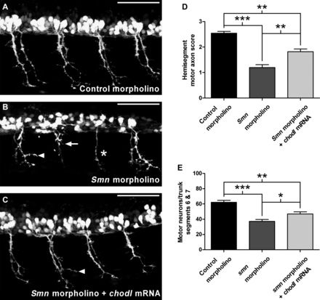
Figure 6. Overexpression of chodl partially rescues the motor axon defects of Smn-depleted zebrafish. (A–C) Lateral ...
Notes:
Figure 6. Overexpression of chodl partially rescues the motor axon defects of Smn-depleted zebrafish. (A–C) Lateral view photomicrographs of HB9:GFP+ zebrafish embryos at 28 h post-fertilization injected with control morpholino (A), Smn (ENSDARG00000018494) morpholino (B) and Smn morpholino with chodl (ENSDARG00000034528) mRNA (C). Control morpholino-injected embryos show hemisegments with wild-type-like ventral motor axons, whereas Smn morpholino-injected fish display numerous bifurcated (arrowhead), truncated (arrow) and missing ventral motor axons (asterisk). chodl mRNA injection with Smn morpholino improves the axonal phenotype caused by Smn knockdown. Scale bars = 50 μm. (D and E) Co-injection of Smn morpholino and chodl mRNA leads to a significant rescue of motor axon outgrowth as assessed by the hemisegment score (see Materials and Methods) (D, P < 0.001, one-way ANOVA) and the number of motor neuronal HB9:GFP+ cells (E, P < 0.001, Kruskal–Wallis) as compared with Smn morpholino-injected embryos. *P < 0.05, **P < 0.01, ***P < 0.001, Bonferroni's/Dunn's multiple comparison test. See also Supplementary Material, Figure S9.
Unless provided in the caption above, the following copyright applies to the content of this slide: © The Author 2013. Published by Oxford University Press. All rights reserved. For Permissions, please email: journals.permissions@oup.com

