Slide 1
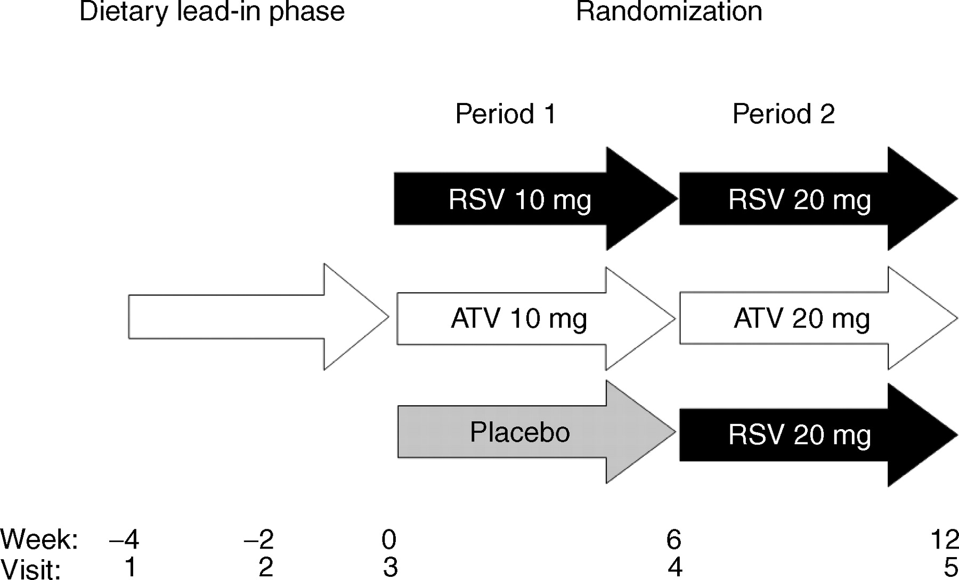
Figure 1 COMETS study design. ATV, atorvastatin; RSV, rosuvastatin.
Notes:
Figure 1 COMETS study design. ATV, atorvastatin; RSV, rosuvastatin.
Unless provided in the caption above, the following copyright applies to the content of this slide: © The European Society of Cardiology 2005. All rights reserved. For Permissions, please e-mail: journals.permissions@oupjournals.org

Slide 2
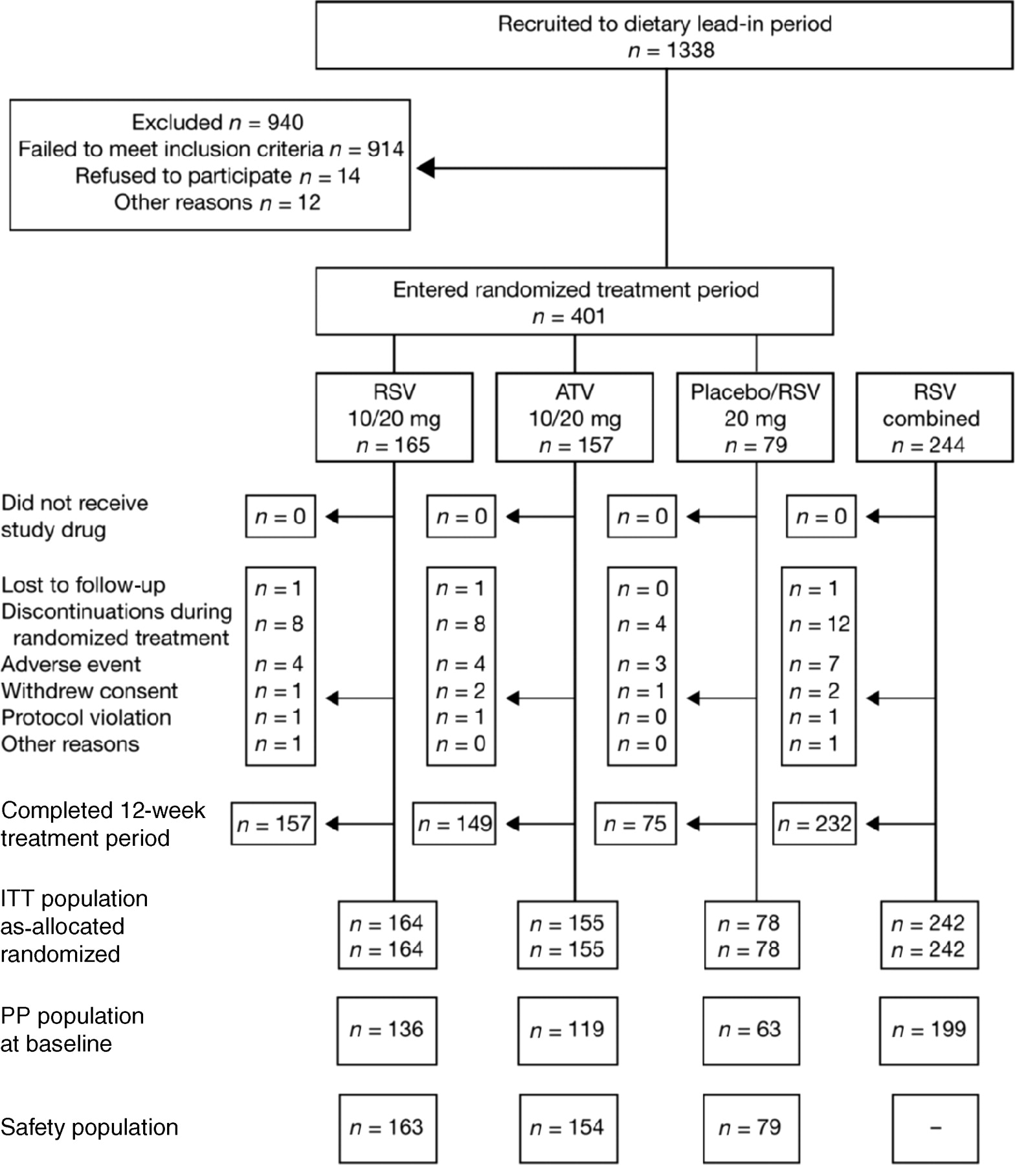
Figure 2 Patient flow and statistical analysis sets. The two ITT groups did not contain an identical set of ...
Notes:
Figure 2 Patient flow and statistical analysis sets. The two ITT groups did not contain an identical set of patients. Five patients who inadvertently received trial medications different from that required by the allocated patient number were also included in the safety analysis.
Unless provided in the caption above, the following copyright applies to the content of this slide: © The European Society of Cardiology 2005. All rights reserved. For Permissions, please e-mail: journals.permissions@oupjournals.org

Slide 3
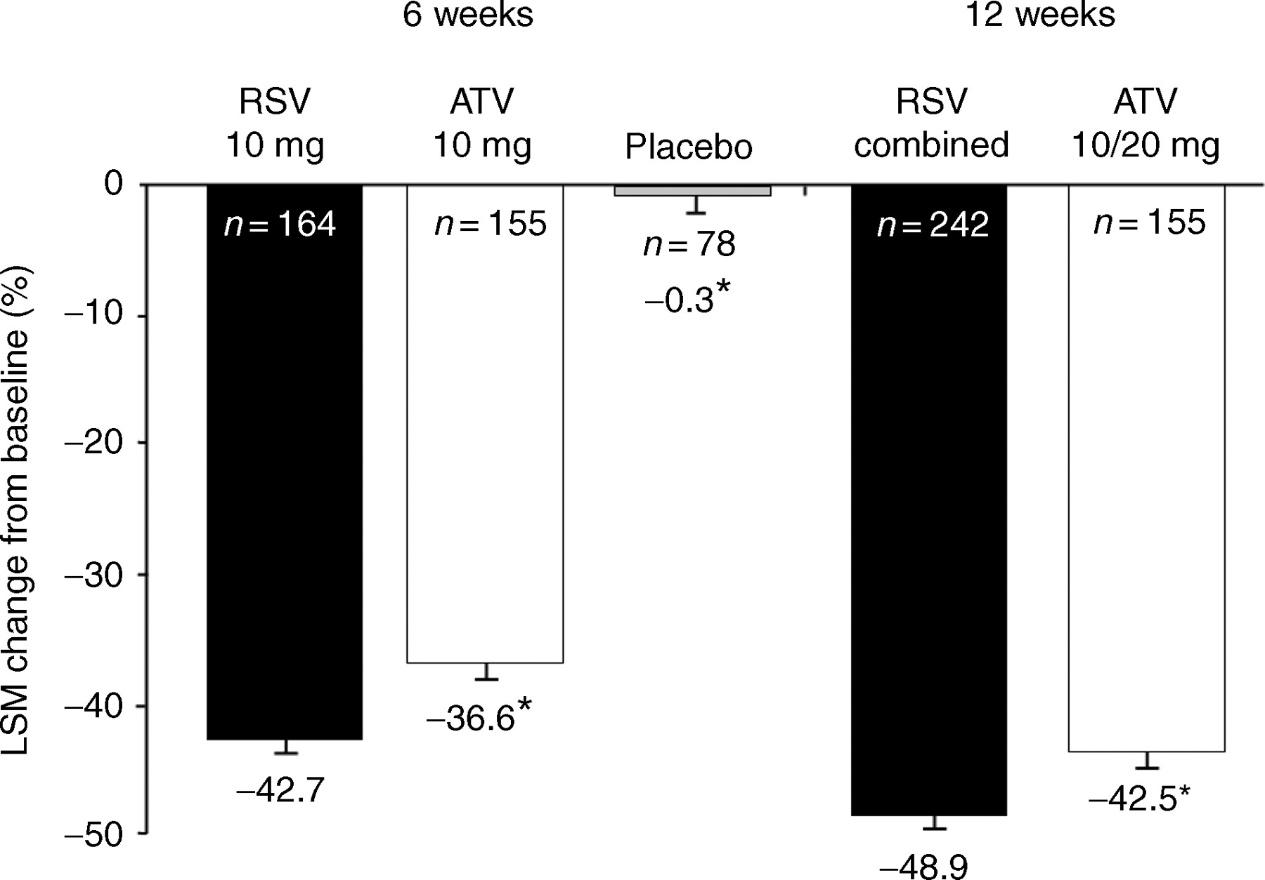
Figure 3 Percentage change from baseline in LDL-C levels (ITT population by as-allocated treatment). LSM, ...
Notes:
Figure 3 Percentage change from baseline in LDL-C levels (ITT population by as-allocated treatment). LSM, least-squares mean. *P<0.001 vs. RSV at the same time point.
Unless provided in the caption above, the following copyright applies to the content of this slide: © The European Society of Cardiology 2005. All rights reserved. For Permissions, please e-mail: journals.permissions@oupjournals.org

