Slide 1
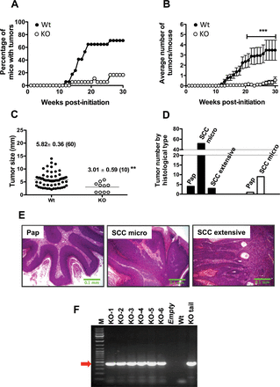
Fig. 1. RasGRP1 KO mice show reduced susceptibility to skin carcinogenesis. Seventeen Wt (closed circles) and 18 ...
Notes:
Fig. 1. RasGRP1 KO mice show reduced susceptibility to skin carcinogenesis. Seventeen Wt (closed circles) and 18 RasGRP1 KO (open circles; KO) mice were treated with TPA following initiation with DMBA and tumors of at least 1mm were counted and measured every week for 30 weeks. (A) Tumor incidence (percentage of mice with tumors). (B) Tumor multiplicity (average number of tumors per mouse ± standard error); ***P < 0.001 (two-way analysis of variance followed by Bonferroni posttest). (C) Tumor size (diameter in mm) at 28 weeks postinitiation; **P < 0.003 (two-tailed t-test). (D) Distribution of tumors by histological type. Tumors were analyzed by histology and classified as papillomas (Pap) or SCC in Wt (filled columns) and KO (empty columns) mice. SCCs were divided into two groups based on their invasiveness: microinvasive (micro; one or a few clusters of cells invading the dermis), or extensive invasion (extensive; advancing fronts of invading cells into the dermis and subcutaneous tissue). (E) Histological appearance of the tumors. Microphotographs of representative hematoxylin and eosin-stained tumor specimens from Wt mice are shown. (F) RasGRP1 KO status in tumors. PCR was performed on DNA isolated from RasGRP1 KO-generated tumors to detect the KO NEO cassette using the following primers: 5′-CTA TCC TCA CTT GAG TCT CTC TT CC-3′ and 5′-CCG TAA TGG GAT AGG TTA CGT TGG TG-3′. Due to the small size of some of the tumors generated in the mutant mice, only 6 out of the 10 tumors formed were analyzed. M, DNA marker; KO-1 to -6, DNA samples derived from RasGRP1 KO-generated tumors; Empty, no sample in the lane; Wt, DNA from Wt mice (negative control); KO tail, DNA from tail biopsies of a RasGRP1 KO mouse (positive control). Red arrow, amplicon of the RasGRP1 KO cassette (431bp).
Unless provided in the caption above, the following copyright applies to the content of this slide: © The Author 2014. Published by Oxford University Press. All rights reserved. For Permissions, please email: journals.permissions@oup.com

Slide 2
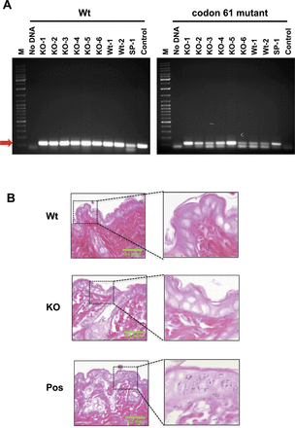
Fig. 2. Lack of RasGRP1 does not affect H-ras mutation status or epidermal apoptosis induced by DMBA. (A) Mutations ...
Notes:
Fig. 2. Lack of RasGRP1 does not affect H-ras mutation status or epidermal apoptosis induced by DMBA. (A) Mutations in codon 61 of H-ras (codon 61 mutant) were evaluated by a PCR approach as described in Materials and methods. M, DNA marker; KO-1 to -6, DNA samples derived from RasGRP1 KO-generated tumors; Wt-1 to -2, DNA samples derived from Wt mice-generated tumors; SP-1, DNA from a keratinocyte cell line derived from papillomas generated using DMBA/TPA in SENCAR mice; Control, genomic DNA from Wt mouse tail. PCR performed with no DNA was included as a control (No DNA). Amplification of Wt H-ras (Wt) was determined for comparison. Red arrow, H-ras amplicon. The lower bands in the gels represent primer dimers. (B) Microphotographs of TUNEL staining of skin samples (Wt; KO, RasGRP1 KO) from mice exposed to DMBA. A positive control was generated by treating skin specimens with a DNA endonuclease (Pos; blue staining in the nucleus). Insets, close-up view of the specimens.
Unless provided in the caption above, the following copyright applies to the content of this slide: © The Author 2014. Published by Oxford University Press. All rights reserved. For Permissions, please email: journals.permissions@oup.com

Slide 3
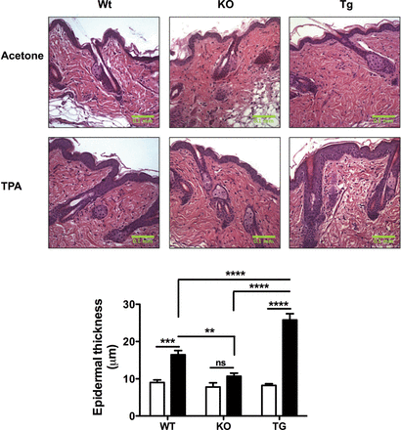
Fig. 3. TPA-induced epidermal hyperplasia is impaired in RasGRP1 KO mice. Wt, RasGRP1 KO (KO) and K5.RasGRP1 (Tg) ...
Notes:
Fig. 3. TPA-induced epidermal hyperplasia is impaired in RasGRP1 KO mice. Wt, RasGRP1 KO (KO) and K5.RasGRP1 (Tg) mice were treated with TPA and epidermal hyperplasia was evaluated as described in Materials and methods. Acetone treatment was also done in place of TPA as vehicle control. Top, representative hematoxylin and eosin-stained sections of skin samples from mice treated with TPA or acetone. Bottom, the thickness of the epidermis (in micrometers) was plotted for each group as mean ± standard error of four to five independent experiments per group. Acetone (empty columns); TPA (filled columns). **P < 0.01; ***P < 0.001; ****P < 0.0001, ns = not significant (two-way analysis of variance followed by Bonferroni posttest).
Unless provided in the caption above, the following copyright applies to the content of this slide: © The Author 2014. Published by Oxford University Press. All rights reserved. For Permissions, please email: journals.permissions@oup.com

Slide 4
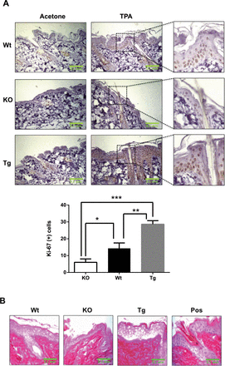
Fig. 4. Epidermal cell proliferation induced by TPA is reduced in RasGRP1 KO mouse skin. Wt, RasGRP1 KO (KO) and ...
Notes:
Fig. 4. Epidermal cell proliferation induced by TPA is reduced in RasGRP1 KO mouse skin. Wt, RasGRP1 KO (KO) and K5.RasGRP1 (Tg) mice were exposed to TPA for evaluation of epidermal hyperplasia as described in Materials and methods. Specimens of each group were stained for the proliferation marker Ki-67 and for measurement of DNA fragmentation by the TUNEL assay as marker of apoptosis. (A) Top, representative images of Ki-67-stained sections for each group treated with either acetone (vehicle control) or TPA. Insets, close-up view of the TPA-treated specimens. Bottom, quantification of Ki-67-positive cells for each group upon treatment with TPA represented as mean ± standard error of three independent experiments per group. *P < 0.05; **P < 0.01; ***P < 0.001. (B) Representative microphotographs of TUNEL staining of skin samples from mice treated with TPA. A positive control was generated by using DNA endonuclease (Pos; blue staining in the nucleus).
Unless provided in the caption above, the following copyright applies to the content of this slide: © The Author 2014. Published by Oxford University Press. All rights reserved. For Permissions, please email: journals.permissions@oup.com

Slide 5
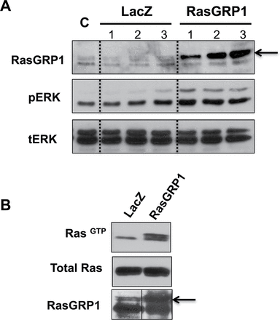
Fig. 5. RasGRP1 activates Ras in response to TPA in keratinocytes carrying a codon 61 H-ras mutant. SP-1 ...
Notes:
Fig. 5. RasGRP1 activates Ras in response to TPA in keratinocytes carrying a codon 61 H-ras mutant. SP-1 keratinocytes were transduced with adenoviruses encoding RasGRP1 or LacZ (control for adenoviral infection) and used 48–72h later. (A) Levels of phospho-extracellular signal-regulated kinase (pERK), total extracellular signal-regulated kinase (tERK) and RasGRP1 were determined by western blot on control, uninfected SP-1 cells (C) and three independent SP-1 cells cultures infected with increasing amounts of adenovirus encoding for LacZ or RasGRP1. Western blots are representative of three independent experiments. (B) SP-1 cells transduced with either LacZ or RasGRP1 were treated with 1 μM TPA for 15min and harvested for active Ras measurement by the pulldown assay. Levels of RasGTP, total Ras and RasGRP1 were determined as described in Materials and methods. Western blots are representative of three independent experiments. The arrows indicate the position of RasGRP1, which shows as a doublet for the endogenous protein. A third, lower band is non-specific. Note that the western blot for RasGRP1 in B has a dividing solid line between lanes, as the lanes shown were not contiguous in the gel. The juxtaposed lanes were acquired under the same condition of brightness and contrast and derived from the same gel.
Unless provided in the caption above, the following copyright applies to the content of this slide: © The Author 2014. Published by Oxford University Press. All rights reserved. For Permissions, please email: journals.permissions@oup.com

