Slide 1
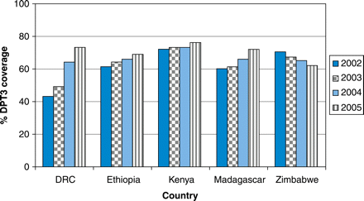
Fig. 1 Three-dose DPT coverage, five African countries, 2002–2005.²
Notes:
Fig. 1 Three-dose DPT coverage, five African countries, 2002–2005.2
Unless provided in the caption above, the following copyright applies to the content of this slide: © Published by Oxford University Press on behalf of the United States Government, the United States Centers for Diseases Control and Prevention, 2009

Slide 2
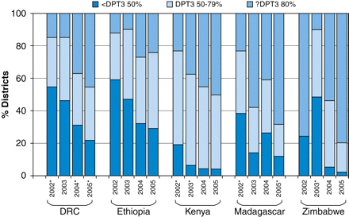
Fig. 2 Proportion of districts with three-dose DPT vaccine coverage <50, 50–79 and ≥80%, five African countries, ...
Notes:
Fig. 2 Proportion of districts with three-dose DPT vaccine coverage <50, 50–79 and ≥80%, five African countries, 2002–2005.2 *Incomplete district date.
Unless provided in the caption above, the following copyright applies to the content of this slide: © Published by Oxford University Press on behalf of the United States Government, the United States Centers for Diseases Control and Prevention, 2009

Slide 3
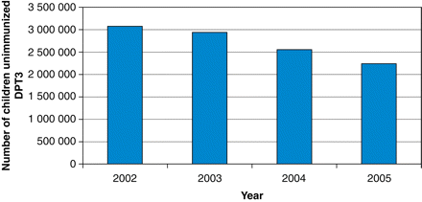
Fig. 3 Estimated number of children not receiving three doses of DTP vaccine in the five evaluated African ...
Notes:
Fig. 3 Estimated number of children not receiving three doses of DTP vaccine in the five evaluated African countries, 2002–2005.2
Unless provided in the caption above, the following copyright applies to the content of this slide: © Published by Oxford University Press on behalf of the United States Government, the United States Centers for Diseases Control and Prevention, 2009

