Slide 1
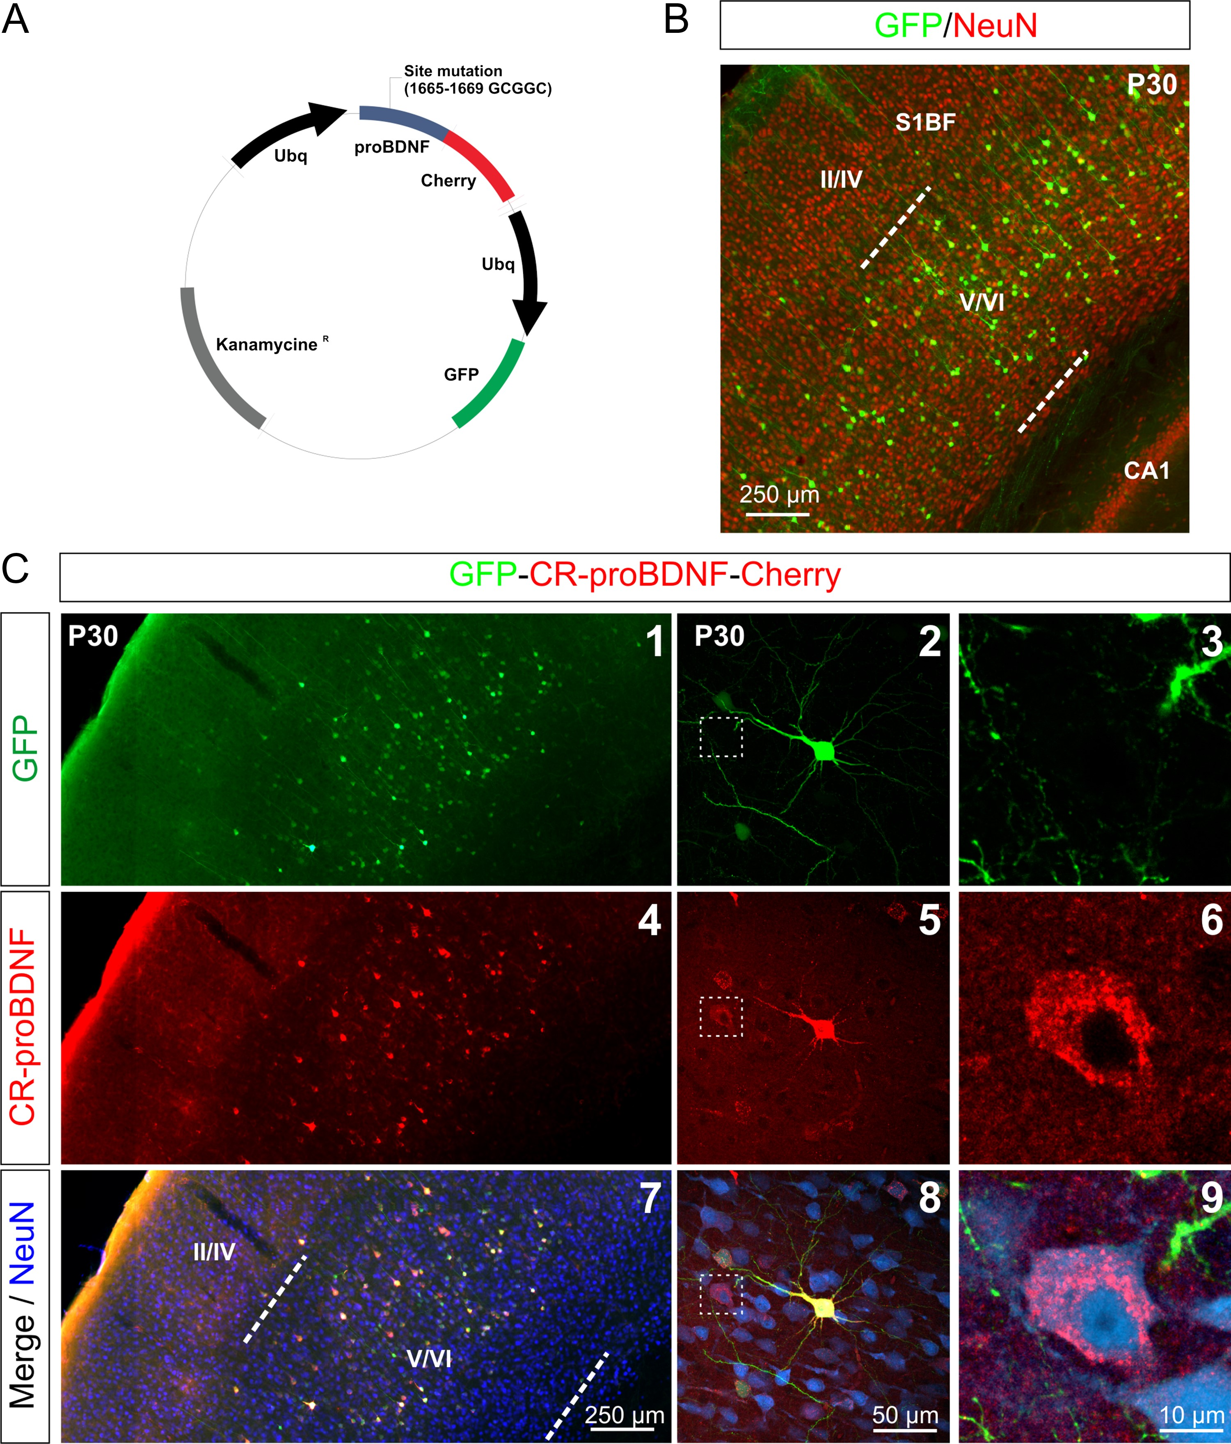
Figure 1. In vivo expression of cleavage-resistant proBDNF (CR-proBDNF). (A) Map of the CR-proBDNF bicistronic plasmid ...
Notes:
Figure 1. In vivo expression of cleavage-resistant proBDNF (CR-proBDNF). (A) Map of the CR-proBDNF bicistronic plasmid vector. Ubiquitin promoters were used to drive expression of GFP and CR-proBDNF-Cherry. (B) Representative neocortical section showing laminar position of transfected cells electroporated at E15 with GFP and processed postnatally at P30 and co-immunostained with NeuN (red). GFP fluorescence intensity profile showed that E15 generated neurons were distributed mainly in the deep layers of the cortex (layers V/VI). (C) Representative neocortical section showing laminar position of transfected cells electroporated at E15 with GFP-CR-proBDNF-Cherry and processed postnatally at P30 (C1, C4 and C7) and co-immunostained with NeuN (blue). pcDNA bicistronic plasmid vector coding for GFP (green; C1-3) and CR-proBDNF-cherry (red; C4-6). GFP and CR-proBDNF-Cherry proteins were expressed in the same cells (yellow; C7-9). The red signal in the NeuN-positive cell (C7-9) is attributable to the CR-proBDNF-Cherry secreted by the electroporated neurons (neuron in yellow; C7-8) that have been endocytosed by unelectroporated neurons (neuron in red; C5–6 and C8-9). S1BF, Somatosensory one Barrel Field.
Unless provided in the caption above, the following copyright applies to the content of this slide: © The Author 2016. Published by Oxford University Press. All rights reserved. For Permissions, please e-mail: journals.permissions@oup.com

Slide 2
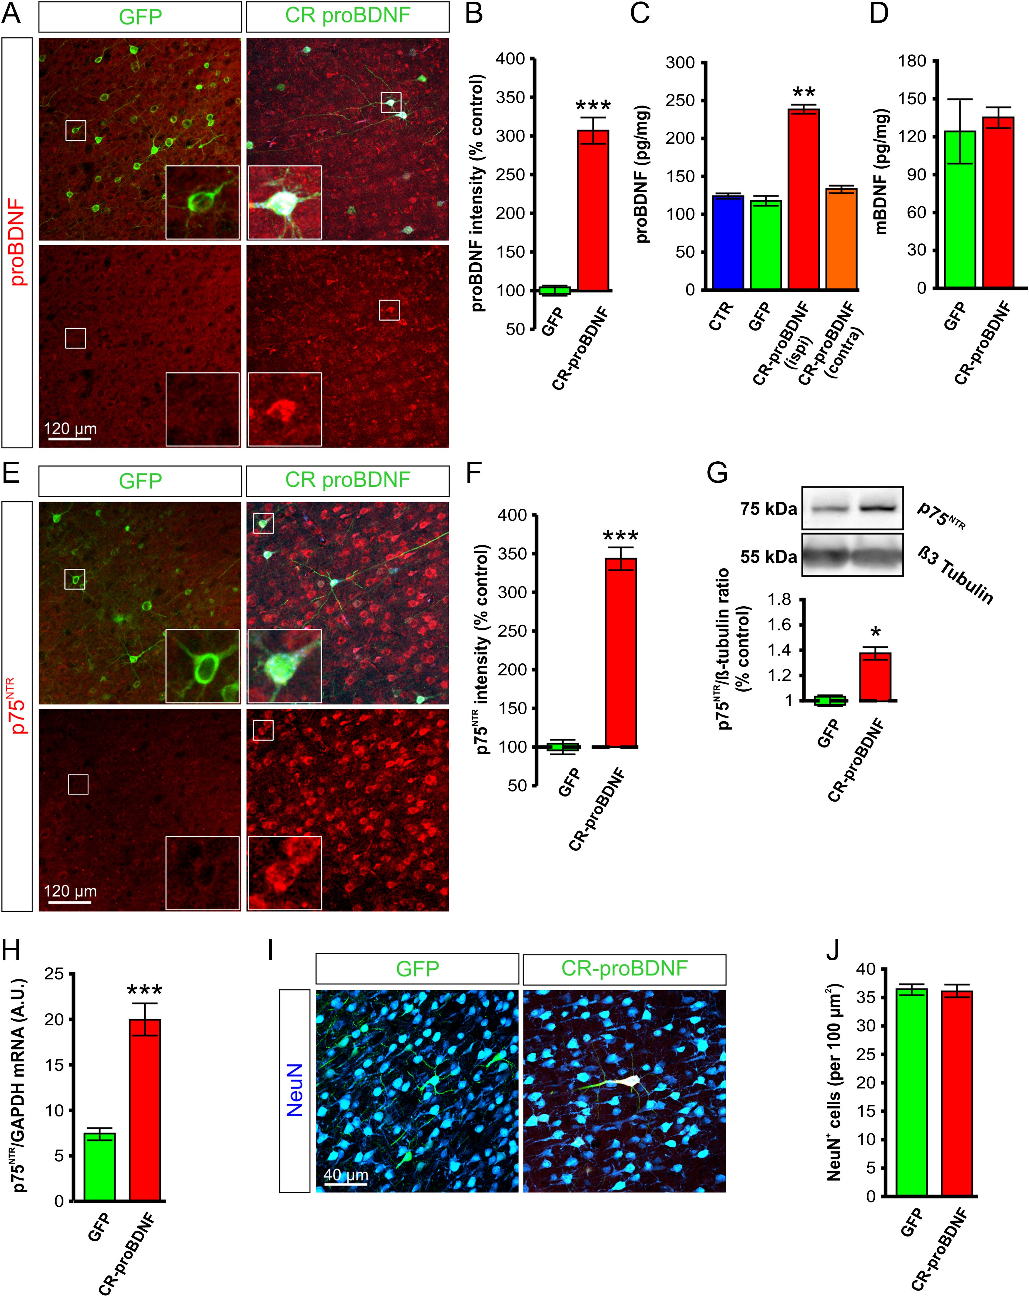
Figure 2. Elevated expression levels of proBDNF and p75^{NTR} in CR-proBDNF cortical neurons. (A, E) ...
Notes:
Figure 2. Elevated expression levels of proBDNF and p75NTR in CR-proBDNF cortical neurons. (A, E) Immunofluorescence signal of P20 neocortical sections electroporated at E15 with GFP only or CR-proBDNF showing cells immunopositive for proBDNF (A) and p75NTR (E) upon chronic expression of CR-proBDNF. (B) Average cortical fluorescence intensity of proBDNF in CR-proBDNF rats normalized to control. Data were obtained from 40 neurons per condition and 4 rats for each group; ***P < 0.001. (C) proBDNF protein levels in cortical tissues in control (CTR), in GFP and in both ipsilateral and contralateral hemisphere from CR-proBDNF. Data were obtained from 4 rats for each group; **P 0.05. (F) Average cortical fluorescence intensity of p75NTR in CR-proBDNF rats normalized to control. Data were obtained from 54 neurons per condition and 4 rats for each group; ***P < 0.001. (G) Western blot analysis with the antibody to p75NTR. p75NTR expression was upregulated in CR-proBDNF tissues. Proteins were visualized using ECL following incubation with HRP-conjugated secondary antibody. Normalized data (p75NTR/ß-Tubulin) are expressed as percentage change with respect to GFP tissues (defined as 100%). Data were obtained from 6 rats per experimental group; *P < 0.05. (H) Relative expression of p75NTR mRNA transcripts in GFP and CR-proBDNF rats. p75NTR gene expression was normalized to the expression of the housekeeping gene, GAPDH, in the same RNA preparation. Data were obtained from 5 rats for each group; ***P 0.05.
Unless provided in the caption above, the following copyright applies to the content of this slide: © The Author 2016. Published by Oxford University Press. All rights reserved. For Permissions, please e-mail: journals.permissions@oup.com

Slide 3
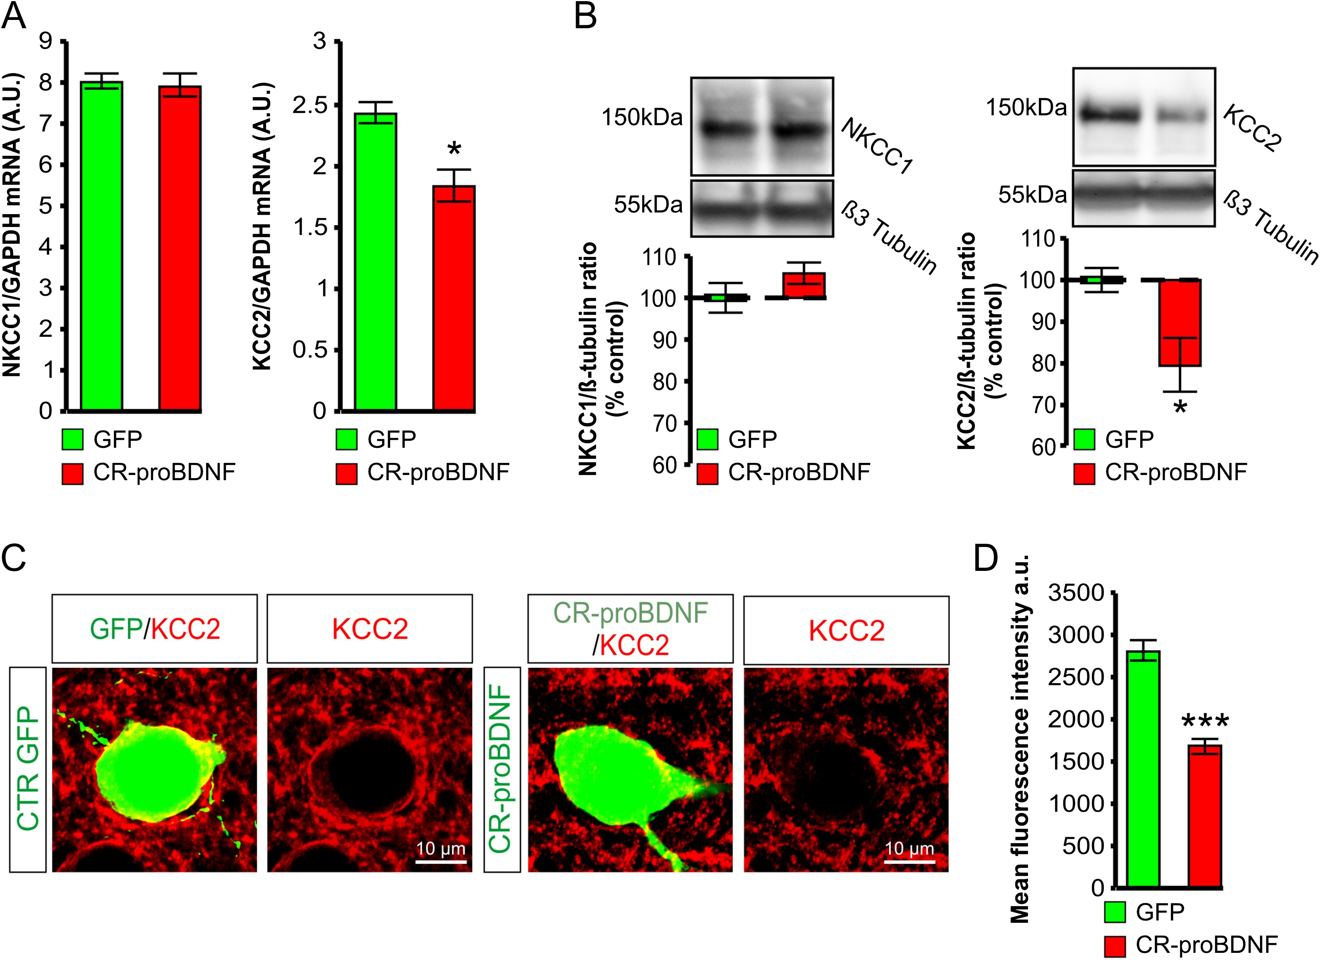
Figure 3. Altered KCC2 expression in cortical neurons expressing CR-proBDNF. (A) Relative expression of KCC2 and NKCC1 ...
Notes:
Figure 3. Altered KCC2 expression in cortical neurons expressing CR-proBDNF. (A) Relative expression of KCC2 and NKCC1 mRNA transcripts in somatosensory cortical tissues electroporated with constructs encoding for GFP (control) or CR-proBDNF. All data are expressed as function of GAPDH expression in the same RNA preparation. Data were obtained from 4 rats for each group. (B) Representative immunoblots for NKCC1 and KCC2 protein extracts from GFP or CR-proBDNF electroporated cortex. Corresponding quantification are shown by the bar graph. Data were obtained from 4 rats for each group; *P < 0.05. (C) Immunoreactivity of KCC2 (red) in P30 cortical neurons expressing GFP (control) or CR-proBDNF. The yellow signal in the CR-proBDNF/GFP panels illustrates the pattern of KCC2 immunostaining at the periphery of somata. Notice that the signal of KCC2 immunostaining is decreased in CR-proBDNF rats compared with control. (D) Bar graphs showing the mean intensity of KCC2 immunofluorescence. Data were obtained from 40 neurons analyzed per condition from 4 rats for each group; ***P < 0.001.
Unless provided in the caption above, the following copyright applies to the content of this slide: © The Author 2016. Published by Oxford University Press. All rights reserved. For Permissions, please e-mail: journals.permissions@oup.com

Slide 4
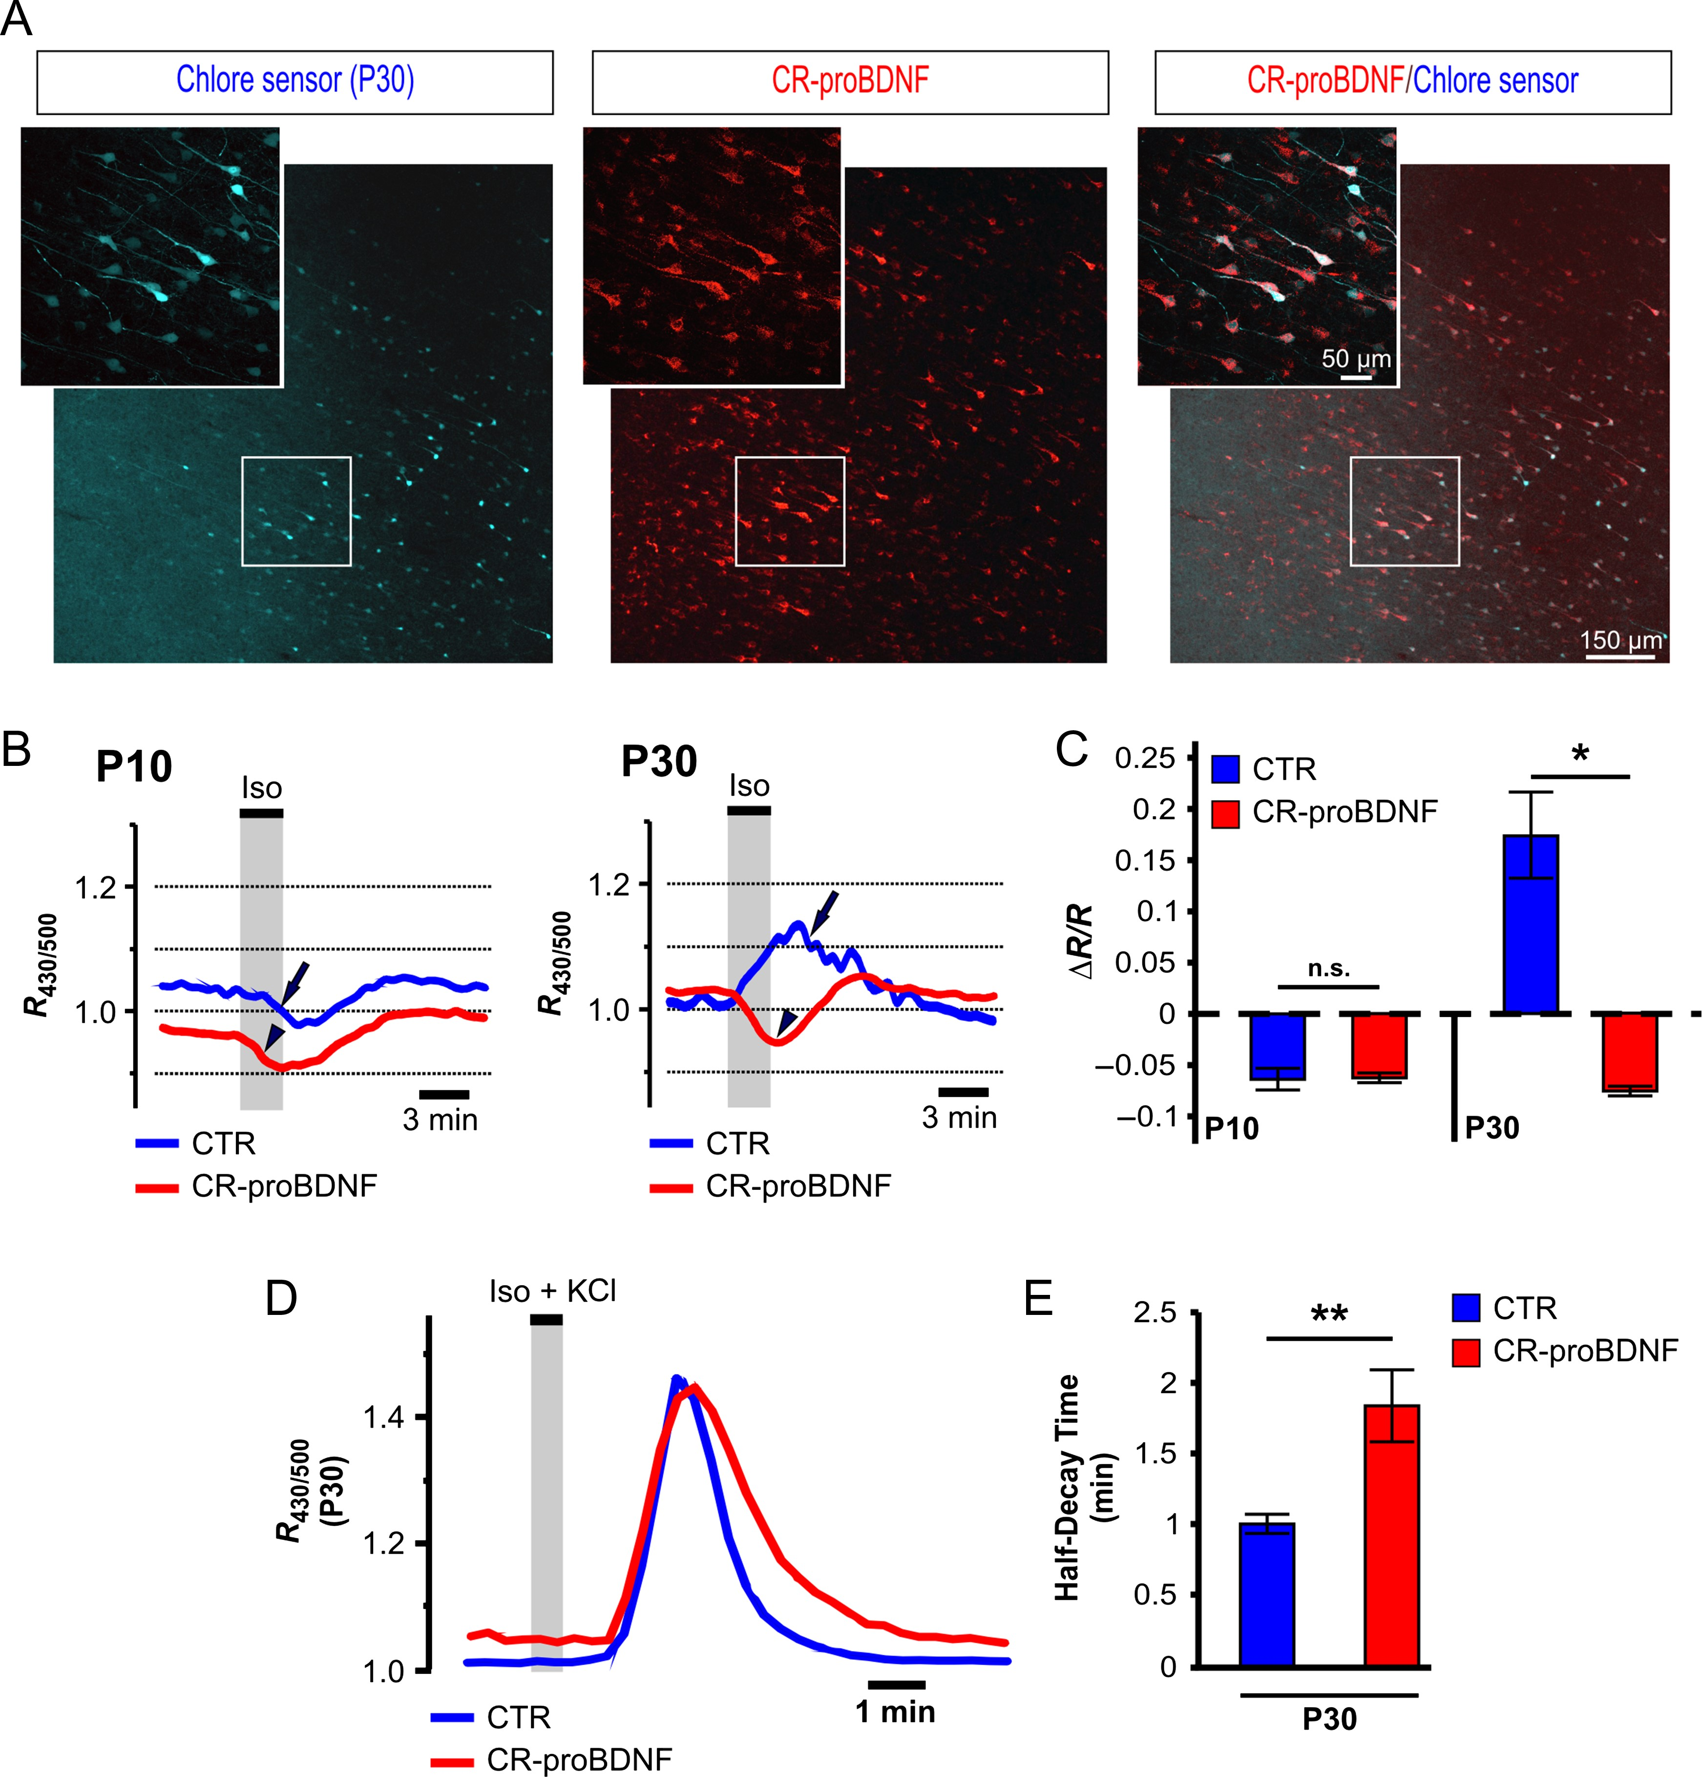
Figure 4. ProBDNF-dependent regulation of Cl-Sensor ratiometric fluorescence in acute cortical slices prepared from ...
Notes:
Figure 4. ProBDNF-dependent regulation of Cl-Sensor ratiometric fluorescence in acute cortical slices prepared from rats on P10 and P30. Rats were electroporated in utero at embryonic day 15 with Cl-Sensor plus scrambled shRNA (Sbl) or Cl-Sensor plus CR-proBDNF. Data represent results obtained from 5 rats per experimental condition. About 2 to 3 slices were recorded per animal. (A) Typical images of Cl-Sensor fluorescence excited at 500 nm in slice from P30 rat electroporated with Cl-Sensor plus CR-proBDNF-Cherry. The region of interest was drawn around the soma of cells located in the focal plane. (B) Example of typical ratiometric fluorescence (R430/500) recordings at P10 and P30 from control (CTR) and CR-proBDNF neurons. Vertical bars indicate the times of application of ACSF containing isoguvacine. Arrows and arrowheads indicate different types of responses between control and CR-proBDNF neurons at P10 and P30. (C) Bar graphs illustrating the mean ± SEM of fluorescence change ΔR/R, where R is the mean of 5 measurements before isoguvacine application and ΔR is the difference between absolute maximum of isoguvacine-induced response and R; *P < 0.05. (D) Example of typical ratiometric fluorescence (R430/500) recordings at P30 from control (blue) and CR-proBDNF neurons (red). Vertical bars indicate the times of application of ACSF containing 10 µM isoguvacine + 25 mM KCl. (E) Half-decay times of the fluorescence recovery after neuronal loading with Cl− at P30; **P < 0.01.
Unless provided in the caption above, the following copyright applies to the content of this slide: © The Author 2016. Published by Oxford University Press. All rights reserved. For Permissions, please e-mail: journals.permissions@oup.com

Slide 5
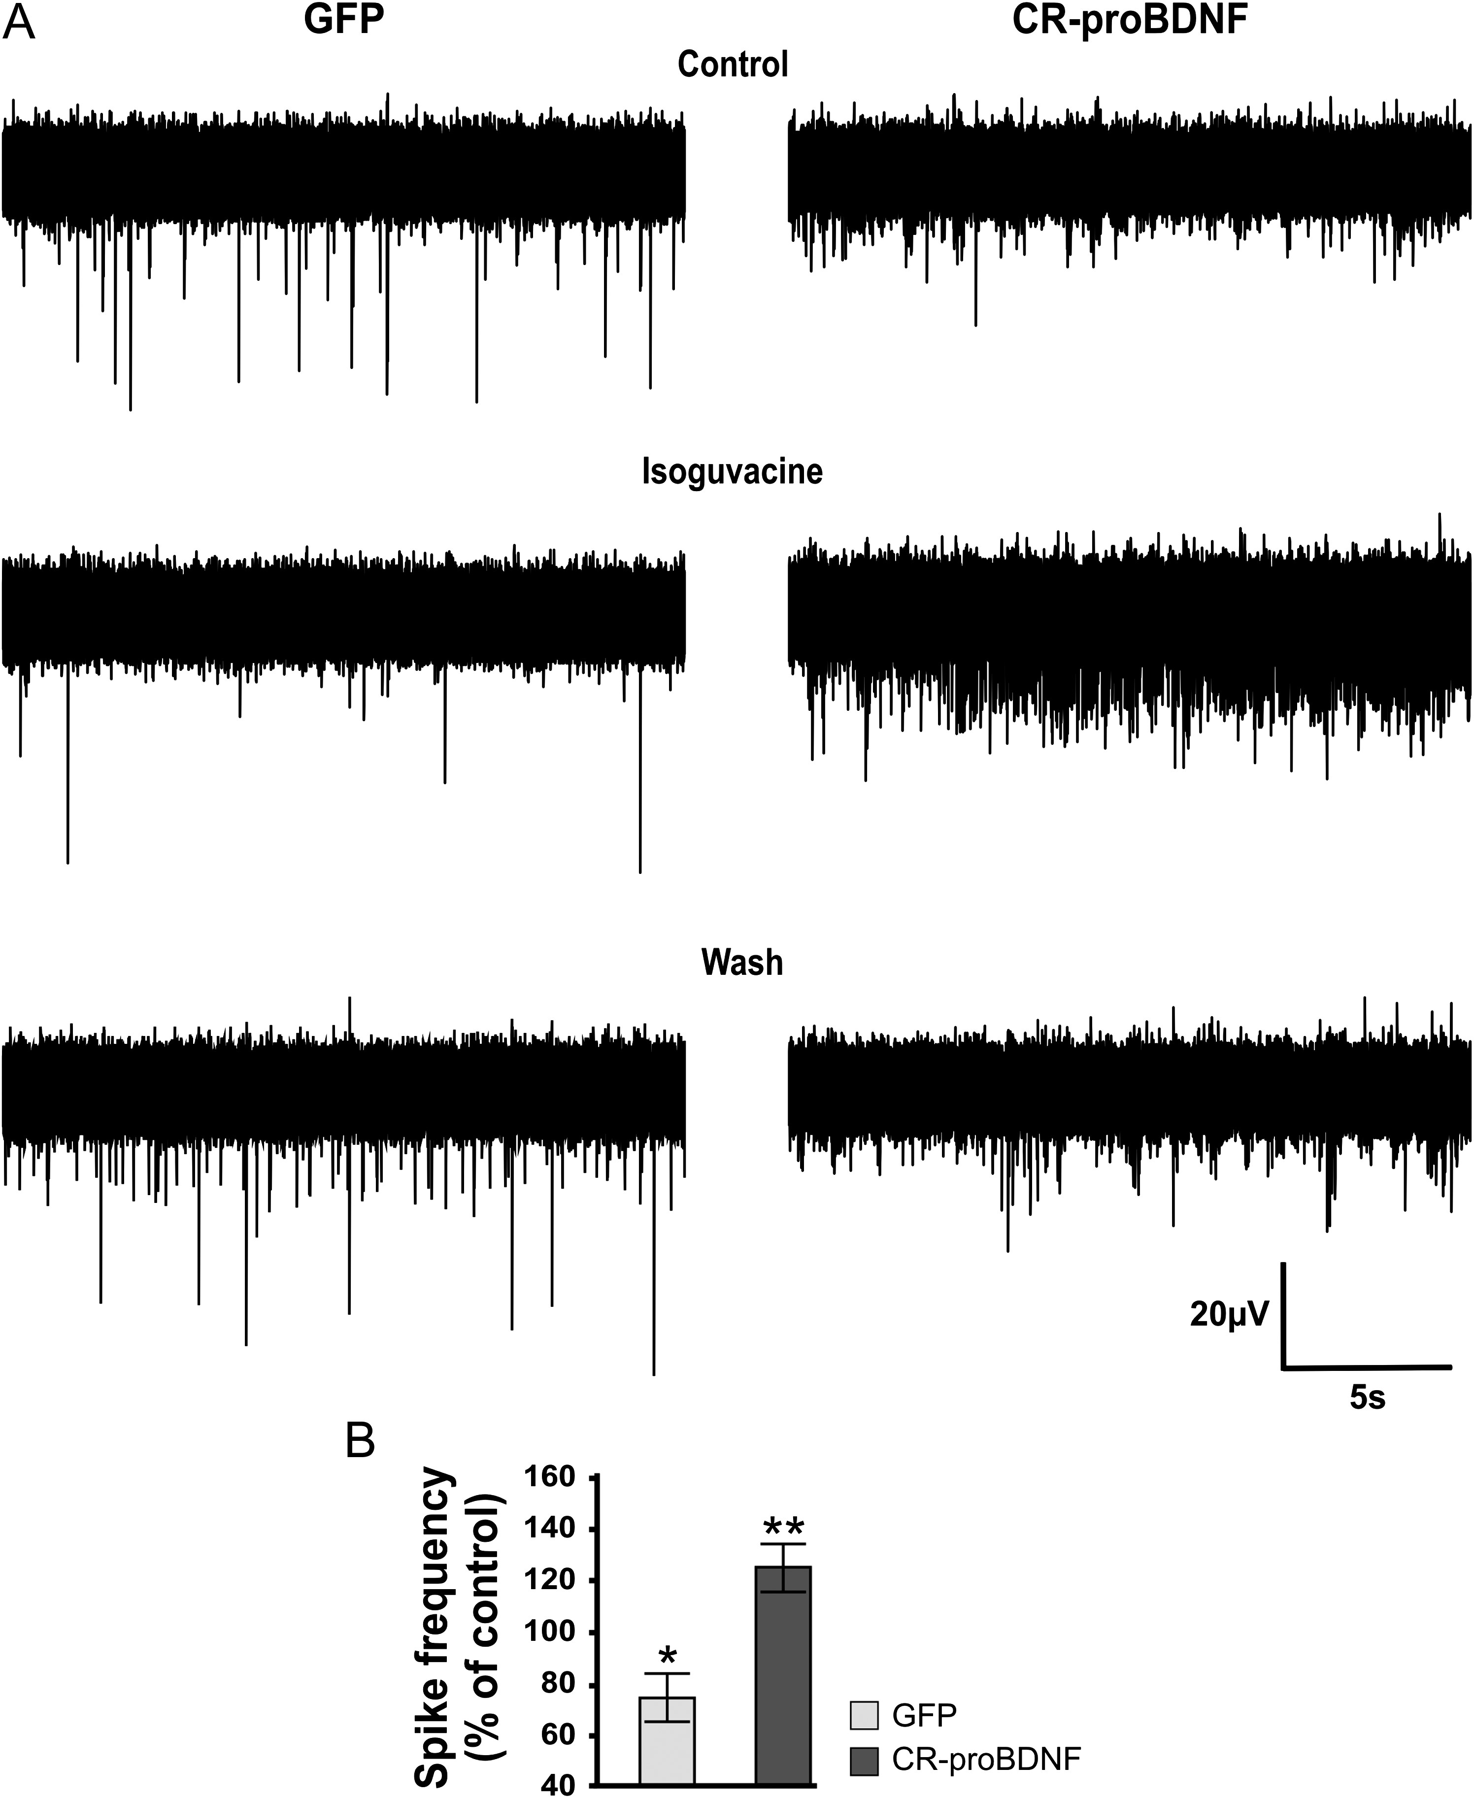
Figure 5. Developmental excitatory-inhibitory GABA sequence is abolished in cortical neurons in CR-proBDNF rats. (A) ...
Notes:
Figure 5. Developmental excitatory-inhibitory GABA sequence is abolished in cortical neurons in CR-proBDNF rats. (A) Effects of isoguvacine (10 µM) in cortical slices from control (GFP) and CR-proBDNF rats: Representative traces of spontaneous extracellular field potentials recorded in cortical slices at P30 in control (GFP; left column) and CR-proBDNF rats (right column). (B) Average histograms of normalized spike frequency in rats at P30. Isoguvacine decreased the spikes frequency in control rats (to 29.4 ± 12.2%) and increased it in CR-proBDNF rats (to 24.6 ± 10.7%). Data were obtained from 2 slices recorded per animal from 6 rats for each group; *P < 0.05, **P < 0.01.
Unless provided in the caption above, the following copyright applies to the content of this slide: © The Author 2016. Published by Oxford University Press. All rights reserved. For Permissions, please e-mail: journals.permissions@oup.com

Slide 6
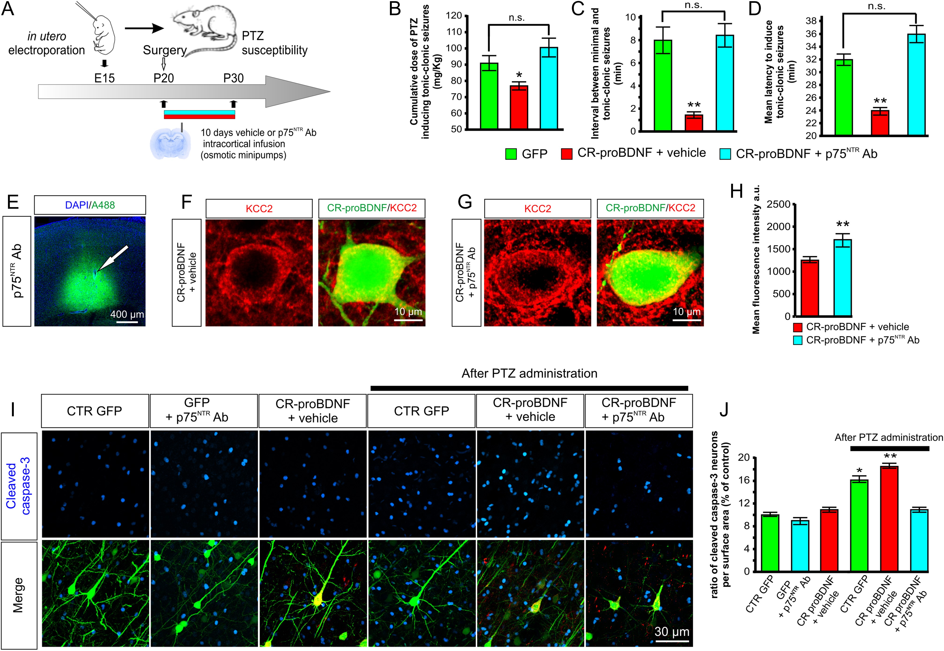
Figure 6. Increased susceptibility to PTZ-induced seizures in proBDNF rats. (A) Experimental paradigm design. ...
Notes:
Figure 6. Increased susceptibility to PTZ-induced seizures in proBDNF rats. (A) Experimental paradigm design. Intracortical infusion of p75NTR functionally blocking antibody (p75NTR Ab) or vehicle solutions are performed from P20 to P30 and experiments are realized at P30. (B) Quantification of doses of PTZ, (C) interval between minimal and generalized seizures, and (D) latency to induce generalized tonic-clonic seizures in 3 groups of rats: GFP control rats (CTR GFP; electroporated with GFP plasmid at E15; n = 10 rats), CR-proBDNF-vehicle treated rats (CR-proBDNF; electroporated with CR-proBDNF plasmid at E15; n = 10 rats) and CR-proBDNF rats treated with a p75NTR Ab (CR-proBDNF + p75NTR Ab; n = 5 rats). *P < 0.05 and **P < 0.01 when compared with GFP control. (E) Staining with an anti-rabbit Alexa Fluor 488 revealed the diffusion of the p75NTR Ab in the tissue sections. Arrow indicates the injection site of p75NTR Ab. (F) KCC2 staining (red) in P30 cortical neurons in CR-proBDNF-vehicle- and (G) p75NTR Ab-treated rats. The yellow signal in the CR-proBDNF/GFP panels illustrates the pattern of KCC2 immunostaining at the periphery of somata. Notice that the signal of KCC2 immunostaining is increased in p75NTR Ab-treated rats compared with vehicle. (H) Bar graphs showing the mean intensity of KCC2 immunofluorescence. Data were obtained from 38 neurons analyzed per condition from 3 animals for each group; **P < 0.01. (I) Immunofluorescence signal of P30 neocortical sections electroporated at E15 with GFP or CR-proBDNF with or without p75NTR Ab treatment before and after PTZ administration and immunolabeled with cleaved caspase-3 antibody. (J) Ratio of cleaved caspase-3-positive neurons (apoptotic) per surface area and expressed as a percentage of control (GFP CTR). Before PTZ administration, overexpression of proBDNF (CR-proBDNF) did not increase the number of apoptotic neurons compared with control (CTR GFP). After PTZ administration, the level of cleaved caspase-3 positive neurons significantly increases in control and proBDNF conditions. Treatment with p75NTR Ab abolished the increase in the number of apoptotic neurons promoted by PTZ administration. Data were obtained from 10 slices per condition from 3 rats for each group. *P < 0.05 and **P < 0.01 when compared with GFP control.
Unless provided in the caption above, the following copyright applies to the content of this slide: © The Author 2016. Published by Oxford University Press. All rights reserved. For Permissions, please e-mail: journals.permissions@oup.com

Slide 7
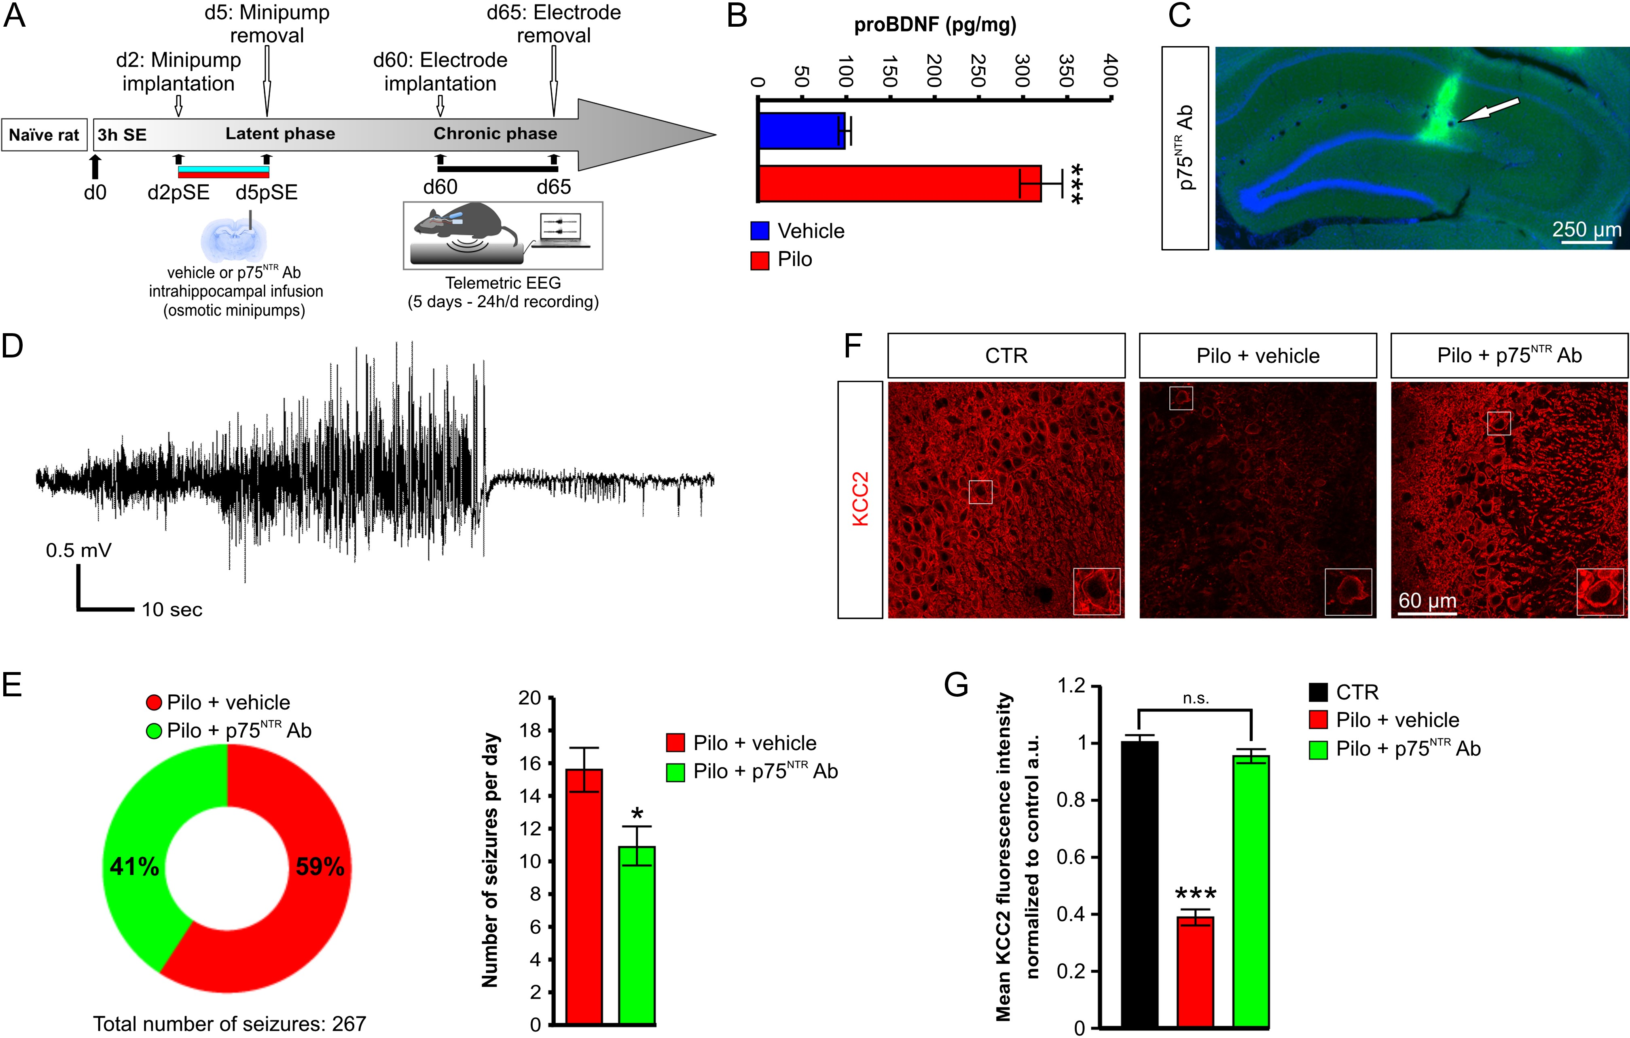
Figure 7. The number of ictal discharges is increased in CR-proBDNF rats. (A) Illustration of the experimental design ...
Notes:
Figure 7. The number of ictal discharges is increased in CR-proBDNF rats. (A) Illustration of the experimental design example of seizure recorded at 2 months post-SE using telemetric EEG. P75NTR Ab or vehicle solutions are infused intrahippocampally continuously using osmotic minipumps from d2 post-SE (d2pSE) to d5 post-SE (d5pSE) and the seizure frequency is assessed 2 months after the end of p75NTR Ab infusion using telemetric EEG with scalp electrode. (B) proBDNF protein levels were significantly increased in the hippocampus 48 h after SE; Data were obtained from 4 animals for each group; ***P < 0.001. (C) Staining with an anti-rabbit Alexa Fluor 488 revealed the diffusion of the p75NTR Ab in the hippocampal sections. Arrow indicates the injection site of p75NTR Ab. (D) Example of a typical ictal event recorded using scalp EEG in chronic epileptic rats at 2 months post-SE. (E) Left, Pie chart showing the fraction of ictal events recorded in pilocarpine (pilo) vehicle- and p75NTR Ab-treated rats (n = 3 rats per group) (158 and 109 ictal events in pilocarpine vehicle- and p75NTR Ab-treated rats, respectively). Right, Bar graph showing the number of ictal events per day in pilo vehicle- and p75NTR Ab-treated epileptic rats. n = 3 per condition; *P < 0.05. (F) KCC2 staining (red) in CA3 region in control (CTR), vehicle-treated d5 post-SE and p75NTR Ab-treated d5 post-SE rats. (G) Bar graphs showing the mean intensity of KCC2 immunofluorescence normalized to control. Data were obtained from 100 to 120 ROIs analyzed per condition from 3 rats for each group; ***P < 0.001.
Unless provided in the caption above, the following copyright applies to the content of this slide: © The Author 2016. Published by Oxford University Press. All rights reserved. For Permissions, please e-mail: journals.permissions@oup.com

