Slide 1
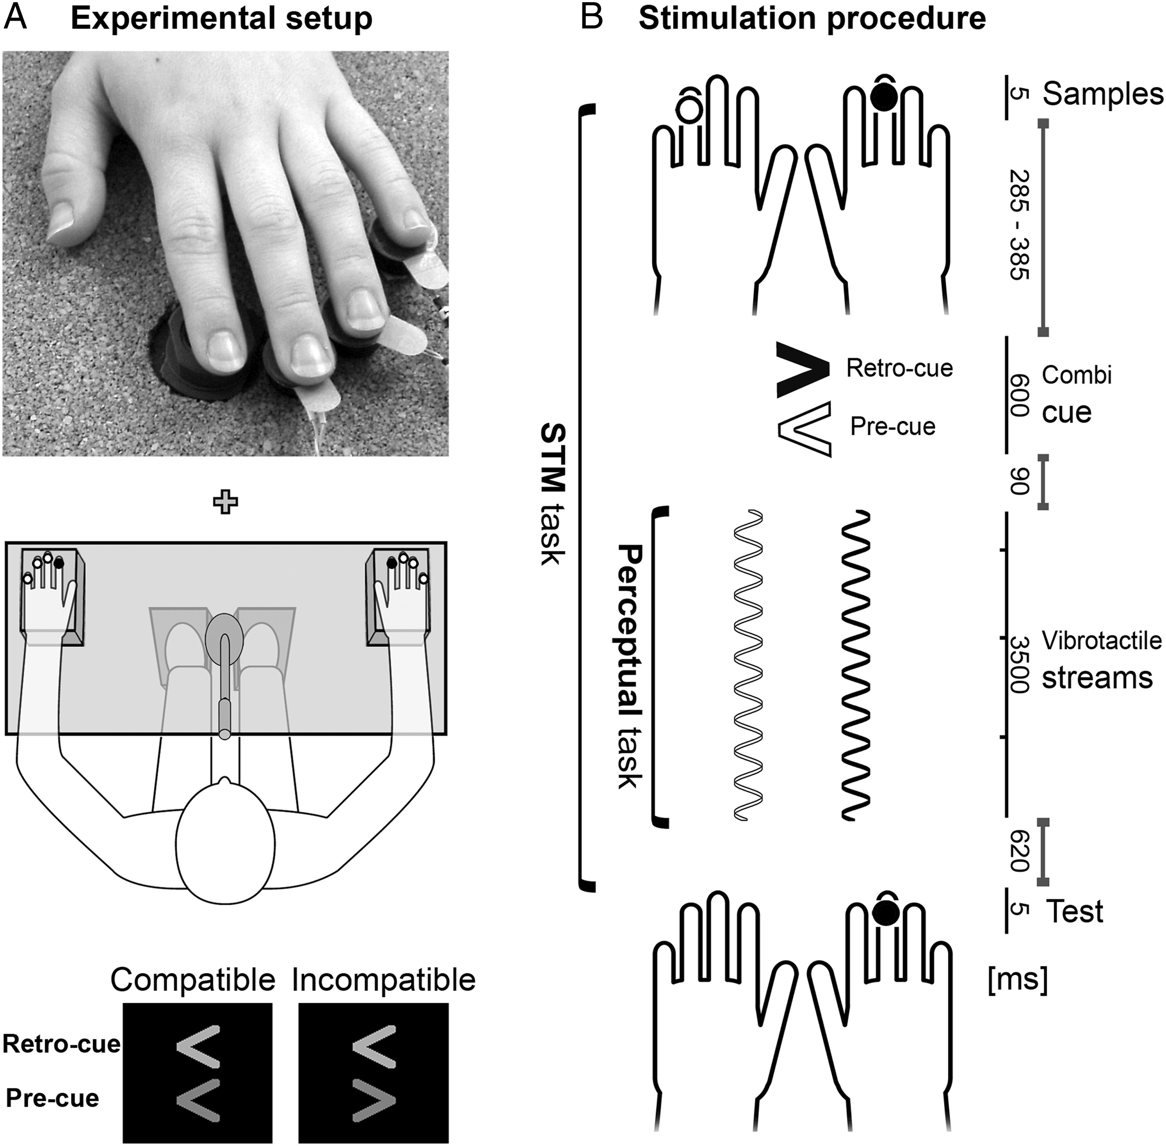
Figure 1. (A) Experimental set-up and stimulation hardware. (Top) A hand equipped with 4 stimulators. Three stimulators ...
Notes:
Figure 1. (A) Experimental set-up and stimulation hardware. (Top) A hand equipped with 4 stimulators. Three stimulators were attached to the distal phalanges of D3, D4, and D5. A further device stimulated D2. (Middle) Vibrotactile streams related to the perceptual task were presented to the index fingers (black dots). The locations of concise pulses involved in the memory task were randomized (white dots). Visual stimuli were shown in the center of the monitor. Participants gave speeded foot button presses and delayed vocal responses in the perceptual and memory task, respectively. (Bottom) The visual cue configurations consisted of two simultaneously presented arrowheads that served as retro- and pre-cue. The arrowheads pointed in the same direction (compatible) or in opposite directions (incompatible). (B) Stimulation procedure. The visual cues succeeded presentation of bilateral tactile sample stimuli and preceded onset of vibrotactile streams. Subjects were instructed to detect transient irregularities (events) in the vibrotactile stream at the prospectively cued hand while memorizing a location at the retrospectively cued hand. Relative to stream onset, events were presented at 3 latencies (500, 1500, or 2500 ms). As to the memory task, test stimuli were delivered to the retrospectively cued hand, at a memorized (50%) or nonmemorized location (50%). In the illustrated example of an incompatible cue trial, the right hand was cued retrospectively (black) and the left hand prospectively (white).
Unless provided in the caption above, the following copyright applies to the content of this slide: © The Author 2012. Published by Oxford University Press. All rights reserved. For Permissions, please e-mail: journals.permissions@oup.com

Slide 2
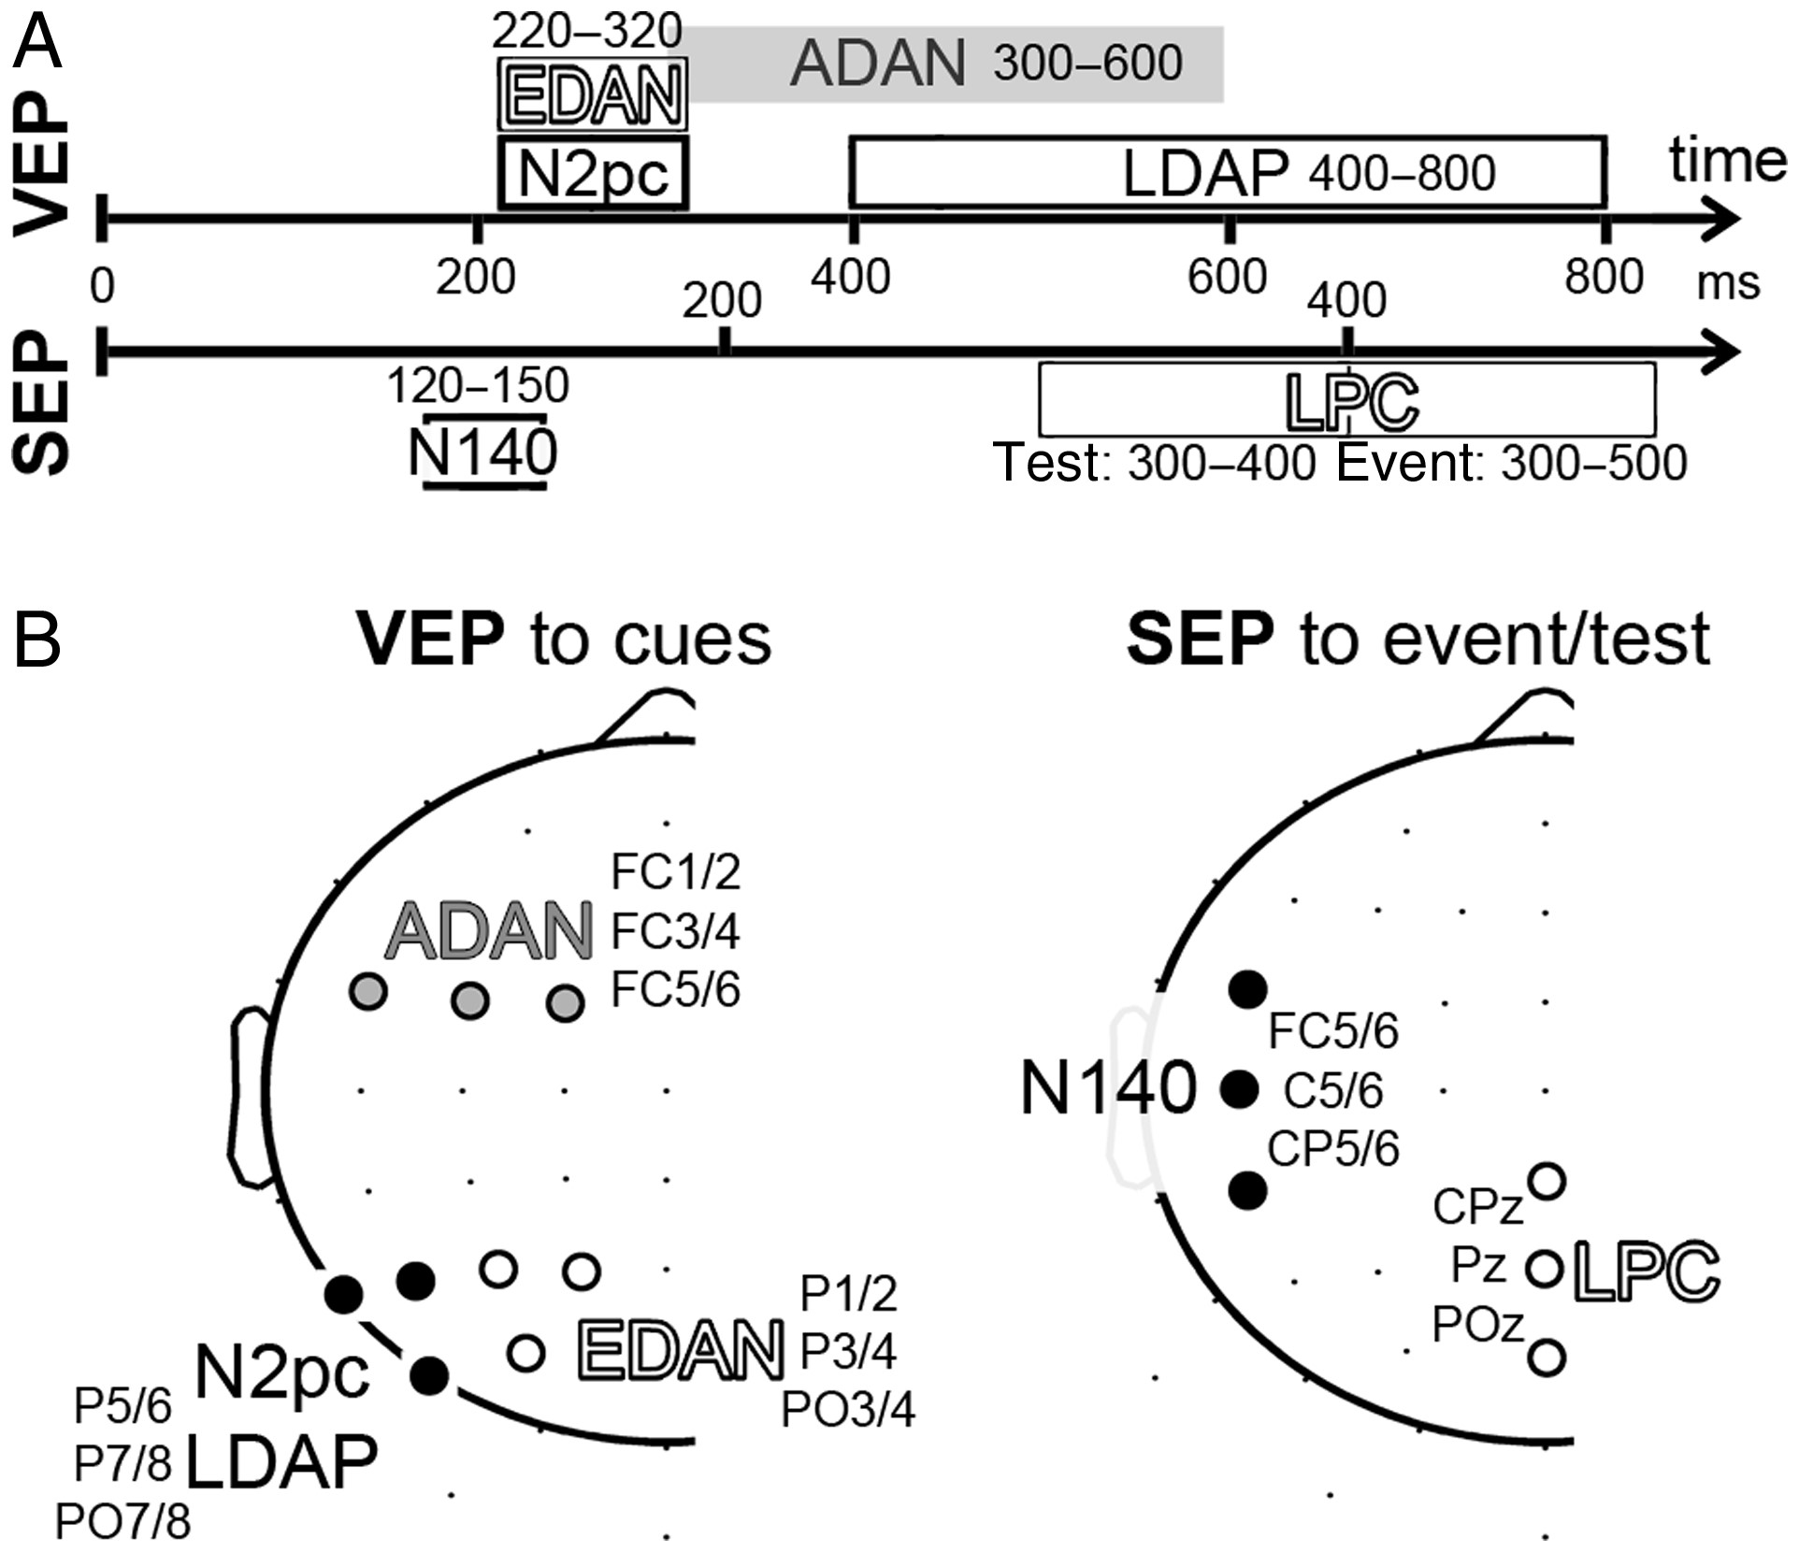
Figure 2. (A) Time windows for the measurement of VEP (top) and SEP (bottom) components. Note the differing LPC time ...
Notes:
Figure 2. (A) Time windows for the measurement of VEP (top) and SEP (bottom) components. Note the differing LPC time ranges for isolated test stimuli versus events in ongoing vibrotactile stimulation. (B) Electrode selection for VEP (left) and SEP (right) components. Lateralized VEP components were measured at symmetric recording clusters contra- and ipsilateral to the pre-cue direction (only 1 hemisphere is shown here). The N140 of the SEP was acquired contra- and ipsilateral to stimulation. The LPC of the SEP was measured at a single nonlateralized recording cluster.
Unless provided in the caption above, the following copyright applies to the content of this slide: © The Author 2012. Published by Oxford University Press. All rights reserved. For Permissions, please e-mail: journals.permissions@oup.com

Slide 3
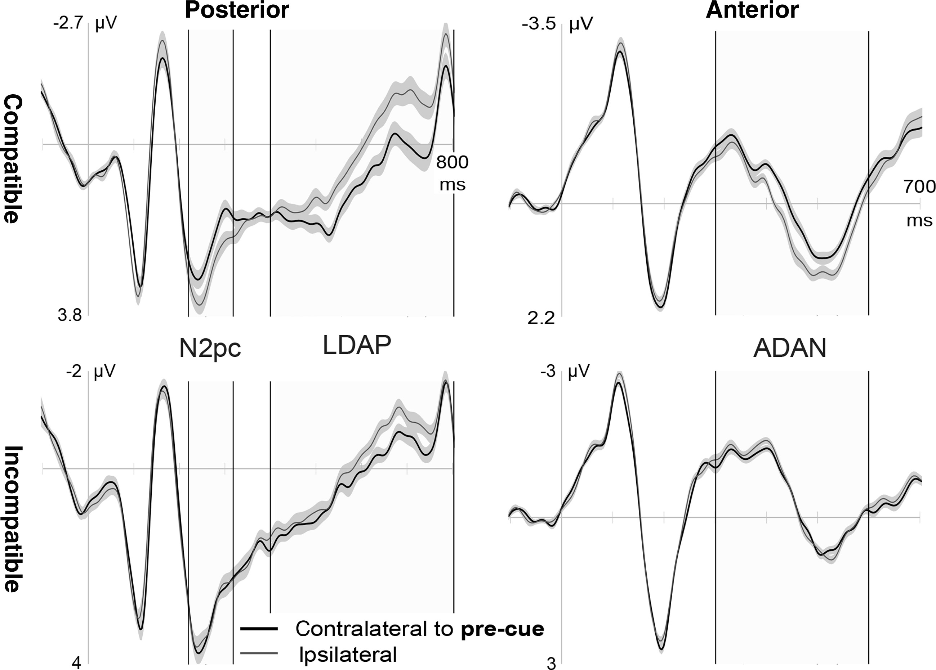
Figure 3. Grand mean VEPs to compatible and incompatible cues are shown in separate rows. VEPs were measured at lateral ...
Notes:
Figure 3. Grand mean VEPs to compatible and incompatible cues are shown in separate rows. VEPs were measured at lateral posterior (left) and anterior (right) scalp regions, contralateral (black line) and ipsilateral (gray) to the pre-cue direction. EBs (shaded) were separately estimated for compatible and incompatible cues and are based on the effect of electrode cluster. At a given time point, nonoverlapping EBs reflect the presence of lateralized activity.
Unless provided in the caption above, the following copyright applies to the content of this slide: © The Author 2012. Published by Oxford University Press. All rights reserved. For Permissions, please e-mail: journals.permissions@oup.com

Slide 4
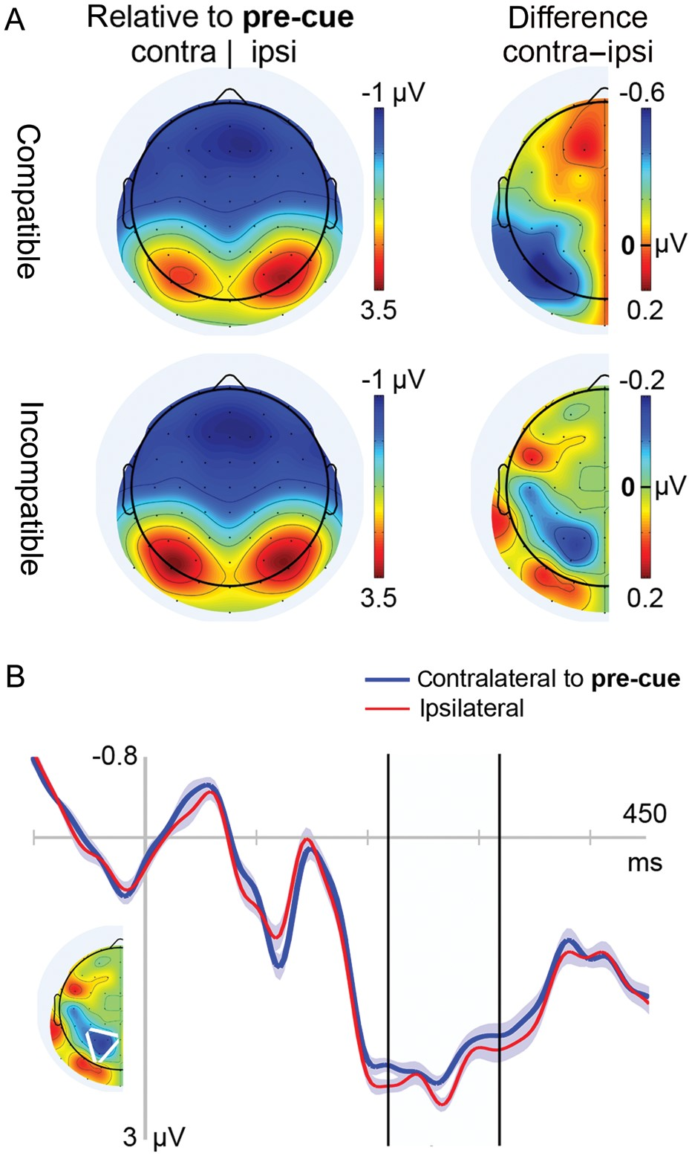
Figure 4. (A) Grand mean isocontour voltage maps and difference maps in the N2pc latency range, in response to ...
Notes:
Figure 4. (A) Grand mean isocontour voltage maps and difference maps in the N2pc latency range, in response to compatible and incompatible cue configurations. Note varying scales of difference maps. (B) Grand mean VEPs to incompatible cues, obtained contralateral (black line) and ipsilateral (gray line) to the pre-cue direction at posterior scalp regions (white triangle). The EDAN was measured during the N2pc time range (black boundaries). EBs based on the effect of electrode cluster.
Unless provided in the caption above, the following copyright applies to the content of this slide: © The Author 2012. Published by Oxford University Press. All rights reserved. For Permissions, please e-mail: journals.permissions@oup.com

Slide 5
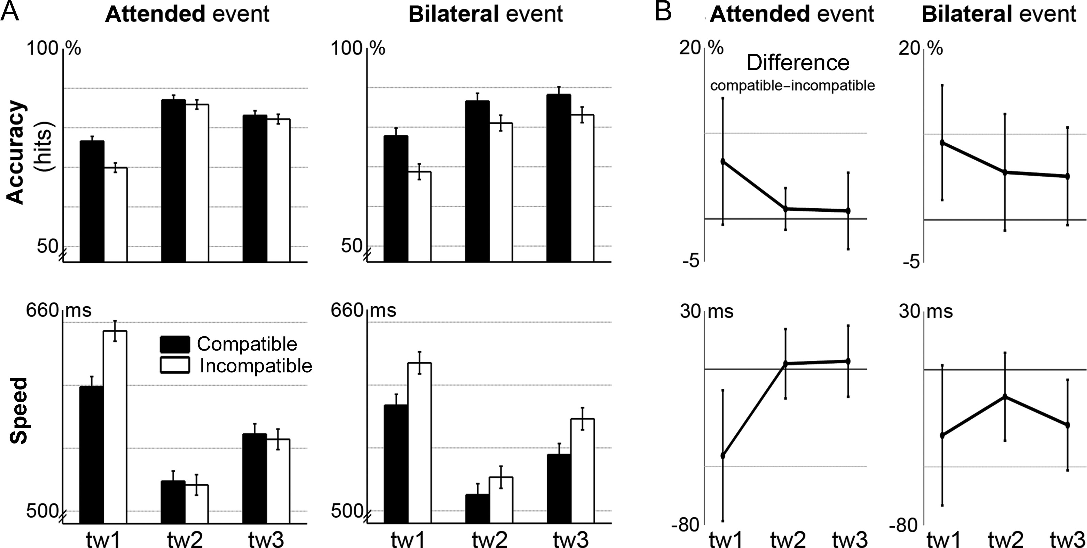
Figure 5. Perceptual task performance. (A) Hit rates (upper row) and reaction times (lower row) to events in ...
Notes:
Figure 5. Perceptual task performance. (A) Hit rates (upper row) and reaction times (lower row) to events in vibrotactile streams that required immediate responses. Such events were either inserted into the attended stream only or simultaneously presented to both hands (bilateral). Black and white bars represent accuracy measures for compatible and incompatible cue trials, respectively, as function of the time window of event presentation (tw: 500, 1500, or 2500 ms relative to stream onset). EBs designate the main effect of cue compatibility, obtained from separate ANOVAs for a specific behavioral measure (accuracy and speed) and event location (unilateral attended and bilateral). (B) Difference values were calculated by subtracting behavioral measures of the compatible minus incompatible cue condition. EBs reflect the influence of event time window on difference values (i.e. the cue compatibility effect) and were estimated by separate statistical tests for a particular measure and event location.
Unless provided in the caption above, the following copyright applies to the content of this slide: © The Author 2012. Published by Oxford University Press. All rights reserved. For Permissions, please e-mail: journals.permissions@oup.com

Slide 6
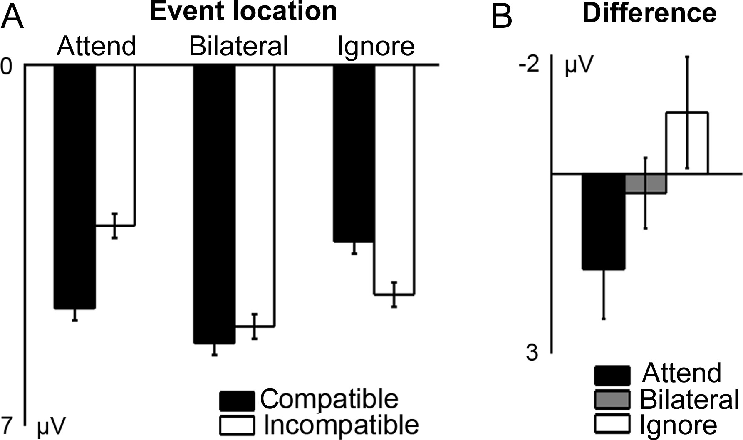
Figure 6. LPC to events in vibrotactile streams. (A) Grand mean amplitudes of the LPC, elicited by transient events in ...
Notes:
Figure 6. LPC to events in vibrotactile streams. (A) Grand mean amplitudes of the LPC, elicited by transient events in ongoing vibrotactile streams. LPC amplitudes in the compatible (black bars) and incompatible (white bars) cue condition are grouped by event location: Events were inserted in the attended or ignored stream, or in both streams. EBs based on the main effect of cue compatibility. (B) LPC modulations due to cue compatibility in terms of difference values of compatible minus incompatible cue trials. The influence of event location on LPC modulations is illustrated for unilateral attended (black), bilateral (gray), and unilateral ignored events (white). EBs based on separate tests of LPC difference values against zero for the factor levels of event location.
Unless provided in the caption above, the following copyright applies to the content of this slide: © The Author 2012. Published by Oxford University Press. All rights reserved. For Permissions, please e-mail: journals.permissions@oup.com

Slide 7
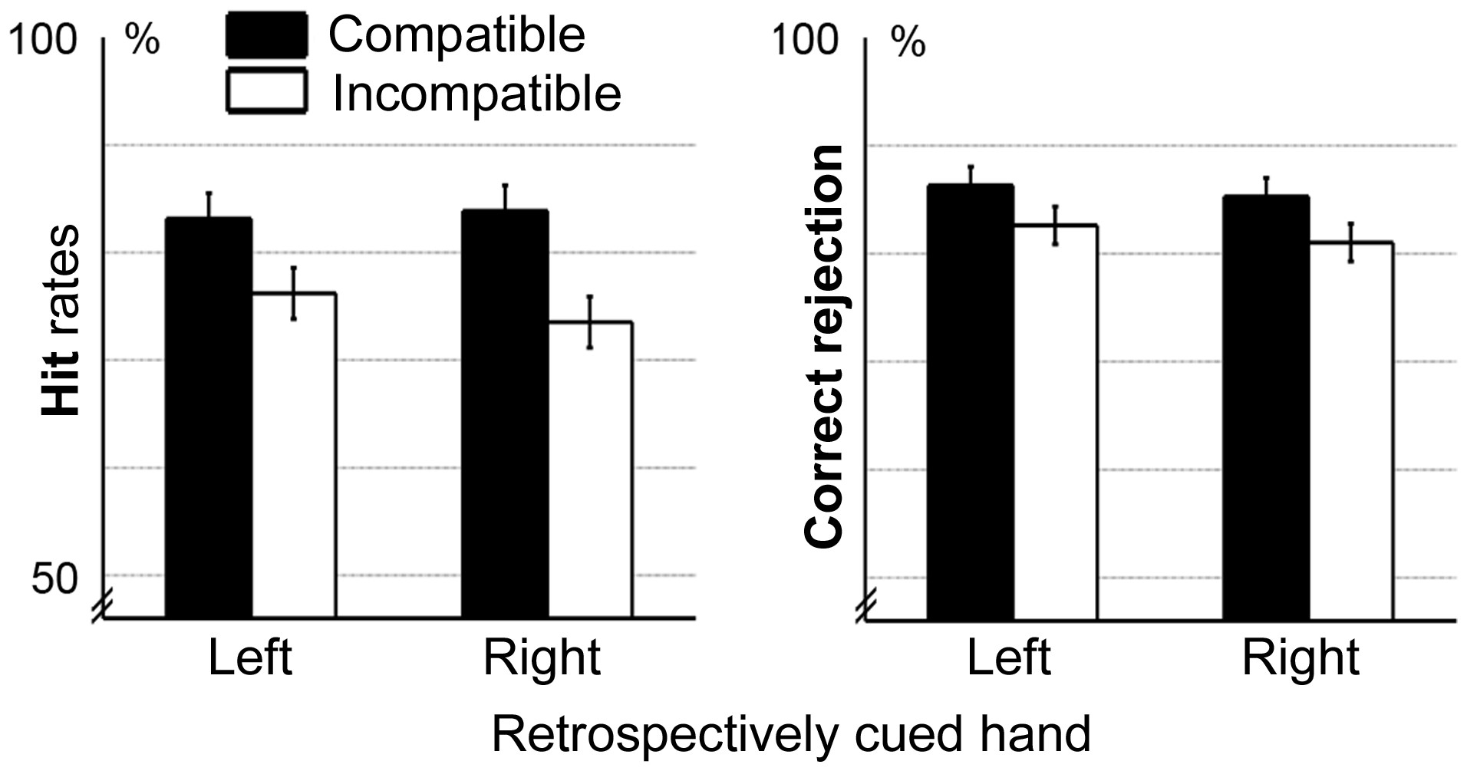
Figure 7. Memory task performance in terms of average hit (left) and correct rejection rates (right), dependent on ...
Notes:
Figure 7. Memory task performance in terms of average hit (left) and correct rejection rates (right), dependent on retro-cue direction. Performance in compatible and incompatible cue trials are represented by black and white bars, respectively. EBs are based on the main effect of cue compatibility, separately estimated for hit and correct rejection rates.
Unless provided in the caption above, the following copyright applies to the content of this slide: © The Author 2012. Published by Oxford University Press. All rights reserved. For Permissions, please e-mail: journals.permissions@oup.com

Slide 8
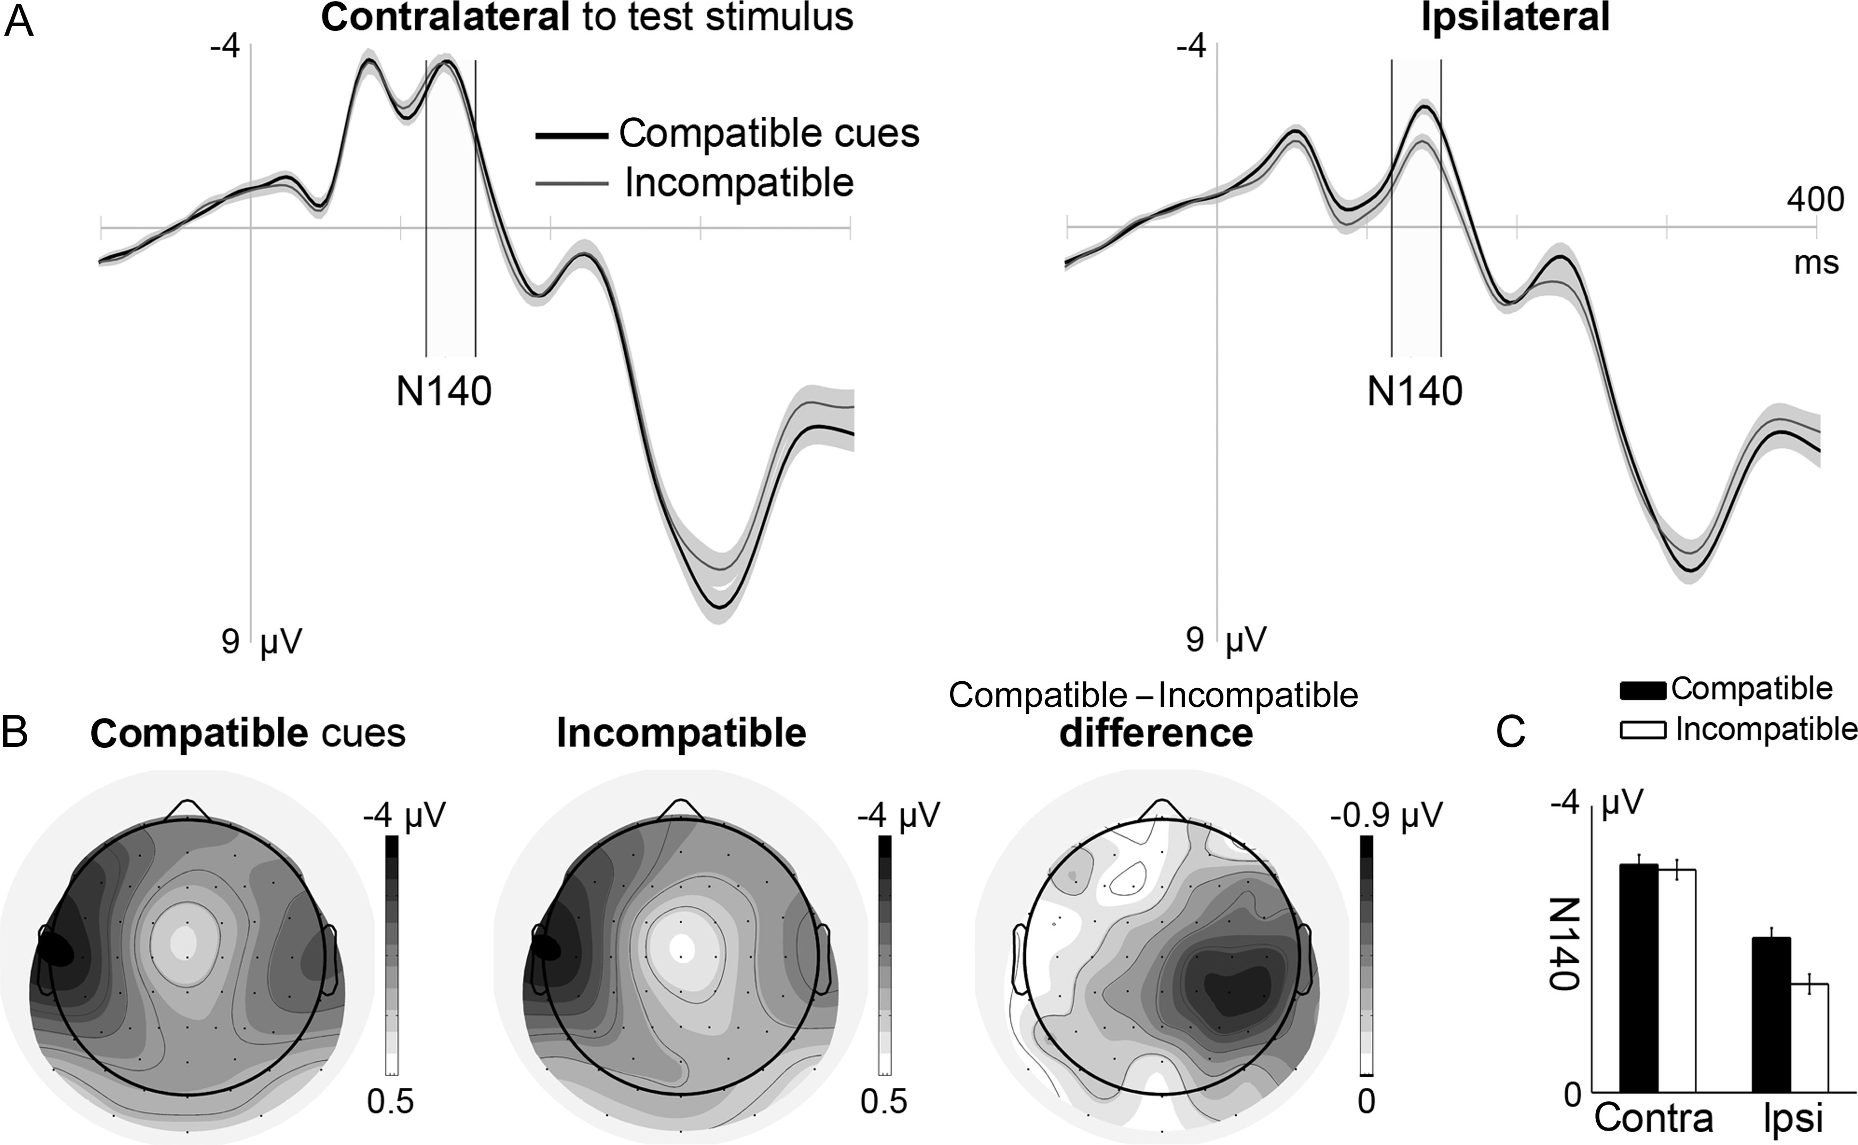
Figure 8. (A) Grand mean SEPs to test stimuli in compatible (black line) and incompatible cue trials (gray line). EBs ...
Notes:
Figure 8. (A) Grand mean SEPs to test stimuli in compatible (black line) and incompatible cue trials (gray line). EBs based on the cue compatibility effect, separately estimated for contralateral and ipsilateral recordings. (B) Grand mean voltage maps in the N140 time range for the compatible and incompatible cue conditions. The difference map represents subtracted voltage maps of compatible minus incompatible cue trials, illustrating the topographical extent of N140 modulations due to cue compatibility. The arrangement of data in voltage and difference maps corresponds to stimulation of the right hand. (C) Mean N140 amplitudes as function of the design factors of cue compatibility and electrode cluster. EBs reflect the main effect of cue compatibility.
Unless provided in the caption above, the following copyright applies to the content of this slide: © The Author 2012. Published by Oxford University Press. All rights reserved. For Permissions, please e-mail: journals.permissions@oup.com

